Slide 1
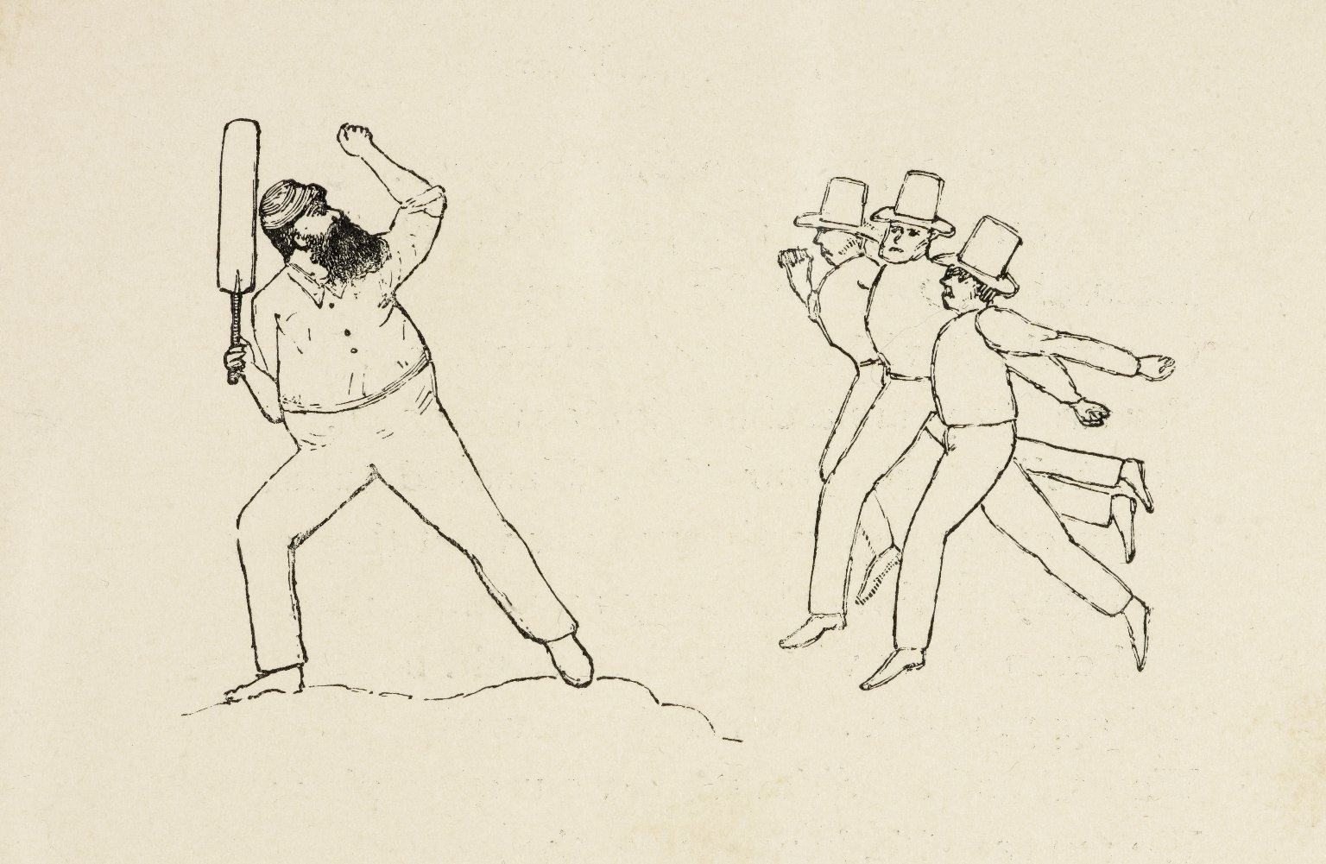
-------------
Image1
-------------
Field Data
Image Number JRL0810088dc
Reference Number Cricket(222) 22/MOF
Link to Catalogue <A href=http://man-fe.hosted.exlibrisgroup.com/MU_VU1:BLENDED:44MAN_ALMA_DS21192910820001631>UoM online catalogue.</a>
Image Title The ghosts
Parent Work Title Crickety cricket
Creator Moffat, Douglas
Creator Role Author
Date Created 1897
Publication Details London : Longmans & Co.
Page/Sheet 61
Image Sequence Number 061
Description Illustration: the ghosts.
Language Code eng-GB
Subject Sports
Subject Cricket
Category of Material Printed
Sub-Category Illustrated works
Technique Used Drawing (image-making)
Support Paper
Time Period Covered 19th Century CE
People Covered Grace, W. G. (William Gilbert), 1848-1915
Current Repository The University of Manchester Library, U.K.
Provenance Brockbank Cricket Collection
Rights Holder - Image The University of Manchester Library
Rights holder - Work The University of Manchester Library
Notes Illustrations by the author and frontispiece by Sir F. Lockwood.
Date Captured (yyyy-mm-dd) 2008-06-19
Image Creation Technique Digital capture by Heritage Imaging, The University of Manchester Library
Date Image Added (yyyy-mm) 2008-12
Metadata Language eng-GB

Slide 2
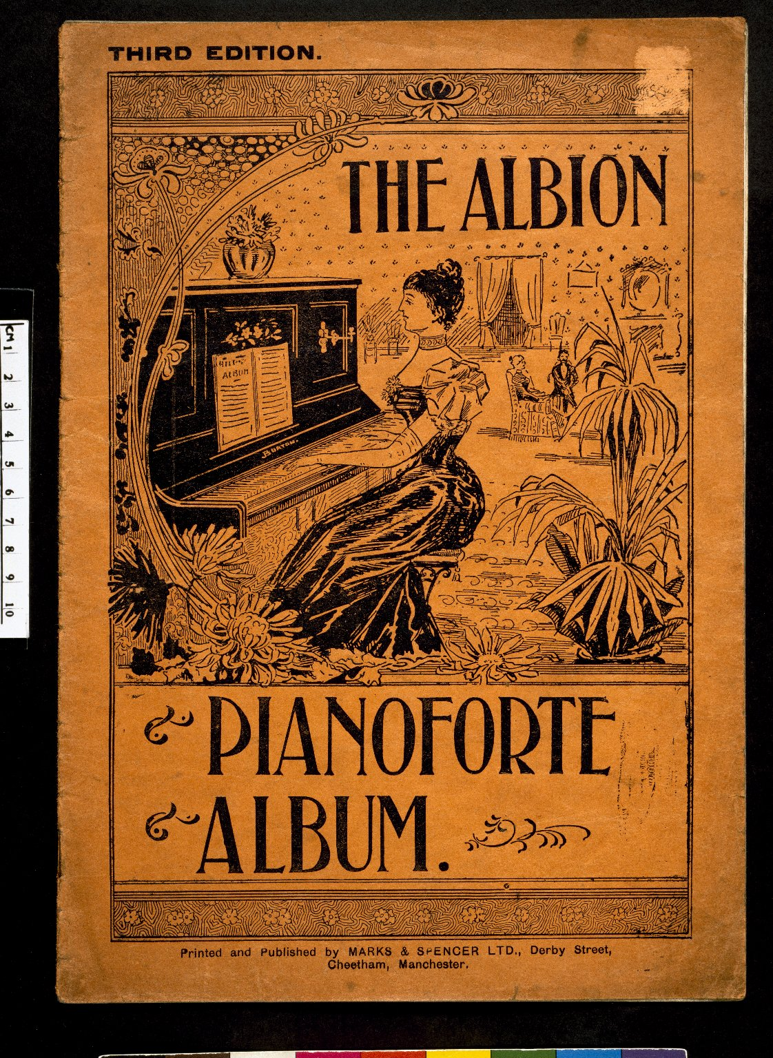
-------------
Image1
-------------
Field Data
Image Number JRL023117tr
Reference Number R154427
Link to Catalogue <A href=http://man-fe.hosted.exlibrisgroup.com/MU_VU1:BLENDED:44MAN_DRL_DSManchester~91~1~42634~102506>UoM online catalogue.</a>
Image Title Pianoforte Album
Parent Work Title Albion pianoforte album [Third edition]
Date Created [1912?]
Publication Details Manchester : Marks & Spencer Ltd
Page/Sheet Front cover
Image Sequence Number 000
Description Front cover of sheet music, with an illustration of a woman sitting at a piano.
Language Code eng-GB
Subject Music
Subject Musical instruments
Category of Material Printed
Sub-Category Music
Time Period Covered 20th Century CE
Current Repository The University of Manchester Library, U.K.
Rights Holder - Image The University of Manchester Library
Rights holder - Work The University of Manchester Library
Image Creation Technique Scanned from colour transparency by Gten, January 2006
Date Image Added (yyyy-mm) 2006-01
Metadata Language eng-GB

Slide 3
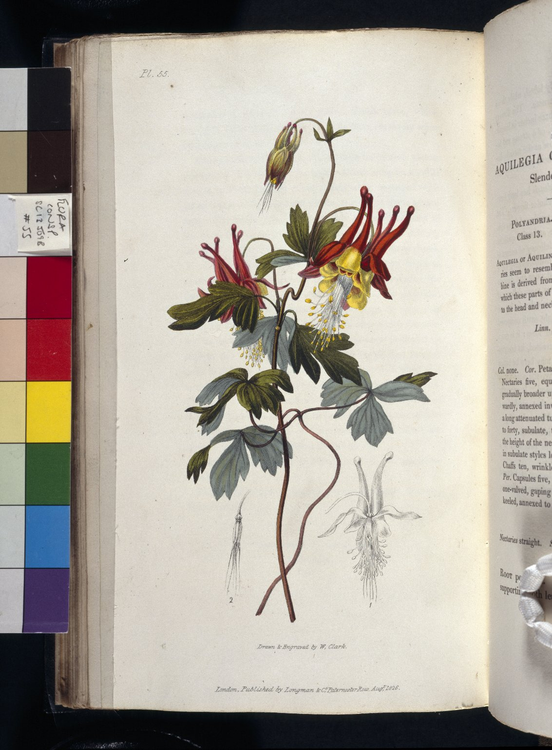
-------------
Image1
-------------
Field Data
Image Number JRL022729tr
Reference Number SC13509B
Link to Catalogue <A href=http://man-fe.hosted.exlibrisgroup.com/MU_VU1:BLENDED:44MAN_ALMA_DS21204077670001631>UoM online catalogue.</a>
Image Title Aquilegia Canaderisis
Parent Work Title Flora conspicua: a selection of the most ornamental flowering, hardy, exotic and indigenous trees, shrubs, and herbaceous plants, for embellishing flower-gardens and pleasure-grounds
Creator Clark, William
Creator Role Artist
Creator Role Engraver
Creator Morris, Richard
Creator Role Author
Date Created 1830
Publication Details London: printed for Thomas Griffiths
Page/Sheet 55
Image Sequence Number 055
Description Illustrated: Aquilegia Canaderisis
Language Code eng-GB
Subject Flowers
Subject Natural History
Subject Botany
Category of Material Printed
Sub-Category Illustrated works
Current Repository The University of Manchester Library, U.K.
Rights Holder - Image The University of Manchester Library
Rights holder - Work The University of Manchester Library
Image Creation Technique Scanned from colour transparency by Gten, April 2004
Metadata Language eng-GB

