Slide 1
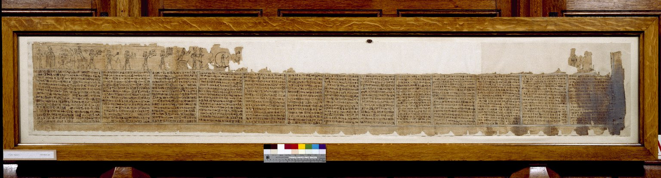
-------------
Image1
-------------
Field Data
Reference number Hieratic P 6
Side recto
Image Number JRL030595tr
Image Title Book of Breathing
Subject Death
Subject Funeral rites and ceremonies
Subject Religion
Subject Egypt--Antiquities
Description Book of Breathing written for a woman named Heryet, whose mother was named Tapelyet. Thirteen columns of text demarcated by black lines. There is some significant damage to the first column, which is blackened. Painted vignettes appear above the text. Unfortunately, damage to the upper section of the papyrus destroyed many of the scenes, leaving traces above column 1 and fully preserved scenes above columns 10-13. The Book of Breathing is an Ancient Egyptian funerary text.
Date created 2nd century
Time period covered 1 BCE - 500 CE
Place covered Egypt
Language Egyptian
Language code egy-EG
Technique used Handwriting
Support material Papyrus
Current repository The University of Manchester Library, U.K.
Category Manuscripts
Sub-Category Scrolls
Image rights The University of Manchester Library
Work rights The University of Manchester Library
Image sequence number hrt006r
Image technique Scanned from colour transparency by Gten, July 2004
Metadata language eng-GB

Slide 2
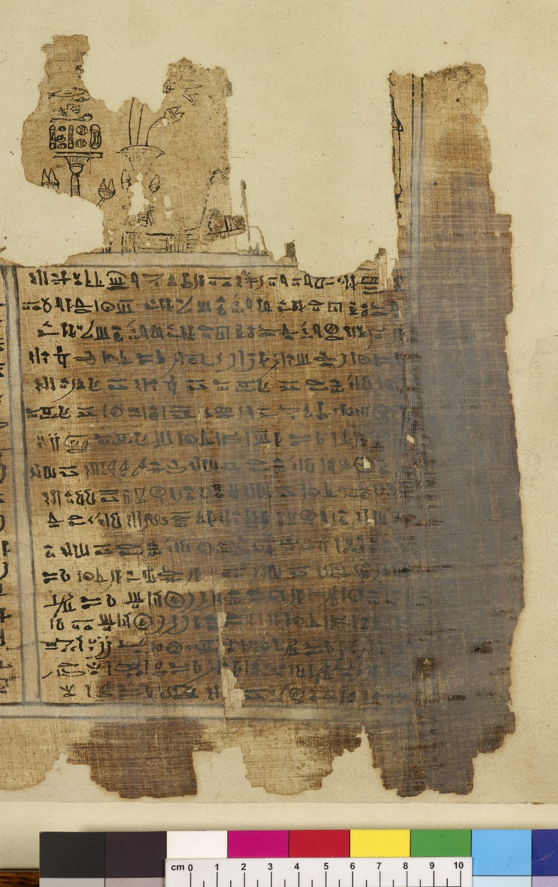
-------------
Image1
-------------
Field Data
Reference number Hieratic P 6
Side recto
Image Number JRL0810096dc
Image Title Book of Breathing
Subject Death
Subject Funeral rites and ceremonies
Subject Religion
Subject Egypt--Antiquities
Section Column 1
Description Book of Breathing written for a woman named Heryet, whose mother was named Tapelyet. There is some significant damage to this first column, which is blackened. The remains of painted vignettes appear above the text. The Book of Breathing is an Ancient Egyptian funerary text.
Date created 2nd century
Time period covered 1 BCE - 500 CE
Place covered Egypt
Language Egyptian
Language code egy-EG
Technique used Handwriting
Support material Papyrus
Current repository The University of Manchester Library, U.K.
Category Manuscripts
Sub-Category Scrolls
Image rights The University of Manchester Library
Work rights The University of Manchester Library
Image sequence number hrt006r-001
Image technique Digital capture by Heritage Imaging, The University of Manchester Library
Date image captured 2008-06-24
Date: issued 2008-11
Metadata language eng-GB

Slide 3
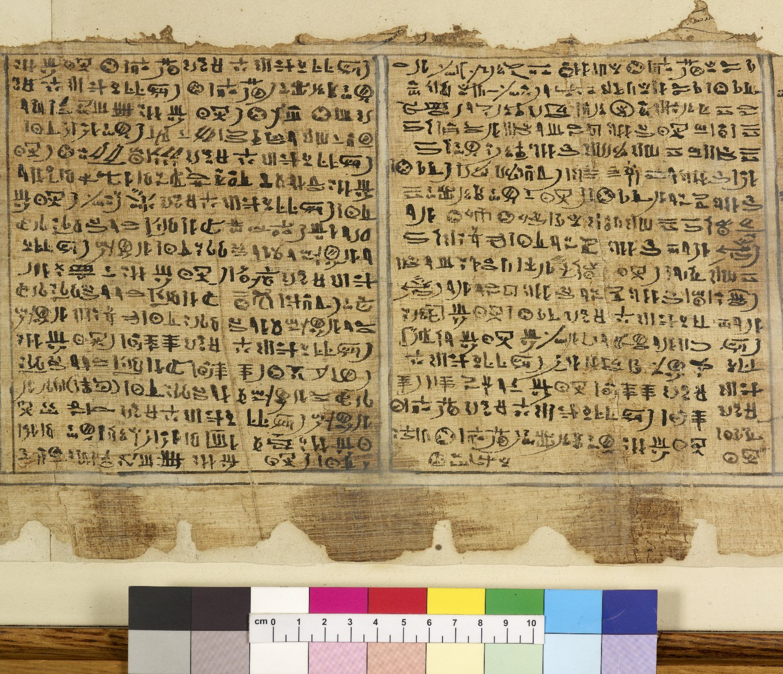
-------------
Image1
-------------
Field Data
Reference number Hieratic P 6
Side recto
Image Number JRL0810097dc
Image Title Book of Breathing
Subject Death
Subject Funeral rites and ceremonies
Subject Religion
Subject Egypt--Antiquities
Section Columns 2 & 3
Description Book of Breathing written for a woman named Heryet, whose mother was named Tapelyet. The second and third columns of text: damage to the upper section of the papyrus has destroyed the painted vignettes which would have appeared above the text. The Book of Breathing is an Ancient Egyptian funerary text.
Date created 2nd century
Time period covered 1 BCE - 500 CE
Place covered Egypt
Language Egyptian
Language code egy-EG
Technique used Handwriting
Support material Papyrus
Current repository The University of Manchester Library, U.K.
Category Manuscripts
Sub-Category Scrolls
Image rights The University of Manchester Library
Work rights The University of Manchester Library
Image sequence number hrt006r-002
Image technique Digital capture by Heritage Imaging, The University of Manchester Library
Date image captured 2008-06-24
Date: issued 2008-11
Metadata language eng-GB

Slide 4
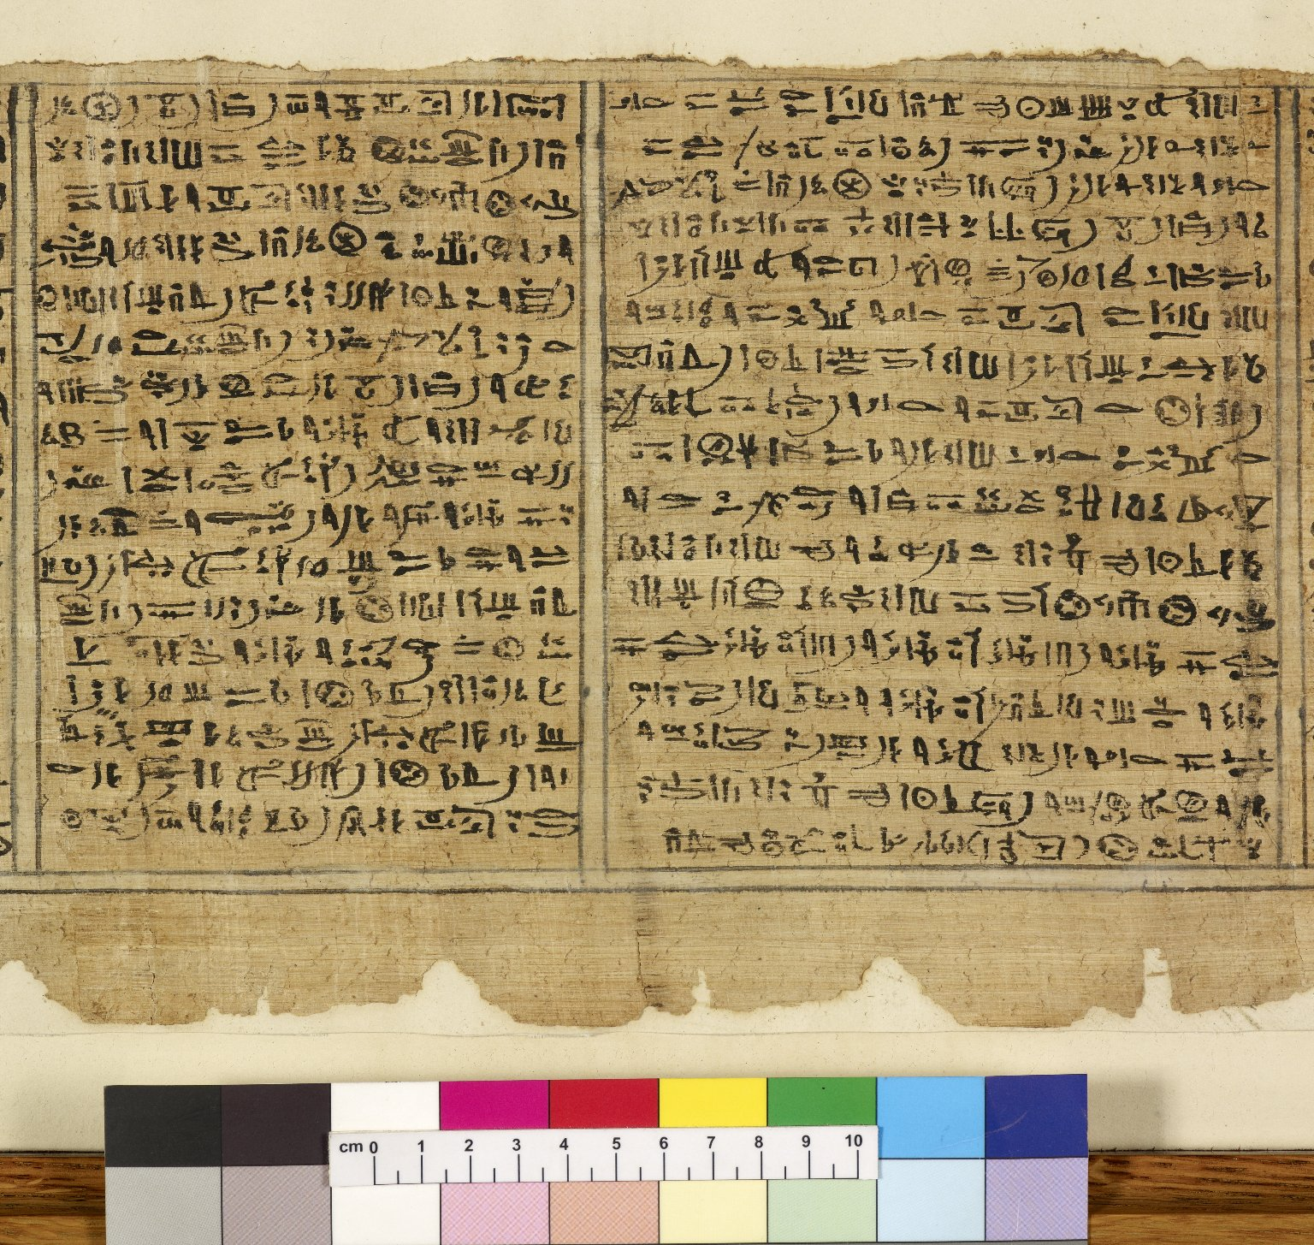
-------------
Image1
-------------
Field Data
Reference number Hieratic P 6
Side recto
Image Number JRL0810098dc
Image Title Book of Breathing
Subject Death
Subject Funeral rites and ceremonies
Subject Religion
Subject Egypt--Antiquities
Section Columns 4 & 5
Description Book of Breathing written for a woman named Heryet, whose mother was named Tapelyet. The fourth and fifth columns of text: damage to the upper section of the papyrus has destroyed the painted vignettes which would have appeared above the text. The Book of Breathing is an Ancient Egyptian funerary text.
Date created 2nd century
Time period covered 1 BCE - 500 CE
Place covered Egypt
Language Egyptian
Language code egy-EG
Technique used Handwriting
Support material Papyrus
Current repository The University of Manchester Library, U.K.
Category Manuscripts
Sub-Category Scrolls
Image rights The University of Manchester Library
Work rights The University of Manchester Library
Image sequence number hrt006r-004
Image technique Digital capture by Heritage Imaging, The University of Manchester Library
Date image captured 2008-06-24
Date: issued 2008-11
Metadata language eng-GB

Slide 6
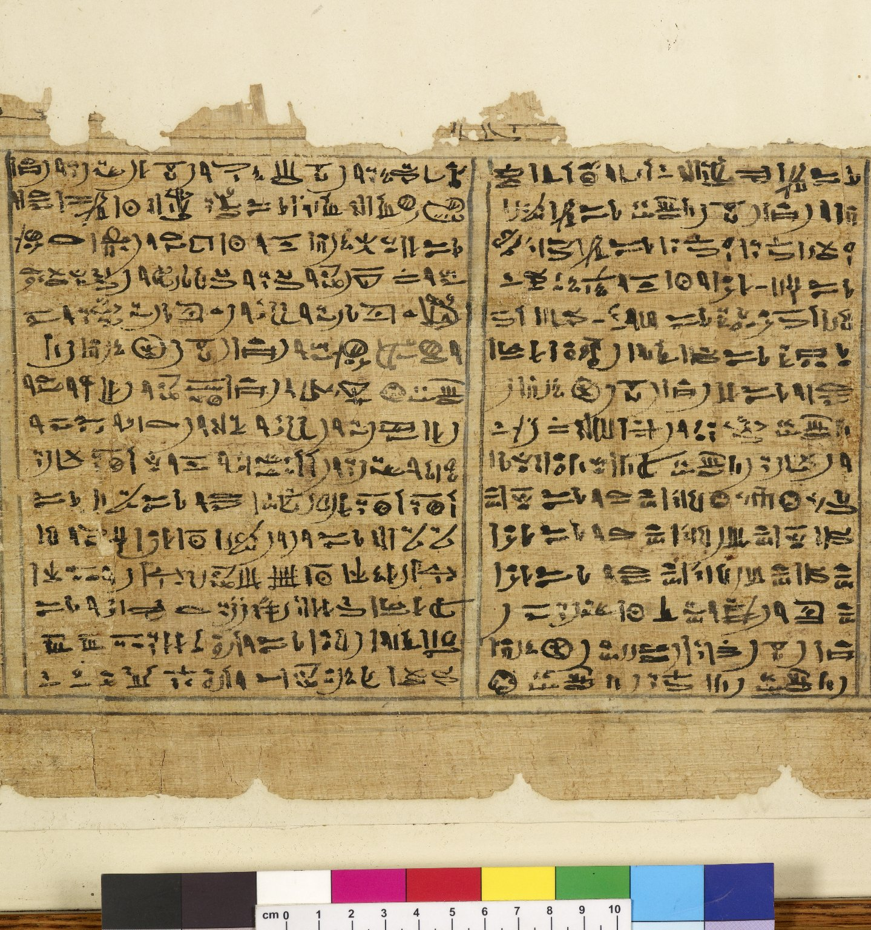
-------------
Image1
-------------
Field Data
Reference number Hieratic P 6
Side recto
Image Number JRL0810100dc
Image Title Book of Breathing
Subject Death
Subject Funeral rites and ceremonies
Subject Religion
Subject Egypt--Antiquities
Section Columns 8 & 9
Description Book of Breathing written for a woman named Heryet, whose mother was named Tapelyet. The eighth and ninth columns of text: damage to the upper section of the papyrus has destroyed the painted vignettes which would have appeared above the text. The Book of Breathing is an Ancient Egyptian funerary text.
Date created 2nd century
Time period covered 1 BCE - 500 CE
Place covered Egypt
Language Egyptian
Language code egy-EG
Technique used Handwriting
Support material Papyrus
Current repository The University of Manchester Library, U.K.
Category Manuscripts
Sub-Category Scrolls
Image rights The University of Manchester Library
Work rights The University of Manchester Library
Image sequence number hrt006r-008
Image technique Digital capture by Heritage Imaging, The University of Manchester Library
Date image captured 2008-06-24
Date: issued 2008-11
Metadata language eng-GB

Slide 7
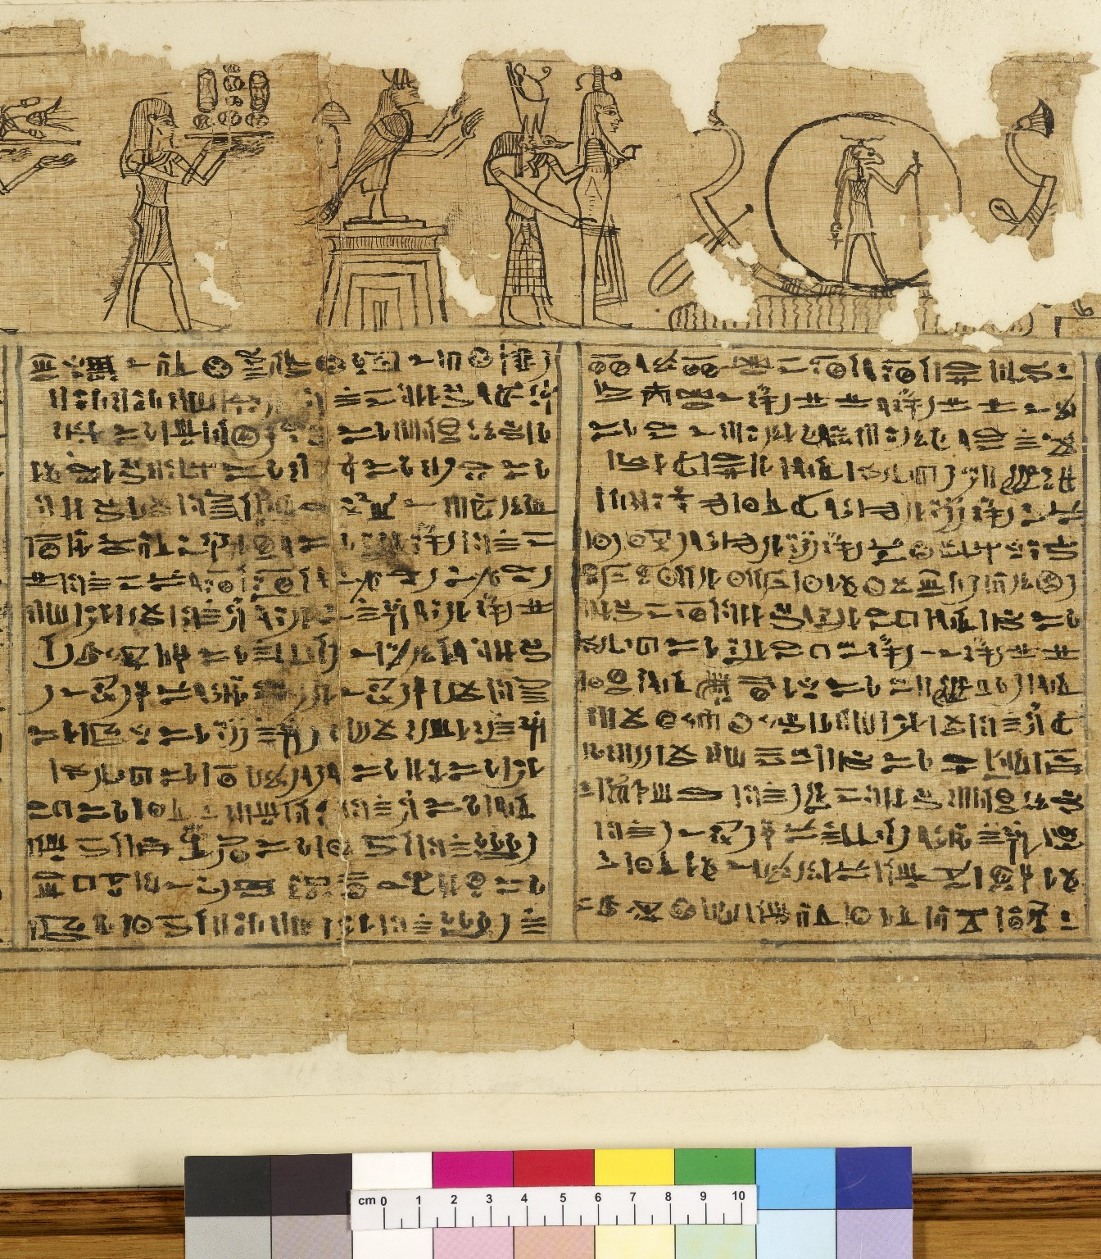
-------------
Image1
-------------
Field Data
Reference number Hieratic P 6
Side recto
Image Number JRL0810101dc
Image Title Book of Breathing
Subject Death
Subject Funeral rites and ceremonies
Subject Religion
Subject Egypt--Antiquities
Section Columns 10 & 11
Description Book of Breathing written for a woman named Heryet, whose mother was named Tapelyet. The tenth and eleventh columns of text: fully preserved painted vignettess appear above the text. The Book of Breathing is an Ancient Egyptian funerary text.
Date created 2nd century
Time period covered 1 BCE - 500 CE
Place covered Egypt
Language Egyptian
Language code egy-EG
Technique used Handwriting
Support material Papyrus
Current repository The University of Manchester Library, U.K.
Category Manuscripts
Sub-Category Scrolls
Image rights The University of Manchester Library
Work rights The University of Manchester Library
Image sequence number hrt006r-010
Image technique Digital capture by Heritage Imaging, The University of Manchester Library
Date image captured 2008-06-24
Date: issued 2008-11
Metadata language eng-GB

Slide 8
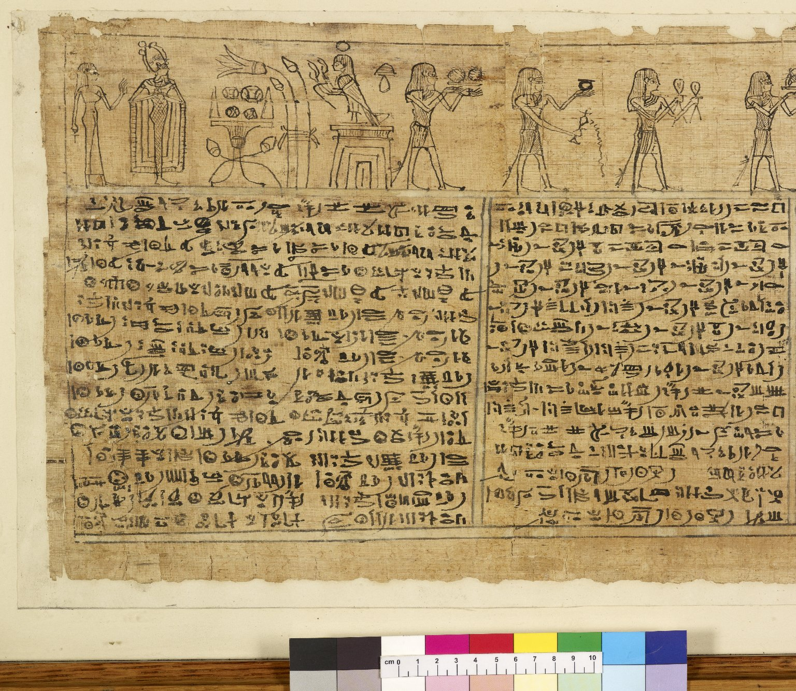
-------------
Image1
-------------
Field Data
Reference number Hieratic P 6
Side recto
Image Number JRL0810102dc
Image Title Book of Breathing
Subject Death
Subject Funeral rites and ceremonies
Subject Religion
Subject Egypt--Antiquities
Section Columns 12 & 13
Description Book of Breathing written for a woman named Heryet, whose mother was named Tapelyet. The twelfth and thirteenth columns of text: fully preserved painted vignettess appear above the text. The Book of Breathing is an Ancient Egyptian funerary text.
Date created 2nd century
Time period covered 1 BCE - 500 CE
Place covered Egypt
Language Egyptian
Language code egy-EG
Technique used Handwriting
Support material Papyrus
Current repository The University of Manchester Library, U.K.
Category Manuscripts
Sub-Category Scrolls
Image rights The University of Manchester Library
Work rights The University of Manchester Library
Image sequence number hrt006r-012
Image technique Digital capture by Heritage Imaging, The University of Manchester Library
Date image captured 2008-06-24
Date: issued 2008-11
Metadata language eng-GB

Slide 10
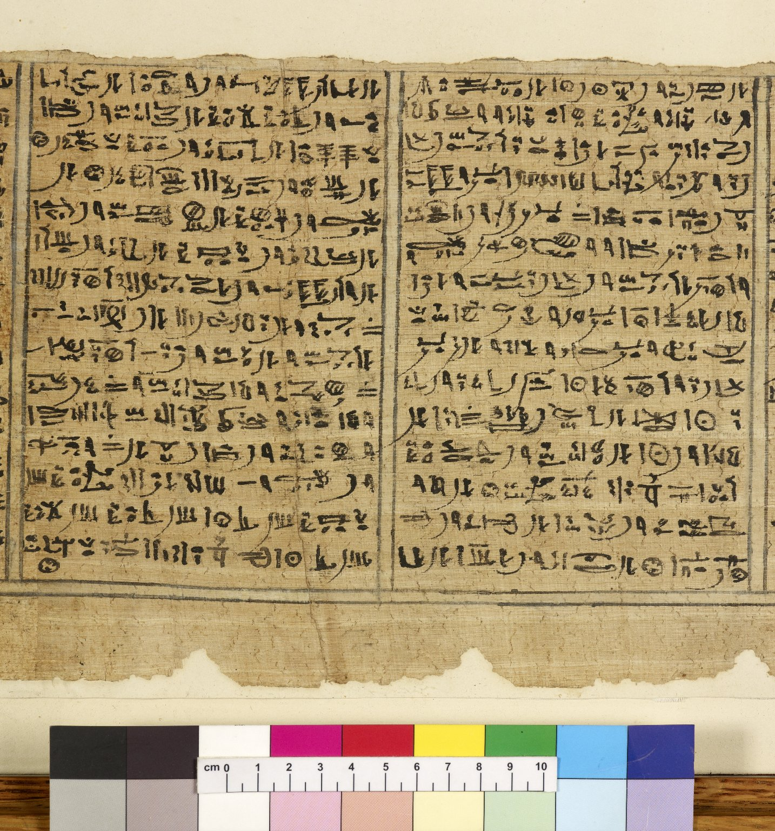
-------------
Image1
-------------
Field Data
Reference number Hieratic P 6
Side recto
Image Number JRL0810099dc
Image Title Book of Breathing
Subject Religion
Subject Death
Subject Funeral rites and ceremonies
Subject Egypt--Antiquities
Section Columns 6 & 7
Description Book of Breathing written for a woman named Heryet, whose mother was named Tapelyet. The sixth and seventh columns of text: damage to the upper section of the papyrus has destroyed the painted vignettes which would have appeared above the text. The Book of Breathing is an Ancient Egyptian funerary text.
Date created 2nd century
Time period covered 1 BCE - 500 CE
Place covered Egypt
Language Egyptian
Language code egy-EG
Technique used Handwriting
Support material Papyrus
Current repository The University of Manchester Library, U.K.
Category Manuscripts
Sub-Category Scrolls
Image rights The University of Manchester Library
Work rights The University of Manchester Library
Image sequence number hrt006r-006
Image technique Digital capture by Heritage Imaging, The University of Manchester Library
Date image captured 2008-06-24
Date: issued 2008-11
Metadata language eng-GB

