Slide 2
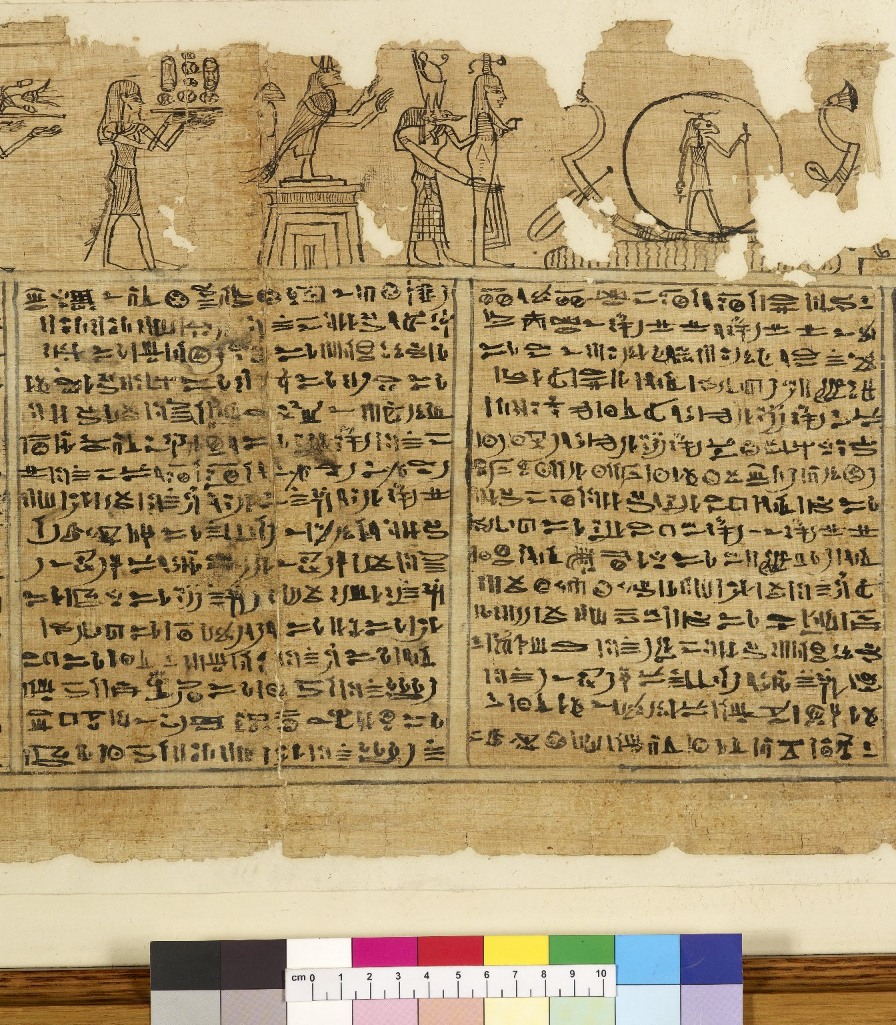
-------------
Image1
-------------
Field Data
Reference number Hieratic P 6
Side recto
Image Number JRL0810101dc
Image Title Book of Breathing
Subject Death
Subject Funeral rites and ceremonies
Subject Religion
Subject Egypt--Antiquities
Section Columns 10 & 11
Description Book of Breathing written for a woman named Heryet, whose mother was named Tapelyet. The tenth and eleventh columns of text: fully preserved painted vignettess appear above the text. The Book of Breathing is an Ancient Egyptian funerary text.
Date created 2nd century
Time period covered 1 BCE - 500 CE
Place covered Egypt
Language Egyptian
Language code egy-EG
Technique used Handwriting
Support material Papyrus
Current repository The University of Manchester Library, U.K.
Category Manuscripts
Sub-Category Scrolls
Image rights The University of Manchester Library
Work rights The University of Manchester Library
Image sequence number hrt006r-010
Image technique Digital capture by Heritage Imaging, The University of Manchester Library
Date image captured 2008-06-24
Date: issued 2008-11
Metadata language eng-GB

Slide 3
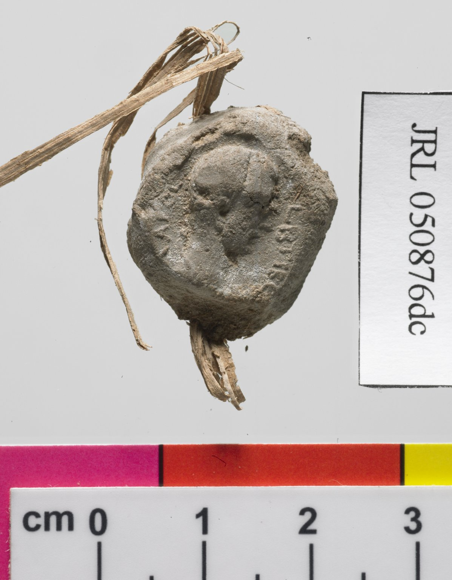
-------------
Image1
-------------
Field Data
Reference number Greek P Add unnumbered seal
Image Number JRL050876dc
Image Title Clay seal
Description Seal
Language Greek
Language code grc-EG
Item height 22 mm
Item width 18.5 mm
Technique used Handwriting
Support material Clay
Current repository The University of Manchester Library, U.K.
Category Manuscripts
Sub-Category Seals
Image rights The University of Manchester Library
Work rights The University of Manchester Library
Image technique Digital capture by Gten
Date image captured 2005-08-25
Metadata language eng-GB

Slide 4
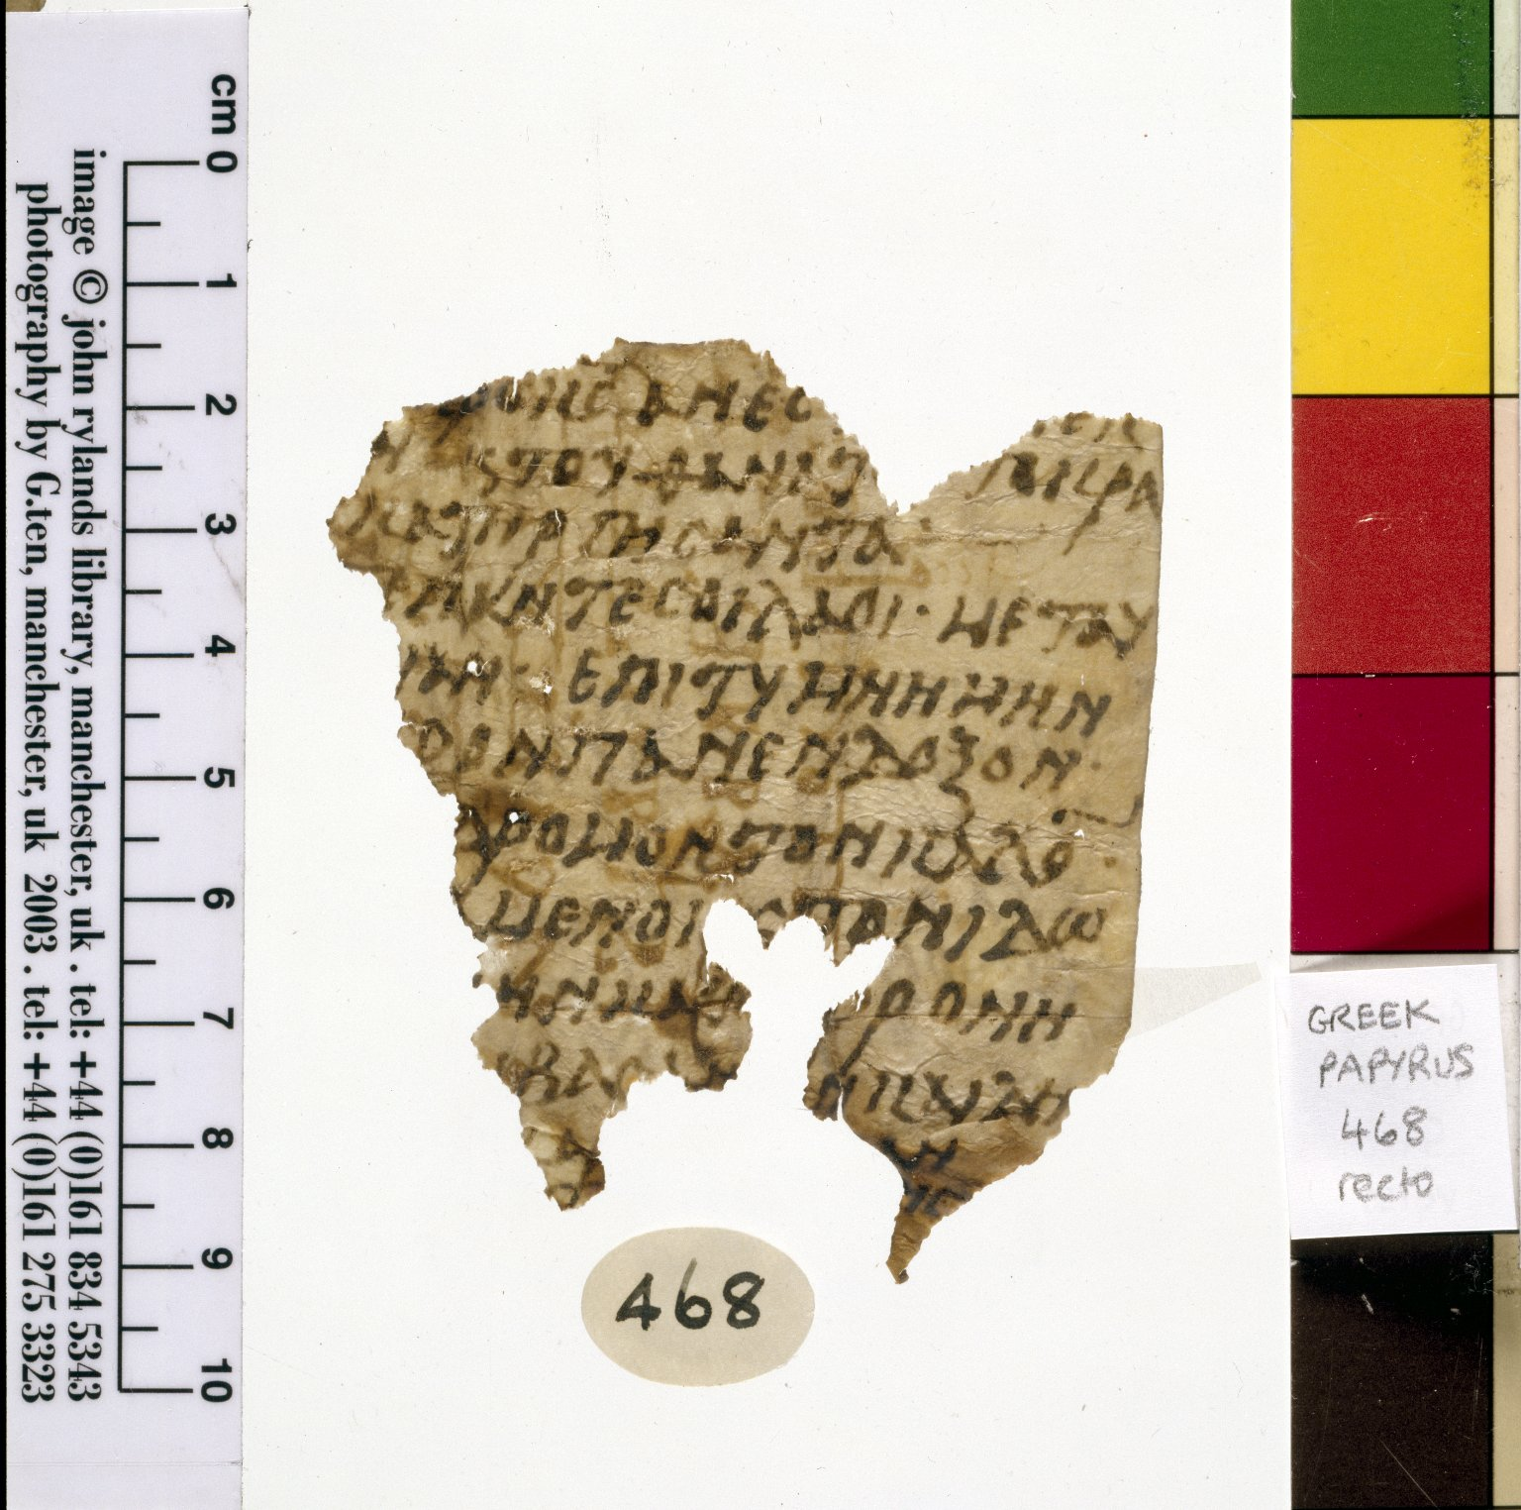
-------------
Image1
-------------
Field Data
Reference number Greek P 468
Side recto
Image Number JRL030541tr
Image Title Liturgical Fragment
Trismegistos Number <A href="http://www.trismegistos.org/text/65056"> 65056 </a>
Subject Christianity
Subject Religion
Citation reference P. Ryl. 3 468
Description Fragment of Coptic manuscript re-used with Greek texts in different hands on either side. The Greek runs at right angles to the Coptic. The hand on the recto is a bold and slanting type, usual in this period. Acquired in 1917.
Date created 6th century CE
Time period covered 500 - 1000 CE
Language Greek
Language code grc
Language Coptic
Language code cop
Item height 70 mm
Item width 80 mm
Technique used Handwriting
Support material Papyrus
Discovery site Egypt
Bibliography Hunt, Arthur S., et al. Catalogue of the Greek and Latin Papyri in the John Rylands Library, Manchester, University Press, 1911-1952
Current repository The University of Manchester Library, U.K.
Category Manuscripts
Sub-Category Fragments
Image rights The University of Manchester Library
Work rights The University of Manchester Library
Image sequence number grc0468r
Image technique Scanned from colour transparency by Gten, June 2004
Metadata language eng-GB

Slide 7
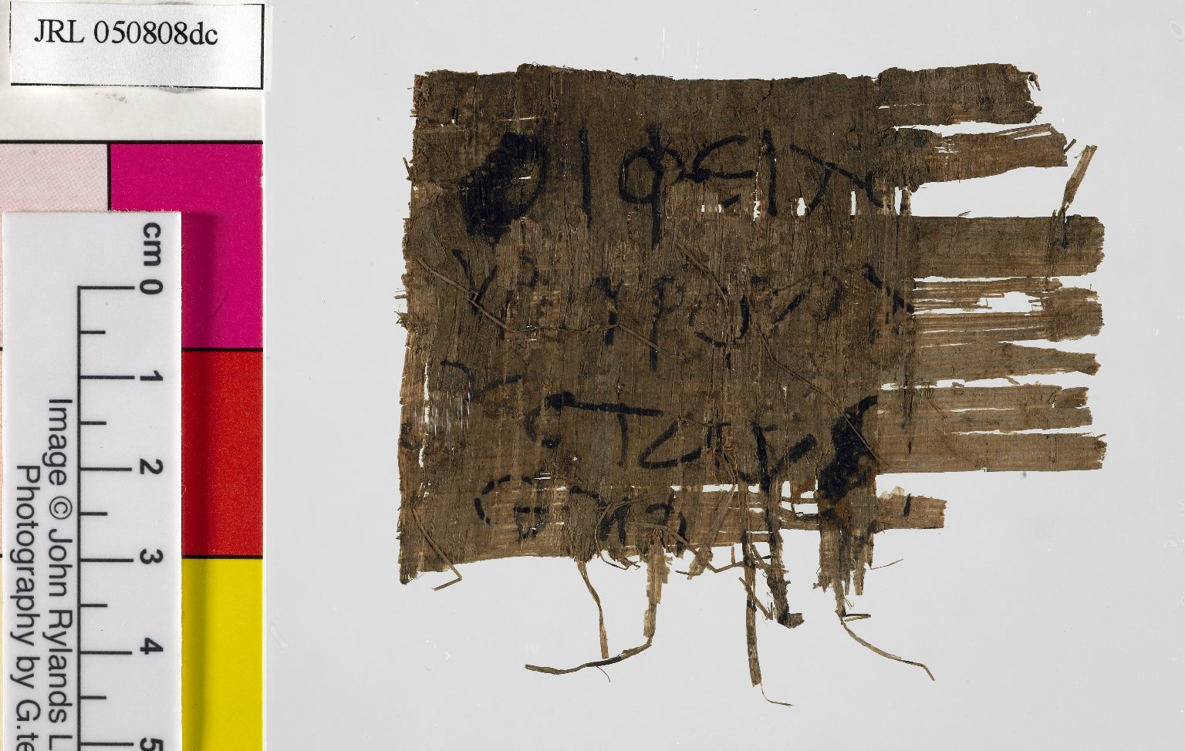
-------------
Image1
-------------
Field Data
Reference number Greek P Add 1075
Side verso
Image Number JRL050808dc
Citation reference P. Ryl. Inv. 1075
Language Greek
Language code grc-EG
Item height 54 mm
Item width 76 mm
Technique used Handwriting
Support material Papyrus
Current repository The University of Manchester Library, U.K.
Category Manuscripts
Sub-Category Fragments
Image rights The University of Manchester Library
Work rights The University of Manchester Library
Image sequence number grcadd1075v
Image technique Digital capture by Gten
Date image captured 2005-08-25
Metadata language eng-GB

