Slide 1
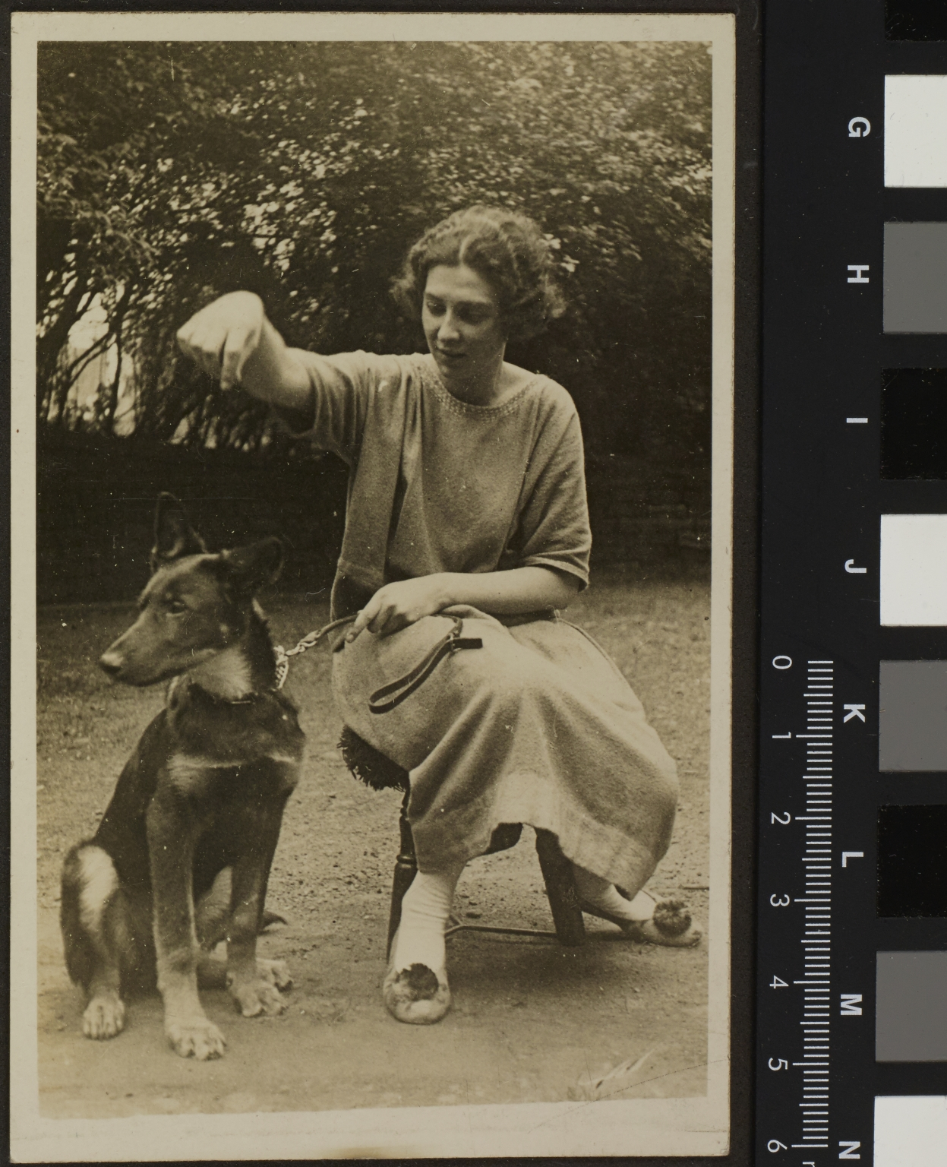
-------------
Image1
-------------
Field Data
Image Number JRL1416607
Reference Number JGS Box 30/1
Image Title Woman with dog
Parent Work Title Papers of J G Sharps
Date Created [date not identified]
Description Postcard: Woman with dog, possibly Constance Harper. The Harper family resided in Plymouth Grove after the Gaskell family.
Category of Material Archives
Sub-Category Postcards
Sub-Category Portraits
Time Period Covered 20th Century CE
Rights Holder - Image The University of Manchester Library
Rights holder - Work IPR restrictions may apply

Slide 2
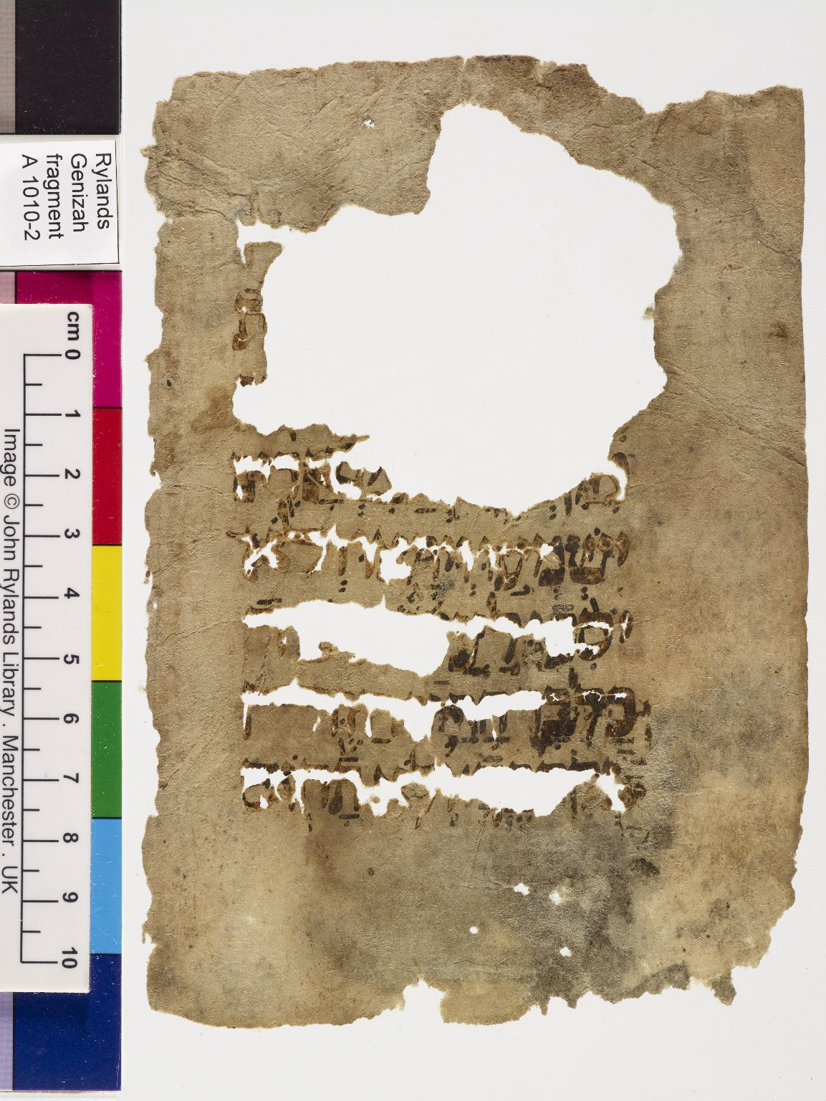
-------------
Image1
-------------
Field Data
Reference number A 1010 - 2
Obverse A 1010 - 1
Image Number JRL0710974dc
Image Title Deuteronomy
Subject Bible
Source title Bible. Deuteronomy.
Section 19.20-1
Language Hebrew
Script Hebrew
Vocalisation Tiberian
Accents Accents
Massorah No Massorah
Support material Paper
Item height 160 mm
Item width 111 mm
Folio 1 / 9 leaves (4 x 2 conjoined), verso
Technique used Handwriting
Notes 8 lines
Discovery site Egypt: Cairo: Ben Ezra synagogue
Current repository The University of Manchester Library, U.K.
Former repository Moses Gaster
Category of Material Manuscripts
Sub-Category Fragments
Image rights The University of Manchester Library
Work rights The University of Manchester Library
Access rights <a rel="license" href="http://creativecommons.org/licenses/by-nc-sa/4.0/"><img alt="Creative Commons License" style="border-width:0" src="https://i.creativecommons.org/l/by-nc-sa/4.0/88x31.png" /></a><br />This work is licensed under a <a rel="license" href="http://creativecommons.org/licenses/by-nc-sa/4.0/">Creative Commons Attribution-NonCommercial-ShareAlike 4.0 International License.</a> Copyright of The University of Manchester
Image sequence number A01010-002
Image technique Digital capture by Gten
Date image captured 2007-08-15
Date: added 2007-11
Metadata language eng-GB

Slide 3
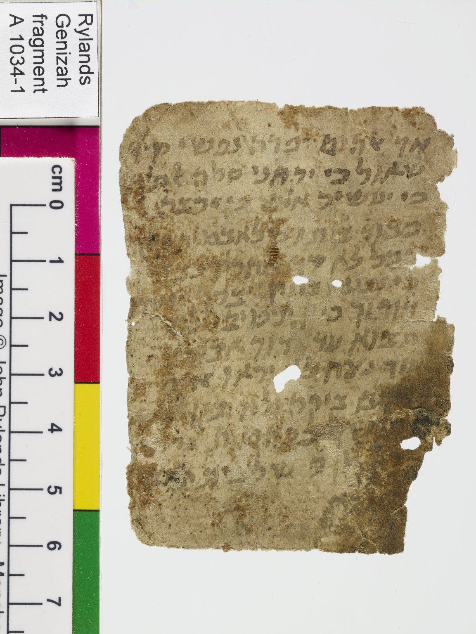
-------------
Image1
-------------
Field Data
Reference number A 1034 - 1
Obverse A 1034 - 2
Image Number JRL0711033dc
Image Title Psalm
Subject Bible
Source title Bible. Psalms.
Section 49.16-21 (lines 1-11)
Language Hebrew
Script Hebrew
Vocalisation No Vocalisation
Accents No Accents
Massorah No Massorah
Support material Paper
Item height 79 mm
Item width 57 mm
Folio 1 / 1 leaf, recto
Technique used Handwriting
Notes 12 lines
Discovery site Egypt: Cairo: Ben Ezra synagogue
Current repository The University of Manchester Library, U.K.
Former repository Moses Gaster
Category of Material Manuscripts
Sub-Category Fragments
Image rights The University of Manchester Library
Work rights The University of Manchester Library
Access rights <a rel="license" href="http://creativecommons.org/licenses/by-nc-sa/4.0/"><img alt="Creative Commons License" style="border-width:0" src="https://i.creativecommons.org/l/by-nc-sa/4.0/88x31.png" /></a><br />This work is licensed under a <a rel="license" href="http://creativecommons.org/licenses/by-nc-sa/4.0/">Creative Commons Attribution-NonCommercial-ShareAlike 4.0 International License.</a> Copyright of The University of Manchester
Image sequence number A01034-1
Image technique Digital capture by Gten
Date image captured 2007-09-04
Date: added 2007-11
Metadata language eng-GB

