Slide 1
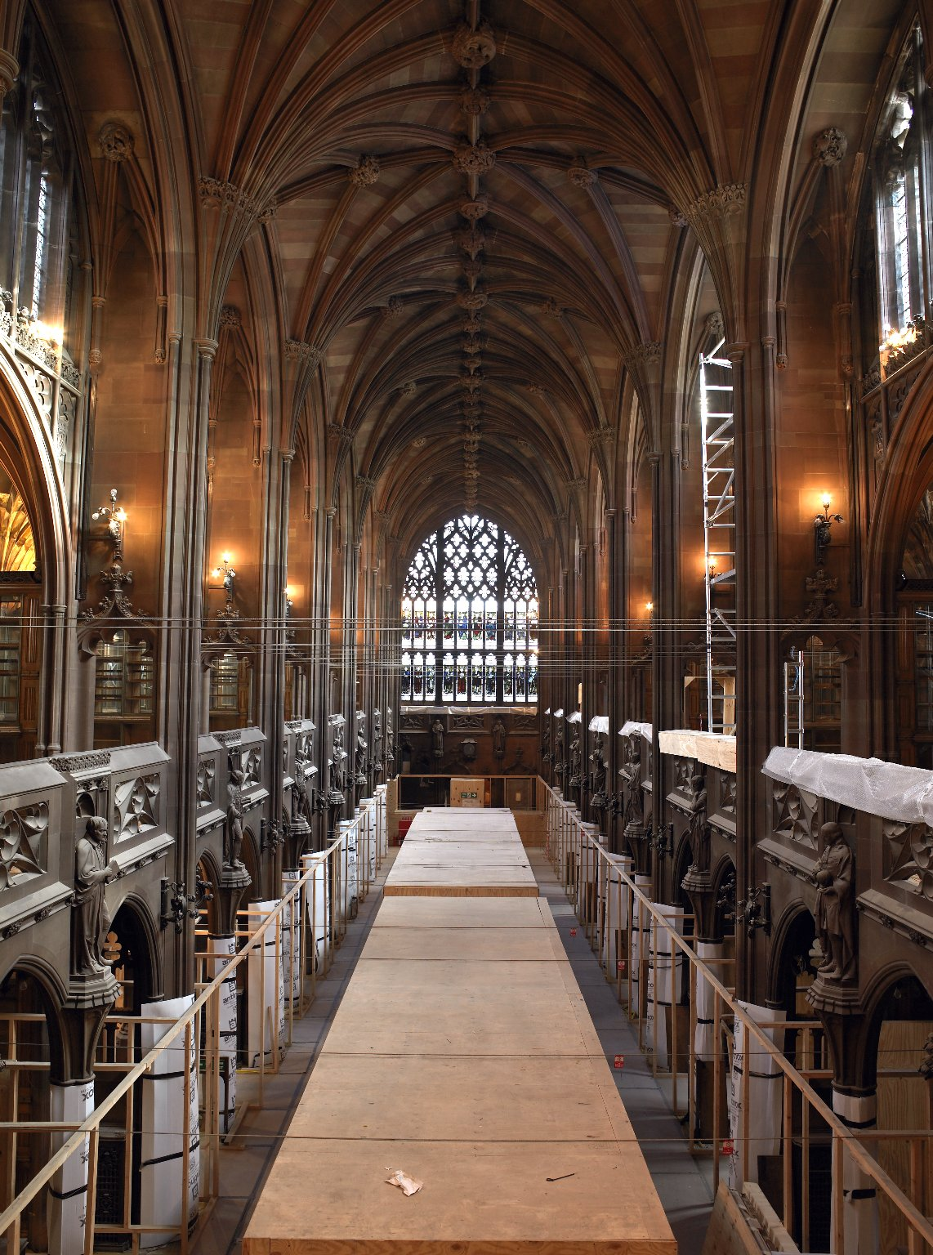
-------------
Image1
-------------
Field Data
Image Number JRL060532dc
Image Title Historic Reading Room
Series Title Unlocking the Rylands building project
Date Created 2006
Subject John Rylands Library
Subject Construction industry
Subject Architecture
Category of Material Photography
Sub-Category Digital photography
Time Period Covered 21st Century CE
Places Covered England: Greater Manchester: Manchester
Rights Holder - Image The University of Manchester Library
Date Captured (yyyy-mm-dd) 2006-01-26
Image Creation Technique Digital capture by Gten
Date Image Added (yyyy-mm) 2006-03
Metadata Language eng-GB

Slide 2
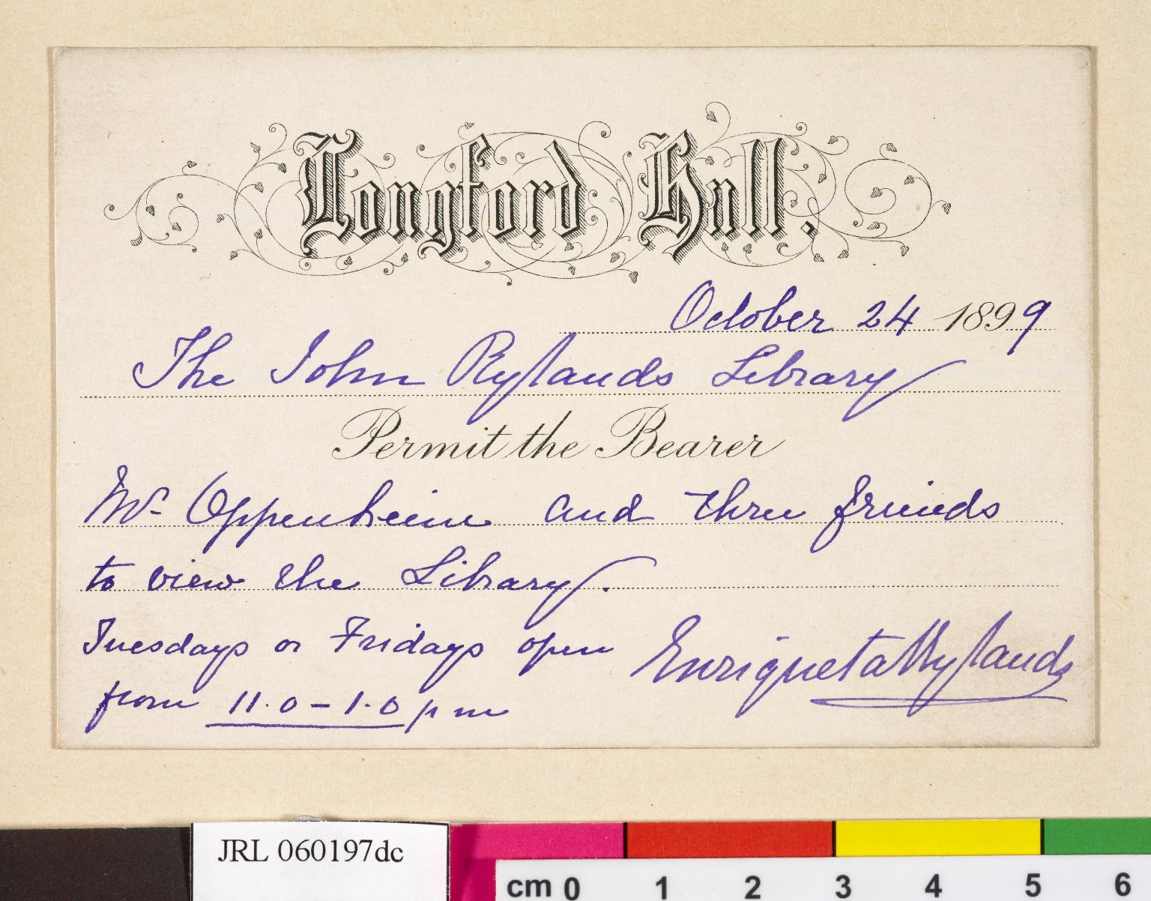
-------------
Image1
-------------
Field Data
Image Number JRL060197dc
Reference Number JRL
Image Title Invitation
Parent Work Title John Rylands Library Inauguration scrapbook
Date Created 1899-10-24
Description An invitation to Mr Oppenheim and three friends to a private viewing of the new John Rylands Library, sent by Mrs Rylands from her home, Longford Hall. The Library was open for viewing Tuesdays and Fridays between 1100 and 1300 hours.
Language Code eng-GB
Subject Autographs
Subject John Rylands Library
Category of Material Archives
Technique Used Handwriting
Support Card
Time Period Covered 19th Century CE
Places Covered England: Greater Manchester: Manchester
Item Height 77 mm
Item Width 113 mm
Current Repository The University of Manchester Library, U.K.
Rights Holder - Image The University of Manchester Library
Rights holder - Work The University of Manchester Library
Access Rights <a rel="license" href="http://creativecommons.org/licenses/by-nc-sa/4.0/"><img alt="Creative Commons License" style="border-width:0" src="https://i.creativecommons.org/l/by-nc-sa/4.0/88x31.png"></a>
Date Captured (yyyy-mm-dd) 2005-12-08
Image Creation Technique Digital capture by Gten
Date Image Added (yyyy-mm) 2006-02
Metadata Language eng-GB

