Slide 1
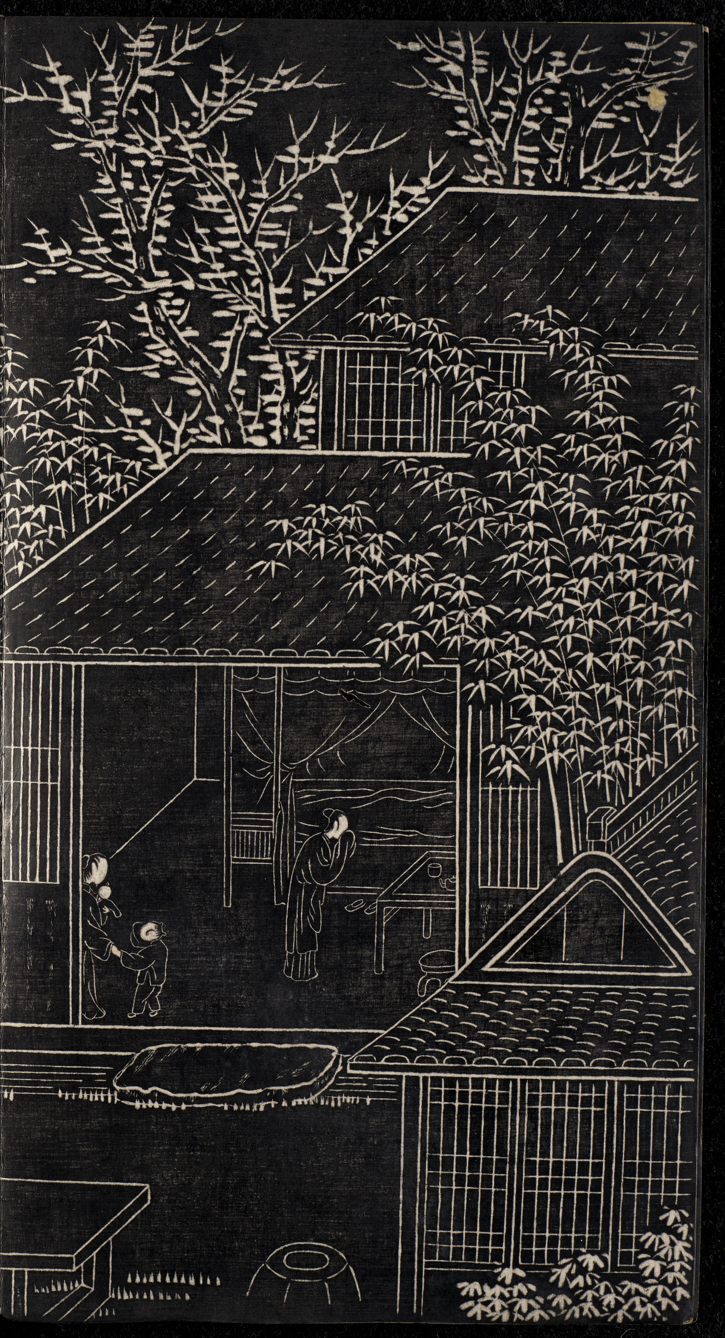
-------------
Image1
-------------
Field Data
Description 10
Originating Url <a target='_blank' href='https://luna.manchester.ac.uk/luna/servlet/detail/Manchester~91~1~433875~225798?page=9' >Open this Book</a><br>
Copyright Internet Archive Copyright

