Slide 1
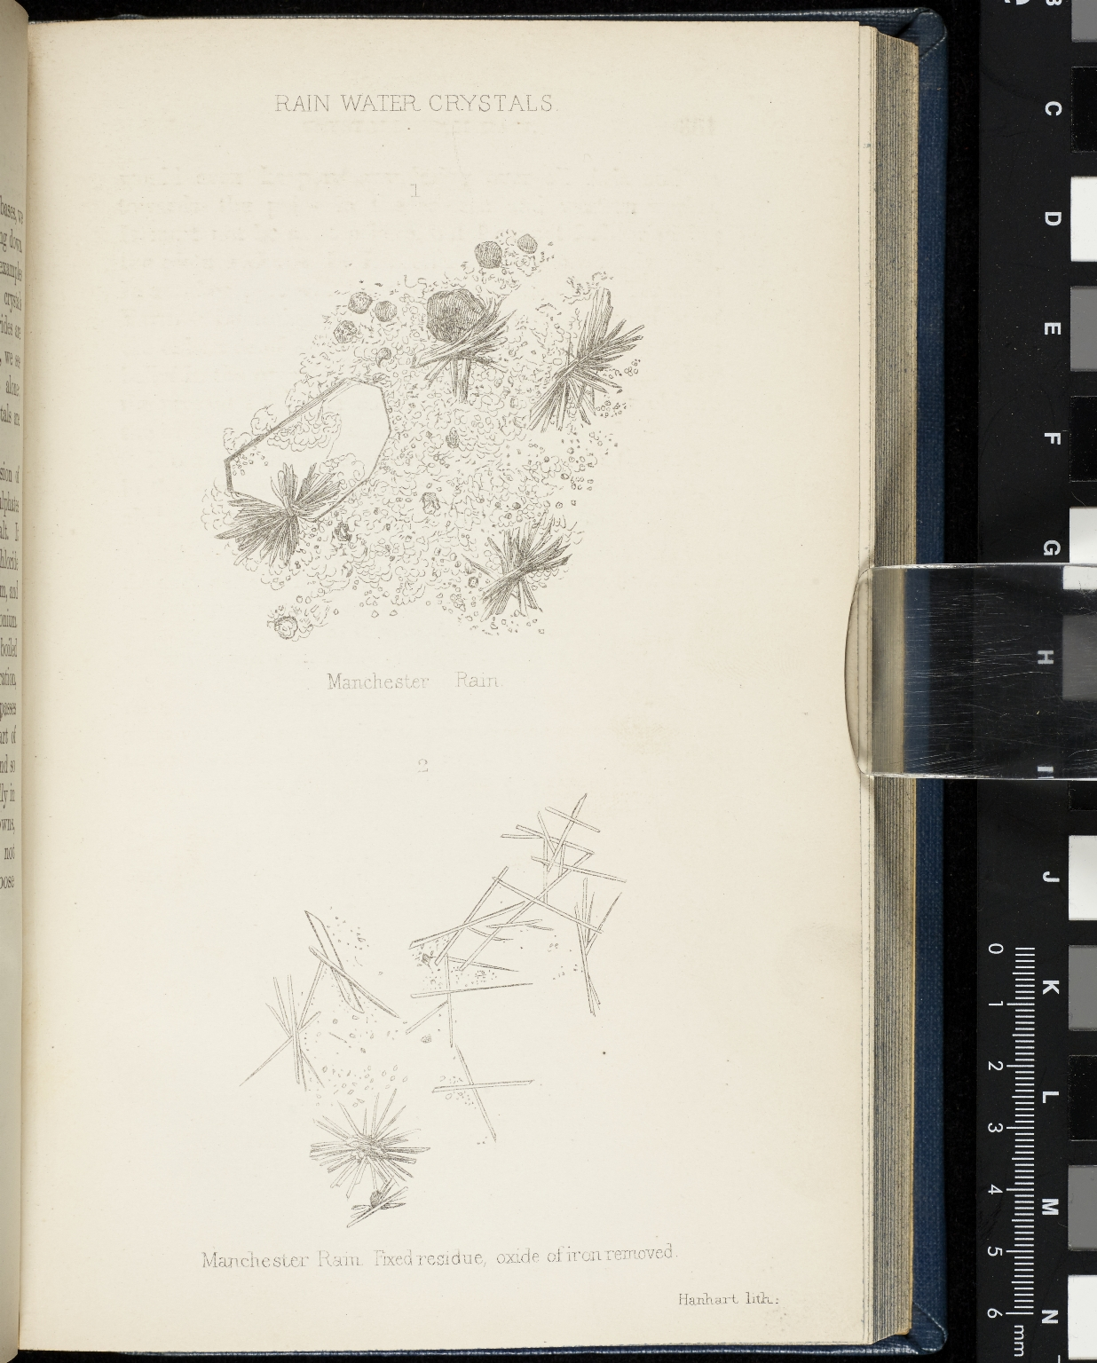
-------------
Image1
-------------
Field Data
Image Number JRL17021898
Reference Number J200011
Link to Catalogue <A href="http://www.librarysearch.manchester.ac.uk/MU_VU1:BLENDED:44MAN_ALMA_DS21206278990001631">UOM online catalogue.</a>
Image Title Rain Water Crystals
Alternative Image Title Manchester Rain
Parent Work Title Air and Rain: The Beginnings of a Chemical Climatology
Alternative Parent Work Title Beginnings of a chemical climatology
Creator Angus Smith, R. Angus (Robert Angus), 1817-1884
Creator Role Author
Date Created 1872
Publication Details London: Longmans, Green and Co.; Great Britain England London.
Description Diagram: rain water crystals, or Manchester rain.
Keyword Climatology; Air; Rain; Rainfall; Chemistry.
Language Code eng-GB
Language English
Subject Weather
Subject Climatology
Category of Material Printed
Medium Ink
Support Paper
Places Covered England: Greater Manchester: Manchester
Current Repository The University of Manchester Library, U.K.
Provenance Joule, James Prescott, 1818-1889, former owner.
Rights Holder - Image The University of Manchester Library
Rights holder - Work The University of Manchester Library
Date Captured (yyyy-mm-dd) 2017-02-13
Image Creation Technique Digital capture by Heritage Imaging, The University of Manchester Library
Date Image Added (yyyy-mm) 2017-03
Metadata Language eng-GB

Slide 2
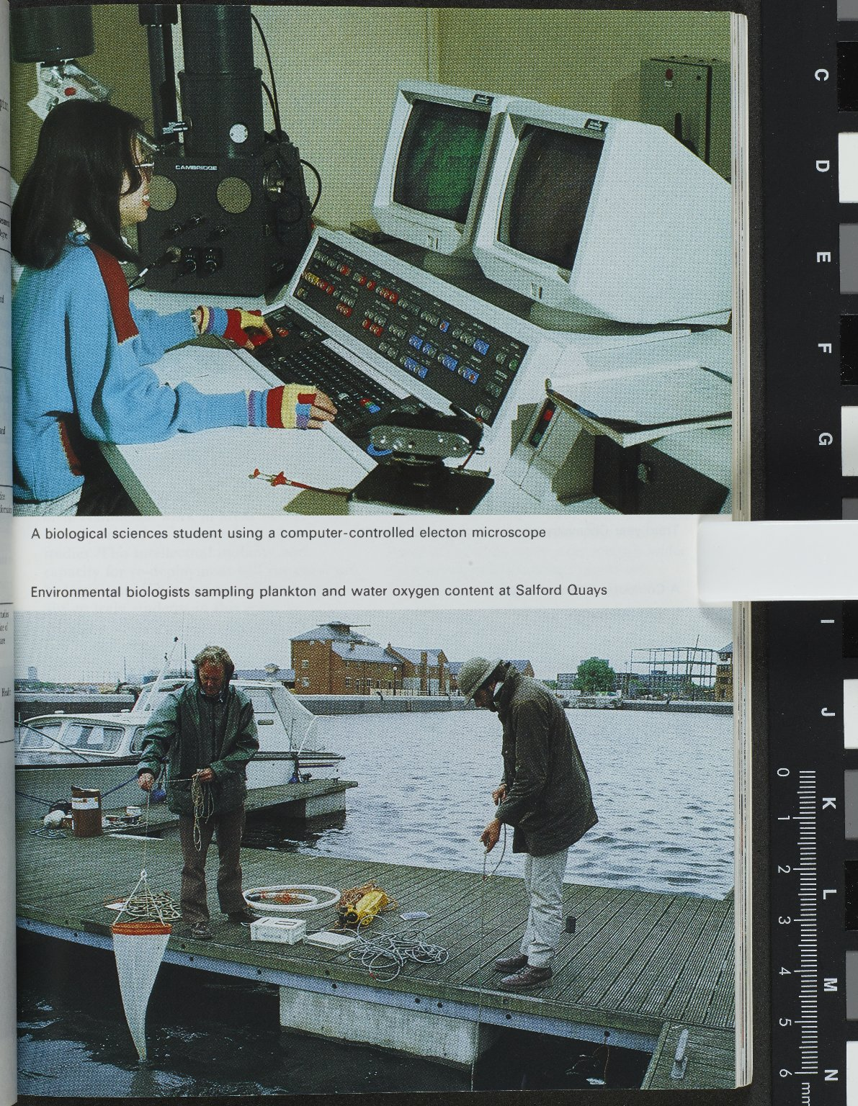
-------------
Image1
-------------
Field Data
Image Number JRL1412541
Reference Number University Archive
Image Title University of Manchester Student activities
Date Created 1990
Page/Sheet facing p.112
Description A biological science student using a computer controlled electron microscope; environmental biologist sampling plankton and water oxygen content at Salford Quays.
Language English
Language Code eng-GB
Subject University of Manchester
Category of Material Archives
Technique Used Printing (process)
Support Paper
Time Period Covered 20th Century CE
Places Covered England: Greater Manchester: Manchester
Rights Holder - Image The University of Manchester Library
Rights holder - Work The University of Manchester Library
Access Rights <a rel="license" href="http://creativecommons.org/licenses/by-nc-sa/4.0/"><img alt="Creative Commons License" style="border-width:0" src="https://i.creativecommons.org/l/by-nc-sa/4.0/88x31.png"></a>
Image Creation Technique Digital capture by Heritage Imaging, The University of Manchester Library

