Slide 1
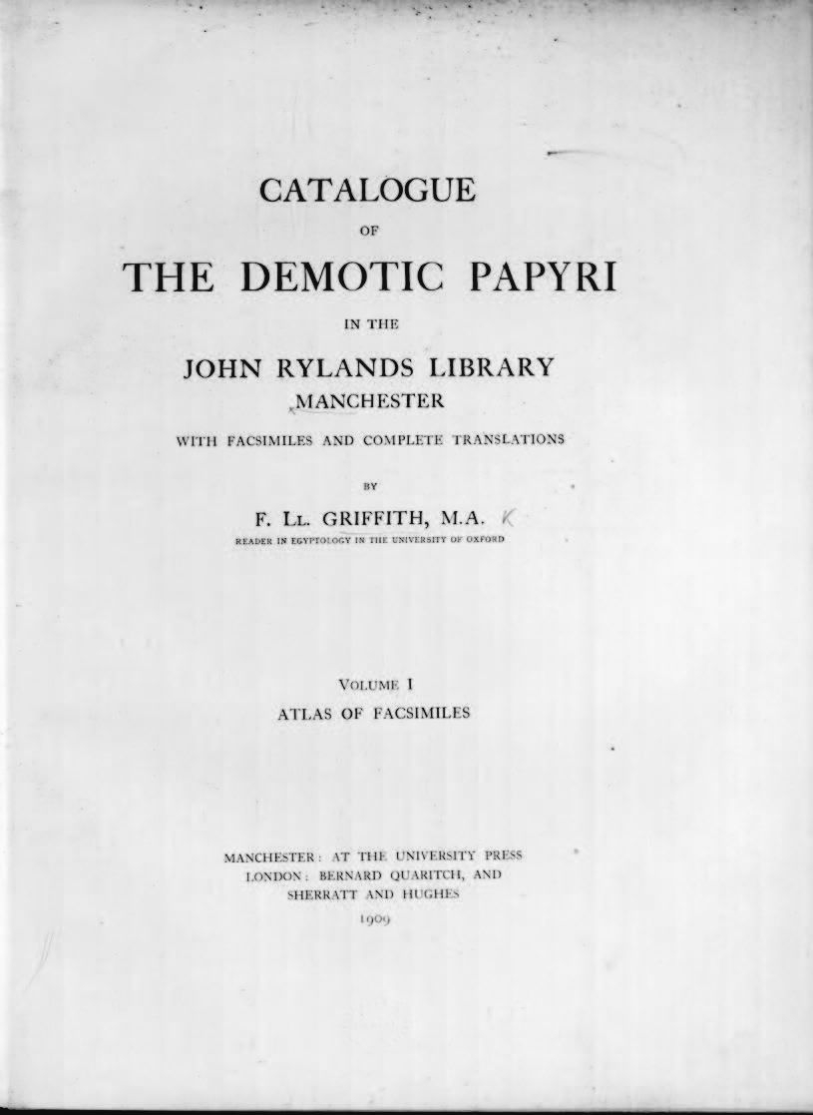
-------------
Image1
-------------
Field Data
Image Number escholar000037.pdf
Reference Number R17740
Link to Catalogue <A href= http://www.librarysearch.manchester.ac.uk/MU_VU1:BLENDED:44MAN_ALMA_DS21208923930001631>UoM online catalogue</a>
Image Title Atlas of facsimiles
Parent Work Title Catalogue of the Demotic Papyri in the John Rylands Library, Manchester Manchester
Creator Griffith, Francis Llewellyn, 1862-1934
Creator Role Author
Date Created 1909
Publication Details Manchester: Manchester University Press
Volume 1
Language English
Language Code eng-GB
Subject Manuscripts--Great Britain--Catalogues
Subject John Rylands Library--Catalogues
Subject Egyptian language--Papyri, Demotic
Subject Egyptian language--Writing, Demotic.
Category of Material Printed
Support Paper
Current Repository The University of Manchester Library, U.K.
Rights Holder - Image The University of Manchester Library
Rights holder - Work Manchester University Press
Image Creation Technique Scanned from original by Hollingworth & Moss Ltd
Date Image Added (yyyy-mm) 2017-07
Metadata Language eng-GB

