Slide 1
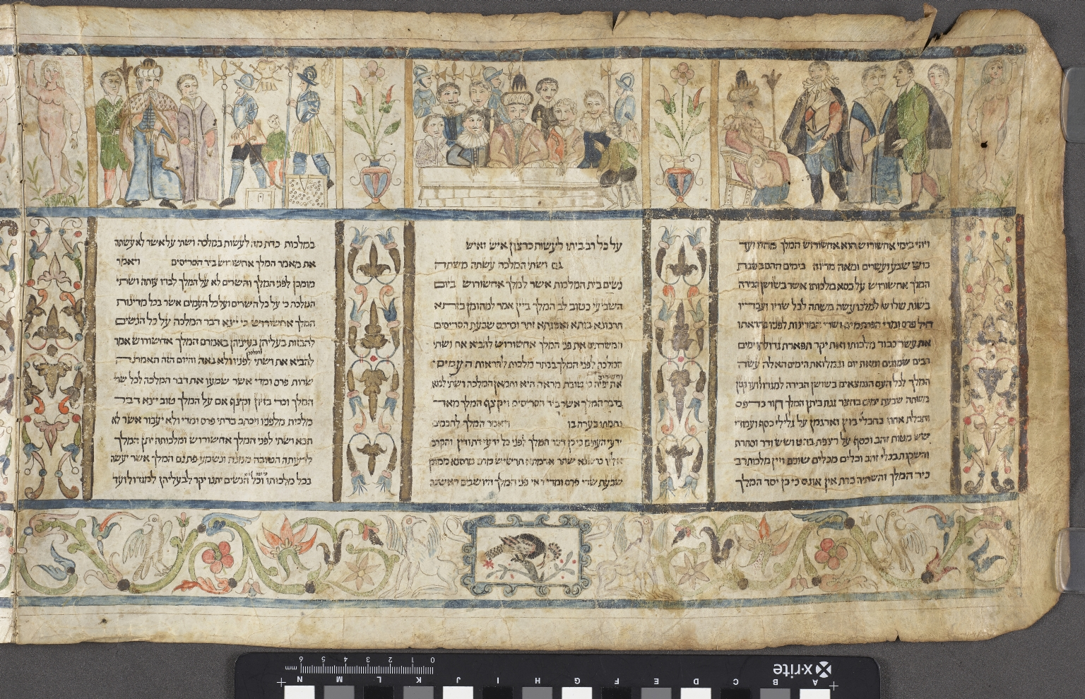
-------------
Image1
-------------
Field Data
Image Number JRL18012628
Reference Number Hebrew MS 22
Image Title Detail of Esther scroll
Parent Work Title Megillat Esther
Alternative Parent Work Title Book of Esther
Creator Pescarol, Moshe ben Avraham
Creator Role Illustrator
Creator Role Scribe
Date Created 1618
Page/Sheet Panel 1
Image Sequence Number 001
Image Sequence Total 012
Description Illuminated scroll, earliest known example of an Italian illustrated Magillah. This section shows three panels, the first shows a King sat on a throne with four men standing in front of him; the second a gathering on a balcony with the King in centre and soldiers in the background; the third shows two soldiers holding pike staffs next to small boy on the right of the illustration. A King is also depicted, accompanied by two men.
Language Hebrew
Language Code heb
Subject Bible. O.T.
Category of Material Manuscripts
Sub-Category Scrolls
Technique Used Handwriting
Technique Used Painting
Creation Site Italy: Ferrara
Current Repository The University of Manchester Library, U.K.
Rights Holder - Image The University of Manchester Library
Rights holder - Work The University of Manchester Library
Access Rights <a rel="license" href="http://creativecommons.org/licenses/by-nc-sa/4.0/"><img alt="Creative Commons License" style="border-width:0" src="https://i.creativecommons.org/l/by-nc-sa/4.0/88x31.png"></a>
Date Image Added (yyyy-mm) 2018-01
Metadata Language eng-GB

Slide 2
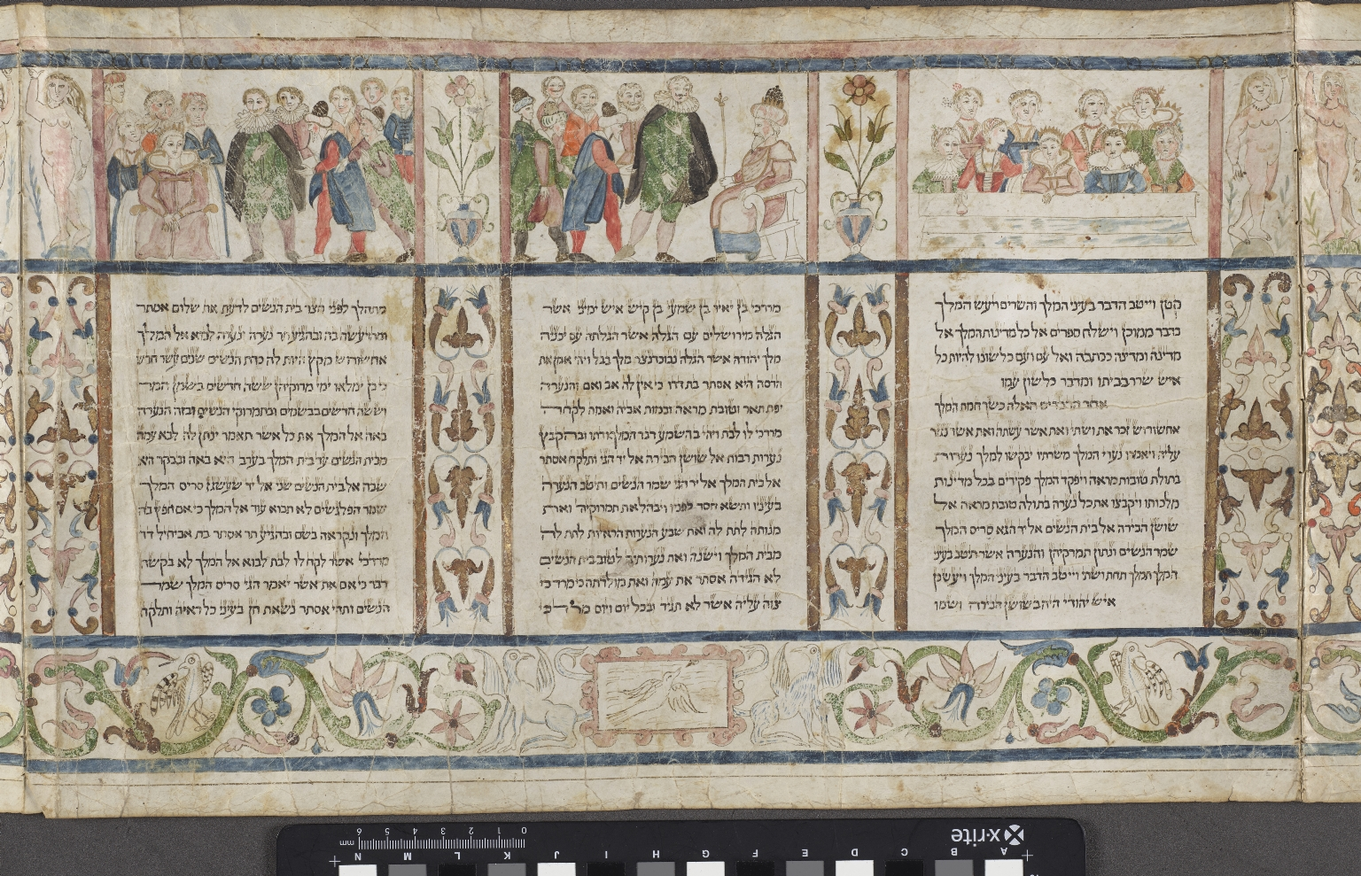
-------------
Image1
-------------
Field Data
Image Number JRL18012629
Reference Number Hebrew MS 22
Image Title Detail of Esther scroll
Parent Work Title Megillat Esther
Alternative Parent Work Title Book of Esther
Creator Pescarol, Moshe ben Avraham
Creator Role Illustrator
Creator Role Scribe
Date Created 1618
Page/Sheet Panel 2
Image Sequence Number 002
Image Sequence Total 012
Description Illuminated scroll, earliest known example of an Italian illustrated Magillah. Three panels, the first shows nine ladies seated at a table; the next shows a King sat on a throne on the right of the illustration, with seven other men standing to the left; the third panel shows large gathering of people. Amongst them is seated a Queen and two men wearing ruffs are depicted in the centre.
Language Hebrew
Language Code heb
Subject Bible. O.T.
Category of Material Manuscripts
Sub-Category Scrolls
Technique Used Handwriting
Technique Used Painting
Creation Site Italy: Ferrara
Current Repository The University of Manchester Library, U.K.
Rights Holder - Image The University of Manchester Library
Rights holder - Work The University of Manchester Library
Access Rights <a rel="license" href="http://creativecommons.org/licenses/by-nc-sa/4.0/"><img alt="Creative Commons License" style="border-width:0" src="https://i.creativecommons.org/l/by-nc-sa/4.0/88x31.png"></a>
Date Image Added (yyyy-mm) 2018-01
Metadata Language eng-GB

Slide 3
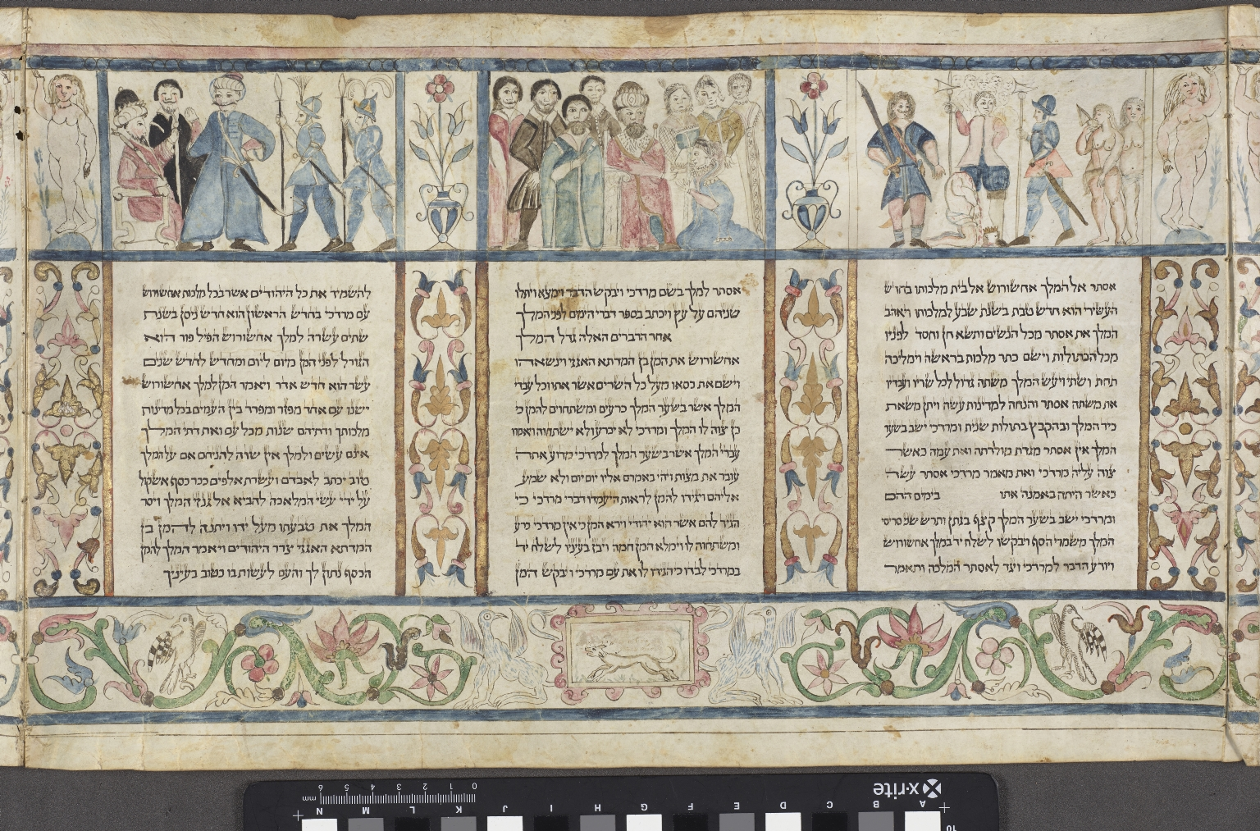
-------------
Image1
-------------
Field Data
Image Number JRL18012630
Reference Number Hebrew MS 22
Image Title Detail of Esther scroll
Parent Work Title Megillat Esther
Alternative Parent Work Title Book of Esther
Creator Pescarol, Moshe ben Avraham
Creator Role Illustrator
Creator Role Scribe
Date Created 1618
Page/Sheet Panel 3
Image Sequence Number 003
Image Sequence Total 012
Description Illuminated scroll, earliest known example of an Italian illustrated Magillah. Three section shows three panels, the first is illustrated with two naked women on right of the illustration, with three soldiers and a decapitated man kneeling in the centre; the second shows nine people, with a woman dressed in blue kneeling down. The third panel shows three soldiers in blue, in front of a seated King. A man dressed in black stands to the side of the King.
Language Hebrew
Language Code heb
Subject Bible. O.T.
Category of Material Manuscripts
Sub-Category Scrolls
Technique Used Handwriting
Technique Used Painting
Creation Site Italy: Ferrara
Current Repository The University of Manchester Library, U.K.
Rights Holder - Image The University of Manchester Library
Rights holder - Work The University of Manchester Library
Access Rights <a rel="license" href="http://creativecommons.org/licenses/by-nc-sa/4.0/"><img alt="Creative Commons License" style="border-width:0" src="https://i.creativecommons.org/l/by-nc-sa/4.0/88x31.png"></a>
Date Image Added (yyyy-mm) 2018-01
Metadata Language eng-GB

Slide 4
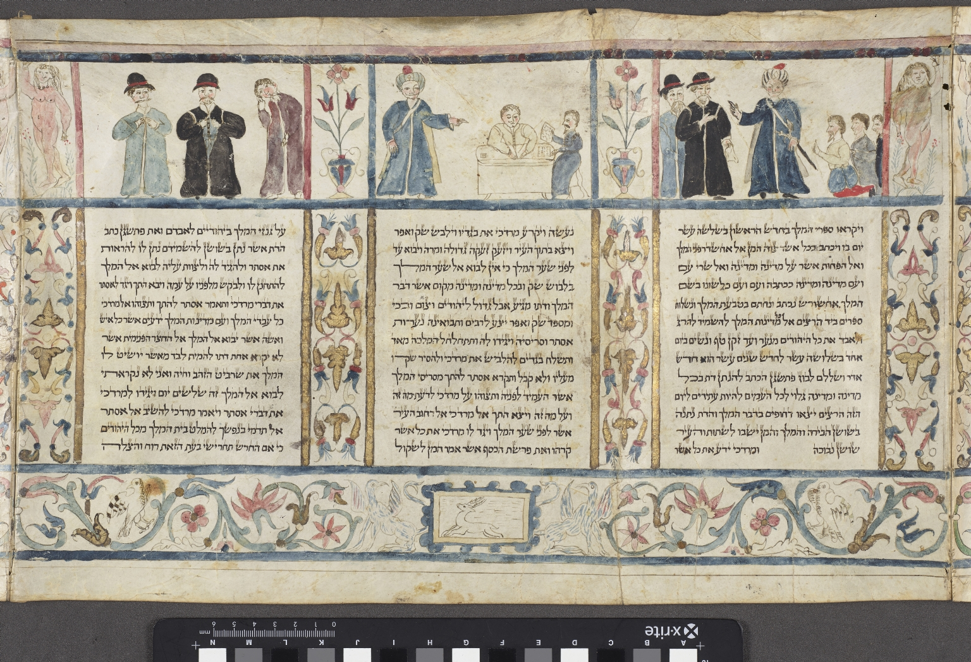
-------------
Image1
-------------
Field Data
Image Number JRL18012631
Reference Number Hebrew MS 22
Image Title Detail of Esther scroll
Parent Work Title Megillat Esther
Alternative Parent Work Title Book of Esther
Creator Pescarol, Moshe ben Avraham
Creator Role Illustrator
Creator Role Scribe
Date Created 1618
Page/Sheet Panel 4
Image Sequence Number 004
Image Sequence Total 012
Description Illuminated scroll, earliest known example of an Italian illustrated Magillah. This section shows three panels, the first depicts a man in a blue coat in the centre, with two men standing on his right and three men kneeling on his left. The second panel shows two men sat at desk, one in blue, one in white. A third man also dressed in blue stands pointing to the two seated men. The third shows three standing men with moustaches, opening their coats.
Language Hebrew
Language Code heb
Subject Bible. O.T.
Category of Material Manuscripts
Sub-Category Scrolls
Technique Used Handwriting
Technique Used Painting
Creation Site Italy: Ferrara
Current Repository The University of Manchester Library, U.K.
Rights Holder - Image The University of Manchester Library
Rights holder - Work The University of Manchester Library
Access Rights <a rel="license" href="http://creativecommons.org/licenses/by-nc-sa/4.0/"><img alt="Creative Commons License" style="border-width:0" src="https://i.creativecommons.org/l/by-nc-sa/4.0/88x31.png"></a>
Date Image Added (yyyy-mm) 2018-01
Metadata Language eng-GB

Slide 5
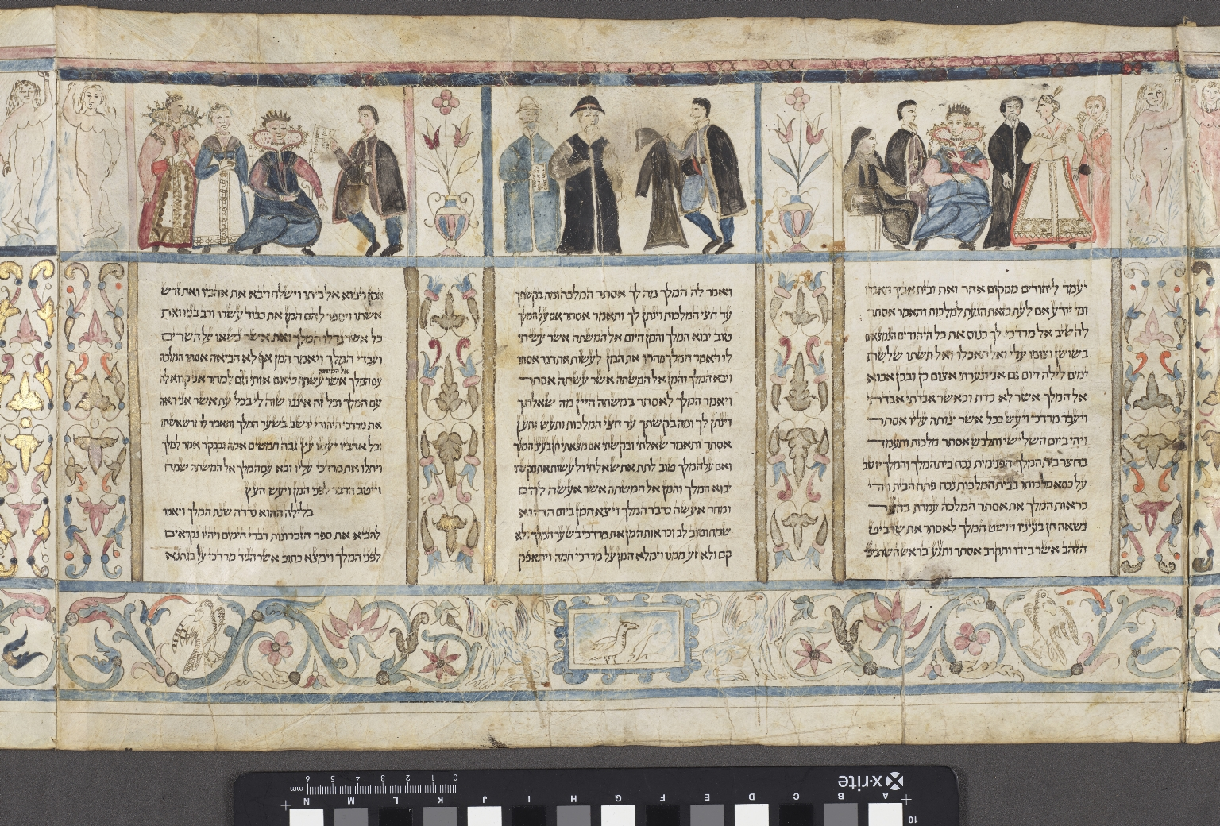
-------------
Image1
-------------
Field Data
Image Number JRL18012632
Reference Number Hebrew MS 22
Image Title Detail of Esther scroll
Parent Work Title Megillat Esther
Alternative Parent Work Title Book of Esther
Creator Pescarol, Moshe ben Avraham
Creator Role Illustrator
Creator Role Scribe
Date Created 1618
Page/Sheet Panel 5
Image Sequence Number 005
Image Sequence Total 012
Description Illuminated scroll, earliest known example of an Italian illustrated Magillah. This section shows three panels, the first shows six people including a seated Queen and a man in black. The second shows three standing men one of whom is holding out a cape. The third panel shows four people including two Royals.
Language Hebrew
Language Code heb
Subject Bible. O.T.
Category of Material Manuscripts
Sub-Category Scrolls
Technique Used Handwriting
Technique Used Painting
Creation Site Italy: Ferrara
Current Repository The University of Manchester Library, U.K.
Rights Holder - Image The University of Manchester Library
Rights holder - Work The University of Manchester Library
Access Rights <a rel="license" href="http://creativecommons.org/licenses/by-nc-sa/4.0/"><img alt="Creative Commons License" style="border-width:0" src="https://i.creativecommons.org/l/by-nc-sa/4.0/88x31.png"></a>
Date Image Added (yyyy-mm) 2018-01
Metadata Language eng-GB

Slide 6
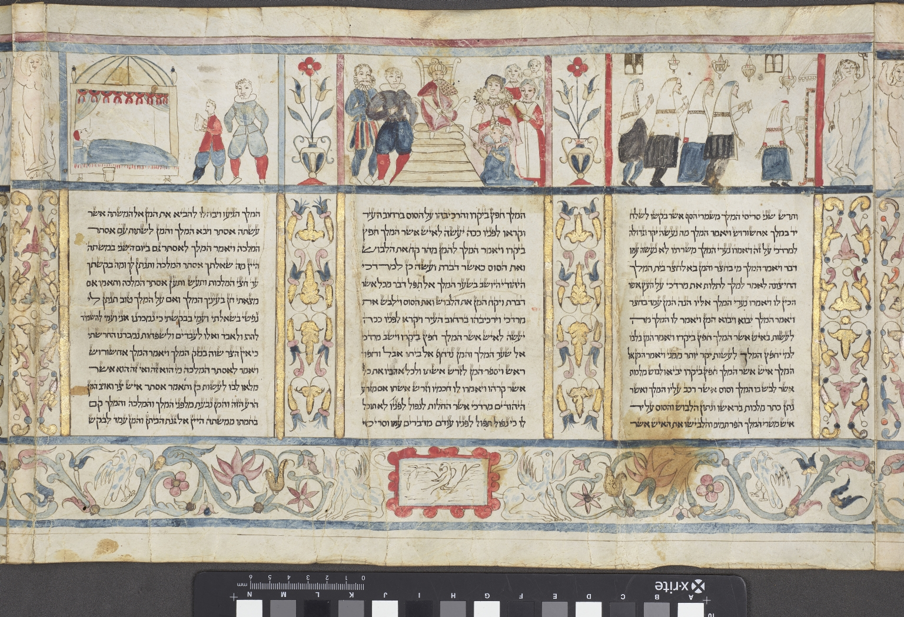
-------------
Image1
-------------
Field Data
Image Number JRL18012633
Reference Number Hebrew MS 22
Image Title Detail of Esther scroll
Parent Work Title Megillat Esther
Alternative Parent Work Title Book of Esther
Creator Pescarol, Moshe ben Avraham
Creator Role Illustrator
Creator Role Scribe
Date Created 1618
Page/Sheet Panel 6
Image Sequence Number 006
Image Sequence Total 012
Description Illuminated scroll, earliest known example of an Italian illustrated Magillah. This section shows three panels, the first shows five men walking, holding paper. The second shows a King sat on a throne with the Queen kneeling at the bottom. Two men stand on the right, and four women on left. The third panel shows a man lying in bed, with a bucket at the bedside. Two men are standing at the foot of bed.
Language Hebrew
Language Code heb
Subject Bible. O.T.
Category of Material Manuscripts
Sub-Category Scrolls
Technique Used Handwriting
Technique Used Painting
Creation Site Italy: Ferrara
Current Repository The University of Manchester Library, U.K.
Rights Holder - Image The University of Manchester Library
Rights holder - Work The University of Manchester Library
Access Rights <a rel="license" href="http://creativecommons.org/licenses/by-nc-sa/4.0/"><img alt="Creative Commons License" style="border-width:0" src="https://i.creativecommons.org/l/by-nc-sa/4.0/88x31.png"></a>
Date Image Added (yyyy-mm) 2018-01
Metadata Language eng-GB

Slide 7
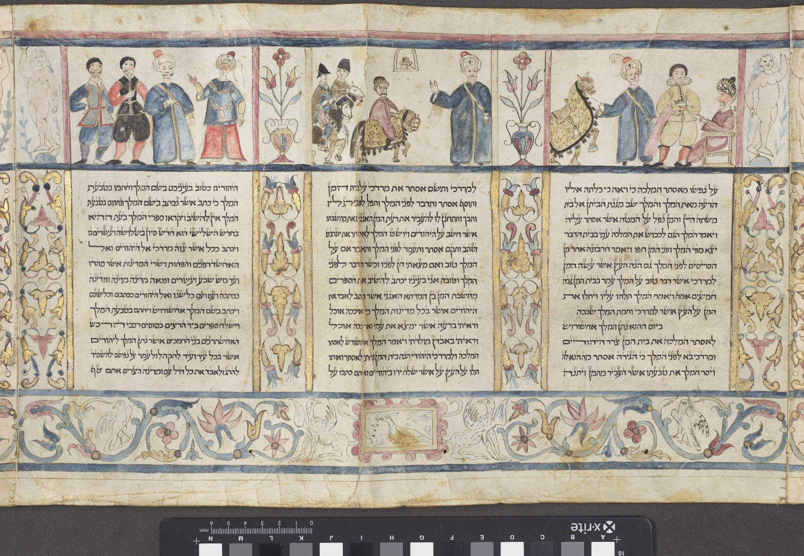
-------------
Image1
-------------
Field Data
Image Number JRL18012634
Reference Number Hebrew MS 22
Image Title Detail of Esther scroll
Parent Work Title Megillat Esther
Alternative Parent Work Title Book of Esther
Creator Pescarol, Moshe ben Avraham
Creator Role Illustrator
Creator Role Scribe
Date Created 1618
Page/Sheet Panel 7
Image Sequence Number 007
Image Sequence Total 012
Description Illuminated scroll, earliest known example of an Italian illustrated Magillah. This section shows three panels, the first shows a rearing horse and three men, one of whom is seated. The second shows three men on horseback and a fourth man standing dressed in blue. The third shows four standing men, two of whom are wearing turbans.
Language Hebrew
Language Code heb
Subject Bible. O.T.
Category of Material Manuscripts
Sub-Category Scrolls
Technique Used Handwriting
Technique Used Painting
Creation Site Italy: Ferrara
Current Repository The University of Manchester Library, U.K.
Rights Holder - Image The University of Manchester Library
Rights holder - Work The University of Manchester Library
Access Rights <a rel="license" href="http://creativecommons.org/licenses/by-nc-sa/4.0/"><img alt="Creative Commons License" style="border-width:0" src="https://i.creativecommons.org/l/by-nc-sa/4.0/88x31.png"></a>
Date Image Added (yyyy-mm) 2018-01
Metadata Language eng-GB

Slide 8
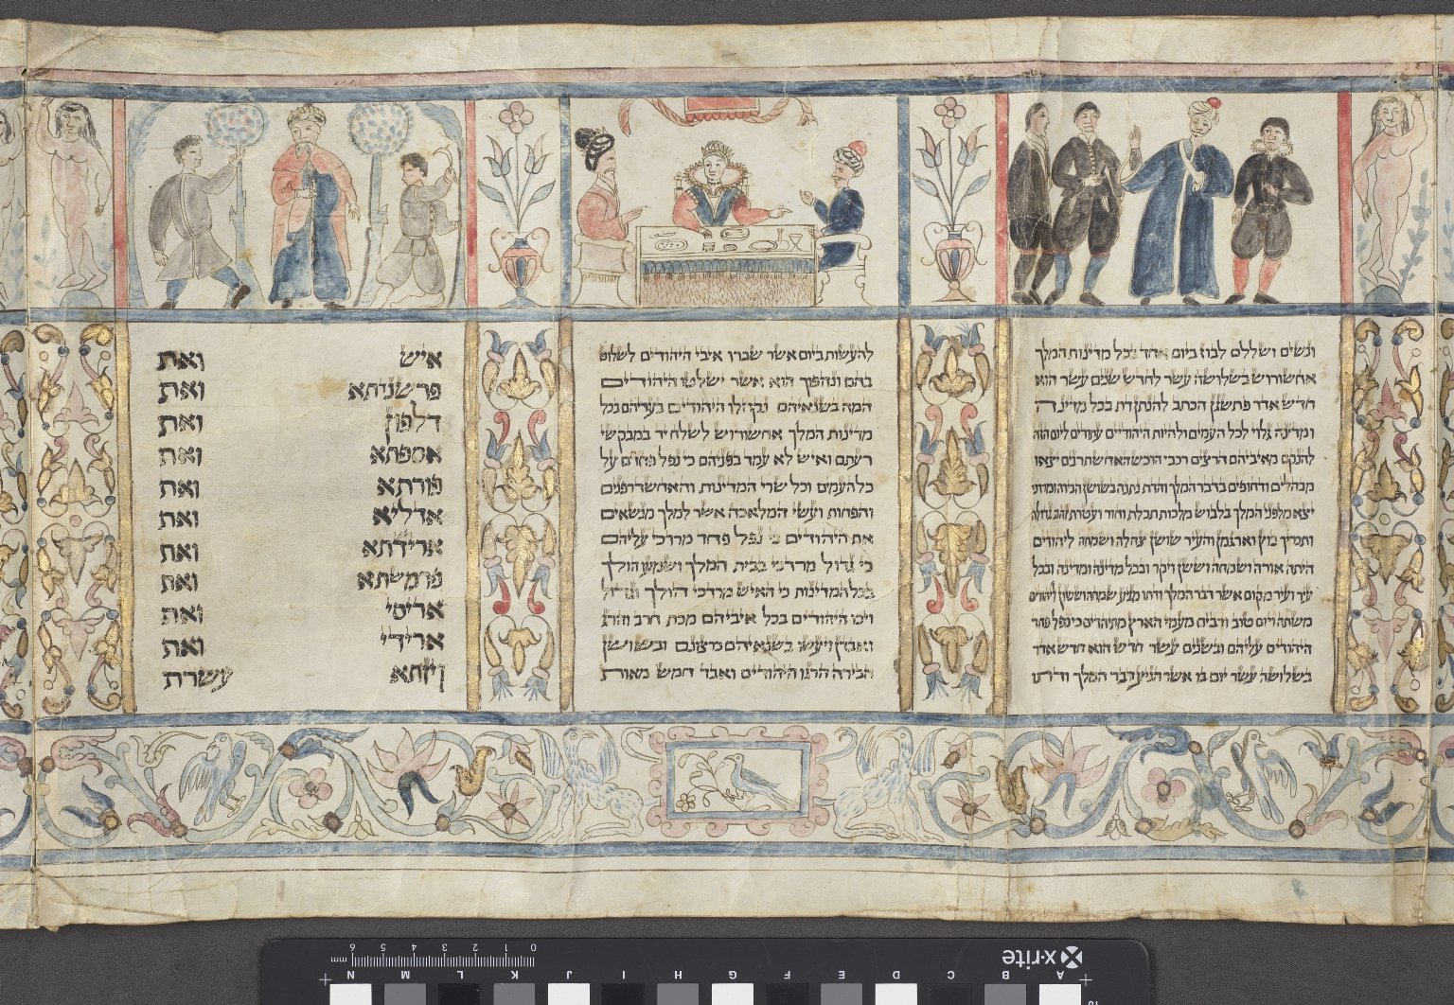
-------------
Image1
-------------
Field Data
Image Number JRL18012635
Reference Number Hebrew MS 22
Image Title Detail of Esther scroll
Parent Work Title Megillat Esther
Alternative Parent Work Title Book of Esther
Creator Pescarol, Moshe ben Avraham
Creator Role Illustrator
Creator Role Scribe
Date Created 1618
Page/Sheet Panel 8
Image Sequence Number 008
Image Sequence Total 012
Description Illuminated scroll, earliest known example of an Italian illustrated Magillah. This section shows three panels, the first shows shows four men standing together. Three men are dressed in black and the fourth in a long blue coat. The second shows a Queen sat at table accompanied by two men in turbans. The third panel shows three standing men, two soldiers in grey stood by a King in the middle wearing a red cape.
Language Hebrew
Language Code heb
Subject Bible. O.T.
Category of Material Manuscripts
Sub-Category Scrolls
Technique Used Handwriting
Technique Used Painting
Creation Site Italy: Ferrara
Current Repository The University of Manchester Library, U.K.
Rights Holder - Image The University of Manchester Library
Rights holder - Work The University of Manchester Library
Access Rights <a rel="license" href="http://creativecommons.org/licenses/by-nc-sa/4.0/"><img alt="Creative Commons License" style="border-width:0" src="https://i.creativecommons.org/l/by-nc-sa/4.0/88x31.png"></a>
Date Image Added (yyyy-mm) 2018-01
Metadata Language eng-GB

Slide 9
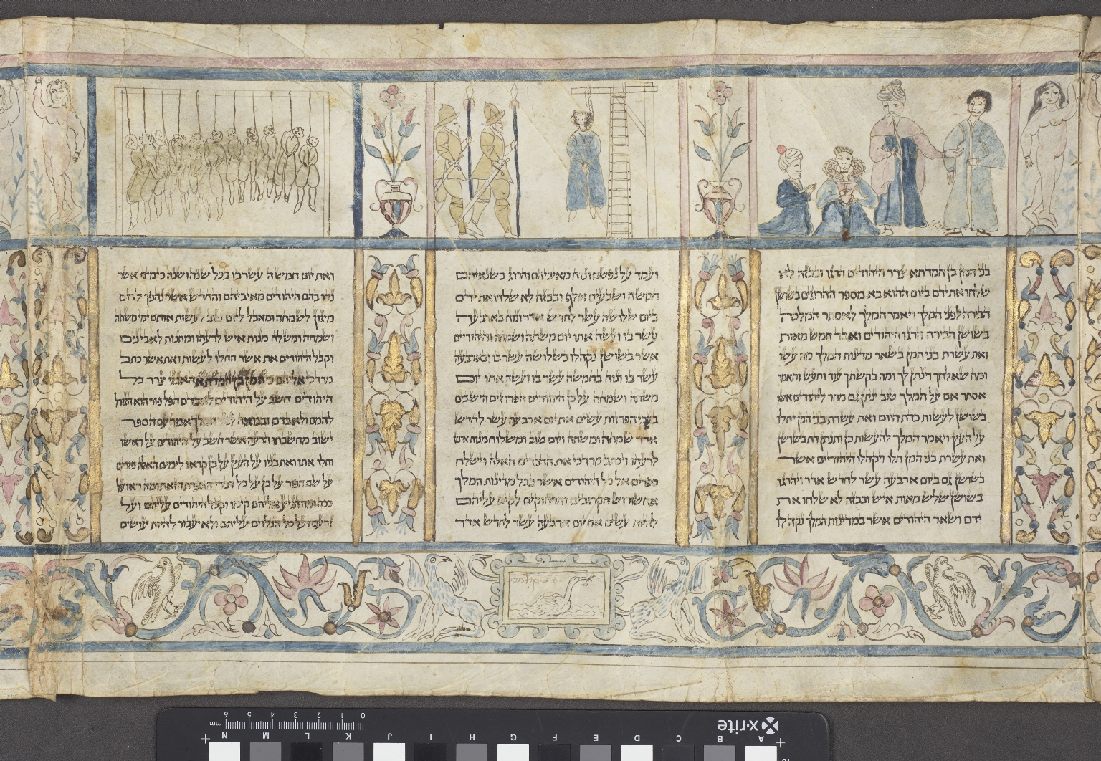
-------------
Image1
-------------
Field Data
Image Number JRL18012636
Reference Number Hebrew MS 22
Image Title Detail of Esther scroll
Parent Work Title Megillat Esther
Alternative Parent Work Title Book of Esther
Creator Pescarol, Moshe ben Avraham
Creator Role Illustrator
Creator Role Scribe
Date Created 1618
Page/Sheet Panel 9
Image Sequence Number 009
Image Sequence Total 012
Description Illuminated scroll, earliest known example of an Italian illustrated Magillah. This section shows three panels, the first shows a Queen and a man in a Turban kneeling, with two other men standing over them. The second panel shows two soldiers on the left and a man hanging on a gibbett on the right of the illustration. The third panel shows shows a group of people hanging from gallows.
Language Hebrew
Language Code heb
Subject Bible. O.T.
Category of Material Manuscripts
Sub-Category Scrolls
Technique Used Handwriting
Technique Used Painting
Creation Site Italy: Ferrara
Current Repository The University of Manchester Library, U.K.
Rights Holder - Image The University of Manchester Library
Rights holder - Work The University of Manchester Library
Access Rights <a rel="license" href="http://creativecommons.org/licenses/by-nc-sa/4.0/"><img alt="Creative Commons License" style="border-width:0" src="https://i.creativecommons.org/l/by-nc-sa/4.0/88x31.png"></a>
Date Image Added (yyyy-mm) 2018-01
Metadata Language eng-GB

Slide 10
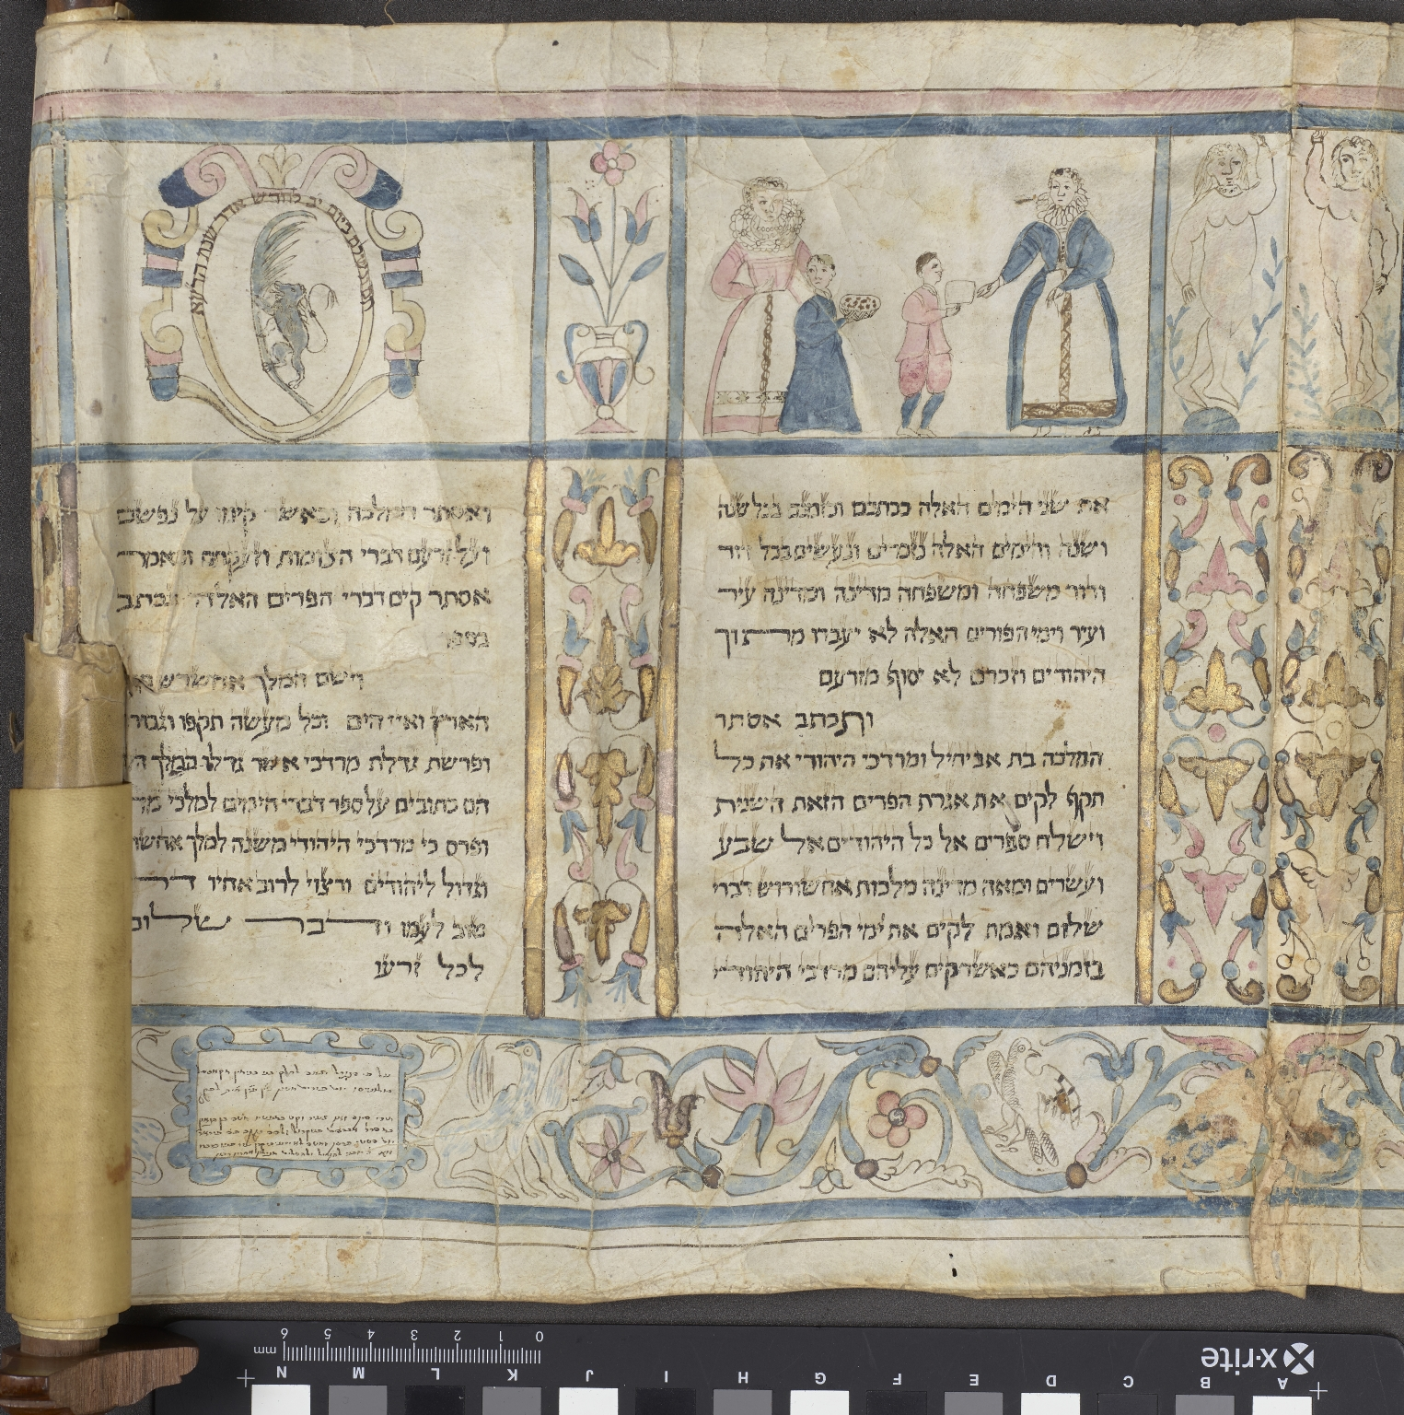
-------------
Image1
-------------
Field Data
Image Number JRL18012637
Reference Number Hebrew MS 22
Image Title Detail of Esther scroll
Parent Work Title Megillat Esther
Alternative Parent Work Title Book of Esther
Creator Pescarol, Moshe ben Avraham
Creator Role Illustrator
Creator Role Scribe
Date Created 1618
Page/Sheet Panel 10
Image Sequence Number 010
Image Sequence Total 012
Description Illuminated scroll, earliest known example of an Italian illustrated Magillah. This section shows two panels, the first shows two ladies wearing white aprons handing out food to two children. The second shows a little blue griffin climbing up a leaf, surrounded by a circular border.
Language Hebrew
Language Code heb
Subject Bible. O.T.
Category of Material Manuscripts
Sub-Category Scrolls
Technique Used Handwriting
Technique Used Painting
Creation Site Italy: Ferrara
Current Repository The University of Manchester Library, U.K.
Rights Holder - Image The University of Manchester Library
Rights holder - Work The University of Manchester Library
Access Rights <a rel="license" href="http://creativecommons.org/licenses/by-nc-sa/4.0/"><img alt="Creative Commons License" style="border-width:0" src="https://i.creativecommons.org/l/by-nc-sa/4.0/88x31.png"></a>
Date Image Added (yyyy-mm) 2018-01
Metadata Language eng-GB

Slide 11
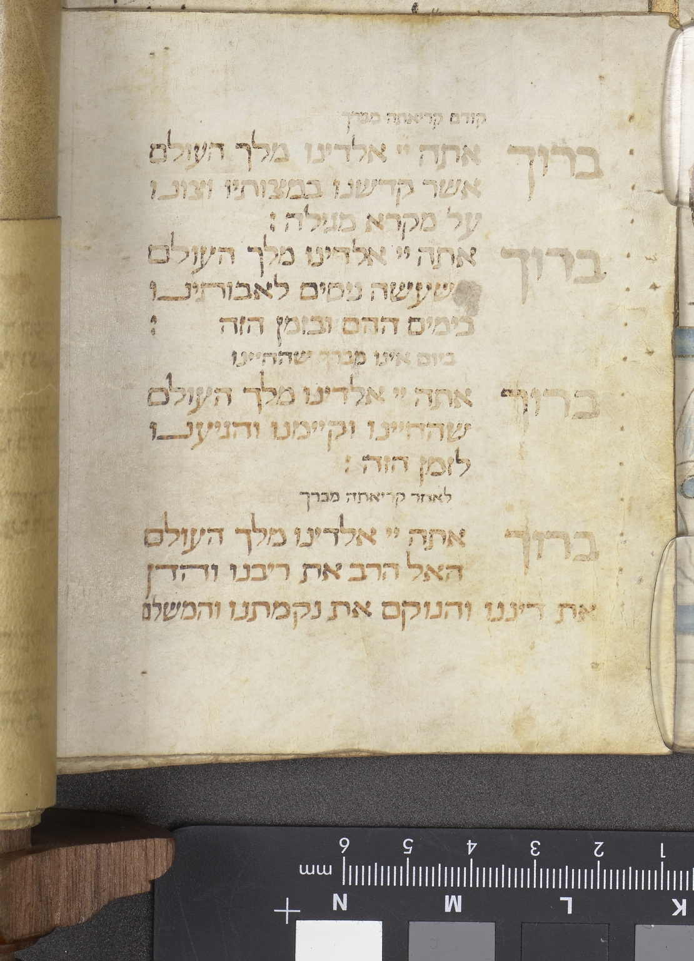
-------------
Image1
-------------
Field Data
Image Number JRL18012638
Reference Number Hebrew MS 22
Image Title Detail of Esther scroll
Parent Work Title Megillat Esther
Alternative Parent Work Title Book of Esther
Creator Pescarol, Moshe ben Avraham
Creator Role Illustrator
Creator Role Scribe
Date Created 1618
Page/Sheet Panel 11
Image Sequence Number 011
Image Sequence Total 012
Description Illuminated scroll, earliest known example of an Italian illustrated Magillah. Endnote.
Language Hebrew
Language Code heb
Subject Bible. O.T.
Category of Material Manuscripts
Sub-Category Scrolls
Technique Used Handwriting
Creation Site Italy: Ferrara
Current Repository The University of Manchester Library, U.K.
Rights Holder - Image The University of Manchester Library
Rights holder - Work The University of Manchester Library
Access Rights <a rel="license" href="http://creativecommons.org/licenses/by-nc-sa/4.0/"><img alt="Creative Commons License" style="border-width:0" src="https://i.creativecommons.org/l/by-nc-sa/4.0/88x31.png"></a>
Date Image Added (yyyy-mm) 2018-01
Metadata Language eng-GB

Slide 12
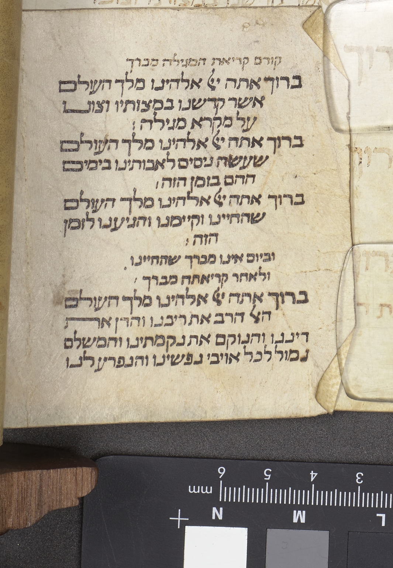
-------------
Image1
-------------
Field Data
Image Number JRL18012639
Reference Number Hebrew MS 22
Image Title Detail of Esther scroll
Parent Work Title Megillat Esther
Alternative Parent Work Title Book of Esther
Creator Pescarol, Moshe ben Avraham
Creator Role Illustrator
Creator Role Scribe
Date Created 1618
Page/Sheet Panel 12
Image Sequence Number 012
Image Sequence Total 012
Description Illuminated scroll, earliest known example of an Italian illustrated Magillah. Endnote.
Language Hebrew
Language Code heb
Subject Bible. O.T.
Category of Material Manuscripts
Sub-Category Scrolls
Technique Used Handwriting
Creation Site Italy: Ferrara
Current Repository The University of Manchester Library, U.K.
Rights Holder - Image The University of Manchester Library
Rights holder - Work The University of Manchester Library
Access Rights <a rel="license" href="http://creativecommons.org/licenses/by-nc-sa/4.0/"><img alt="Creative Commons License" style="border-width:0" src="https://i.creativecommons.org/l/by-nc-sa/4.0/88x31.png"></a>
Date Image Added (yyyy-mm) 2018-01
Metadata Language eng-GB

