Slide 1
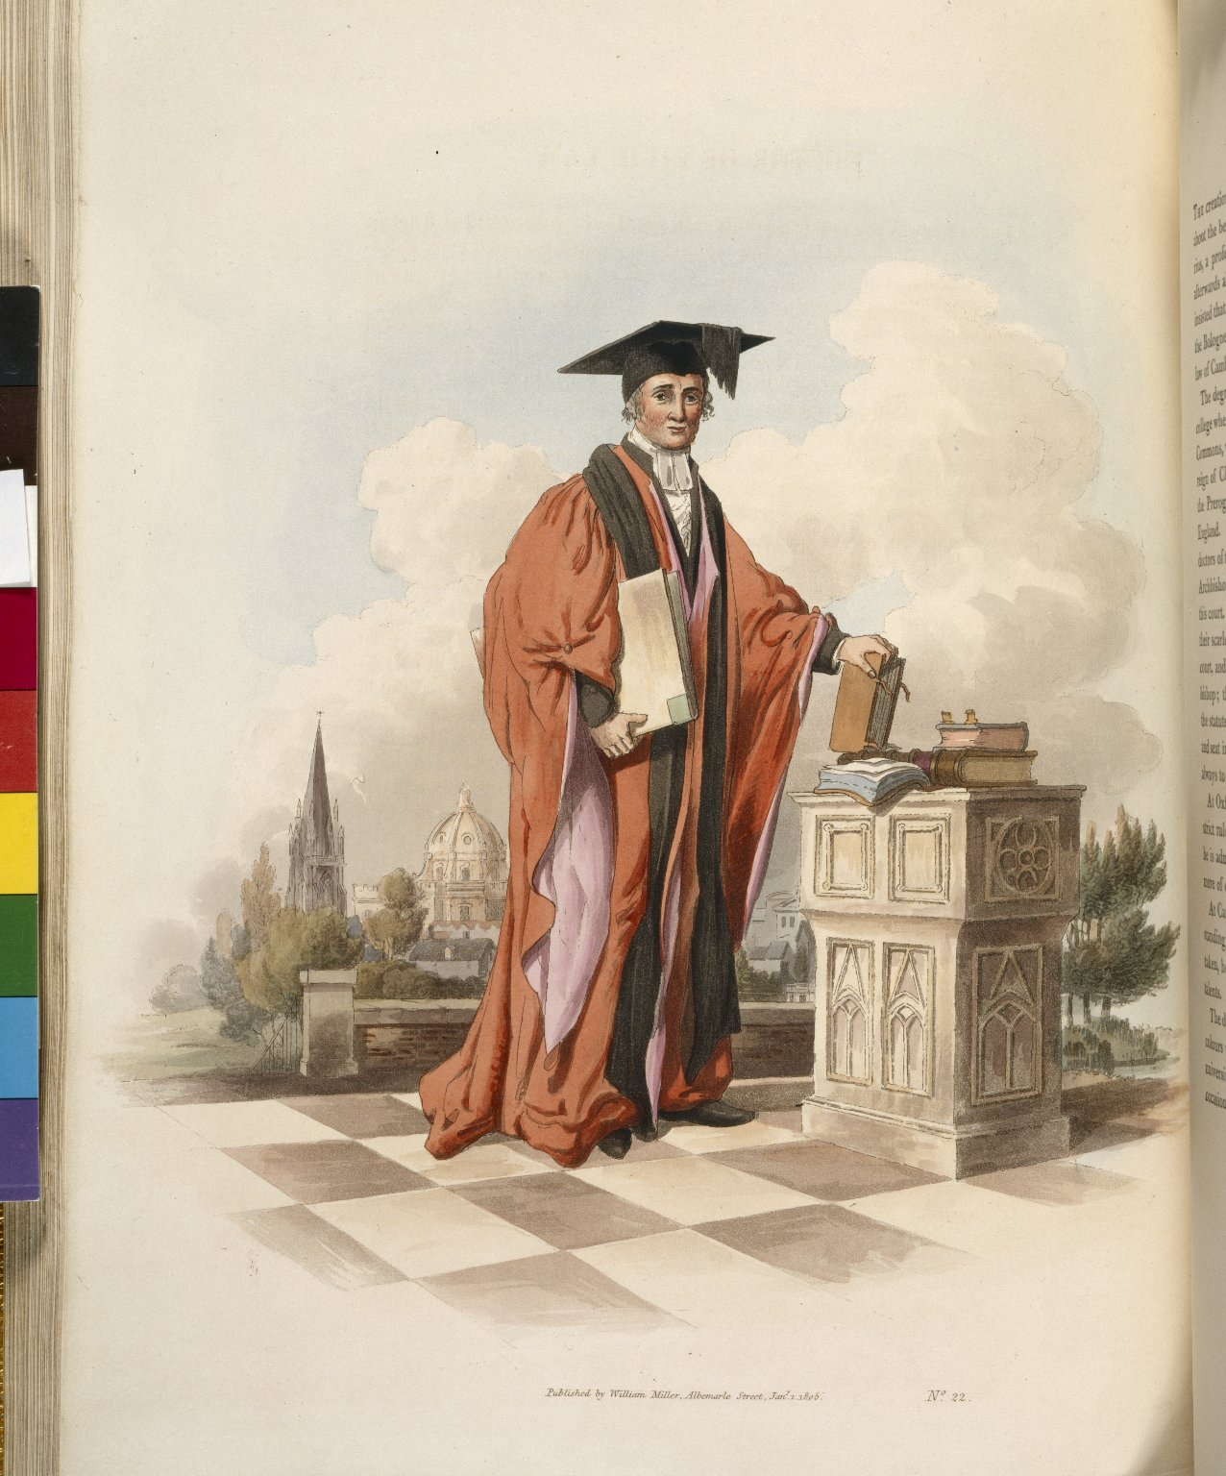
-------------
Image1
-------------
Field Data
Image Number JRL022812tr
Reference Number Spencer 15180
Link to Catalogue <A href=http://man-fe.hosted.exlibrisgroup.com/MU_VU1:BLENDED:44MAN_ALMA_DS21147054800001631>UoM online catalogue</a>
Image Title Doctor of Civil Law
Parent Work Title Costume of Great Britain (designed, engraved, and written by W.H. Pyne)
Creator Pyne, W. H. (William Henry), 1769-1843
Creator Role Author
Date Created 1808
Publication Details London: William Miller
Page/Sheet Plate 23
Image Sequence Number 023
Description Illustrated: Doctor of Civil Law
Language Code eng-GB
Language English
Subject Clothing and dress
Subject Costume--Great Britain
Category of Material Printed
Sub-Category Illustrated works
Time Period Covered 19th Century CE
Places Covered Great Britain
Current Repository The University of Manchester Library, U.K.
Provenance Spencer, George John Spencer, Earl, 1758-1834, former owner
Rights Holder - Image The University of Manchester Library
Rights holder - Work The University of Manchester Library
Date Captured (yyyy-mm-dd) 2004-12
Image Creation Technique Scanned from colour transparency by Gten
Metadata Language eng-GB

Slide 2
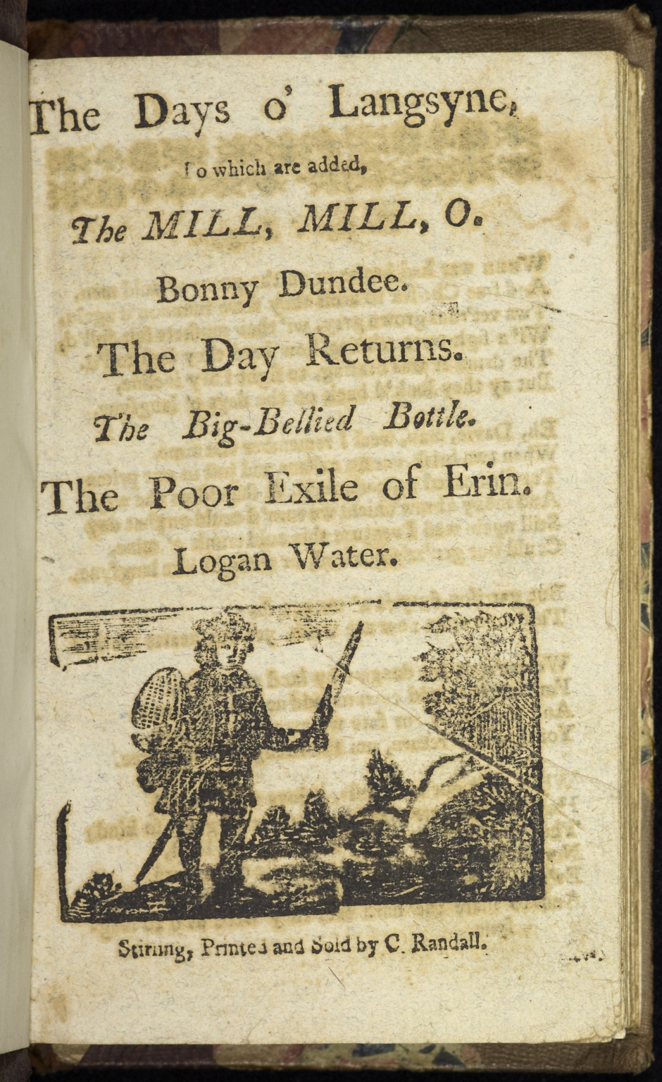
-------------
Image1
-------------
Field Data
Image Number Townend_F.2.10_007
Reference Number 103537
Link to Catalogue <A href="http://copac.ac.uk/crn/65103537/html">COPAC online catalogue</a>
Image Title Title page
Parent Work Title The Days o 'Langsyne
Creator Randall, C.
Creator Role Printer
Date Created 1800
Publication Details Stirling : C. Randall
Page/Sheet 1
Description Title page of 'The Days o 'Langsyne'. Additional songs: 'The mill, mill, o'; 'Bonny Dundee'; 'The Day Returns'; 'The Big-bellied Bottle'; 'The Poor Exile of Erin', and 'Loagn Water'. Includes woodcut illustration of a man.
Language Code eng-GB
Language English
Subject Chapbooks, Scottish
Subject Ballads, Scots--Scotland--Texts
Subject Folk songs, Scots--Scotland
Subject Scottish poetry
Category of Material Printed
Sub-Category Chapbooks
Technique Used Woodcut (process)
Medium Ink
Support Paper
Item Height 160 mm
Item Width 112 mm
Item Depth 20 mm
Current Repository National Trust, Townend Hall, Windermere
Rights Holder - Image National Trust
Rights holder - Work National Trust
Notes Bound with 25 other ballads and chap-books. Date of imprint is a supposition based on similar material printed by Randall in ESTC.
Date Captured (yyyy-mm-dd) 2010-08-25
Multi Page Number 35
Image Creation Technique Digital capture by Heritage Imaging, The University of Manchester Library
Date Image Added (yyyy-mm) 2011-01
Metadata Language eng-GB

Slide 3
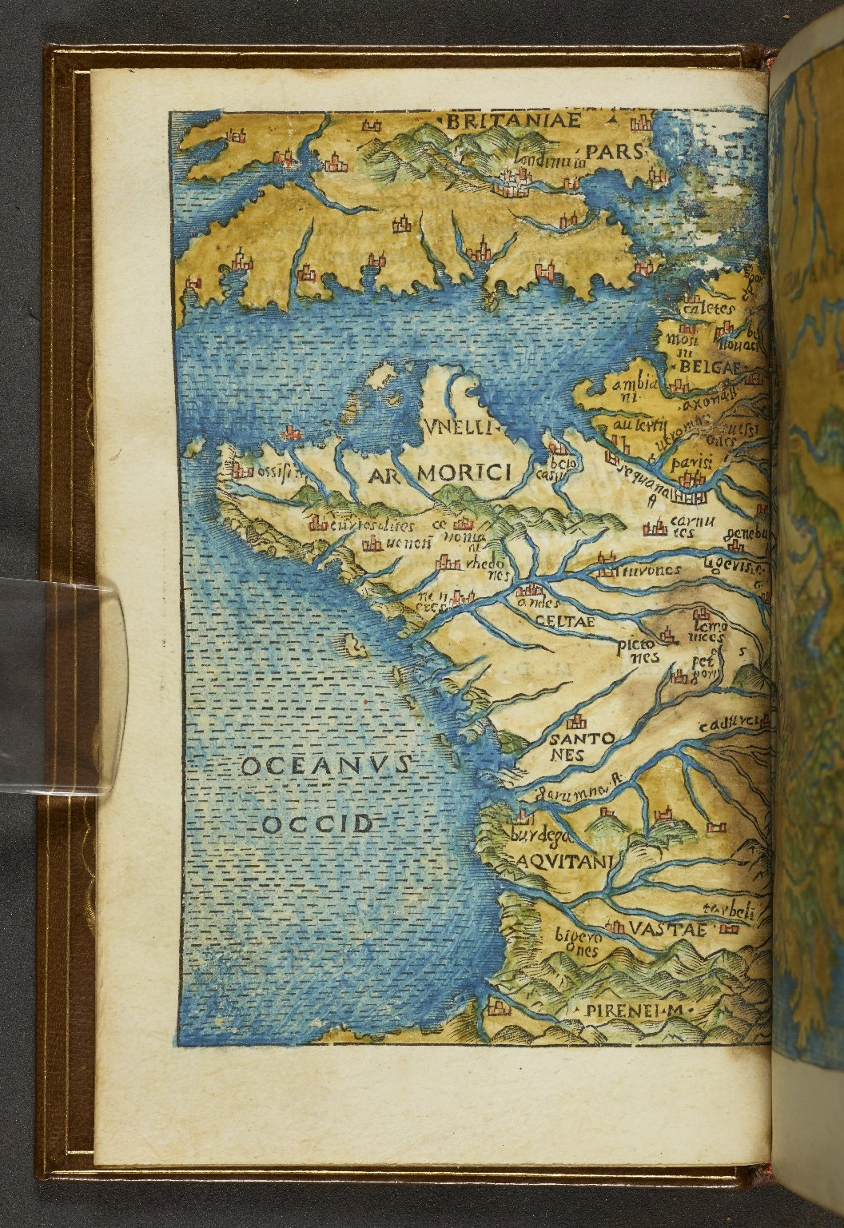
-------------
Image1
-------------
Field Data
Image Number JRL1500769
Reference Number Aldine 3553
Link to Catalogue <A href="http://man-fe.hosted.exlibrisgroup.com/MU_VU1:44MAN_ALMA_DS21164282330001631">UoM online catalogue.</a>
Image Title Map of Gaul
Parent Work Title Hoc volvmine continentvr haec. Commentariorum de bello Gallico libri VIII ; De bello ciuili pompeiano. libri IIII. ; De bello Alexandrino. liber I. ; De bello Africano. liber I. ; De Bello Hispaniensi. liber I. : Pictura totius Galliæ, diuisæ in parteis treis, secundum C. Cæsaris Commentarios. Nomina locorum, urbiumq[ue];, & populorum Galliæ, ut olim dicebantur latine, & nunc dicuntur gallice, secundum ordinem alphabeti. Pictura pontis in Rheno. Item Auarici. Alexiæ. Vxelloduni. Massiliæ. Literæ Max. Pontificum, nequis libros cura nostra excusos imprimat, uendatue &c. ut in literis sub pœna excommunicationis lata sententia.
Creator Giocondo, Giovanni, approximately 1433-1515
Creator Role Editor
Creator Torresanus, Andreas, de Asula, 1451-1529
Creator Role Printer
Creator Manuzio, Aldo, 1449 or 50-1515
Creator Role Printer
Creator Caesar, Julius
Creator Role Author
Date Created 1513-04
Publication Details Venetiis: in aedibus Aldi, et Andreae soceri
Description Hand coloured map of Gaul.
Keyword Aldus Manutius; Aldine Press.
Language Code lat-IT
Language Latin
Subject Rome -- History, Military -- 265-30 B.C
Subject Rome -- History -- Republic, 265-30 B.C -- Early works to 1800
Subject Military history
Category of Material Printed
Category of Material Maps
Medium Ink
Support Vellum
Places Covered France
Current Repository The University of Manchester Library, U.K.
Provenance Spencer, George John Spencer, Earl, 1758-1834, former owner
Rights Holder - Image The University of Manchester Library
Rights holder - Work The University of Manchester Library
Date Captured (yyyy-mm-dd) 2014-09-11
Image Creation Technique Digital capture by Heritage Imaging, The University of Manchester Library
Date Image Added (yyyy-mm) 2014-09
Metadata Language eng-GB

