Slide 1
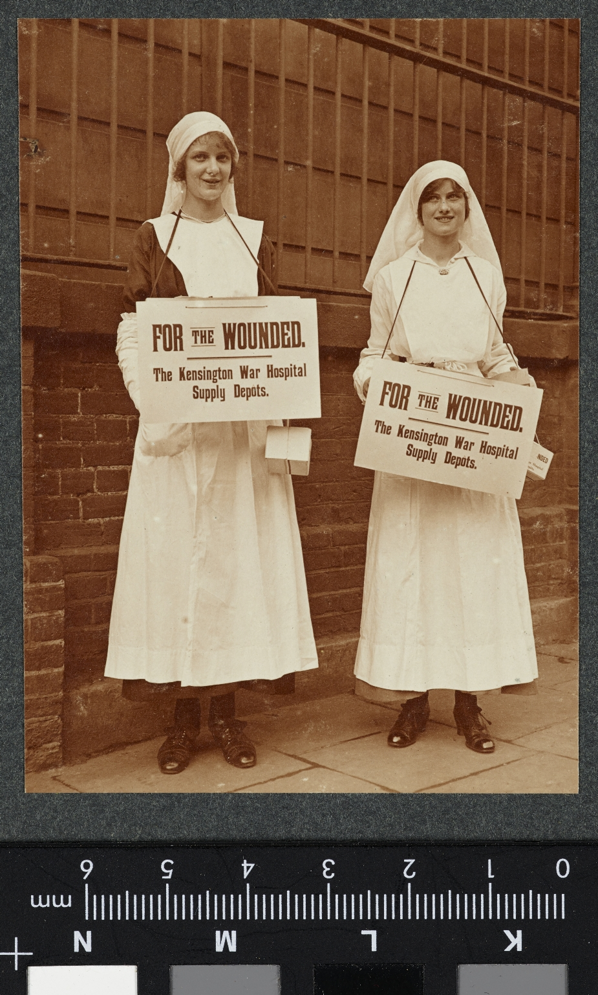
-------------
Image1
-------------
Field Data
Image Number JRL17110500
Reference Number VPH.5.100
Image Title Flag Day Girls
Parent Work Title Album of women's work in wartime
Creator Reavil, Mr Arthur
Creator Role Photographer
Date Created 1914-1919
Description Two women standing dressed in nurses uniform with headresses. Both carry around their necks boxes labelled 'For the Wounded, The Kensington War Hospital Supply Depots.'
Keyword World War; First World War; Homefront.
Subject World War, 1914-1918
Subject Photography--History--20th century
Subject World War, 1914-1918--Photographs
Category of Material Photography
Sub-Category Analogue photography
Technique Used Gelatin silver process
Support Paper
Creation Site England
Time Period Covered 20th Century CE
Places Covered England
Item Height 97 mm
Item Width 69 mm
Current Repository The University of Manchester Library, U.K.
Provenance Mr & Mrs Burleigh, former owners
Rights Holder - Image The University of Manchester Library
Rights Holder - Work The University of Manchester Library
Access Rights <a rel="license" href="http://creativecommons.org/licenses/by-nc-sa/4.0/"><img alt="Creative Commons License" style="border-width:0" src="https://i.creativecommons.org/l/by-nc-sa/4.0/88x31.png"></a>
Bibliography <A href="https://luna.manchester.ac.uk/luna/servlet/s/61020q">Album of Women's Work in Wartime.</a>
Image Creation Technique Digital capture by Heritage Imaging, The University of Manchester Library
Date Image Added (yyyy-mm) 2017-11
Metadata Language eng-GB

Slide 2
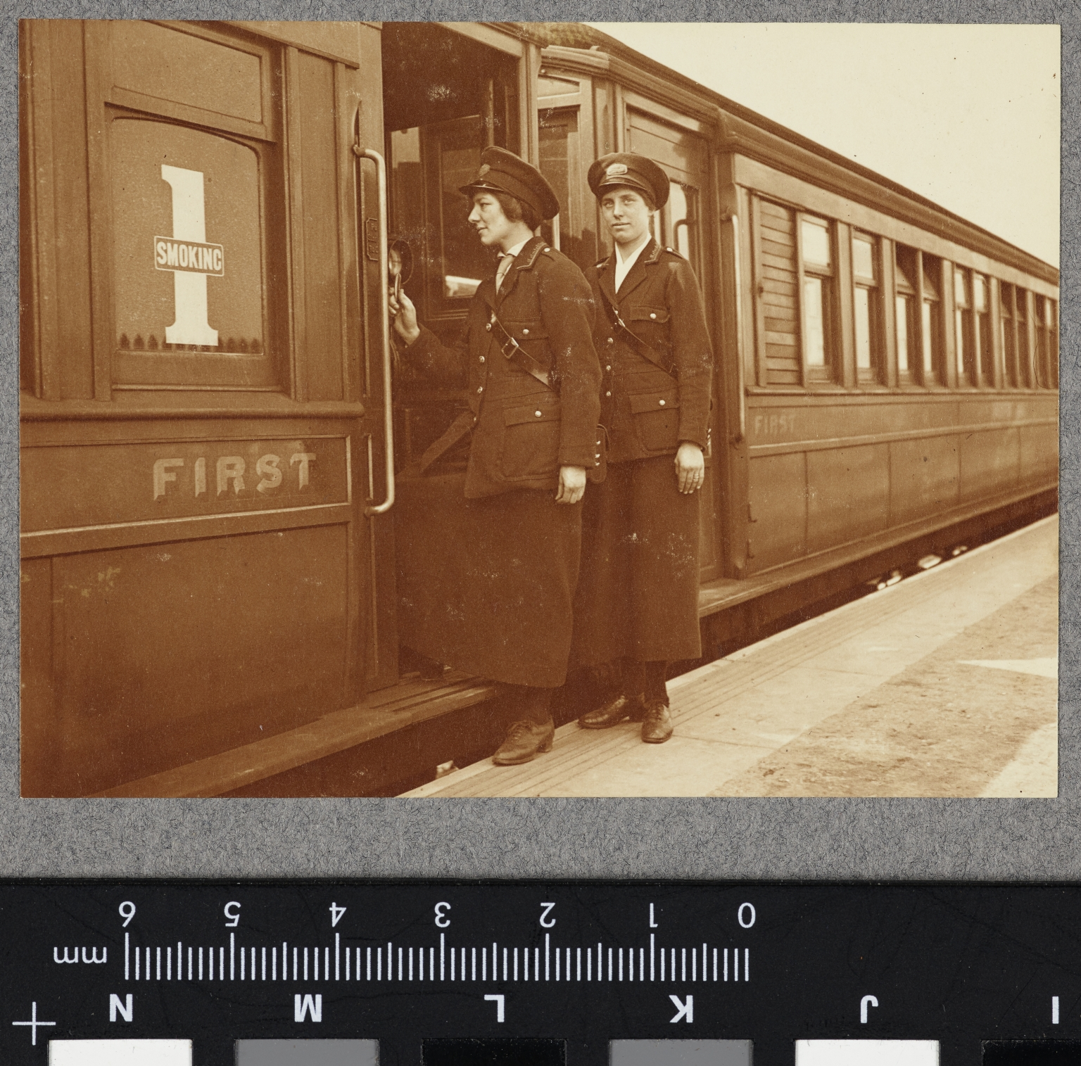
-------------
Image1
-------------
Field Data
Image Number JRL17110411
Reference Number VPH.5.11
Image Title Metropolitan Railways Travelling Ticket Inspectors
Parent Work Title Album of women's work in wartime
Creator Reavil, Mr Arthur
Creator Role Photographer
Date Created 1914-1919
Description Metropolitan Railway. Travelling Ticket Inspectors. Two women in uniform getting aboard a train. The train has 'first' on the door as numeral and word, also the word 'smoking'.
Keyword World War; First World War; Homefront; Railways.
Subject World War, 1914-1918
Subject Photography--History--20th century
Subject World War, 1914-1918--Photographs
Category of Material Photography
Sub-Category Analogue photography
Technique Used Gelatin silver process
Support Paper
Creation Site England: London
Time Period Covered 20th Century CE
Places Covered England: London
Item Height 75 mm
Item Width 100 mm
Current Repository The University of Manchester Library, U.K.
Provenance Mr & Mrs Burleigh, former owners
Rights Holder - Image The University of Manchester Library
Rights Holder - Work The University of Manchester Library
Access Rights <a rel="license" href="http://creativecommons.org/licenses/by-nc-sa/4.0/"><img alt="Creative Commons License" style="border-width:0" src="https://i.creativecommons.org/l/by-nc-sa/4.0/88x31.png"></a>
Bibliography <A href="https://luna.manchester.ac.uk/luna/servlet/s/61020q">Album of Women's Work in Wartime.</a>
Image Creation Technique Digital capture by Heritage Imaging, The University of Manchester Library
Date Image Added (yyyy-mm) 2017-11
Metadata Language eng-GB

Slide 3
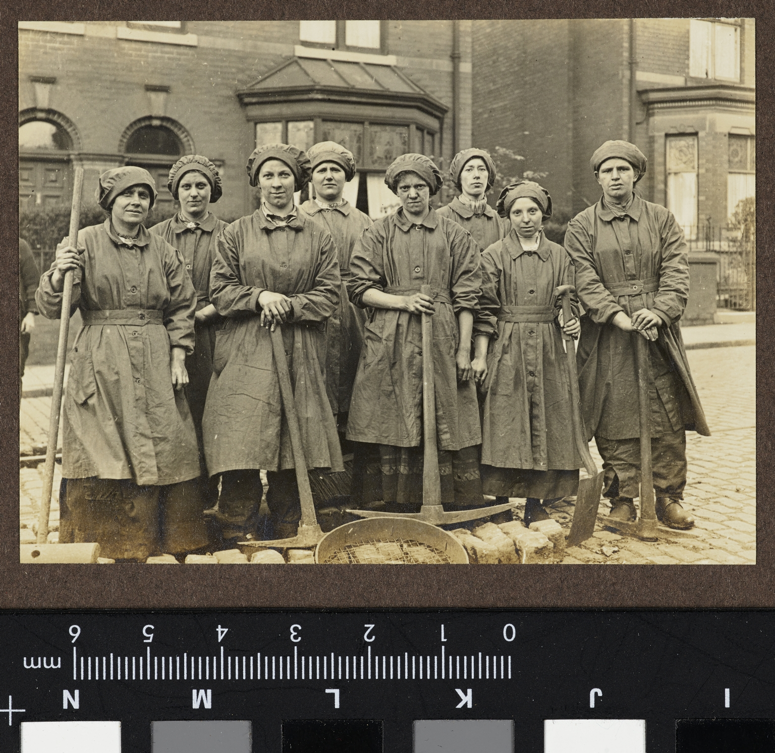
-------------
Image1
-------------
Field Data
Image Number JRL17110518
Reference Number VPH.5.117
Image Title Tram Permanent Way Repairers, Atherton, Lancashire
Parent Work Title Album of women's work in wartime
Creator Reavil, Mr Arthur
Creator Role Photographer
Date Created 1914-1919
Description Group of women dressed in dirty overalls and caps standing in a house lined cobbled street. They are holding pick axes, spades and brushes. There is a rubble sieve on the ground in front of them.
Keyword World War; First World War; Homefront; Trams.
Subject World War, 1914-1918
Subject Photography--History--20th century
Subject World War, 1914-1918--Photographs
Category of Material Photography
Sub-Category Analogue photography
Technique Used Gelatin silver prints
Support Paper
Creation Site England: Lancashire: Atherton
Time Period Covered 20th Century CE
Places Covered England: Lancashire: Atherton
Item Height 74 mm
Item Width 101 mm
Current Repository The University of Manchester Library, U.K.
Provenance Mr & Mrs Burleigh, former owners
Rights Holder - Image The University of Manchester Library
Rights Holder - Work The University of Manchester Library
Access Rights <a rel="license" href="http://creativecommons.org/licenses/by-nc-sa/4.0/"><img alt="Creative Commons License" style="border-width:0" src="https://i.creativecommons.org/l/by-nc-sa/4.0/88x31.png"></a>
Bibliography <A href="https://luna.manchester.ac.uk/luna/servlet/s/61020q">Album of Women's Work in Wartime.</a>
Image Creation Technique Digital capture by Heritage Imaging, The University of Manchester Library
Date Image Added (yyyy-mm) 2017-11
Metadata Language eng-GB

