Slide 1
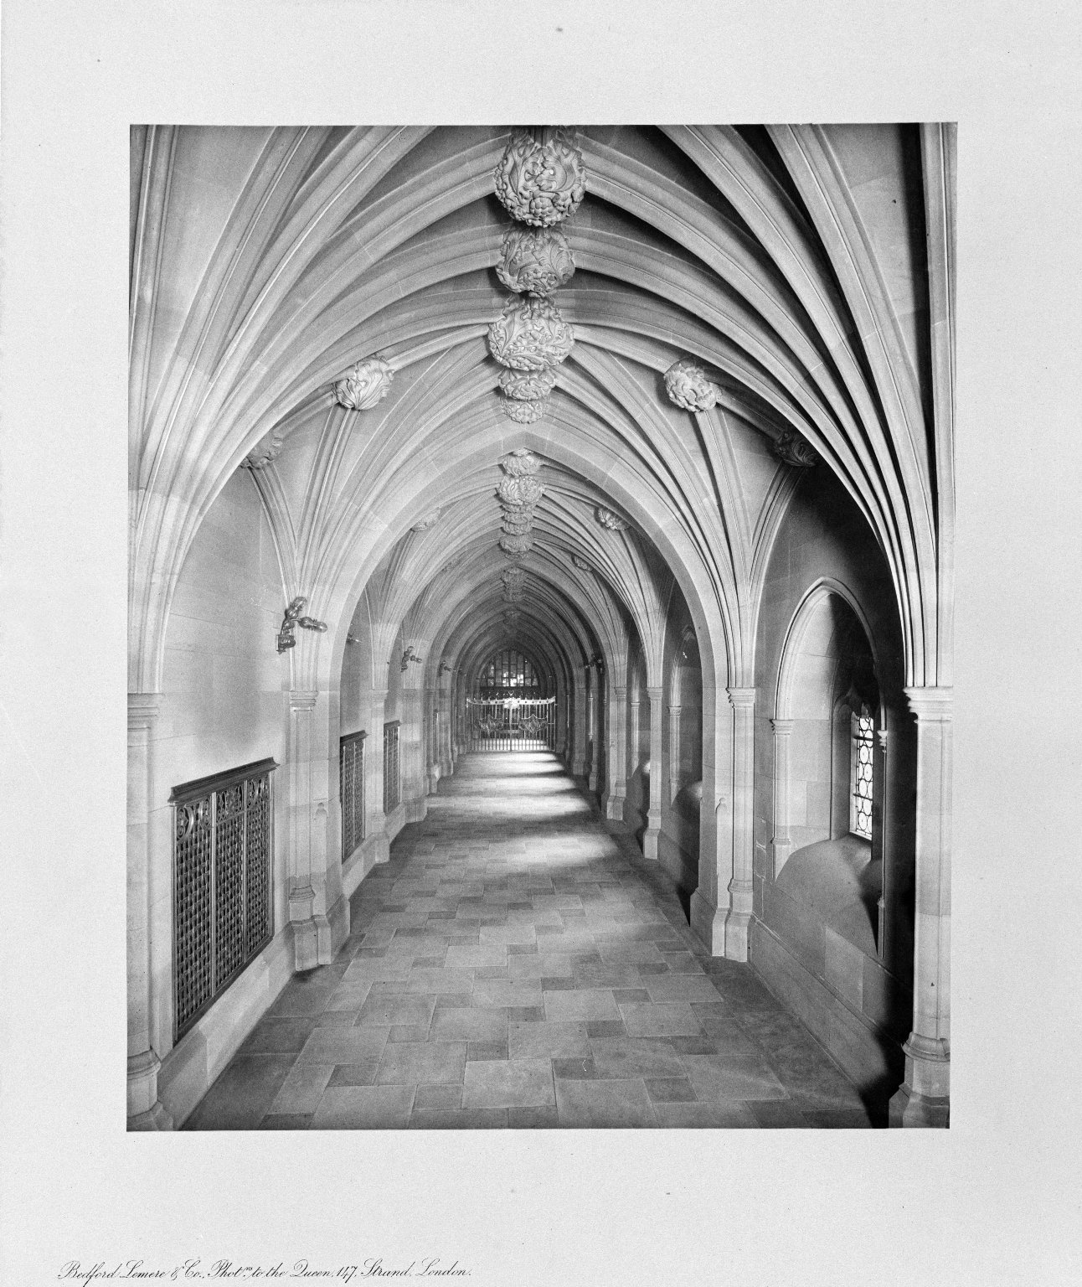
-------------
Image1
-------------
Field Data
Image Number JRL021808bw
Reference Number R15240
Link to Catalogue <A href="http://man-fe.hosted.exlibrisgroup.com/MU_VU1:BLENDED:44MAN_ALMA_DS21154288450001631">UoM online catalogue</a>
Image Title Cloisters
Parent Work Title John Rylands Library, Manchester, 1900
Creator Bedford Lemere and Co.
Creator Role Photographer
Date Created 1900
Publication Details London
Page/Sheet Print 8
Image Sequence Number 008
Description Print 8: Cloisters of the John Rylands Library, Deansgate, Manchester. The Library opened to the public on 1st January 1900. Basil Champneys 1842-1935, architect.
Subject Library buildings
Subject John Rylands Library
Subject Architecture
Category of Material Printed
Category of Material Photography
Sub-Category Analogue photography
Time Period Covered 20th Century CE
Places Covered England: Greater Manchester: Manchester
Current Repository The University of Manchester Library, U.K.
Rights Holder - Image The University of Manchester Library
Rights holder - Work The University of Manchester Library
Access Rights <a rel="license" href="http://creativecommons.org/licenses/by-nc-sa/4.0/"><img alt="Creative Commons License" style="border-width:0" src="https://i.creativecommons.org/l/by-nc-sa/4.0/88x31.png"></a>
Image Creation Technique Scanned from black/white negative by Gten, January 2006
Date Image Added (yyyy-mm) 2006-01
Metadata Language eng-GB

Slide 2
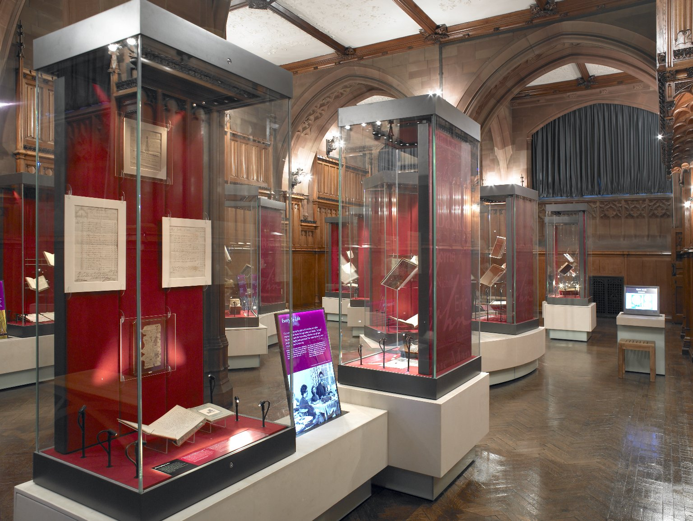
-------------
Image1
-------------
Field Data
Image Number JRL0812843dc
Image Title Rylands Gallery
Date Created 2007
Description View of the exhibition cases in the Rylands Gallery at the John Rylands Library, Deansgate, Manchester. The room is beautifully panelled in Polish oak, the stonework is shawk (sandstone) and the original Art Nouveau light fittings are cast in bronze and gunmetal.
Subject Library buildings
Subject John Rylands Library
Subject Architecture
Category of Material Photography
Sub-Category Digital photography
Time Period Covered 21st Century CE
Places Covered England: Greater Manchester: Manchester
Current Site The John Rylands Library, Deansgate, Manchester, U.K.
Rights Holder - Image University of Manchester Library
Rights holder - Work The University of Manchester Library
Date Captured (yyyy-mm-dd) 2007
Image Creation Technique Digital capture by Gten
Date Image Added (yyyy-mm) 2011-05
Metadata Language eng-GB

Slide 3
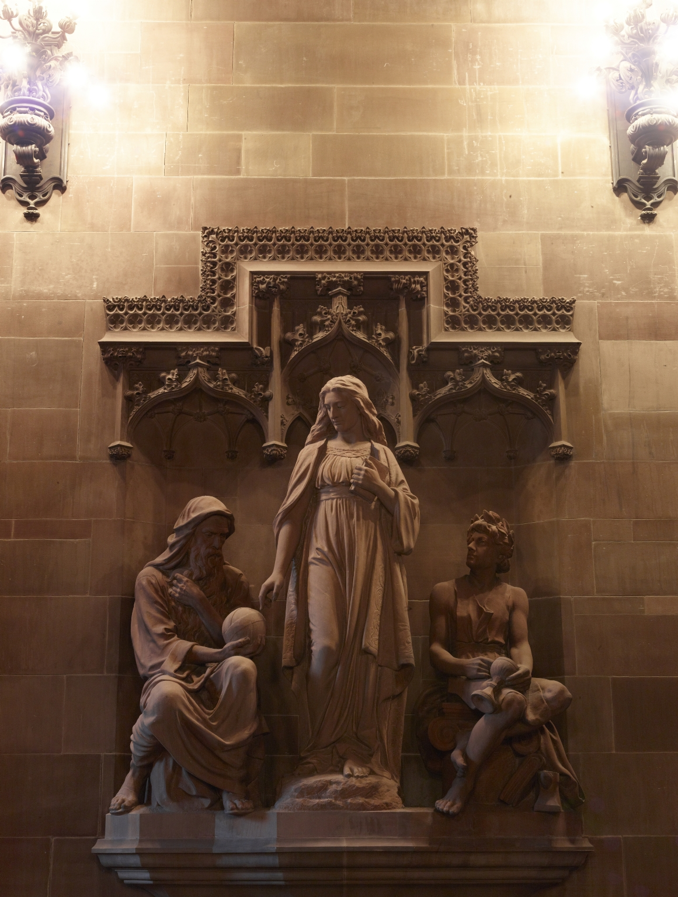
-------------
Image1
-------------
Field Data
Image Number JRL1212328
Image Title Theology Directing the Labours of Science and Art
Creator Champneys, Basil, 1842-1935
Creator Role Architect
Creator Cassidy, John, 1860-1939
Creator Role Sculptor
Date Created 1898
Description A statue of three figures, Theology Directing the Labours of Science and Art, dominates the historic Entrance Hall. Hewn from Penrith sandstone by John Cassidy, the sculpture took three years to complete and embodies Mrs Rylands’ intention for Nonconformist theology to be the Library’s primary focus.
Subject Architecture
Subject Library buildings
Subject John Rylands Library
Sub-Category Sculpture
Technique Used Sculpting
Support Shawk stone
Creation Site England: Manchester
Time Period Covered 19th Century CE
Places Covered England: Greater Manchester: Manchester
Current Site The John Rylands Library, Deansgate, Manchester, U.K.
Rights Holder - Image The University of Manchester Library
Rights holder - Work The University of Manchester Library
Access Rights <a rel="license" href="http://creativecommons.org/licenses/by-nc-sa/4.0/"><img alt="Creative Commons License" style="border-width:0" src="https://i.creativecommons.org/l/by-nc-sa/4.0/88x31.png"></a>
Date Captured (yyyy-mm-dd) 2012-02-13
Image Creation Technique Digital capture by Heritage Imaging, The University of Manchester Library
Metadata Language eng-GB

Slide 4
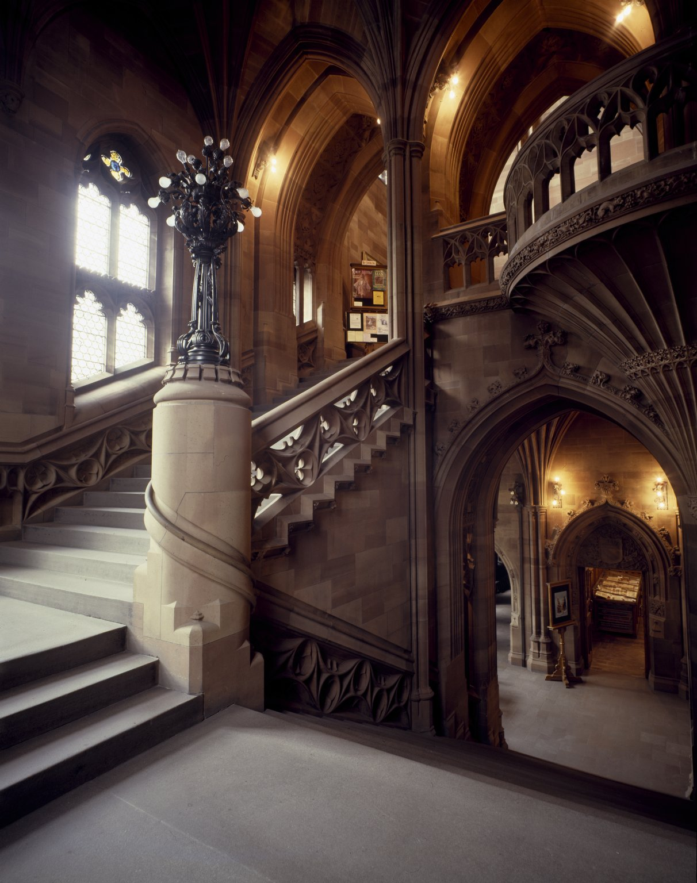
-------------
Image1
-------------
Field Data
Image Number JRL022825tr
Image Title Main Staircase
Image Sequence Number B00003
Description View of the Main Staircase leading to the Reading Room of the John Rylands Library, Deansgate. The entrance to the Exhibition Room can be seen bottom right. Materials: shawk (sandstone) walls, original Art Nouveau light fittings in bronze and gun-metal. Basil Champneys 1842-1935, architect.
Subject John Rylands Library
Subject Electric conduits
Subject Library buildings
Subject Lighting, Architectural and decorative
Subject Architecture
Category of Material Photography
Sub-Category Analogue photography
Time Period Covered 21st Century CE
Places Covered England: Greater Manchester: Manchester
Current Site The John Rylands Library, Deansgate, Manchester, U.K.
Rights Holder - Image The University of Manchester Library
Rights holder - Work The University of Manchester Library
Access Rights <a rel="license" href="http://creativecommons.org/licenses/by-nc-sa/4.0/"><img alt="Creative Commons License" style="border-width:0" src="https://i.creativecommons.org/l/by-nc-sa/4.0/88x31.png"></a>
Image Creation Technique Scanned from colour transparency by Gten, June 2005
Metadata Language eng-GB

Slide 5
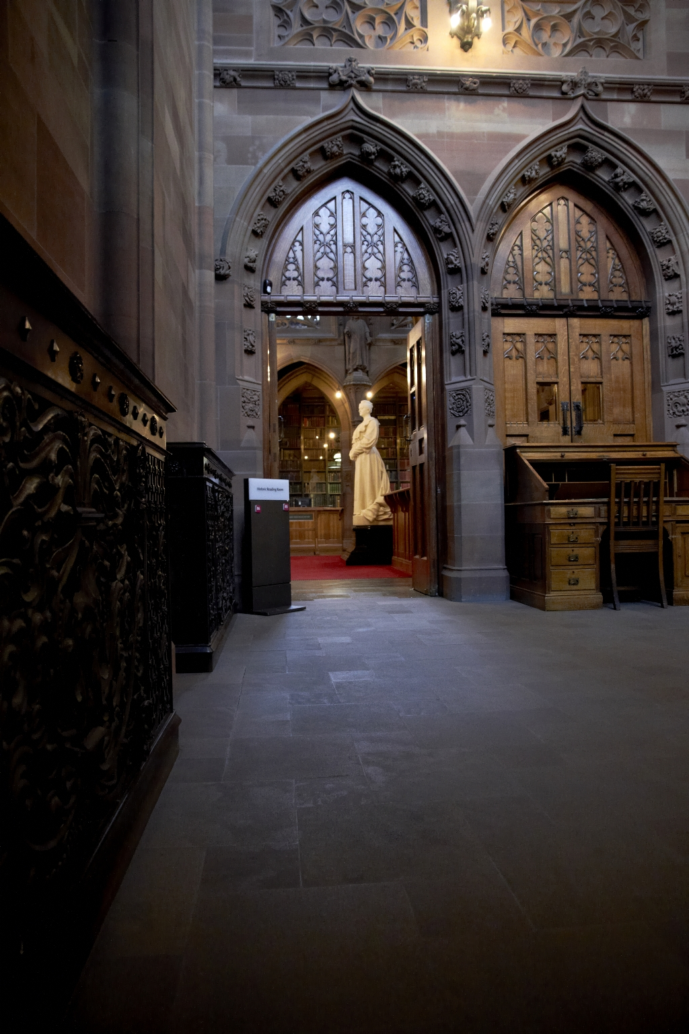
-------------
Image1
-------------
Field Data
Image Number JRL1212371
Image Title Entrance to the Historic Reading Room
Date Created 2012
Description Double doors leading to the Historic Reading Room of the John Rylands Library, as seen from the landing at the top of the stone staircase. Materials include shawk (sandstone) and oak. Basil Champneys 1842-1935, architect.
Subject Architecture
Subject Library buildings
Subject John Rylands Library
Category of Material Photography
Sub-Category Digital photography
Creation Site England: Manchester
Time Period Covered 21st Century CE
Places Covered England: Greater Manchester: Manchester
Current Site The John Rylands Library, Deansgate, Manchester, U.K.
Rights Holder - Image The University of Manchester Library
Rights holder - Work The University of Manchester Library
Access Rights <a rel="license" href="http://creativecommons.org/licenses/by-nc-sa/4.0/"><img alt="Creative Commons License" style="border-width:0" src="https://i.creativecommons.org/l/by-nc-sa/4.0/88x31.png"></a>
Date Captured (yyyy-mm-dd) 2012-02-13
Image Creation Technique Digital capture by Heritage Imaging, The University of Manchester Library
Metadata Language eng-GB

Slide 6
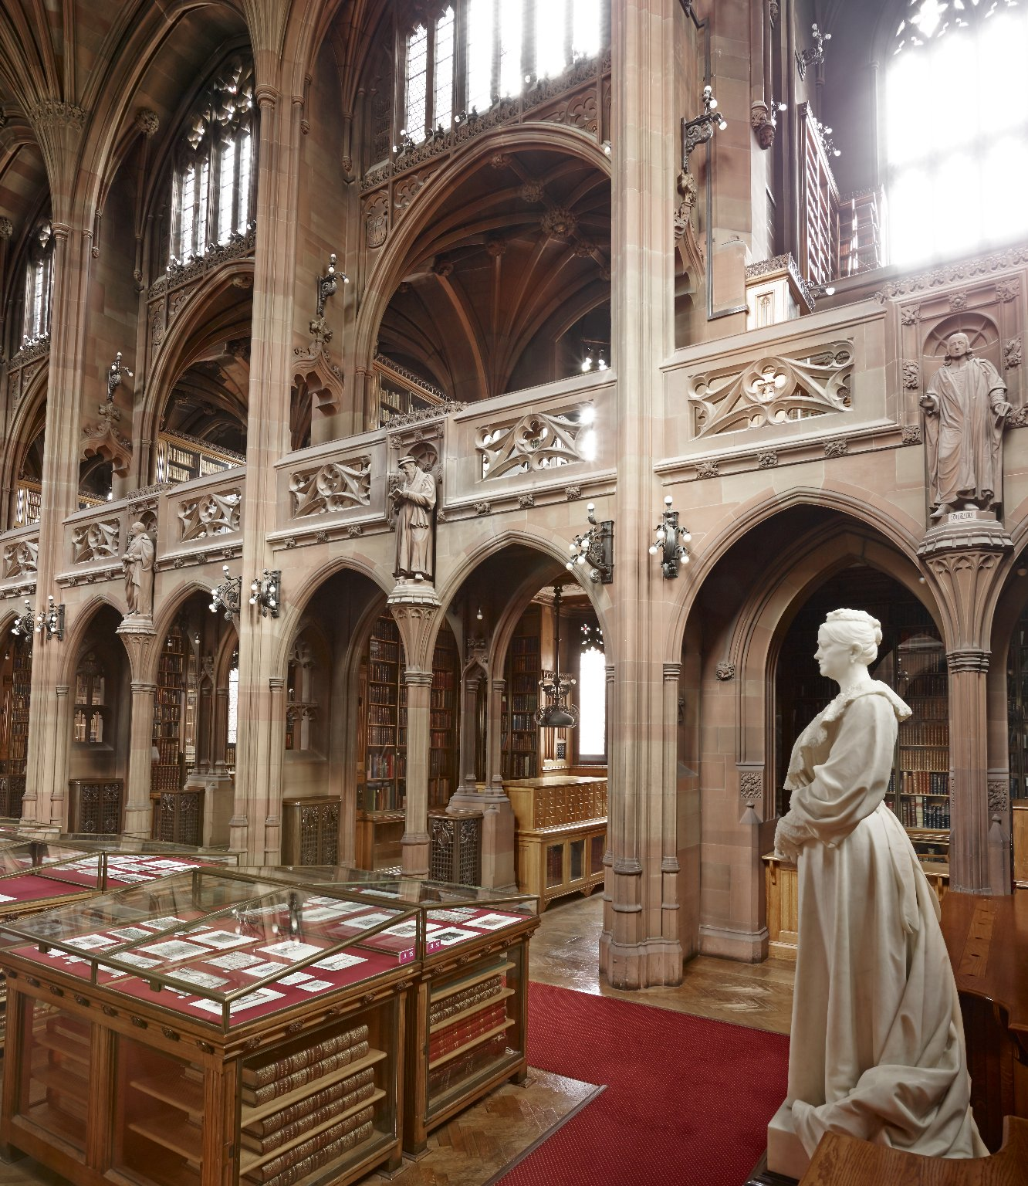
-------------
Image1
-------------
Field Data
Image Number JRL1412511
Image Title Interior of the Historic Reading Room
Date Created 2014
Description Section of Historic Reading Room; view from the double doors at the top of the Historic Staircase featuring Mrs Rylands statue. Basil Champneys 1842-1935, architect; John Cassidy 1860-1939, sculptor.
Subject John Rylands Library
Subject Library buildings
Subject Architecture
Subject Sculpture
Category of Material Photography
Sub-Category Digital photography
Time Period Covered 21st Century CE
Places Covered England: Greater Manchester: Manchester
Rights Holder - Image The University of Manchester Library
Rights holder - Work The University of Manchester Library
Access Rights <a rel="license" href="http://creativecommons.org/licenses/by-nc-sa/4.0/"><img alt="Creative Commons License" style="border-width:0" src="https://i.creativecommons.org/l/by-nc-sa/4.0/88x31.png"></a>
Date Captured (yyyy-mm-dd) 2014-04-24
Image Creation Technique Digital capture by Heritage Imaging, The University of Manchester Library
Metadata Language eng-GB

Slide 7
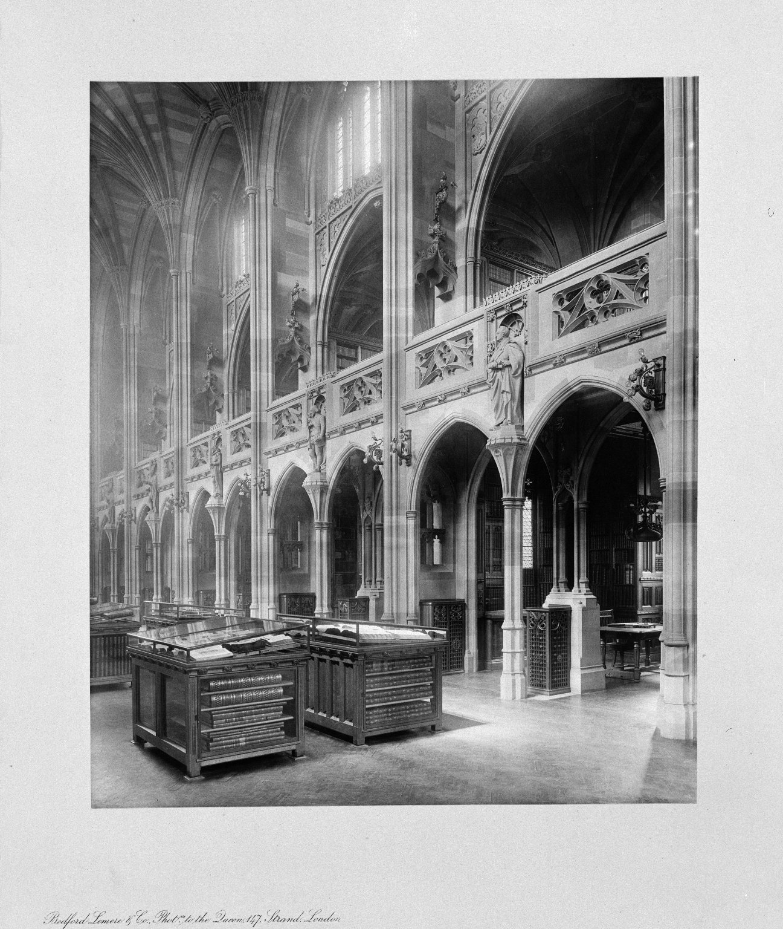
-------------
Image1
-------------
Field Data
Image Number JRL021815bw
Reference Number R15240
Link to Catalogue <A href="http://man-fe.hosted.exlibrisgroup.com/MU_VU1:BLENDED:44MAN_ALMA_DS21154288450001631">UoM online catalogue</a>
Image Title Interior of the Reading Room
Parent Work Title John Rylands Library, Manchester, 1900
Creator Bedford Lemere and Co.
Creator Role Photographer
Date Created 1900
Publication Details London
Page/Sheet Print 15
Image Sequence Number 015
Description Print 15: Interior of the Reading Room (diagonal view into reader alcoves), of the John Rylands Library, Deansgate, Manchester. The Library opened to the public on 1st January 1900. Basil Champneys 1842-1935, architect.
Subject Library buildings
Subject John Rylands Library
Subject Architecture
Category of Material Printed
Category of Material Photography
Sub-Category Analogue photography
Time Period Covered 20th Century CE
Places Covered England: Greater Manchester: Manchester
Current Repository The University of Manchester Library, U.K.
Rights Holder - Image The University of Manchester Library
Rights holder - Work The University of Manchester Library
Access Rights <a rel="license" href="http://creativecommons.org/licenses/by-nc-sa/4.0/"><img alt="Creative Commons License" style="border-width:0" src="https://i.creativecommons.org/l/by-nc-sa/4.0/88x31.png"></a>
Image Creation Technique Scanned from black/white negative by Gten, January 2006
Date Image Added (yyyy-mm) 2006-01
Metadata Language eng-GB

Slide 8
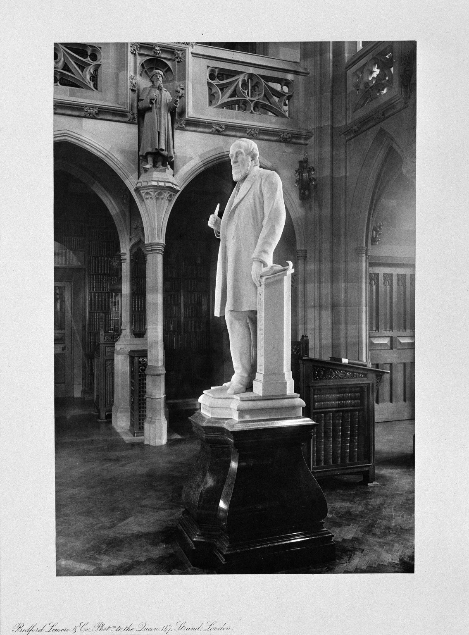
-------------
Image1
-------------
Field Data
Image Number JRL021822bw
Reference Number R15240
Link to Catalogue <A href="http://man-fe.hosted.exlibrisgroup.com/MU_VU1:BLENDED:44MAN_ALMA_DS21154288450001631">UoM online catalogue</a>
Image Title Statue of John Rylands
Parent Work Title John Rylands Library, Manchester, 1900
Creator Bedford Lemere and Co.
Creator Role Photographer
Date Created 1900
Publication Details London
Page/Sheet Print 22
Image Sequence Number 022
Description Print 22: Statue of John Rylands by John Cassidy in the Reading Room of the John Rylands Library, Deansgate, Manchester. The Library opened to the public on 1st January 1900. Basil Champneys 1842-1935, architect.
Subject Library buildings
Subject Architecture
Subject Sculpture
Subject John Rylands Library
Category of Material Printed
Category of Material Photography
Sub-Category Analogue photography
Time Period Covered 20th Century CE
Places Covered England: Greater Manchester: Manchester
Current Repository The University of Manchester Library, U.K.
Rights Holder - Image The University of Manchester Library
Rights holder - Work The University of Manchester Library
Access Rights <a rel="license" href="http://creativecommons.org/licenses/by-nc-sa/4.0/"><img alt="Creative Commons License" style="border-width:0" src="https://i.creativecommons.org/l/by-nc-sa/4.0/88x31.png"></a>
Image Creation Technique Scanned from black/white negative by Gten, January 2006
Date Image Added (yyyy-mm) 2006-01
Metadata Language eng-GB

