Slide 1
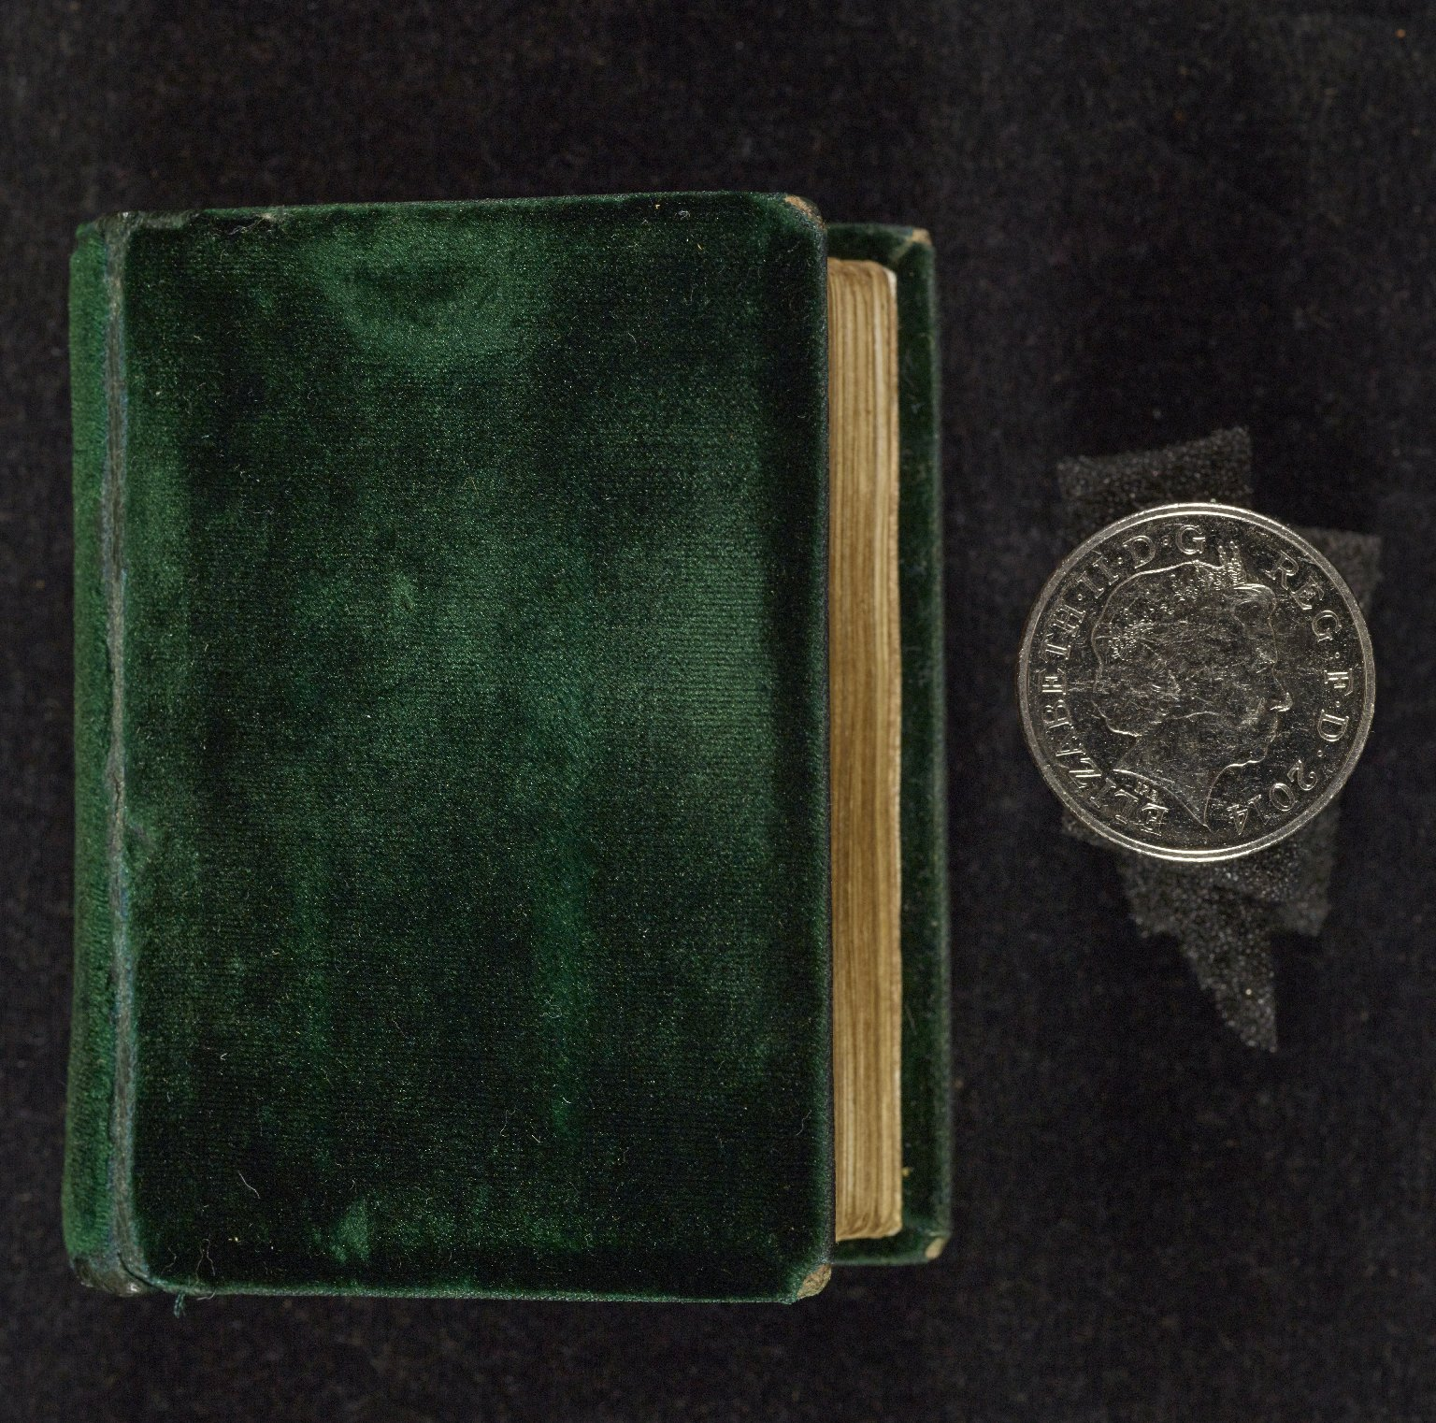
-------------
Image1
-------------
Field Data
Image Number JRL1500622
Reference Number Latin MS 21
Image Title Green velvet binding
Parent Work Title Horae (Mary, Queen of Scots)
Translated Parent Work Title Book of Hours (Mary, Queen of Scots)
Date Created 15th century [late]
Page/Sheet Upper cover
Subject Books of hours
Subject Bookbinding
Subject Catholic Church
Subject Christianity
Category of Material Photography
Sub-Category Digital photography
Item Width 68 mm
Item Depth 46 mm
Current Repository The University of Manchester Library, U.K.
Provenance Lindsay family Earls of Crawford and Balcarres, former owner
Rights Holder - Image The University of Manchester Library
Rights holder - Work The University of Manchester Library
Access Rights <a rel="license" href="http://creativecommons.org/licenses/by-nc-sa/4.0/"><img alt="Creative Commons License" style="border-width:0" src="https://i.creativecommons.org/l/by-nc-sa/4.0/88x31.png" /></a><br />This work is licensed under a <a rel="license" href="http://creativecommons.org/licenses/by-nc-sa/4.0/">Creative Commons Attribution-NonCommercial-ShareAlike 4.0 International License.</a> Copyright of The University of Manchester
Date Captured (yyyy-mm-dd) 2014-08-28
Image Creation Technique Digital capture by Heritage Imaging, The University of Manchester Library
Date Image Added (yyyy-mm) 2014-09
Metadata Language eng-GB

Slide 2
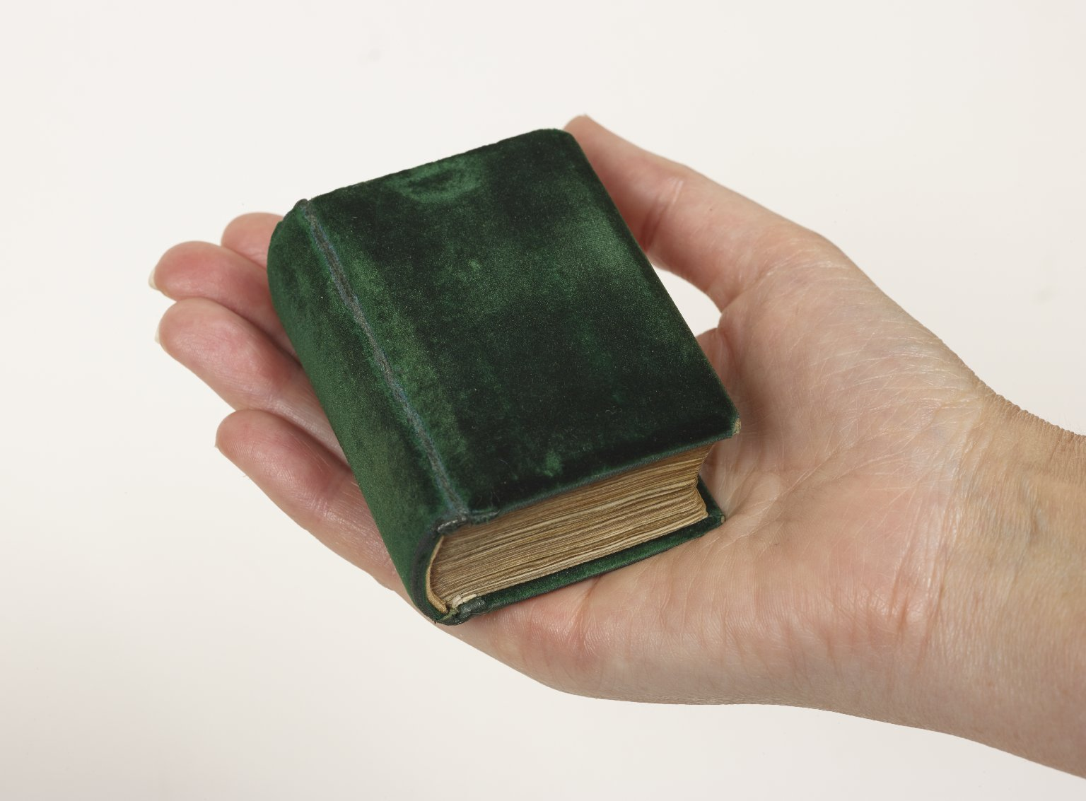
-------------
Image1
-------------
Field Data
Image Number JRL1500621
Reference Number Latin MS 21
Image Title Green velvet binding
Parent Work Title Horae (Mary, Queen of Scots)
Translated Parent Work Title Book of Hours (Mary, Queen of Scots)
Subject Books of hours
Subject Bookbinding
Subject Catholic Church
Subject Christianity
Category of Material Photography
Sub-Category Digital photography
Item Width 68 mm
Item Depth 46 mm
Current Repository The University of Manchester Library, U.K.
Provenance Lindsay family Earls of Crawford and Balcarres, former owner
Rights Holder - Image The University of Manchester Library
Rights holder - Work The University of Manchester Library
Access Rights <a rel="license" href="http://creativecommons.org/licenses/by-nc-sa/4.0/"><img alt="Creative Commons License" style="border-width:0" src="https://i.creativecommons.org/l/by-nc-sa/4.0/88x31.png" /></a><br />This work is licensed under a <a rel="license" href="http://creativecommons.org/licenses/by-nc-sa/4.0/">Creative Commons Attribution-NonCommercial-ShareAlike 4.0 International License.</a> Copyright of The University of Manchester
Date Captured (yyyy-mm-dd) 2014-08-28
Image Creation Technique Digital capture by Heritage Imaging, The University of Manchester Library
Date Image Added (yyyy-mm) 2014-09
Metadata Language eng-GB

Slide 3
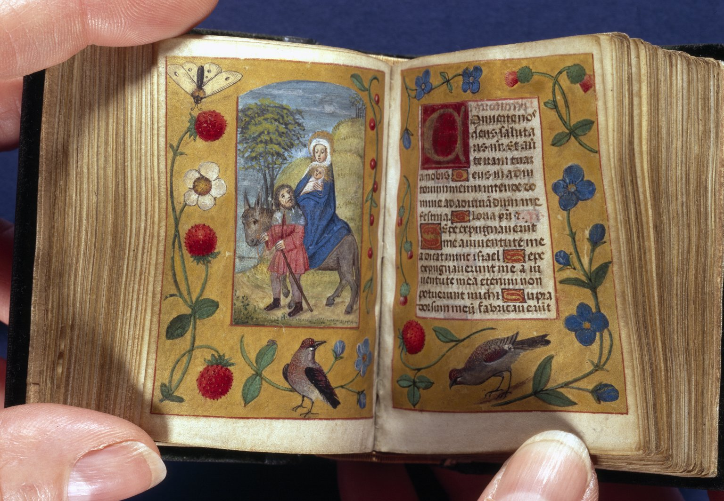
-------------
Image1
-------------
Field Data
Image Number JRL021637tr
Reference Number Latin MS 21
Image Title Compline: The Flight
Parent Work Title Horae (Mary, Queen of Scots)
Translated Parent Work Title Book of Hours (Mary, Queen of Scots)
Date Created 15th century [late]
Page/Sheet 106v-107r
Image Sequence Number 106v
Description Illustrated: f.106v: Compline: The Flight, Joseph leads the ass. Decorated borders: flora, birds & a butterfly. Italian Gothic hand; Flemish scribe.
Language Code lat
Subject Books of hours
Subject Christianity
Subject Catholic Church
Category of Material Photography
Sub-Category Digital photography
Item Height 68 mm
Item Width 46 mm
Current Repository The University of Manchester Library, U.K.
Provenance Lindsay family Earls of Crawford and Balcarres, former owner
Rights Holder - Image The University of Manchester Library
Rights holder - Work The University of Manchester Library
Access Rights <a rel="license" href="http://creativecommons.org/licenses/by-nc-sa/4.0/"><img alt="Creative Commons License" style="border-width:0" src="https://i.creativecommons.org/l/by-nc-sa/4.0/88x31.png" /></a><br />This work is licensed under a <a rel="license" href="http://creativecommons.org/licenses/by-nc-sa/4.0/">Creative Commons Attribution-NonCommercial-ShareAlike 4.0 International License.</a> Copyright of The University of Manchester
Image Creation Technique Scanned from colour transparency by Gten, August 2003
Metadata Language eng-GB

Slide 4
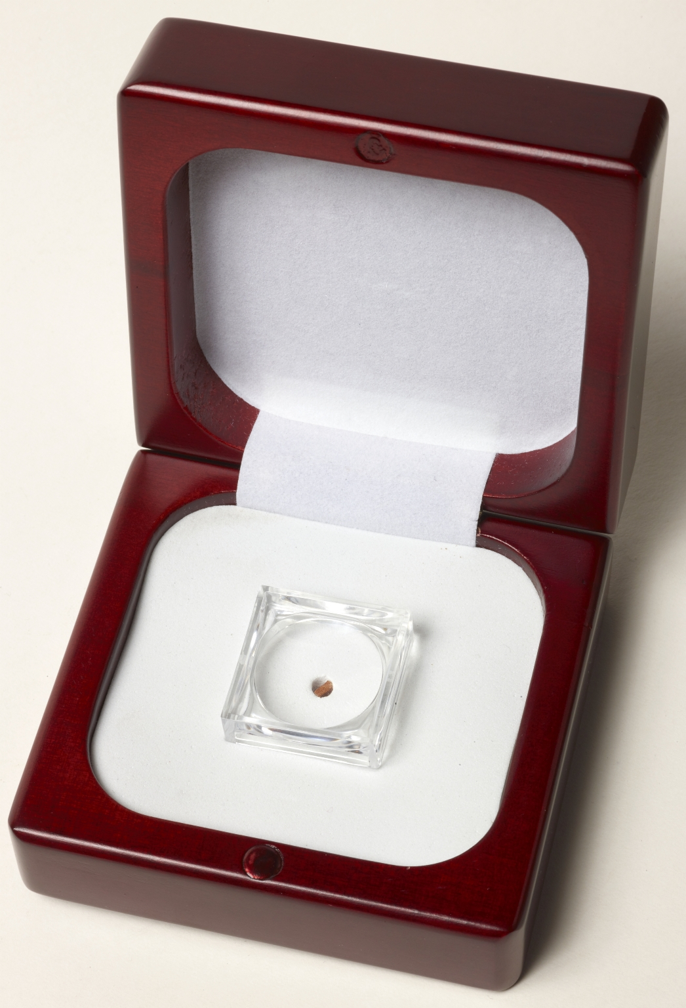
-------------
Image1
-------------
Field Data
Image Number JRL16111294
Reference Number R219527
Link to Catalogue <A href="http://www.librarysearch.manchester.ac.uk/MU_VU1:BLENDED:44MAN_ALMA_DS21157060550001631">UOM online catalogue.</a>
Image Title Alphabet Book in Display Box
Alternative Image Title Miniature book in Display Box
Parent Work Title Bilder-ABC: das kleinste Buch der Welt
Creator Reichert, Joshua, 1937-
Creator Role Author
Date Created 2000
Publication Details Leipzig: Faber & Faber; Germany Leipzig
Description Bilder-ABC: das kleinste Buch der Welt. At the time of issue, this is the smallest known mechanically produced book. Accompanied by a single folded explanatory sheet (70 x 180 mm.), printed on both sides with 26 colour illustrations. Bound in leather; housed in a wooden box; including a magnifier; as issued by the publisher. Edition limited to 300 copies.
Keyword Tiny; Miniature; Alphabet.
Language Code ger-DE
Language German
Subject Miniature books--Specimens
Subject Alphabet books
Subject Illustrated books
Category of Material Printed
Medium Ink
Support Paper
Time Period Covered 21st Century CE
Item Height 2.9 mm
Item Width 2.4 mm
Current Repository The University of Manchester Library, UK
Rights Holder - Image The University of Manchester Library
Rights holder - Work Copyright restrictions apply.
Date Captured (yyyy-mm-dd) 2016-11-14
Image Creation Technique Digital capture by Heritage Imaging, The University of Manchester Library
Date Image Added (yyyy-mm) 2017-01
Metadata Language eng-GB

Slide 5
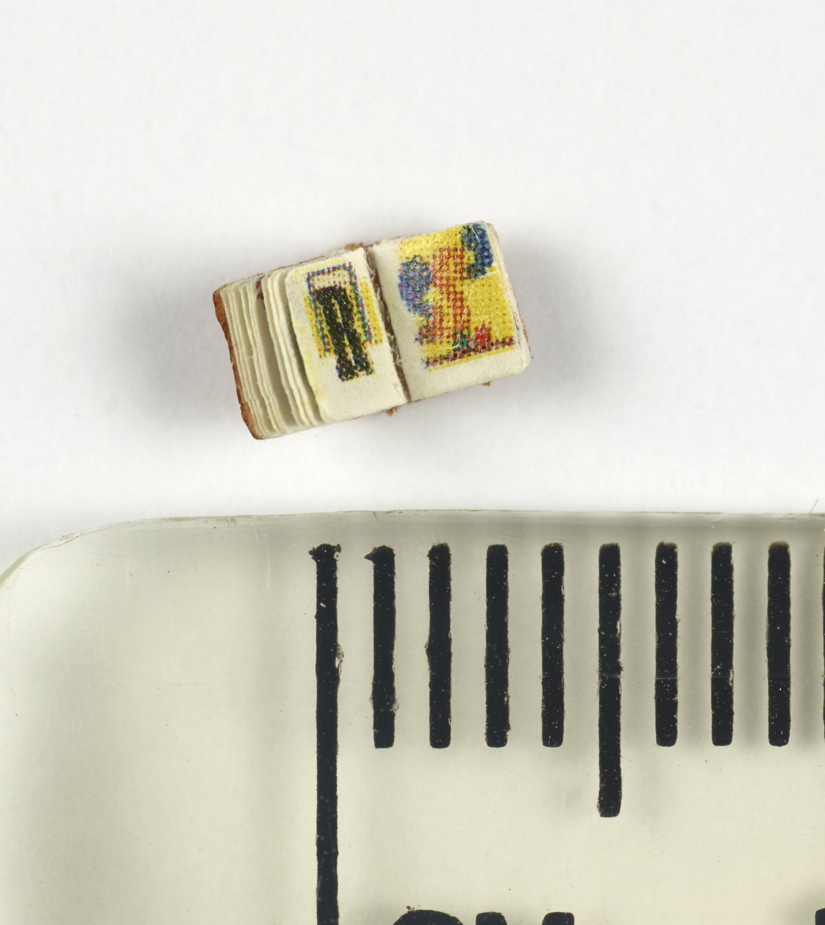
-------------
Image1
-------------
Field Data
Image Number JRL16111295
Reference Number R219527
Link to Catalogue <A href="http://www.librarysearch.manchester.ac.uk/MU_VU1:BLENDED:44MAN_ALMA_DS21157060550001631">UOM online catalogue.</a>
Image Title Alphabet Book
Alternative Image Title Miniature book
Parent Work Title Bilder-ABC: das kleinste Buch der Welt
Creator Reichert, Joshua, 1937-
Creator Role Author
Date Created 2000
Publication Details Leipzig: Faber & Faber; Germany Leipzig
Description Bilder-ABC: das kleinste Buch der Welt; opening of R and S. At the time of issue, this is the smallest known mechanically produced book. Accompanied by a single folded explanatory sheet (70 x 180 mm.), printed on both sides with 26 colour illustrations. Edition limited to 300 copies.
Keyword Tiny; Miniature; Alphabet.
Language Code ger-DE
Language German
Subject Miniature books--Specimens
Subject Alphabet books
Subject Illustrated books
Category of Material Printed
Medium Ink
Support Paper
Time Period Covered 21st Century CE
Item Height 2.9 mm
Item Width 2.4 mm
Current Repository The University of Manchester Library, UK
Rights Holder - Image The University of Manchester Library
Rights holder - Work Copyright restrictions apply.
Date Captured (yyyy-mm-dd) 2016-11-14
Image Creation Technique Digital capture by Heritage Imaging, The University of Manchester Library
Date Image Added (yyyy-mm) 2017-01
Metadata Language eng-GB

