Slide 2
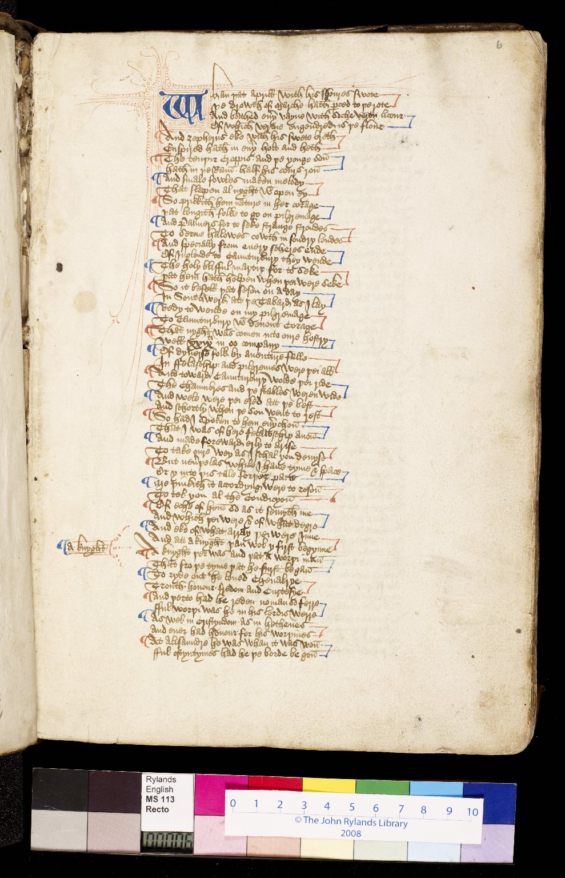
-------------
Image1
-------------
Field Data
Image Number JRL0903460dc
Reference Number English MS 113
Link to Catalogue <A href=https://www.librarysearch.manchester.ac.uk/primo-explore/fulldisplay?docid=44MAN_ELGAR_DSgb133engms113&context=L&vid=MU_NUI&search_scope=BLENDED&tab=local&lang=en_US>UoM online catalogue.</a>
Image Title General Prologue
Parent Work Title Canterbury Tales and other works
Alternative Parent Work Title Canterbury Tales
Creator Chaucer, Geoffrey, -1400
Creator Role Author
Creator Brode, John
Creator Role Scribe
Display Creator Chaucer, Geoffrey, -1400
Date Created 15th century [late]
Page 6r
Image Sequence Number 006r
Description Beginning of the general prologue: Pen-flourished initial 'W' in blue and red ink, with alternate blue and red ceasura. The text begins 'Whan þat aprill with his showres swote...'. The script is a current anglicana of a rather legal sort, in 54-60 long lines.
Language Code enm-GB
Subject English literature
Subject English literature--Manuscripts
Subject Literature, Medieval
Subject Poetry, Medieval
Subject Literature, Medieval--Manuscripts
Category of Material Manuscripts
Sub-Category Codex
Technique Used Handwriting
Medium Ink
Support Paper
Time Period Covered 1200 - 1500 CE
Places Covered England
People Covered Chaucer, Geoffrey, -1400
Item Height 300 mm
Item Width 210 mm
Current Repository The University of Manchester Library, U.K.
Provenance Woolcombe, Mr., of Pitton
Provenance Hull, John, d. 1549. A customs officer of Exeter and Dartmouth.
Provenance Pearce, Samuel Winter, Reverend, of Shaugh and Sampford Spinney in Devon.
Provenance Hodson, Lawrence W., of Compton Hall near Wolverhampton.
Rights Holder - Image The University of Manchester Library
Rights holder - Work The University of Manchester Library
Access Rights <a rel="license" href="http://creativecommons.org/licenses/by-nc-sa/4.0/"><img alt="Creative Commons License" style="border-width:0" src="https://i.creativecommons.org/l/by-nc-sa/4.0/88x31.png" /></a>
References Tyson, Moses, 'Hand-List of the Collection of English Manuscripts in the John Rylands Library' (1928), p.24.
References Parts of this catalogue have been reproduced from Ker, N.R., 'Medieval manuscripts in British libraries, vol. III, Lampeter-Oxford' (Oxford: Clarendon Press, 1983), pp. 420-21. By kind permission of Oxford University Press.
References Manley, John M., and Rickert, Edith, 'The text of the Canterbury Tales studied on the basis of all known manuscripts. Volume 1, Descriptions of the manuscripts' (Chicago: University of Chicago, 1940), pp. 349-55.
Bibliographic Citation Griffiths, J., New light on the provenance of a copy of the Canterbury Tales, John Rylands Library, MS Eng. 113, 'Bulletin of the John Rylands University Library of Manchester', vol. 77 no.2 (1995), pp25-30.
Cost Purchased by the John Rylands Library from the London bookseller Bernard Quaritch for £180.00 in May 1910.
Date Captured (yyyy-mm-dd) 2008-11-06
Multi Page Number 65
Image Creation Technique Digital capture by Heritage Imaging, The University of Manchester Library
Date Image Added (yyyy-mm) 2009-03
Metadata Language eng-GB

Slide 3
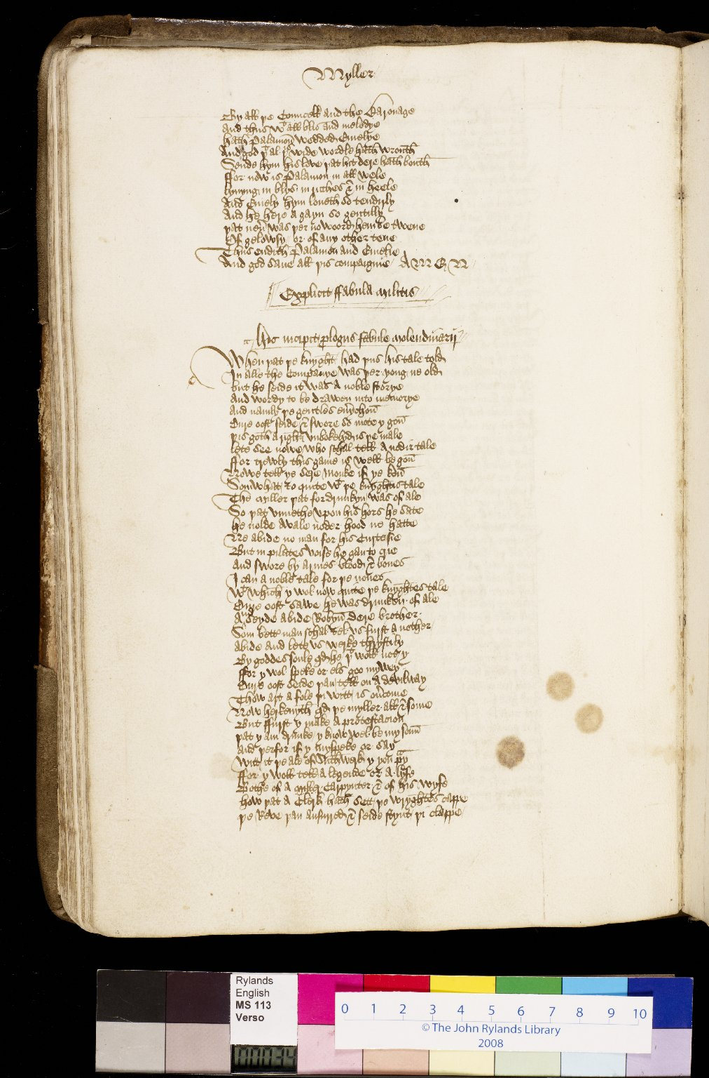
-------------
Image1
-------------
Field Data
Image Number JRL0903517dc
Reference Number English MS 113
Link to Catalogue <A href=https://www.librarysearch.manchester.ac.uk/primo-explore/fulldisplay?docid=44MAN_ELGAR_DSgb133engms113&context=L&vid=MU_NUI&search_scope=BLENDED&tab=local&lang=en_US>UoM online catalogue.</a>
Image Title Prologue to the Miller's tale
Parent Work Title Canterbury Tales and other works
Alternative Parent Work Title Canterbury Tales
Creator Chaucer, Geoffrey, -1400
Creator Role Author
Creator Brode, John
Creator Role Scribe
Display Creator Chaucer, Geoffrey, -1400
Date Created 15th century [late]
Page 34v
Image Sequence Number 034v
Description Miller's Tale: the Knight's noble tale is discussed and the Monk is invited to tell the next story. However, the proceedings are interupted by the Miller, who is drunk. The Miller demands that his tale is heard next. The script is a current anglicana of a rather legal sort.
Language Code enm-GB
Subject English literature--Manuscripts
Subject English literature
Subject Poetry, Medieval
Subject Literature, Medieval
Subject Literature, Medieval--Manuscripts
Category of Material Manuscripts
Sub-Category Codex
Technique Used Handwriting
Medium Ink
Support Paper
Time Period Covered 1200 - 1500 CE
Places Covered England
People Covered Chaucer, Geoffrey, -1400
Item Height 300 mm
Item Width 210 mm
Current Repository The University of Manchester Library, U.K.
Provenance Pearce, Samuel Winter, Reverend, of Shaugh and Sampford Spinney in Devon.
Provenance Hodson, Lawrence W., of Compton Hall near Wolverhampton.
Provenance Woolcombe, Mr., of Pitton
Provenance Hull, John, d. 1549. A customs officer of Exeter and Dartmouth.
Rights Holder - Image The University of Manchester Library
Rights holder - Work The University of Manchester Library
Access Rights <a rel="license" href="http://creativecommons.org/licenses/by-nc-sa/4.0/"><img alt="Creative Commons License" style="border-width:0" src="https://i.creativecommons.org/l/by-nc-sa/4.0/88x31.png" /></a>
References Tyson, Moses, 'Hand-List of the Collection of English Manuscripts in the John Rylands Library' (1928), p.24.
References Parts of this catalogue have been reproduced from Ker, N.R., 'Medieval manuscripts in British libraries, vol. III, Lampeter-Oxford' (Oxford: Clarendon Press, 1983), pp. 420-21. By kind permission of Oxford University Press.
References Manley, John M., and Rickert, Edith, 'The text of the Canterbury Tales studied on the basis of all known manuscripts. Volume 1, Descriptions of the manuscripts' (Chicago: University of Chicago, 1940), pp. 349-55.
Bibliographic Citation Griffiths, J., New light on the provenance of a copy of the Canterbury Tales, John Rylands Library, MS Eng. 113, 'Bulletin of the John Rylands University Library of Manchester', vol. 77 no.2 (1995), pp25-30.
Cost Purchased by the John Rylands Library from the London bookseller Bernard Quaritch for £180.00 in May 1910.
Date Captured (yyyy-mm-dd) 2008-11-07
Multi Page Number 350
Image Creation Technique Digital capture by Heritage Imaging, The University of Manchester Library
Date Image Added (yyyy-mm) 2009-03
Metadata Language eng-GB

Slide 4
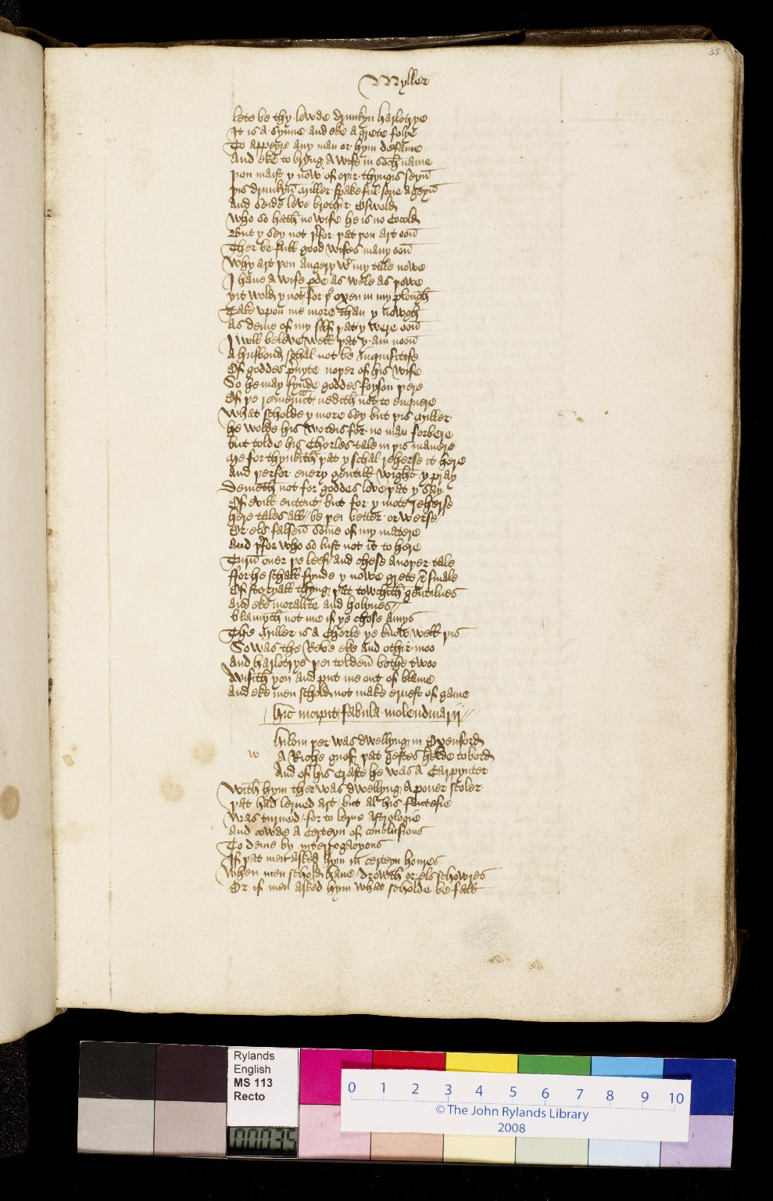
-------------
Image1
-------------
Field Data
Image Number JRL0903518dc
Reference Number English MS 113
Link to Catalogue <A href=https://www.librarysearch.manchester.ac.uk/primo-explore/fulldisplay?docid=44MAN_ELGAR_DSgb133engms113&context=L&vid=MU_NUI&search_scope=BLENDED&tab=local&lang=en_US>UoM online catalogue.</a>
Image Title Miller's tale
Parent Work Title Canterbury Tales and other works
Alternative Parent Work Title Canterbury Tales
Creator Chaucer, Geoffrey, -1400
Creator Role Author
Creator Brode, John
Creator Role Scribe
Display Creator Chaucer, Geoffrey, -1400
Date Created 15th century [late]
Page 35r
Image Sequence Number 035r
Description Miller's Tale: the Miller begins his tale, a bawdy story of an adulterous wife. The script is a current anglicana of a rather legal sort.
Language Code enm-GB
Subject English literature--Manuscripts
Subject English literature
Subject Poetry, Medieval
Subject Literature, Medieval
Subject Literature, Medieval--Manuscripts
Category of Material Manuscripts
Sub-Category Codex
Technique Used Handwriting
Medium Ink
Support Paper
Time Period Covered 1200 - 1500 CE
Places Covered England
People Covered Chaucer, Geoffrey, -1400
Item Height 300 mm
Item Width 210 mm
Current Repository The University of Manchester Library, U.K.
Provenance Pearce, Samuel Winter, Reverend, of Shaugh and Sampford Spinney in Devon.
Provenance Hodson, Lawrence W., of Compton Hall near Wolverhampton.
Provenance Woolcombe, Mr., of Pitton
Provenance Hull, John, d. 1549. A customs officer of Exeter and Dartmouth.
Rights Holder - Image The University of Manchester Library
Rights holder - Work The University of Manchester Library
Access Rights <a rel="license" href="http://creativecommons.org/licenses/by-nc-sa/4.0/"><img alt="Creative Commons License" style="border-width:0" src="https://i.creativecommons.org/l/by-nc-sa/4.0/88x31.png" /></a>
References Tyson, Moses, 'Hand-List of the Collection of English Manuscripts in the John Rylands Library' (1928), p.24.
References Parts of this catalogue have been reproduced from Ker, N.R., 'Medieval manuscripts in British libraries, vol. III, Lampeter-Oxford' (Oxford: Clarendon Press, 1983), pp. 420-21. By kind permission of Oxford University Press.
References Manley, John M., and Rickert, Edith, 'The text of the Canterbury Tales studied on the basis of all known manuscripts. Volume 1, Descriptions of the manuscripts' (Chicago: University of Chicago, 1940), pp. 349-55.
Bibliographic Citation Griffiths, J., New light on the provenance of a copy of the Canterbury Tales, John Rylands Library, MS Eng. 113, 'Bulletin of the John Rylands University Library of Manchester', vol. 77 no.2 (1995), pp25-30.
Cost Purchased by the John Rylands Library from the London bookseller Bernard Quaritch for £180.00 in May 1910.
Date Captured (yyyy-mm-dd) 2008-11-06
Multi Page Number 355
Image Creation Technique Digital capture by Heritage Imaging, The University of Manchester Library
Date Image Added (yyyy-mm) 2009-03
Metadata Language eng-GB

Slide 5
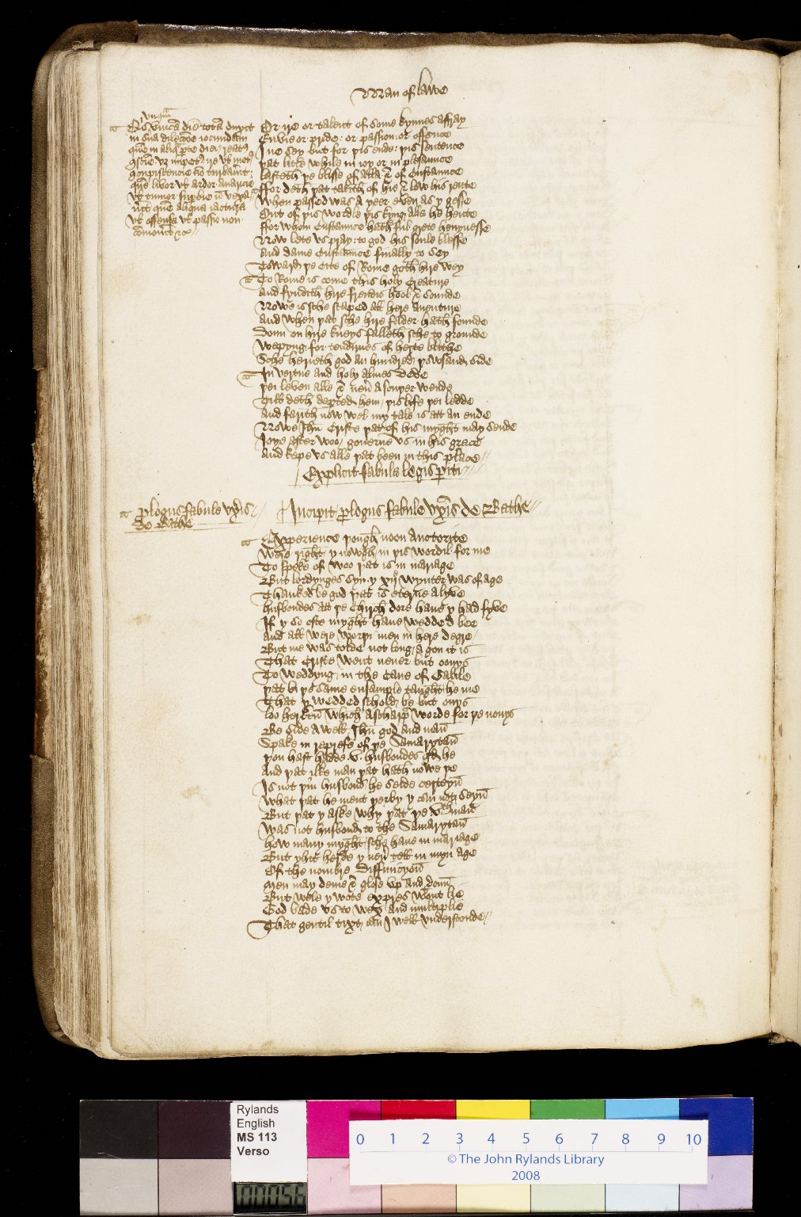
-------------
Image1
-------------
Field Data
Image Number JRL0903561dc
Reference Number English MS 113
Link to Catalogue <A href=https://www.librarysearch.manchester.ac.uk/primo-explore/fulldisplay?docid=44MAN_ELGAR_DSgb133engms113&context=L&vid=MU_NUI&search_scope=BLENDED&tab=local&lang=en_US>UoM online catalogue.</a>
Image Title Prologue to the Wife of Bath's tale
Parent Work Title Canterbury Tales and other works
Alternative Parent Work Title Canterbury Tales
Creator Chaucer, Geoffrey, -1400
Creator Role Author
Creator Brode, John
Creator Role Scribe
Display Creator Chaucer, Geoffrey, -1400
Date Created 15th century [late]
Page 56v
Image Sequence Number 056v
Description Wife of Bath's Tale: in the lengthy prologue to her tale the Wife of Bath describes her experiences of marriage, having been married five times . The script is a current anglicana of a rather legal sort.
Language Code enm-GB
Subject English literature--Manuscripts
Subject English literature
Subject Poetry, Medieval
Subject Literature, Medieval
Subject Literature, Medieval--Manuscripts
Category of Material Manuscripts
Sub-Category Codex
Technique Used Handwriting
Medium Ink
Support Paper
Time Period Covered 1200 - 1500 CE
Places Covered England
People Covered Chaucer, Geoffrey, -1400
Item Height 300 mm
Item Width 210 mm
Current Repository The University of Manchester Library, U.K.
Provenance Pearce, Samuel Winter, Reverend, of Shaugh and Sampford Spinney in Devon.
Provenance Hodson, Lawrence W., of Compton Hall near Wolverhampton.
Provenance Woolcombe, Mr., of Pitton
Provenance Hull, John, d. 1549. A customs officer of Exeter and Dartmouth.
Rights Holder - Image The University of Manchester Library
Rights holder - Work The University of Manchester Library
Access Rights <a rel="license" href="http://creativecommons.org/licenses/by-nc-sa/4.0/"><img alt="Creative Commons License" style="border-width:0" src="https://i.creativecommons.org/l/by-nc-sa/4.0/88x31.png" /></a>
References Tyson, Moses, 'Hand-List of the Collection of English Manuscripts in the John Rylands Library' (1928), p.24.
References Parts of this catalogue have been reproduced from Ker, N.R., 'Medieval manuscripts in British libraries, vol. III, Lampeter-Oxford' (Oxford: Clarendon Press, 1983), pp. 420-21. By kind permission of Oxford University Press.
References Manley, John M., and Rickert, Edith, 'The text of the Canterbury Tales studied on the basis of all known manuscripts. Volume 1, Descriptions of the manuscripts' (Chicago: University of Chicago, 1940), pp. 349-55.
Bibliographic Citation Griffiths, J., New light on the provenance of a copy of the Canterbury Tales, John Rylands Library, MS Eng. 113, 'Bulletin of the John Rylands University Library of Manchester', vol. 77 no.2 (1995), pp25-30.
Cost Purchased by the John Rylands Library from the London bookseller Bernard Quaritch for £180.00 in May 1910.
Date Captured (yyyy-mm-dd) 2008-11-07
Multi Page Number 570
Image Creation Technique Digital capture by Heritage Imaging, The University of Manchester Library
Date Image Added (yyyy-mm) 2009-03
Metadata Language eng-GB

Slide 6
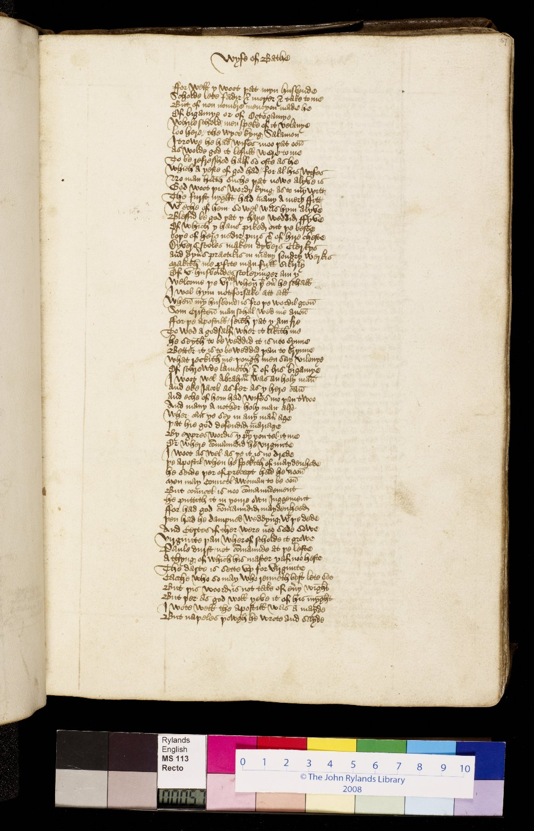
-------------
Image1
-------------
Field Data
Image Number JRL0903562dc
Reference Number English MS 113
Link to Catalogue <A href=https://www.librarysearch.manchester.ac.uk/primo-explore/fulldisplay?docid=44MAN_ELGAR_DSgb133engms113&context=L&vid=MU_NUI&search_scope=BLENDED&tab=local&lang=en_US>UoM online catalogue.</a>
Image Title Prologue to the Wife of Bath's tale
Parent Work Title Canterbury Tales and other works
Alternative Parent Work Title Canterbury Tales
Creator Chaucer, Geoffrey, -1400
Creator Role Author
Creator Brode, John
Creator Role Scribe
Display Creator Chaucer, Geoffrey, -1400
Date Created 15th century [late]
Page 57r
Image Sequence Number 057r
Description Wife of Bath's Tale: in the lengthy prologue to her tale the Wife of Bath describes her experiences of marriage, having been married five times. The script is a current anglicana of a rather legal sort.
Language Code enm-GB
Subject English literature--Manuscripts
Subject English literature
Subject Poetry, Medieval
Subject Literature, Medieval
Subject Literature, Medieval--Manuscripts
Category of Material Manuscripts
Sub-Category Codex
Technique Used Handwriting
Medium Ink
Support Paper
Time Period Covered 1200 - 1500 CE
Places Covered England
People Covered Chaucer, Geoffrey, -1400
Item Height 300 mm
Item Width 210 mm
Current Repository The University of Manchester Library, U.K.
Provenance Pearce, Samuel Winter, Reverend, of Shaugh and Sampford Spinney in Devon.
Provenance Hodson, Lawrence W., of Compton Hall near Wolverhampton.
Provenance Woolcombe, Mr., of Pitton
Provenance Hull, John, d. 1549. A customs officer of Exeter and Dartmouth.
Rights Holder - Image The University of Manchester Library
Rights holder - Work The University of Manchester Library
Access Rights <a rel="license" href="http://creativecommons.org/licenses/by-nc-sa/4.0/"><img alt="Creative Commons License" style="border-width:0" src="https://i.creativecommons.org/l/by-nc-sa/4.0/88x31.png" /></a>
References Tyson, Moses, 'Hand-List of the Collection of English Manuscripts in the John Rylands Library' (1928), p.24.
References Parts of this catalogue have been reproduced from Ker, N.R., 'Medieval manuscripts in British libraries, vol. III, Lampeter-Oxford' (Oxford: Clarendon Press, 1983), pp. 420-21. By kind permission of Oxford University Press.
References Manley, John M., and Rickert, Edith, 'The text of the Canterbury Tales studied on the basis of all known manuscripts. Volume 1, Descriptions of the manuscripts' (Chicago: University of Chicago, 1940), pp. 349-55.
Bibliographic Citation Griffiths, J., New light on the provenance of a copy of the Canterbury Tales, John Rylands Library, MS Eng. 113, 'Bulletin of the John Rylands University Library of Manchester', vol. 77 no.2 (1995), pp25-30.
Cost Purchased by the John Rylands Library from the London bookseller Bernard Quaritch for £180.00 in May 1910.
Date Captured (yyyy-mm-dd) 2008-11-06
Multi Page Number 575
Image Creation Technique Digital capture by Heritage Imaging, The University of Manchester Library
Date Image Added (yyyy-mm) 2009-03
Metadata Language eng-GB

Slide 7
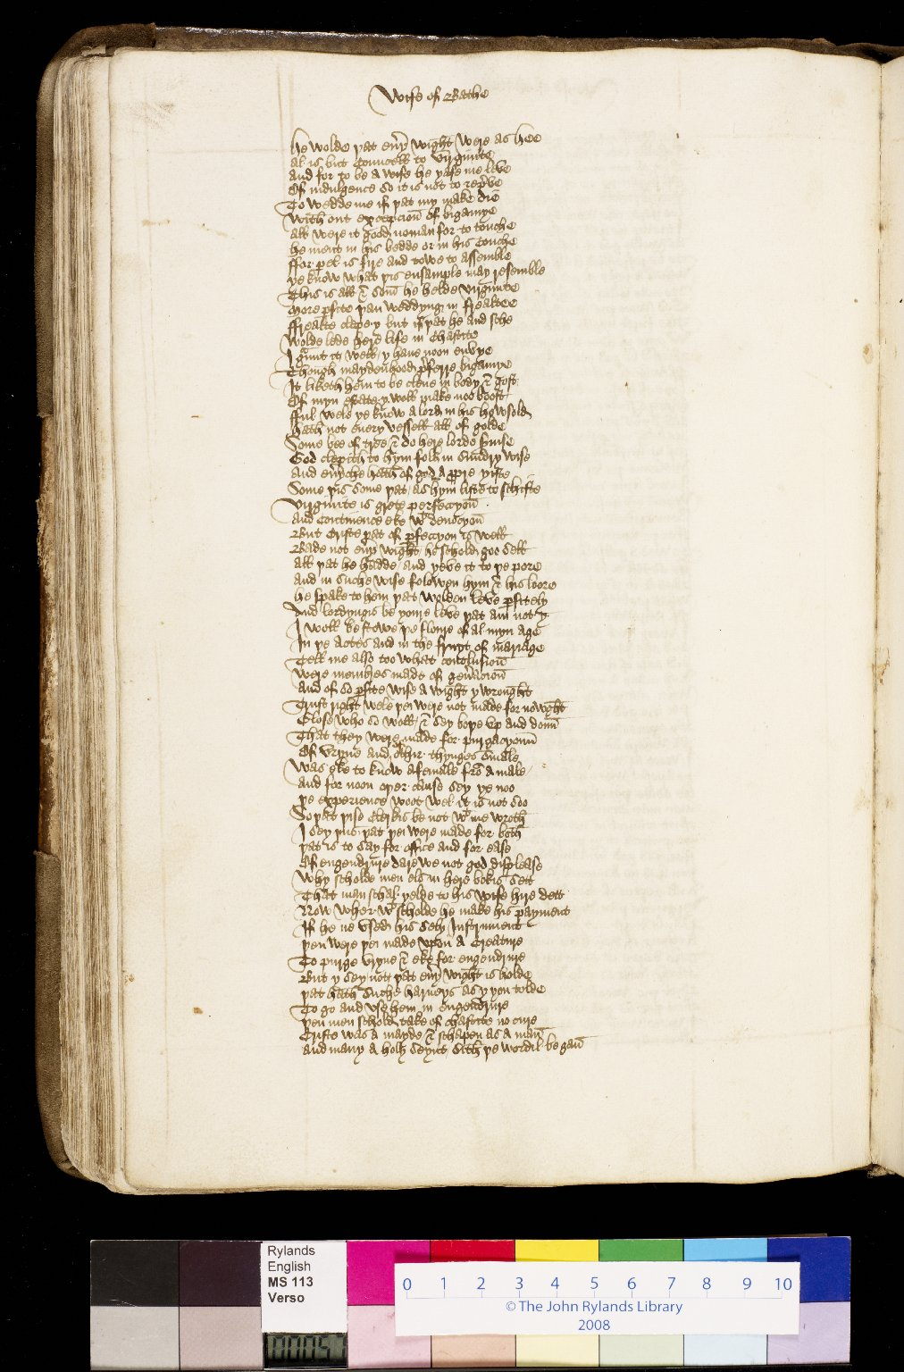
-------------
Image1
-------------
Field Data
Image Number JRL0903563dc
Reference Number English MS 113
Link to Catalogue <A href=https://www.librarysearch.manchester.ac.uk/primo-explore/fulldisplay?docid=44MAN_ELGAR_DSgb133engms113&context=L&vid=MU_NUI&search_scope=BLENDED&tab=local&lang=en_US>UoM online catalogue.</a>
Image Title Prologue to the Wife of Bath's tale
Parent Work Title Canterbury Tales and other works
Alternative Parent Work Title Canterbury Tales
Creator Chaucer, Geoffrey, -1400
Creator Role Author
Creator Brode, John
Creator Role Scribe
Display Creator Chaucer, Geoffrey, -1400
Date Created 15th century [late]
Page 57v
Image Sequence Number 057v
Description Wife of Bath's Tale: in the lengthy prologue to her tale the Wife of Bath describes her experiences of marriage, having been married five times. The script is a current anglicana of a rather legal sort.
Language Code enm-GB
Subject English literature--Manuscripts
Subject English literature
Subject Poetry, Medieval
Subject Literature, Medieval
Subject Literature, Medieval--Manuscripts
Category of Material Manuscripts
Sub-Category Codex
Technique Used Handwriting
Medium Ink
Support Paper
Time Period Covered 1200 - 1500 CE
Places Covered England
People Covered Chaucer, Geoffrey, -1400
Item Height 300 mm
Item Width 210 mm
Current Repository The University of Manchester Library, U.K.
Provenance Pearce, Samuel Winter, Reverend, of Shaugh and Sampford Spinney in Devon.
Provenance Hodson, Lawrence W., of Compton Hall near Wolverhampton.
Provenance Woolcombe, Mr., of Pitton
Provenance Hull, John, d. 1549. A customs officer of Exeter and Dartmouth.
Rights Holder - Image The University of Manchester Library
Rights holder - Work The University of Manchester Library
Access Rights <a rel="license" href="http://creativecommons.org/licenses/by-nc-sa/4.0/"><img alt="Creative Commons License" style="border-width:0" src="https://i.creativecommons.org/l/by-nc-sa/4.0/88x31.png" /></a>
References Tyson, Moses, 'Hand-List of the Collection of English Manuscripts in the John Rylands Library' (1928), p.24.
References Parts of this catalogue have been reproduced from Ker, N.R., 'Medieval manuscripts in British libraries, vol. III, Lampeter-Oxford' (Oxford: Clarendon Press, 1983), pp. 420-21. By kind permission of Oxford University Press.
References Manley, John M., and Rickert, Edith, 'The text of the Canterbury Tales studied on the basis of all known manuscripts. Volume 1, Descriptions of the manuscripts' (Chicago: University of Chicago, 1940), pp. 349-55.
Bibliographic Citation Griffiths, J., New light on the provenance of a copy of the Canterbury Tales, John Rylands Library, MS Eng. 113, 'Bulletin of the John Rylands University Library of Manchester', vol. 77 no.2 (1995), pp25-30.
Cost Purchased by the John Rylands Library from the London bookseller Bernard Quaritch for £180.00 in May 1910.
Date Captured (yyyy-mm-dd) 2008-11-07
Multi Page Number 580
Image Creation Technique Digital capture by Heritage Imaging, The University of Manchester Library
Date Image Added (yyyy-mm) 2009-03
Metadata Language eng-GB

Slide 8
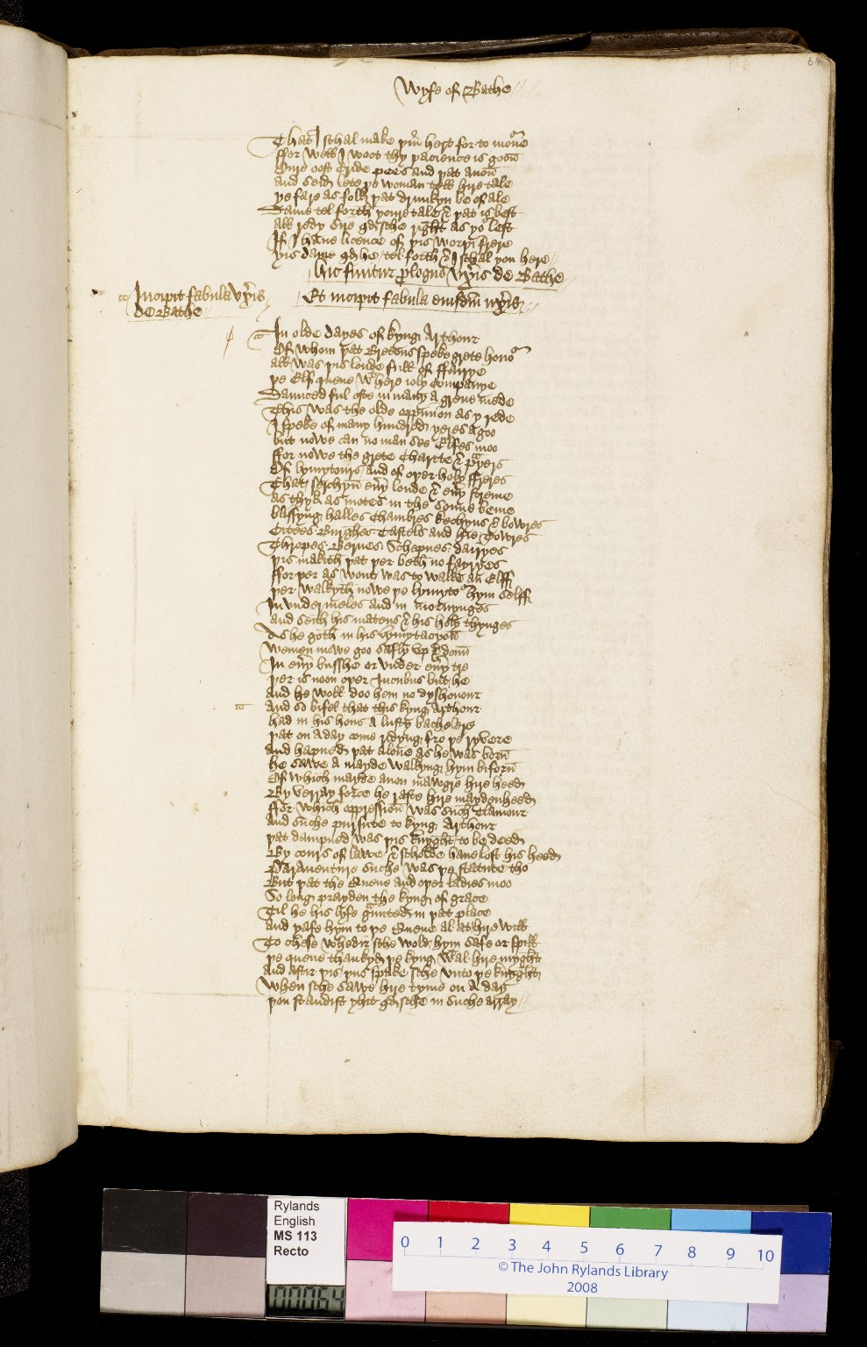
-------------
Image1
-------------
Field Data
Image Number JRL0903576dc
Reference Number English MS 113
Link to Catalogue <A href=https://www.librarysearch.manchester.ac.uk/primo-explore/fulldisplay?docid=44MAN_ELGAR_DSgb133engms113&context=L&vid=MU_NUI&search_scope=BLENDED&tab=local&lang=en_US>UoM online catalogue.</a>
Image Title Wife of Bath's tale
Parent Work Title Canterbury Tales and other works
Alternative Parent Work Title Canterbury Tales
Creator Chaucer, Geoffrey, -1400
Creator Role Author
Creator Brode, John
Creator Role Scribe
Display Creator Chaucer, Geoffrey, -1400
Date Created 15th century [late]
Page 64r
Image Sequence Number 064r
Description Wife of Bath's Tale: a tale about a knight who is sent on a quest to find out what women really desire. The script is a current anglicana of a rather legal sort.
Language Code enm-GB
Subject English literature--Manuscripts
Subject Literature, Medieval--Manuscripts
Subject English literature
Subject Literature, Medieval
Subject Poetry, Medieval
Category of Material Manuscripts
Sub-Category Codex
Technique Used Handwriting
Medium Ink
Support Paper
Time Period Covered 1200 - 1500 CE
Places Covered England
People Covered Chaucer, Geoffrey, -1400
Item Height 300 mm
Item Width 210 mm
Current Repository The University of Manchester Library, U.K.
Provenance Pearce, Samuel Winter, Reverend, of Shaugh and Sampford Spinney in Devon.
Provenance Hodson, Lawrence W., of Compton Hall near Wolverhampton.
Provenance Hull, John, d. 1549. A customs officer of Exeter and Dartmouth.
Provenance Woolcombe, Mr., of Pitton
Rights Holder - Image The University of Manchester Library
Rights holder - Work The University of Manchester Library
Access Rights <a rel="license" href="http://creativecommons.org/licenses/by-nc-sa/4.0/"><img alt="Creative Commons License" style="border-width:0" src="https://i.creativecommons.org/l/by-nc-sa/4.0/88x31.png" /></a>
References Tyson, Moses, 'Hand-List of the Collection of English Manuscripts in the John Rylands Library' (1928), p.24.
References Parts of this catalogue have been reproduced from Ker, N.R., 'Medieval manuscripts in British libraries, vol. III, Lampeter-Oxford' (Oxford: Clarendon Press, 1983), pp. 420-21. By kind permission of Oxford University Press.
References Manley, John M., and Rickert, Edith, 'The text of the Canterbury Tales studied on the basis of all known manuscripts. Volume 1, Descriptions of the manuscripts' (Chicago: University of Chicago, 1940), pp. 349-55.
Bibliographic Citation Griffiths, J., New light on the provenance of a copy of the Canterbury Tales, John Rylands Library, MS Eng. 113, 'Bulletin of the John Rylands University Library of Manchester', vol. 77 no.2 (1995), pp25-30.
Cost Purchased by the John Rylands Library from the London bookseller Bernard Quaritch for £180.00 in May 1910.
Date Captured (yyyy-mm-dd) 2008-11-06
Multi Page Number 645
Image Creation Technique Digital capture by Heritage Imaging, The University of Manchester Library
Date Image Added (yyyy-mm) 2009-03
Metadata Language eng-GB

Slide 9
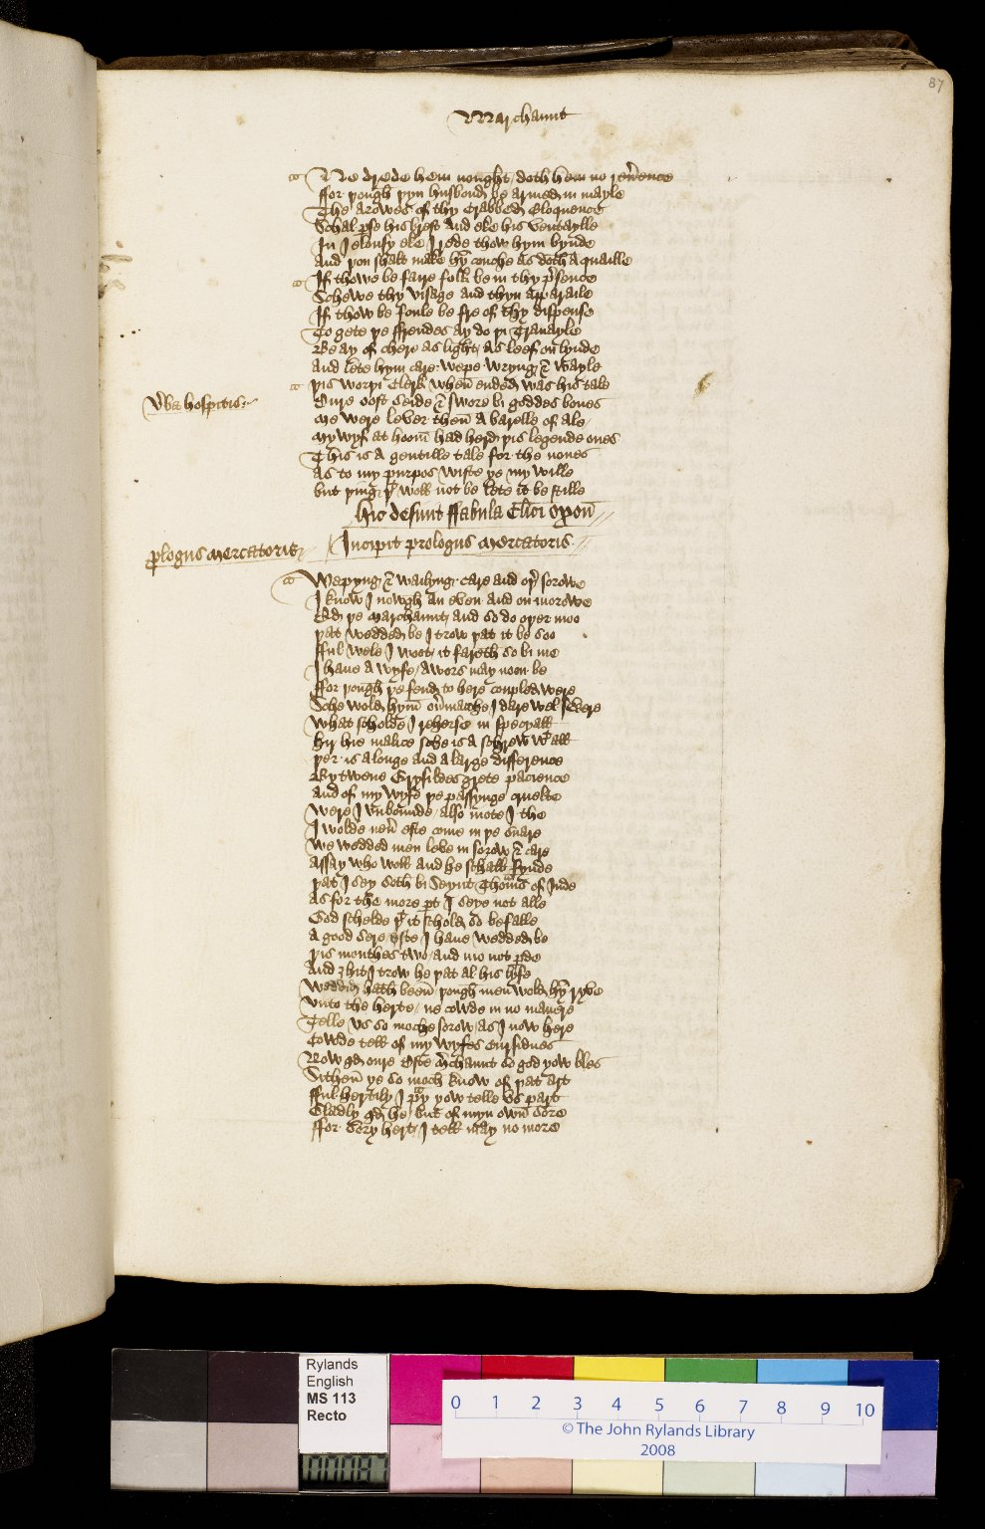
-------------
Image1
-------------
Field Data
Image Number JRL0903622dc
Reference Number English MS 113
Link to Catalogue <A href=https://www.librarysearch.manchester.ac.uk/primo-explore/fulldisplay?docid=44MAN_ELGAR_DSgb133engms113&context=L&vid=MU_NUI&search_scope=BLENDED&tab=local&lang=en_US>UoM online catalogue.</a>
Image Title Prologue to the Merchant's tale
Parent Work Title Canterbury Tales and other works
Alternative Parent Work Title Canterbury Tales
Creator Chaucer, Geoffrey, -1400
Creator Role Author
Creator Brode, John
Creator Role Scribe
Display Creator Chaucer, Geoffrey, -1400
Date Created 15th century [late]
Page 87r
Image Sequence Number 087r
Description Merchant's tale: the Merchant compares his own wife unfavourably to that of the faithful Griselda in the Clerk's tale. The host invites the Merchant to elaborate but the Merchant retorts that although he will tell a story about marriage, he will not relate the story of his own. The script is a current anglicana of a rather legal sort.
Language Code enm-GB
Subject Literature, Medieval--Manuscripts
Subject Poetry, Medieval
Subject Literature, Medieval
Subject English literature
Subject English literature--Manuscripts
Category of Material Manuscripts
Sub-Category Codex
Technique Used Handwriting
Medium Ink
Support Paper
Time Period Covered 1200 - 1500 CE
Places Covered England
People Covered Chaucer, Geoffrey, -1400
Item Height 300 mm
Item Width 210 mm
Current Repository The University of Manchester Library, U.K.
Provenance Pearce, Samuel Winter, Reverend, of Shaugh and Sampford Spinney in Devon.
Provenance Hodson, Lawrence W., of Compton Hall near Wolverhampton.
Provenance Woolcombe, Mr., of Pitton
Provenance Hull, John, d. 1549. A customs officer of Exeter and Dartmouth.
Rights Holder - Image The University of Manchester Library
Rights holder - Work The University of Manchester Library
Access Rights <a rel="license" href="http://creativecommons.org/licenses/by-nc-sa/4.0/"><img alt="Creative Commons License" style="border-width:0" src="https://i.creativecommons.org/l/by-nc-sa/4.0/88x31.png" /></a>
References Tyson, Moses, 'Hand-List of the Collection of English Manuscripts in the John Rylands Library' (1928), p.24.
References Parts of this catalogue have been reproduced from Ker, N.R., 'Medieval manuscripts in British libraries, vol. III, Lampeter-Oxford' (Oxford: Clarendon Press, 1983), pp. 420-21. By kind permission of Oxford University Press.
References Manley, John M., and Rickert, Edith, 'The text of the Canterbury Tales studied on the basis of all known manuscripts. Volume 1, Descriptions of the manuscripts' (Chicago: University of Chicago, 1940), pp. 349-55.
Bibliographic Citation Griffiths, J., New light on the provenance of a copy of the Canterbury Tales, John Rylands Library, MS Eng. 113, 'Bulletin of the John Rylands University Library of Manchester', vol. 77 no.2 (1995), pp25-30.
Cost Purchased by the John Rylands Library from the London bookseller Bernard Quaritch for £180.00 in May 1910.
Date Captured (yyyy-mm-dd) 2008-11-06
Multi Page Number 875
Image Creation Technique Digital capture by Heritage Imaging, The University of Manchester Library
Date Image Added (yyyy-mm) 2009-03
Metadata Language eng-GB

Slide 10
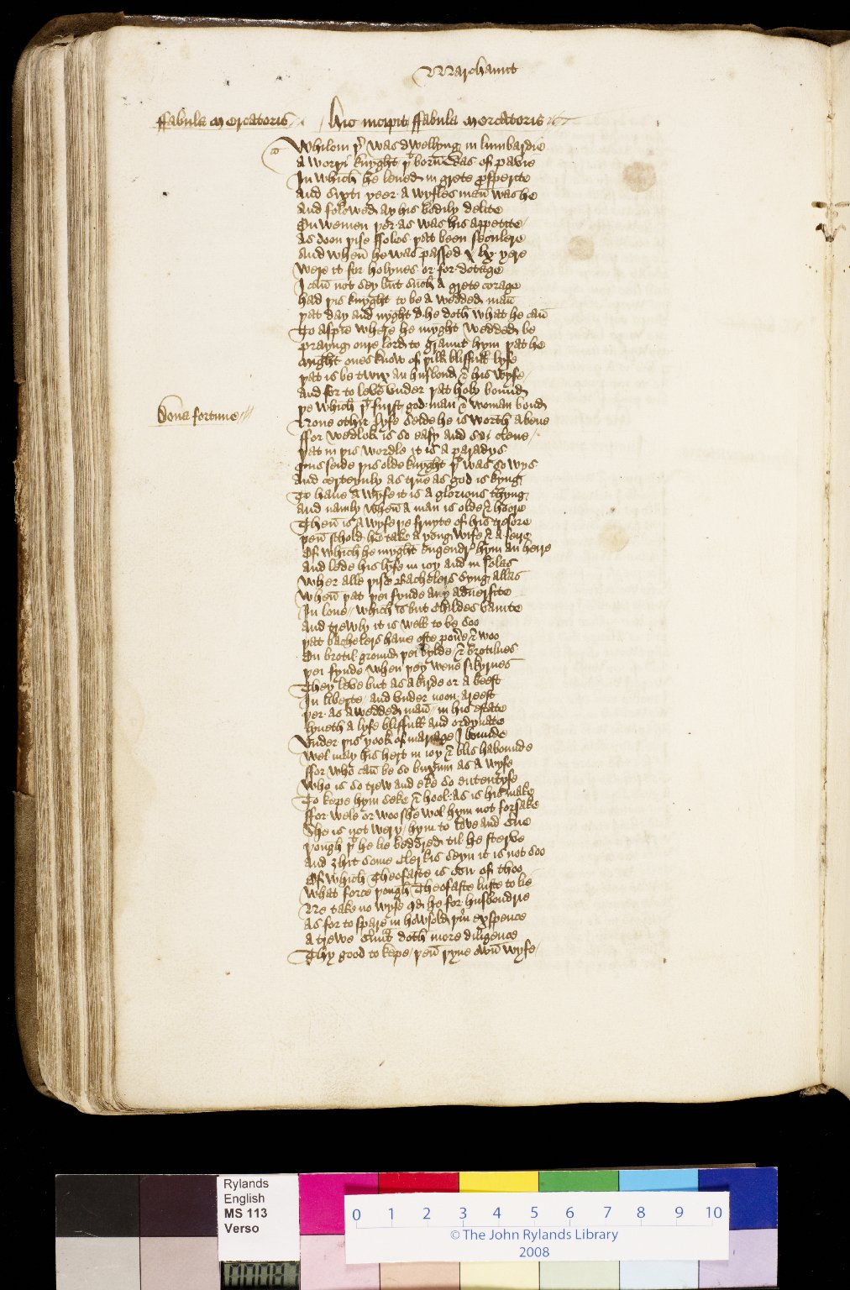
-------------
Image1
-------------
Field Data
Image Number JRL0903623dc
Reference Number English MS 113
Link to Catalogue <A href=https://www.librarysearch.manchester.ac.uk/primo-explore/fulldisplay?docid=44MAN_ELGAR_DSgb133engms113&context=L&vid=MU_NUI&search_scope=BLENDED&tab=local&lang=en_US>UoM online catalogue.</a>
Image Title Merchant's tale
Parent Work Title Canterbury Tales and other works
Alternative Parent Work Title Canterbury Tales
Creator Chaucer, Geoffrey, -1400
Creator Role Author
Creator Brode, John
Creator Role Scribe
Display Creator Chaucer, Geoffrey, -1400
Date Created 15th century [late]
Page 87v
Image Sequence Number 087v
Description Merchant's tale: a tale about an older man with a much younger wife, who is unfaithful to her husband with a young squire. The script is a current anglicana of a rather legal sort.
Language Code enm-GB
Subject Literature, Medieval--Manuscripts
Subject Poetry, Medieval
Subject Literature, Medieval
Subject English literature
Subject English literature--Manuscripts
Category of Material Manuscripts
Sub-Category Codex
Technique Used Handwriting
Medium Ink
Support Paper
Time Period Covered 1200 - 1500 CE
Places Covered England
People Covered Chaucer, Geoffrey, -1400
Item Height 300 mm
Item Width 210 mm
Current Repository The University of Manchester Library, U.K.
Provenance Pearce, Samuel Winter, Reverend, of Shaugh and Sampford Spinney in Devon.
Provenance Hodson, Lawrence W., of Compton Hall near Wolverhampton.
Provenance Hull, John, d. 1549. A customs officer of Exeter and Dartmouth.
Provenance Woolcombe, Mr., of Pitton
Rights Holder - Image The University of Manchester Library
Rights holder - Work The University of Manchester Library
Access Rights <a rel="license" href="http://creativecommons.org/licenses/by-nc-sa/4.0/"><img alt="Creative Commons License" style="border-width:0" src="https://i.creativecommons.org/l/by-nc-sa/4.0/88x31.png" /></a>
References Tyson, Moses, 'Hand-List of the Collection of English Manuscripts in the John Rylands Library' (1928), p.24.
References Parts of this catalogue have been reproduced from Ker, N.R., 'Medieval manuscripts in British libraries, vol. III, Lampeter-Oxford' (Oxford: Clarendon Press, 1983), pp. 420-21. By kind permission of Oxford University Press.
References Manley, John M., and Rickert, Edith, 'The text of the Canterbury Tales studied on the basis of all known manuscripts. Volume 1, Descriptions of the manuscripts' (Chicago: University of Chicago, 1940), pp. 349-55.
Bibliographic Citation Griffiths, J., New light on the provenance of a copy of the Canterbury Tales, John Rylands Library, MS Eng. 113, 'Bulletin of the John Rylands University Library of Manchester', vol. 77 no.2 (1995), pp25-30.
Cost Purchased by the John Rylands Library from the London bookseller Bernard Quaritch for £180.00 in May 1910.
Date Captured (yyyy-mm-dd) 2008-11-07
Multi Page Number 880
Image Creation Technique Digital capture by Heritage Imaging, The University of Manchester Library
Date Image Added (yyyy-mm) 2009-03
Metadata Language eng-GB

Slide 11
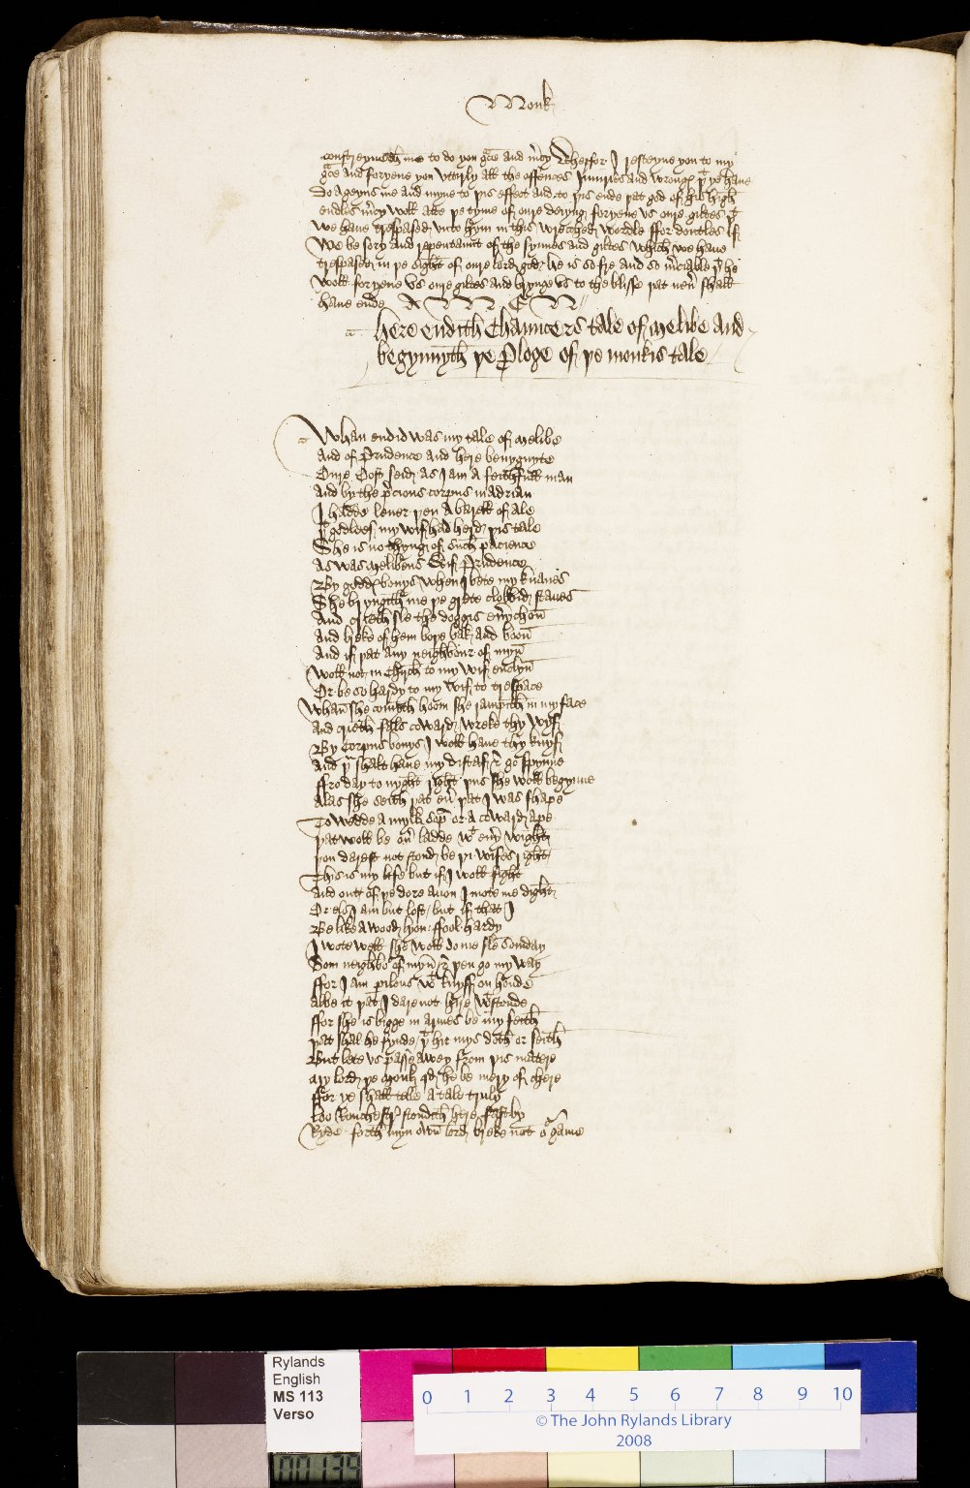
-------------
Image1
-------------
Field Data
Image Number JRL0903727dc
Reference Number English MS 113
Link to Catalogue <A href=https://www.librarysearch.manchester.ac.uk/primo-explore/fulldisplay?docid=44MAN_ELGAR_DSgb133engms113&context=L&vid=MU_NUI&search_scope=BLENDED&tab=local&lang=en_US>UoM online catalogue.</a>
Image Title Prologue to the Monk's tale
Parent Work Title Canterbury Tales and other works
Alternative Parent Work Title Canterbury Tales
Creator Brode, John
Creator Role Scribe
Creator Chaucer, Geoffrey, -1400
Creator Role Author
Display Creator Chaucer, Geoffrey, -1400
Date Created 15th century [late]
Page 139v
Image Sequence Number 139v
Description Monk's tale: the host asks the Monk for the next story. The script is a current anglicana of a rather legal sort.
Language Code enm-GB
Subject English literature--Manuscripts
Subject English literature
Subject Literature, Medieval
Subject Literature, Medieval--Manuscripts
Subject Poetry, Medieval
Category of Material Manuscripts
Sub-Category Codex
Technique Used Handwriting
Medium Ink
Support Paper
Time Period Covered 1200 - 1500 CE
Places Covered England
People Covered Chaucer, Geoffrey, -1400
Item Height 300 mm
Item Width 210 mm
Current Repository The University of Manchester Library, U.K.
Provenance Pearce, Samuel Winter, Reverend, of Shaugh and Sampford Spinney in Devon.
Provenance Hodson, Lawrence W., of Compton Hall near Wolverhampton.
Provenance Hull, John, d. 1549. A customs officer of Exeter and Dartmouth.
Provenance Woolcombe, Mr., of Pitton
Rights Holder - Image The University of Manchester Library
Rights holder - Work The University of Manchester Library
Access Rights <a rel="license" href="http://creativecommons.org/licenses/by-nc-sa/4.0/"><img alt="Creative Commons License" style="border-width:0" src="https://i.creativecommons.org/l/by-nc-sa/4.0/88x31.png" /></a>
References Tyson, Moses, 'Hand-List of the Collection of English Manuscripts in the John Rylands Library' (1928), p.24.
References Parts of this catalogue have been reproduced from Ker, N.R., 'Medieval manuscripts in British libraries, vol. III, Lampeter-Oxford' (Oxford: Clarendon Press, 1983), pp. 420-21. By kind permission of Oxford University Press.
References Manley, John M., and Rickert, Edith, 'The text of the Canterbury Tales studied on the basis of all known manuscripts. Volume 1, Descriptions of the manuscripts' (Chicago: University of Chicago, 1940), pp. 349-55.
Bibliographic Citation Griffiths, J., New light on the provenance of a copy of the Canterbury Tales, John Rylands Library, MS Eng. 113, 'Bulletin of the John Rylands University Library of Manchester', vol. 77 no.2 (1995), pp25-30.
Cost Purchased by the John Rylands Library from the London bookseller Bernard Quaritch for £180.00 in May 1910.
Date Captured (yyyy-mm-dd) 2008-11-07
Multi Page Number 1400
Image Creation Technique Digital capture by Heritage Imaging, The University of Manchester Library
Date Image Added (yyyy-mm) 2009-03
Metadata Language eng-GB

Slide 12
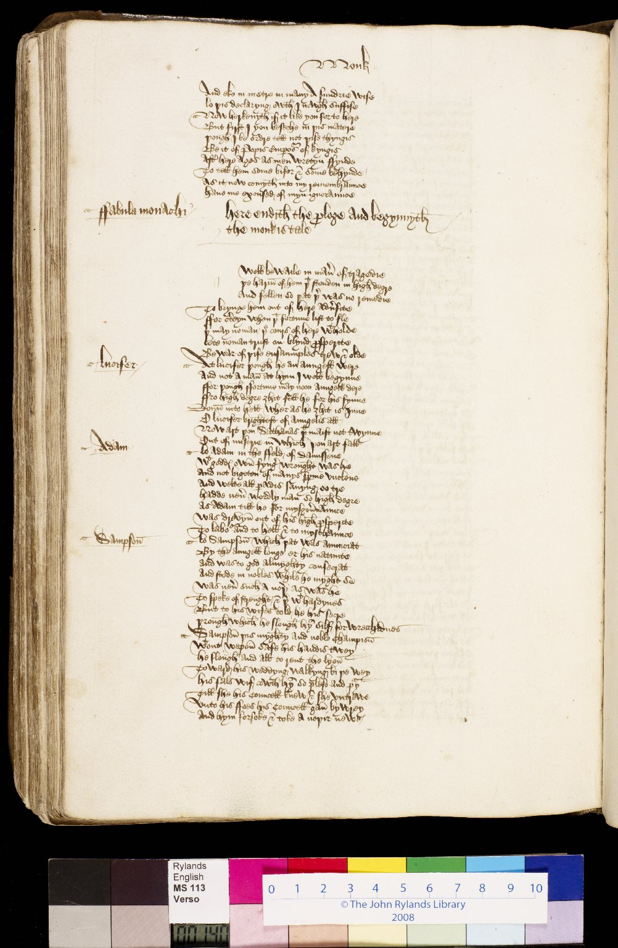
-------------
Image1
-------------
Field Data
Image Number JRL0903729dc
Reference Number English MS 113
Link to Catalogue <A href=https://www.librarysearch.manchester.ac.uk/primo-explore/fulldisplay?docid=44MAN_ELGAR_DSgb133engms113&context=L&vid=MU_NUI&search_scope=BLENDED&tab=local&lang=en_US>UoM online catalogue.</a>
Image Title Monk's tale
Parent Work Title Canterbury Tales and other works
Alternative Parent Work Title Canterbury Tales
Creator Brode, John
Creator Role Scribe
Creator Chaucer, Geoffrey, -1400
Creator Role Author
Display Creator Chaucer, Geoffrey, -1400
Date Created 15th century [late]
Page 140v
Image Sequence Number 140v
Description Monk's tale: a number of tragic short tales. The script is a current anglicana of a rather legal sort.
Language Code enm-GB
Subject English literature--Manuscripts
Subject English literature
Subject Literature, Medieval
Subject Literature, Medieval--Manuscripts
Subject Poetry, Medieval
Category of Material Manuscripts
Sub-Category Codex
Technique Used Handwriting
Medium Ink
Support Paper
Time Period Covered 1200 - 1500 CE
Places Covered England
People Covered Chaucer, Geoffrey, -1400
Item Height 300 mm
Item Width 210 mm
Current Repository The University of Manchester Library, U.K.
Provenance Pearce, Samuel Winter, Reverend, of Shaugh and Sampford Spinney in Devon.
Provenance Hodson, Lawrence W., of Compton Hall near Wolverhampton.
Provenance Hull, John, d. 1549. A customs officer of Exeter and Dartmouth.
Provenance Woolcombe, Mr., of Pitton
Rights Holder - Image The University of Manchester Library
Rights holder - Work The University of Manchester Library
Access Rights <a rel="license" href="http://creativecommons.org/licenses/by-nc-sa/4.0/"><img alt="Creative Commons License" style="border-width:0" src="https://i.creativecommons.org/l/by-nc-sa/4.0/88x31.png" /></a>
References Tyson, Moses, 'Hand-List of the Collection of English Manuscripts in the John Rylands Library' (1928), p.24.
References Parts of this catalogue have been reproduced from Ker, N.R., 'Medieval manuscripts in British libraries, vol. III, Lampeter-Oxford' (Oxford: Clarendon Press, 1983), pp. 420-21. By kind permission of Oxford University Press.
References Manley, John M., and Rickert, Edith, 'The text of the Canterbury Tales studied on the basis of all known manuscripts. Volume 1, Descriptions of the manuscripts' (Chicago: University of Chicago, 1940), pp. 349-55.
Bibliographic Citation Griffiths, J., New light on the provenance of a copy of the Canterbury Tales, John Rylands Library, MS Eng. 113, 'Bulletin of the John Rylands University Library of Manchester', vol. 77 no.2 (1995), pp25-30.
Cost Purchased by the John Rylands Library from the London bookseller Bernard Quaritch for £180.00 in May 1910.
Date Captured (yyyy-mm-dd) 2008-11-07
Multi Page Number 1410
Image Creation Technique Digital capture by Heritage Imaging, The University of Manchester Library
Date Image Added (yyyy-mm) 2009-03
Metadata Language eng-GB

Slide 13
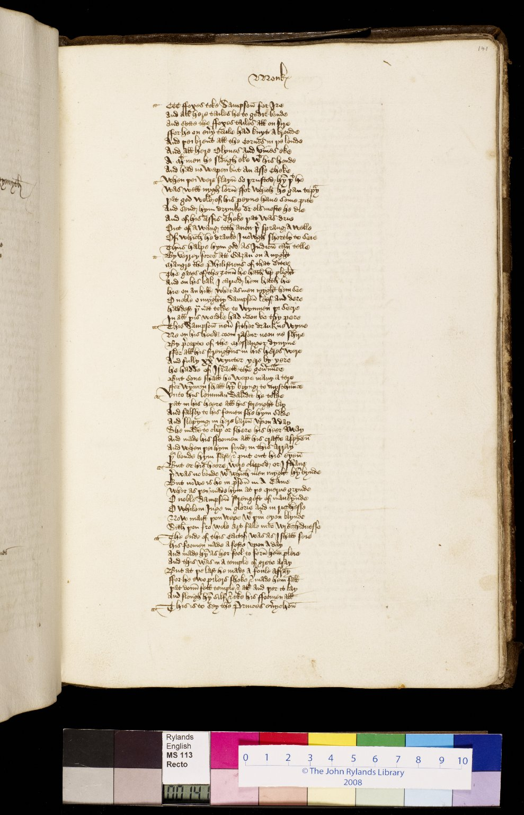
-------------
Image1
-------------
Field Data
Image Number JRL0903730dc
Reference Number English MS 113
Link to Catalogue <A href=https://www.librarysearch.manchester.ac.uk/primo-explore/fulldisplay?docid=44MAN_ELGAR_DSgb133engms113&context=L&vid=MU_NUI&search_scope=BLENDED&tab=local&lang=en_US>UoM online catalogue.</a>
Image Title Monk's tale
Parent Work Title Canterbury Tales and other works
Alternative Parent Work Title Canterbury Tales
Creator Brode, John
Creator Role Scribe
Creator Chaucer, Geoffrey, -1400
Creator Role Author
Display Creator Chaucer, Geoffrey, -1400
Date Created 15th century [late]
Page 141r
Image Sequence Number 141r
Description Monk's tale: a number of tragic short tales. The script is a current anglicana of a rather legal sort.
Language Code enm-GB
Subject English literature--Manuscripts
Subject English literature
Subject Literature, Medieval
Subject Literature, Medieval--Manuscripts
Subject Poetry, Medieval
Category of Material Manuscripts
Sub-Category Codex
Technique Used Handwriting
Medium Ink
Support Paper
Time Period Covered 1200 - 1500 CE
Places Covered England
People Covered Chaucer, Geoffrey, -1400
Item Height 300 mm
Item Width 210 mm
Current Repository The University of Manchester Library, U.K.
Provenance Pearce, Samuel Winter, Reverend, of Shaugh and Sampford Spinney in Devon.
Provenance Hodson, Lawrence W., of Compton Hall near Wolverhampton.
Provenance Hull, John, d. 1549. A customs officer of Exeter and Dartmouth.
Provenance Woolcombe, Mr., of Pitton
Rights Holder - Image The University of Manchester Library
Rights holder - Work The University of Manchester Library
Access Rights <a rel="license" href="http://creativecommons.org/licenses/by-nc-sa/4.0/"><img alt="Creative Commons License" style="border-width:0" src="https://i.creativecommons.org/l/by-nc-sa/4.0/88x31.png" /></a>
References Tyson, Moses, 'Hand-List of the Collection of English Manuscripts in the John Rylands Library' (1928), p.24.
References Parts of this catalogue have been reproduced from Ker, N.R., 'Medieval manuscripts in British libraries, vol. III, Lampeter-Oxford' (Oxford: Clarendon Press, 1983), pp. 420-21. By kind permission of Oxford University Press.
References Manley, John M., and Rickert, Edith, 'The text of the Canterbury Tales studied on the basis of all known manuscripts. Volume 1, Descriptions of the manuscripts' (Chicago: University of Chicago, 1940), pp. 349-55.
Bibliographic Citation Griffiths, J., New light on the provenance of a copy of the Canterbury Tales, John Rylands Library, MS Eng. 113, 'Bulletin of the John Rylands University Library of Manchester', vol. 77 no.2 (1995), pp25-30.
Cost Purchased by the John Rylands Library from the London bookseller Bernard Quaritch for £180.00 in May 1910.
Date Captured (yyyy-mm-dd) 2008-11-06
Multi Page Number 1415
Image Creation Technique Digital capture by Heritage Imaging, The University of Manchester Library
Date Image Added (yyyy-mm) 2009-03
Metadata Language eng-GB

