Slide 1
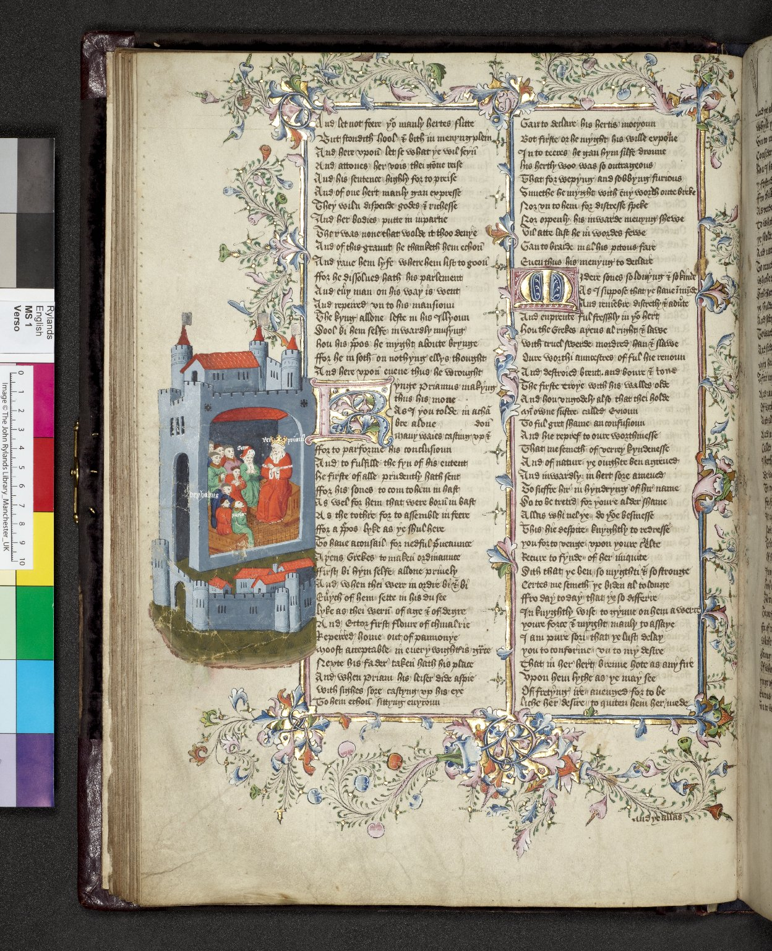
-------------
Image1
-------------
Field Data
Image Number JRL0926978dc
Reference Number English MS 1
Link to Catalogue <A href=https://www.librarysearch.manchester.ac.uk/primo-explore/fulldisplay?docid=44MAN_ELGAR_DSgb133engms1&context=L&vid=MU_NUI&search_scope=BLENDED&tab=local&lang=en_US>UoM online catalogue.</a>
Image Title Priam sends for his sons
Parent Work Title Siege of Troy
Alternative Parent Work Title Sege of Troy
Creator Lydgate, John, 1370?-1451?
Creator Role Author
Display Creator Lydgate, John, 1370?-1451?
Date Created 15th century [mid]
Page 40v
Image Sequence Number 040v
Description Siege of Troy. Book two: the Trojans agree to go to war with Greece. Priam sends for all his sons and tells then that the destruction of Troy and misuse of Hesione should be avenged. Illustrated detail in margin: Priam's council with his sons and others. There is a floriated, illuminated full border and two illuminated initials in the text. The illustration has been identified as being painted by an artist stylistically close to William Abell, an important mid-fifteenth English illuminator. The written space is 305 x 200 mm, 2 columns and 44 lines and the script is anglicana formata by two hands.
Language Code enm-GB
Subject Troy (Extinct city)--History
Subject Mythology, Greek--Poetry
Subject Trojan War
Subject Poetry, Medieval
Subject Mythology, Greek, in literature
Subject Literature, Medieval
Subject Literature, Medieval--Manuscripts
Subject English literature
Subject English literature--Manuscripts
Category of Material Manuscripts
Sub-Category Codex
Sub-Category Miniatures (paintings)
Technique Used Handwriting
Technique Used Illumination (image-making process)
Medium Ink
Support Vellum
Time Period Covered 1500 - 750 BCE
Places Covered Turkey: Marmara: Çanakkale: Troy
People Covered Hesione (Greek mythology)
People Covered Lydgate, John, 1370?-1451?
People Covered Priam (Greek mythology)
Item Height 451 mm
Item Width 326 mm
Current Repository John Rylands University Library, The University of Manchester, U.K.
Provenance Lindsay family Earls of Crawford and Balcarres, former owner
Provenance Perkins, Henry
Provenance Sykes, Mark Masterson, Sir
Provenance Dent, John
Provenance Mundy family of Markeaton Hall, Derbyshire.
Provenance Morgan, Hugh, of Monmouth in the marches of Walys
Provenance Carent family
Rights Holder - Image The University of Manchester Library
Rights holder - Work The University of Manchester Library
Access Rights <a rel="license" href="http://creativecommons.org/licenses/by-nc-sa/4.0/"><img alt="Creative Commons License" style="border-width:0" src="https://i.creativecommons.org/l/by-nc-sa/4.0/88x31.png" /></a>
References Bergen, Henry, 'Lydgate's Troy book. A.D. 1412-20 edited from the best manuscripts, with introduction, notes, and glossary.' (London: Pub. for the Early English Text Society, by K. Paul, Trench, Trübner & Co., 1906-35.)
References Parts of this catalogue have been reproduced from Ker, N.R., 'Medieval manuscripts in British libraries, vol. III, Lampeter-Oxford' (Oxford: Clarendon Press, 1983), pp. 338-9. By kind permission of Oxford University Press
References Tyson, Moses, 'Hand-List of the Collection of English Manuscripts in the John Rylands Library' (1928), p.7.
Notes Purchased by Lord Crawford from London bookseller Bernard Quaritch.
Date Captured (yyyy-mm-dd) 2009-07-06
Multi Page Number 430
Image Creation Technique Digital capture by Heritage Imaging, The University of Manchester Library
Date Image Added (yyyy-mm) 2009-09
Metadata Language eng-GB

Slide 2
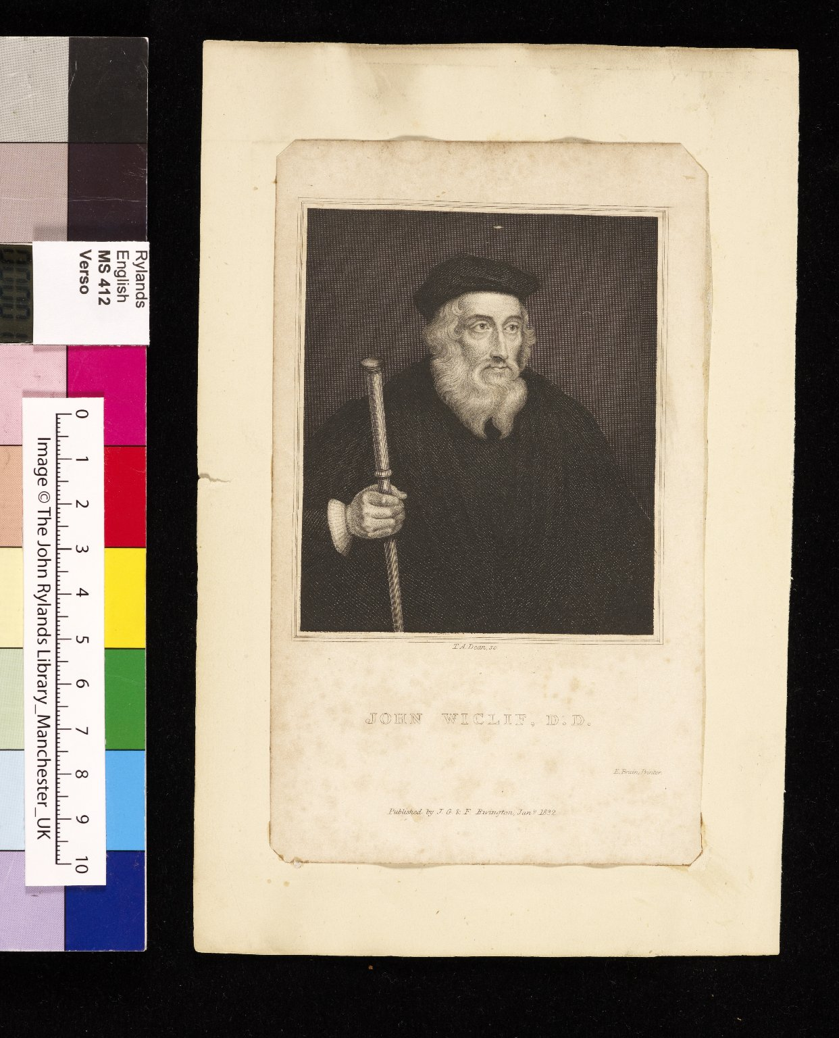
-------------
Image1
-------------
Field Data
Image Number JRL0911335dc
Reference Number English MS 412
Link to Catalogue <A href=http://man-fe.hosted.exlibrisgroup.com/MU_VU1:BLENDED:44MAN_ELGAR_DSgb133engmss412-413>UoM online catalogue.</a>
Image Title Endpaper
Alternative Image Title John Wycliffe
Parent Work Title Pore Caitif
Alternative Parent Work Title Pore Catiiff
Alternative Parent Work Title Poore Caitiff
Translated Parent Work Title Poor Wretch
Creator Rivington, J.G. & F.
Creator Role Publisher
Creator Dean, T.A.
Creator Role Artist
Creator Brain, E.
Creator Role Printer
Creator Attribution Wycliffe, John, -1384
Display Creator Wycliffe, John, -1384
Date Created 15th century [c.1400]
Image Sequence Number 001d
Description Endpaper: tipped in is a printed plate of John Wycliffe dated 1832.
Language Code eng-GB
Subject Christianity
Subject Religion
Category of Material Manuscripts
Sub-Category Codex
Sub-Category Portrait
Technique Used Engraving
Technique Used Printing (process)
Medium Ink
Support Paper
Time Period Covered 1200 - 1500 CE
People Covered Wycliffe, John, -1384
Item Height 204 mm
Item Width 141 mm
Current Repository The University of Manchester Library, U.K.
Provenance Percy, Thomas, Bishop of Dromore (there are notes in his hand on folio 1).
Provenance Stow, John (identified by Ker).
Provenance Wake, Henry Thomas, Quaker bookseller of Fritchley near Derby.
Provenance Green, Joseph Joshua
Rights Holder - Image The University of Manchester Library
Rights holder - Work The University of Manchester Library
Cost Purchased by the John Rylands Library from Mrs E. Green on 17 January 1927 for £10.00.
Date Captured (yyyy-mm-dd) 2009-03-04
Multi Page Number 20
Image Creation Technique Digital capture by Heritage Imaging, The University of Manchester Library
Date Image Added (yyyy-mm) 2009-06
Metadata Language eng-GB

