Slide 1
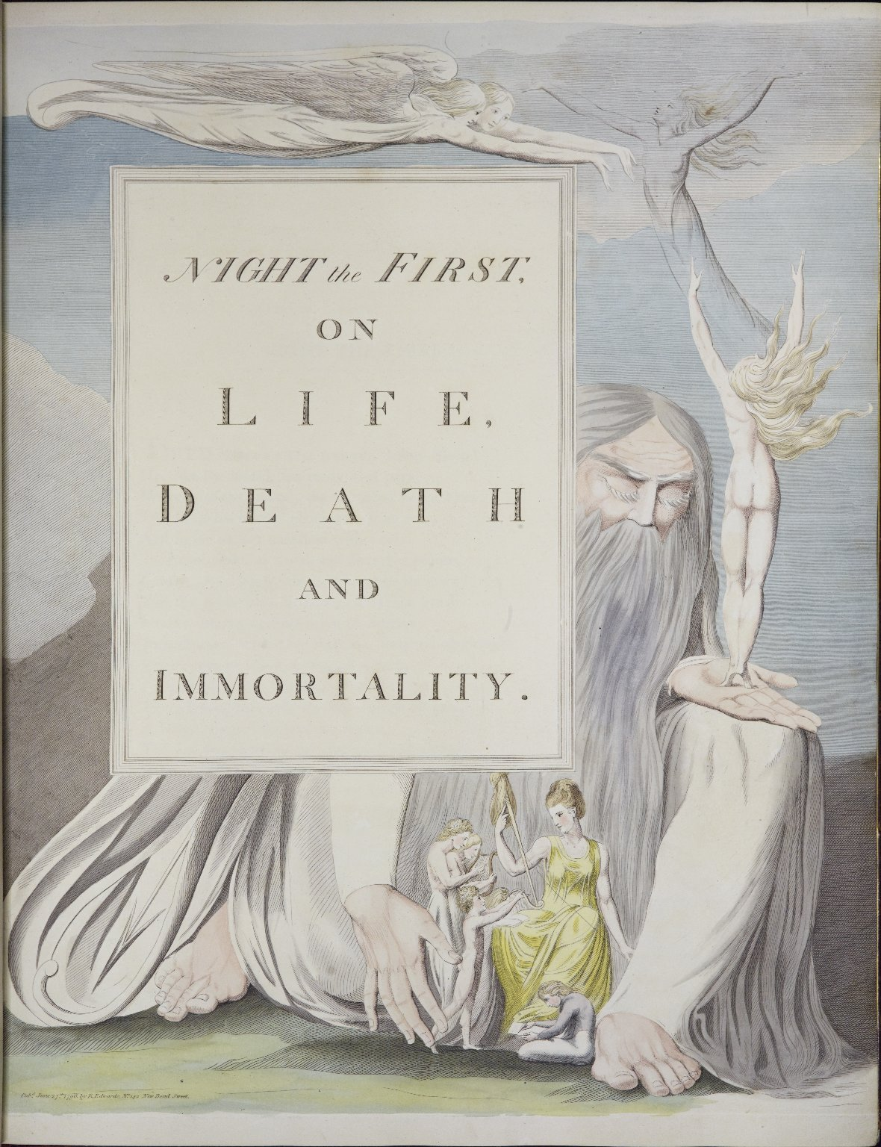
-------------
Image1
-------------
Field Data
Image Number JRL1215513
Reference Number Spencer 16123
Link to Catalogue <A href=http://man-fe.hosted.exlibrisgroup.com/MU_VU1:BLENDED:44MAN_ALMA_DS21171731320001631>UoM online catalogue.</a>
Image Title Night the First, on Life, Death and Immortality
Parent Work Title The complaint, and the consolation;: or, Night thoughts
Alternative Parent Work Title The complaint or night-thoughts
Alternative Parent Work Title Night thoughts
Creator Young, Edward, 1683-1765
Creator Role Author
Creator Edwards, Richard, active 1792-1801
Creator Role Editor
Creator Blake, William, 1757-1827
Creator Role Illustrator
Date Created 1797
Publication Details London: printed by R. Noble, for R. Edwards
Page/Sheet xiii
Image Sequence Number 000s
Description Frontispiece to Night the First: Death in the character of an old man, having swept away with one hand part of the family seen in this print, is presenting with the other their spirits to immortality. The engraving has been hand coloured by William Blake.
Language Code eng-GB
Subject English literature
Subject Poetry
Category of Material Printed
Sub-Category Illustrated works
Technique Used Painting (image-making)
Technique Used Engraving (printing process)
Medium Watercolour (paint)
Support Paper
Item Height Opening: 423 mm
Item Width Opening: 640 mm
Current Repository The University of Manchester Library, U.K.
Provenance Spencer, George John Spencer, Earl, 1758-1834, former owner
Rights Holder - Image The University of Manchester Library
Rights holder - Work The University of Manchester Library
Access Rights <a rel="license" href="http://creativecommons.org/licenses/by-nc-sa/4.0/"><img alt="Creative Commons License" style="border-width:0" src="https://i.creativecommons.org/l/by-nc-sa/4.0/88x31.png" /></a><br />This work is licensed under a <a rel="license" href="http://creativecommons.org/licenses/by-nc-sa/4.0/">Creative Commons Attribution-NonCommercial-ShareAlike 4.0 International License.</a> Copyright of The University of Manchester
Bibliographic Citation Young, Edward, 'The complaint, and the consolation; or, Night thoughts' (London: printed by R. Noble, for R. Edwards, 1797)
Date Captured (yyyy-mm-dd) 2012-03-19
Multi Page Number 95
Image Creation Technique Digital capture by Heritage Imaging, The University of Manchester Library
Date Image Added (yyyy-mm) 2012-06
Metadata Language eng-GB

