Slide 1
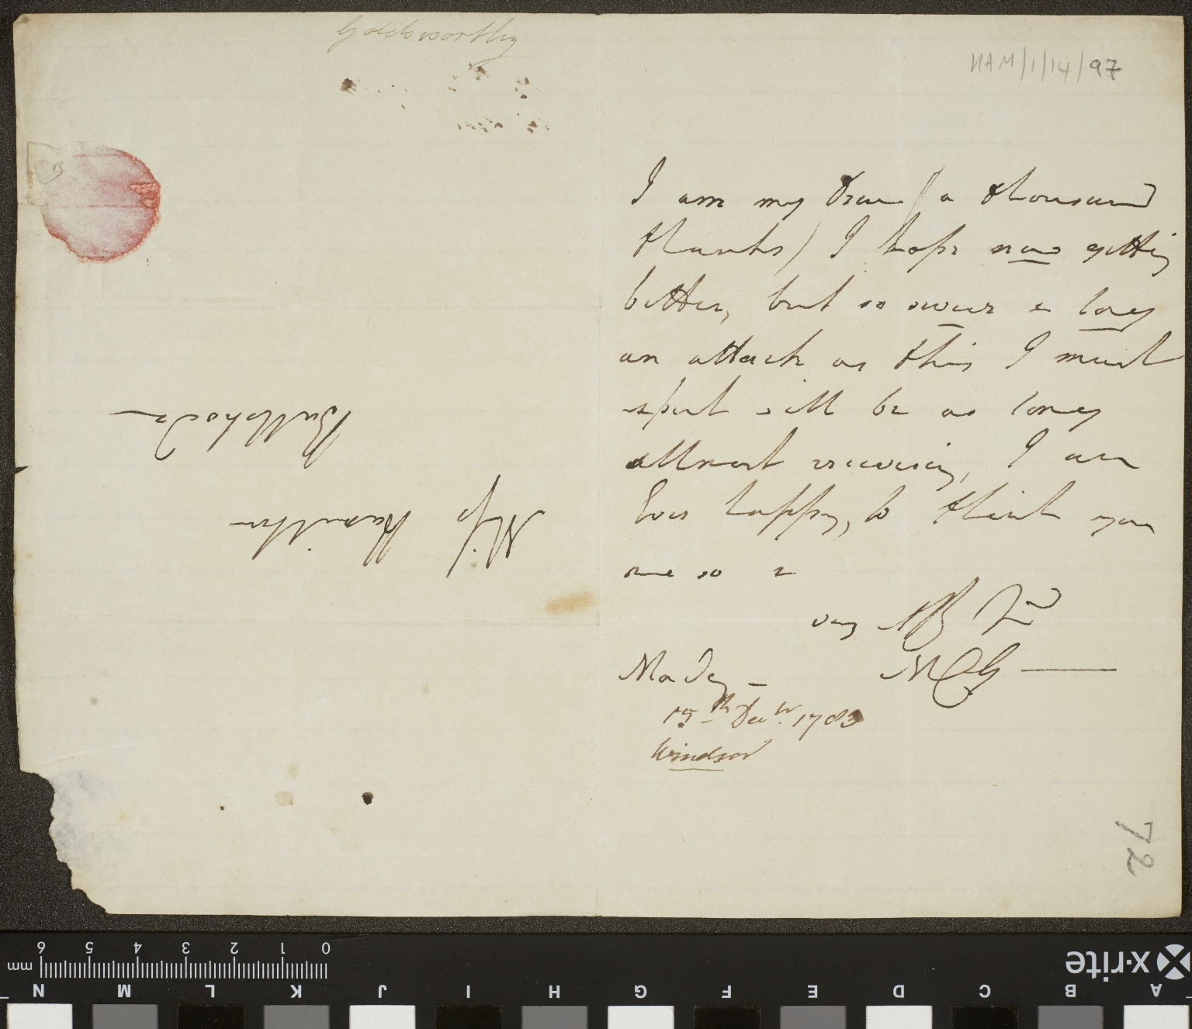
-------------
Image1
-------------
Field Data
Image Number JRL15070240
Reference Number HAM/1/14/97
Link to Catalogue <A href="https://www.librarysearch.manchester.ac.uk/discovery/fulldisplay?docid=alma992976139180301631&context=L&vid=44MAN_INST:MU_NUI&search_scope=MyInst_and_CI&tab=Everything&lang=en">Mary Hamilton Papers</a>
Series Title Correspondence from Martha Carolina Goldsworthy
Parent Work Title Letter from Martha Carolina Goldsworthy to Mary Hamilton
Creator Goldsworthy, Martha Carolina
Creator Role Author
Date Created 1783-12-15
Description Goldsworthy is feeling quite better but with such a long attack of illness as she has had she must expect a long recovery. She sends a ‘thousand thanks’ to Hamilton.
Language Code eng-GB
Language English
Subject Great Britain--Social life and customs
Subject Letters
Category of Material Archives
Sub-Category Correspondence
Technique Used Handwriting
Medium Ink
Support Paper
Time Period Covered 18th Century CE
People Covered Hamilton, Mary, 1756-1816
Current Repository The University of Manchester Library, U.K.
Rights Holder - Image The University of Manchester Library
Rights Holder - Work Copyright restrictions may apply
Image Creation Technique Digital capture by The University of Manchester Library
Date Captured (yyyy-mm-dd) 13/07/2015
Access Rights <a rel="license" href="http://creativecommons.org/licenses/by-nc-sa/4.0/"><img alt="Creative Commons License" style="border-width:0" src="https://i.creativecommons.org/l/by-nc-sa/4.0/88x31.png"></a>
Metadata Schema eng-GB
Collection Code Mary Hamilton Papers

Slide 2
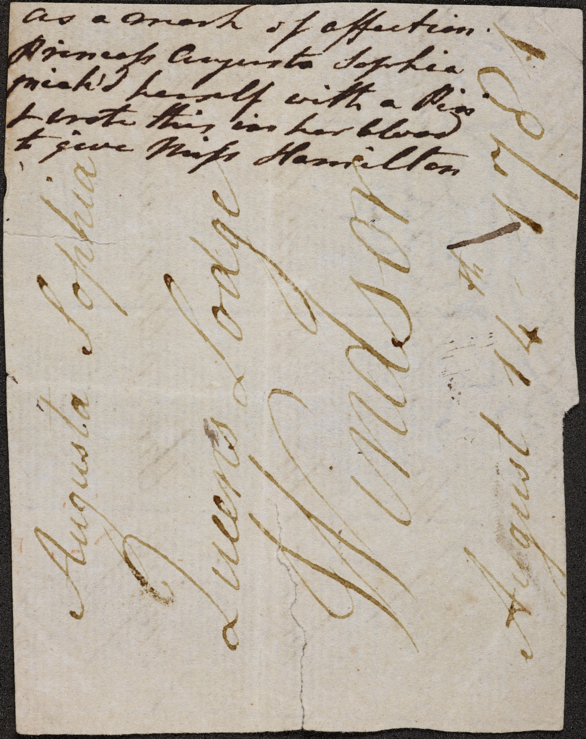
-------------
Image1
-------------
Field Data
Image Number JRL1313192
Reference Number HAM/1/1/4/30
Link to Catalogue <A href="https://www.librarysearch.manchester.ac.uk/discovery/fulldisplay?docid=alma992976139180301631&context=L&vid=44MAN_INST:MU_NUI&search_scope=MyInst_and_CI&tab=Everything&lang=en">Mary Hamilton Papers</a>
Series Title Correspondence from the Royal Family
Parent Work Title Note from Princess Augusta Sophia to Mary Hamilton
Creator Augusta Sophia, Princess, daughter of George III, King of Great Britain, 1768-1840
Creator Role Author
Date Created 1781-08-14
Description The note is written on the back of a part of a letter written in another hand. The note states that it has been written by Princess Augusta in her own blood to Hamilton as a 'mark of affection'. The note was found inside a modern envelope in the Princess Royal's file (HAM/1/1/5).
Language Code eng-GB
Language English
Subject Letters
Subject Great Britain--Court and courtiers
Category of Material Archives
Sub-Category Correspondence
Technique Used Handwriting
Medium Ink
Support Paper
Time Period Covered 18th Century CE
Current Repository The University of Manchester Library, U.K.
Rights Holder - Image The University of Manchester Library
Rights Holder - Work Copyright restrictions may apply
Date Captured (yyyy-mm-dd) 2013-07-04
Image Creation Technique Digital capture by The University of Manchester Library
Access Rights <a rel="license" href="http://creativecommons.org/licenses/by-nc-sa/4.0/"><img alt="Creative Commons License" style="border-width:0" src="https://i.creativecommons.org/l/by-nc-sa/4.0/88x31.png"></a>
Date Image Added (yyyy-mm) 2016-03
Metadata Language eng-GB
Collection Code Mary Hamilton Papers

Slide 3
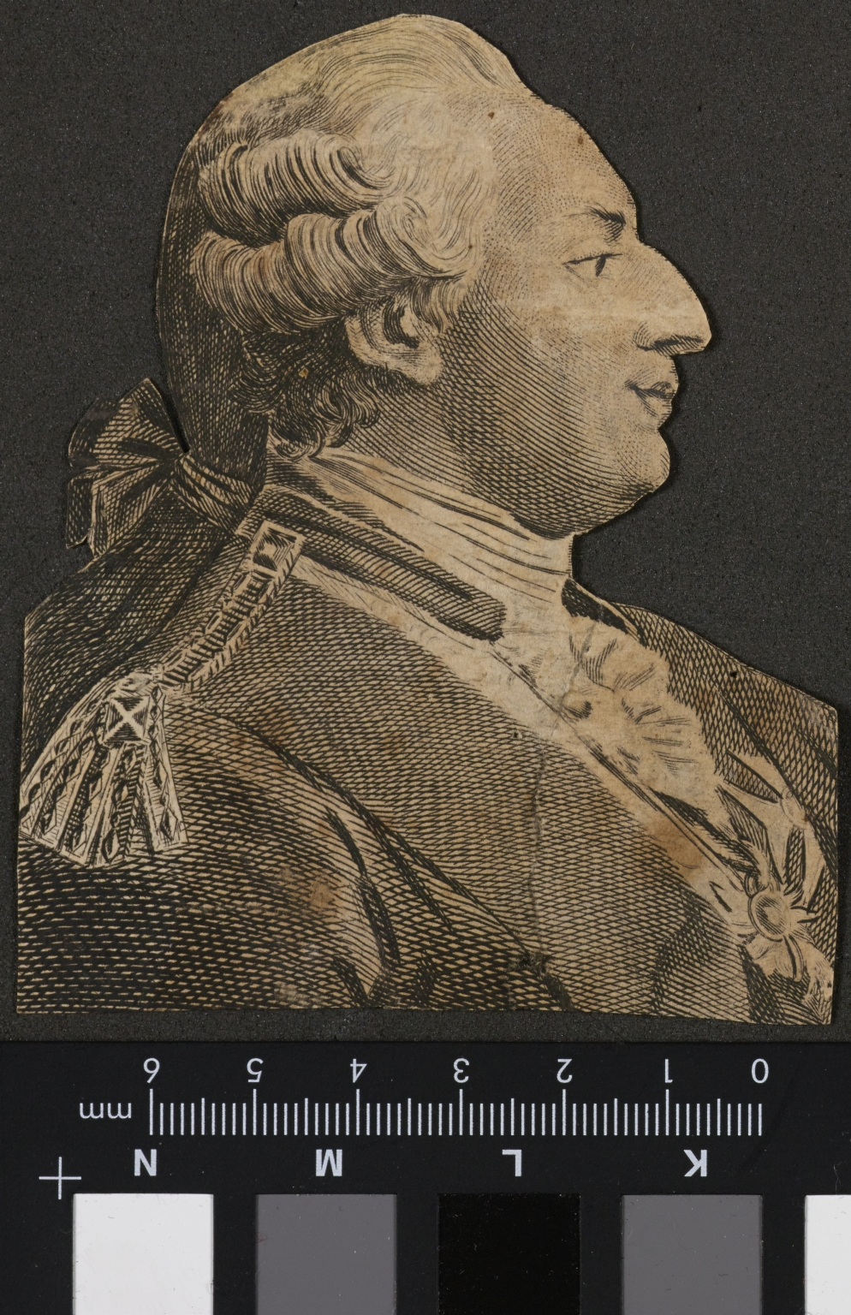
-------------
Image1
-------------
Field Data
Image Number JRL1415099
Reference Number HAM/1/1/2/11
Link to Catalogue <A href="https://www.librarysearch.manchester.ac.uk/discovery/fulldisplay?docid=alma992976139180301631&context=L&vid=44MAN_INST:MU_NUI&search_scope=MyInst_and_CI&tab=Everything&lang=en">Mary Hamilton Papers</a>
Image Title Printed Illustration of George III
Series Title Correspondence from the Royal Family
Date Created c1780
Description A printed illustration of George III. The image is in profile and has been cut-out of a newspaper or other publication.
Language Code eng-GB
Language English
Subject Great Britain--Court and courtiers
Category of Material Archives
Sub-Category Portraits
Technique Used Printing
Support Paper
Time Period Covered 18th Century CE
People Covered George III, King of Great Britain, 1738-1820
Current Repository The University of Manchester Library, U.K.
Rights Holder - Image The University of Manchester Library
Rights Holder - Work Copyright restrictions may apply
Date Captured (yyyy-mm-dd) 2014-06-26
Image Creation Technique Digital capture by The University of Manchester Library
Access Rights <a rel="license" href="http://creativecommons.org/licenses/by-nc-sa/4.0/"><img alt="Creative Commons License" style="border-width:0" src="https://i.creativecommons.org/l/by-nc-sa/4.0/88x31.png"></a>
Date Image Added (yyyy-mm) 2014-07
Metadata Language eng-GB
Collection Code Mary Hamilton Collection

Slide 4
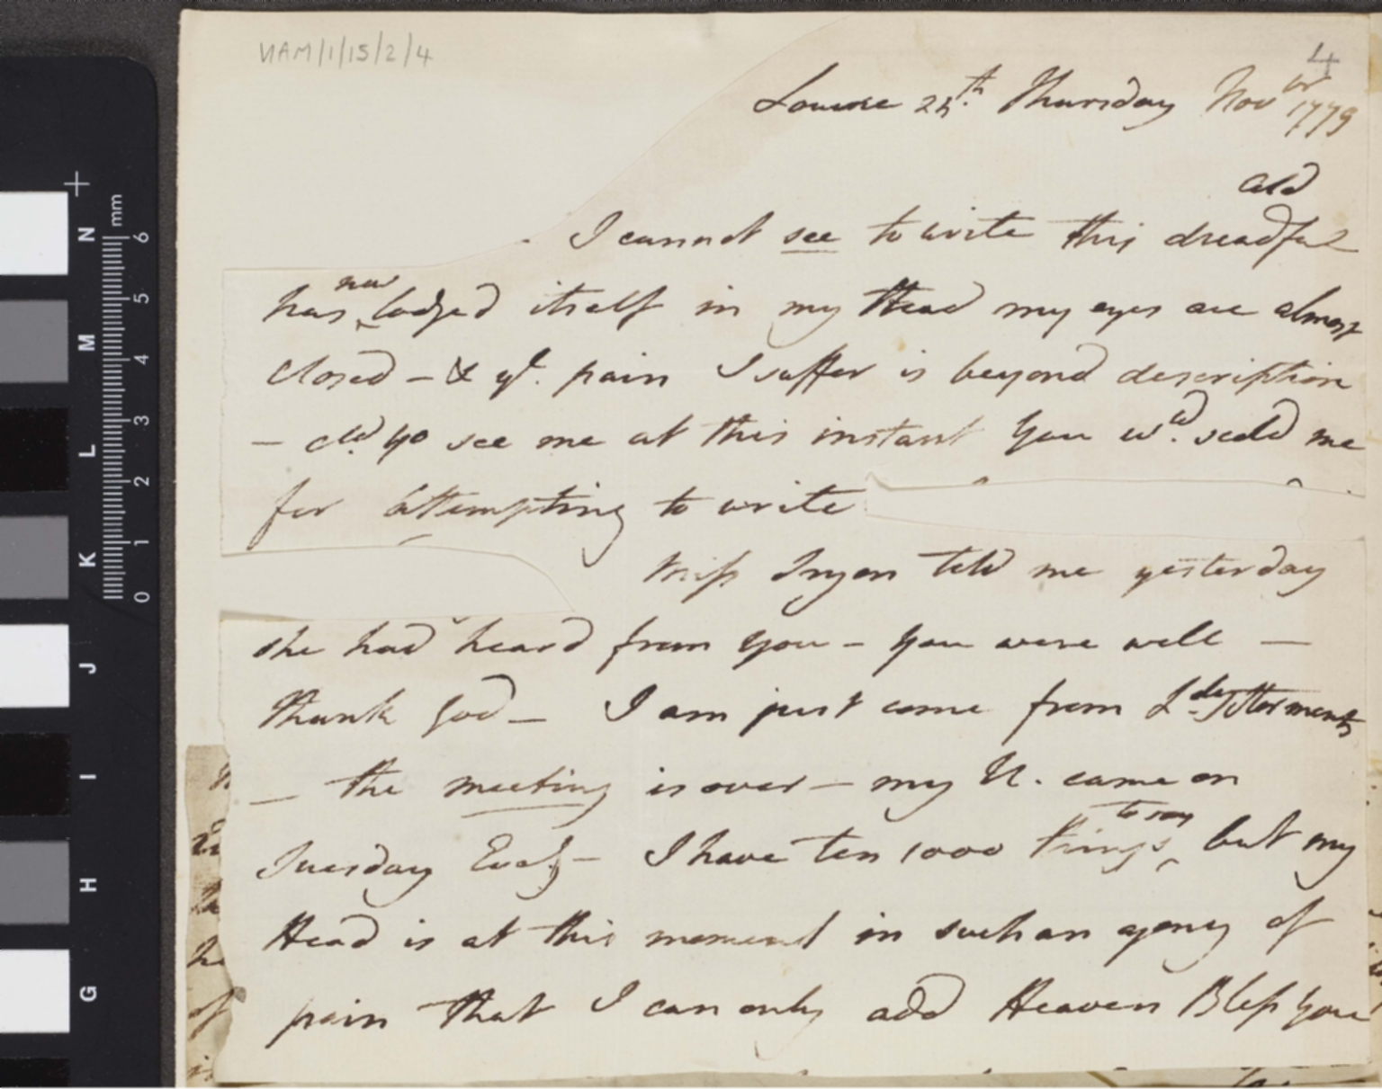
-------------
Image1
-------------
Field Data
Image Number HAM_1_15_2_4.pdf
Reference Number HAM/1/15/2/4
Link to Catalogue <A href="https://www.librarysearch.manchester.ac.uk/discovery/fulldisplay?docid=alma992976139180301631&context=L&vid=44MAN_INST:MU_NUI&search_scope=MyInst_and_CI&tab=Everything&lang=en">Mary Hamilton Papers</a>
Series Title Correspondence from Mary Hamilton to Charlotte Margaret Gunning
Parent Work Title Notes from Mary Hamilton to Charlotte Margaret Gunning
Creator Hamilton, Mary, 1756-1816
Creator Role Author
Date Created c1779
Description In the first note (25 November 1779) Hamilton writes on her poor health. She is ill with a cold which has affected her eyes which have almost closed and she is finding it difficult for her to write. Hamilton writes that she has much to do but because of the pain that she is in is unable to do. The second note is dated December. Hamilton writes that it was her duty to wait (upon the Royal family) and that the Queen was more 'than usually kind'. She also notes that a 'Mr J' continues to torment her and has sent her a present which she has returned. The third note (21 May 1780) Hamilton writes that Gunning's note has raised and that she will write a type of journal for Gunning and that she expects the same from Gunning. The final note (10 August 1780) is incomplete. Hamilton has not time enough to write Gunning a long letter but forwards her one she has written to 'LW' [Lady Wake?] for her to read. In it she notes that she has outlines how she spends her day and writes that it will please Gunning 'to follow me through the day'.
Language Code eng-GB
Subject Great Britain--Social life and customs
Subject Letters
Category of Material Archives
Sub-Category Correspondence
Technique Used Handwriting
Medium Ink
Support Paper
Time Period Covered 18th Century CE
People Covered Hamilton, Mary, 1756-1816
People Covered Charlotte, Queen, consort of George III, King of Great Britain, 1744-1818
Current Repository The University of Manchester Library, U.K.
Rights Holder - Image The University of Manchester Library
Rights Holder - Work Copyright restrictions may apply
Notes Four notes have been pasted on to one sheet.
Date Captured (yyyy-mm-dd) 2014-07-27
Image Creation Technique Digital capture by The University of Manchester Library
Access Rights <a rel="license" href="http://creativecommons.org/licenses/by-nc-sa/4.0/"><img alt="Creative Commons License" style="border-width:0" src="https://i.creativecommons.org/l/by-nc-sa/4.0/88x31.png"></a>
Date Image Added (yyyy-mm) 2014-07
Metadata Language eng-GB
Collection Code Mary Hamilton Collection

