Slide 2
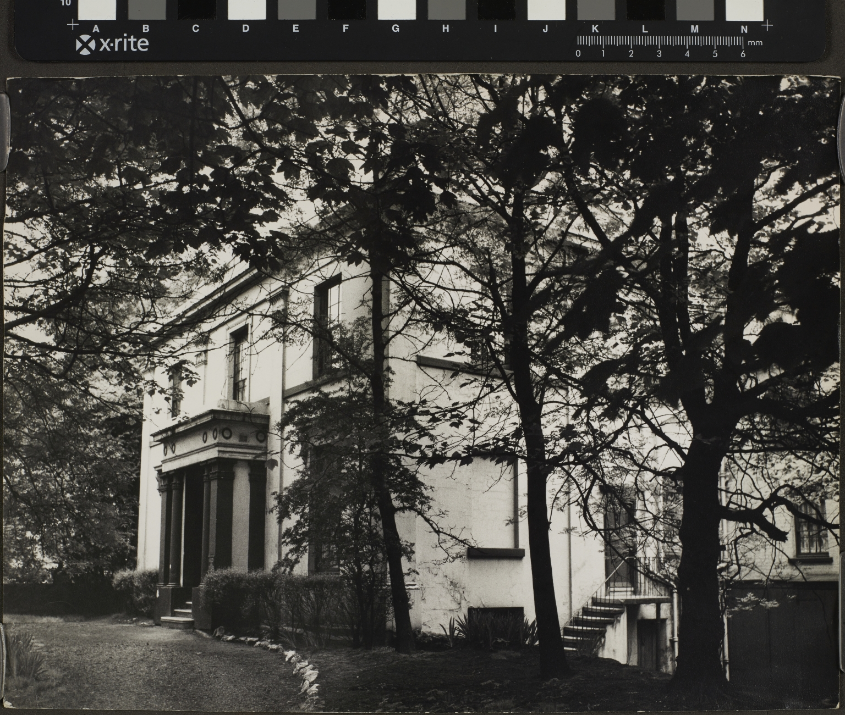
-------------
Image1
-------------
Field Data
Image Number JRL1416613
Reference Number VCA/7/610, folder 6
Image Title Plymouth Grove
Parent Work Title University of Manchester, Vice-Chancellor's Archive
Creator Arron, Michael
Creator Role Photographer
Date Created 1968
Description Photograph of Plymouth Grove in 1968.
Category of Material Archives
Sub-Category Analogue photography
Support Paper
Creation Site England: Greater Manchester: Manchester
Time Period Covered 20th Century CE
People Covered Gaskell, Elizabeth Cleghorn, 1810-1865
Rights Holder - Image The University of Manchester Library
Rights holder - Work The University of Manchester Library
Access Rights <a rel="license" href="http://creativecommons.org/licenses/by-nc-sa/4.0/"><img alt="Creative Commons License" style="border-width:0" src="https://i.creativecommons.org/l/by-nc-sa/4.0/88x31.png"></a>

Slide 3
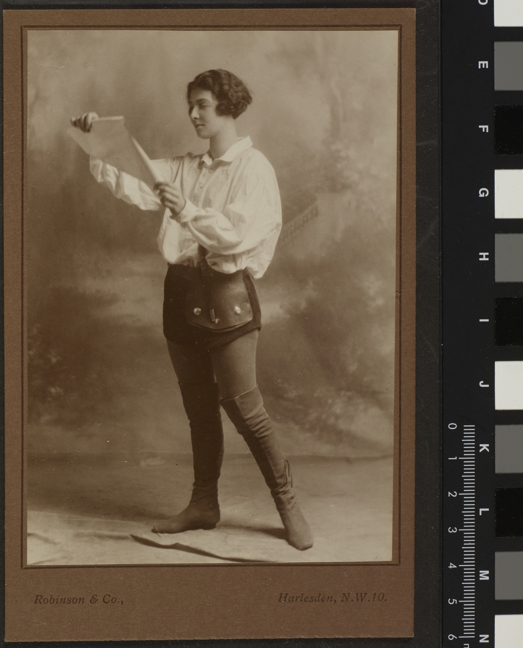
-------------
Image1
-------------
Field Data
Image Number JRL1416608
Reference Number JGS Box 30/1
Image Title Posed photograph of a woman
Parent Work Title Papers of J G Sharps
Creator Robinson & Co. Harlesden N.W.
Creator Role Photographer
Date Created [date not identified]
Description Woman in pose, possibly Constance Harper, wearing blouse and knee high boots. The Harper family resided in Plymouth Grove after the Gaskell family.
Category of Material Archives
Sub-Category Portraits
Support Paper
Time Period Covered 20th Century CE
Rights Holder - Image The University of Manchester Library
Rights holder - Work IPR restrictions may apply

