Slide 1
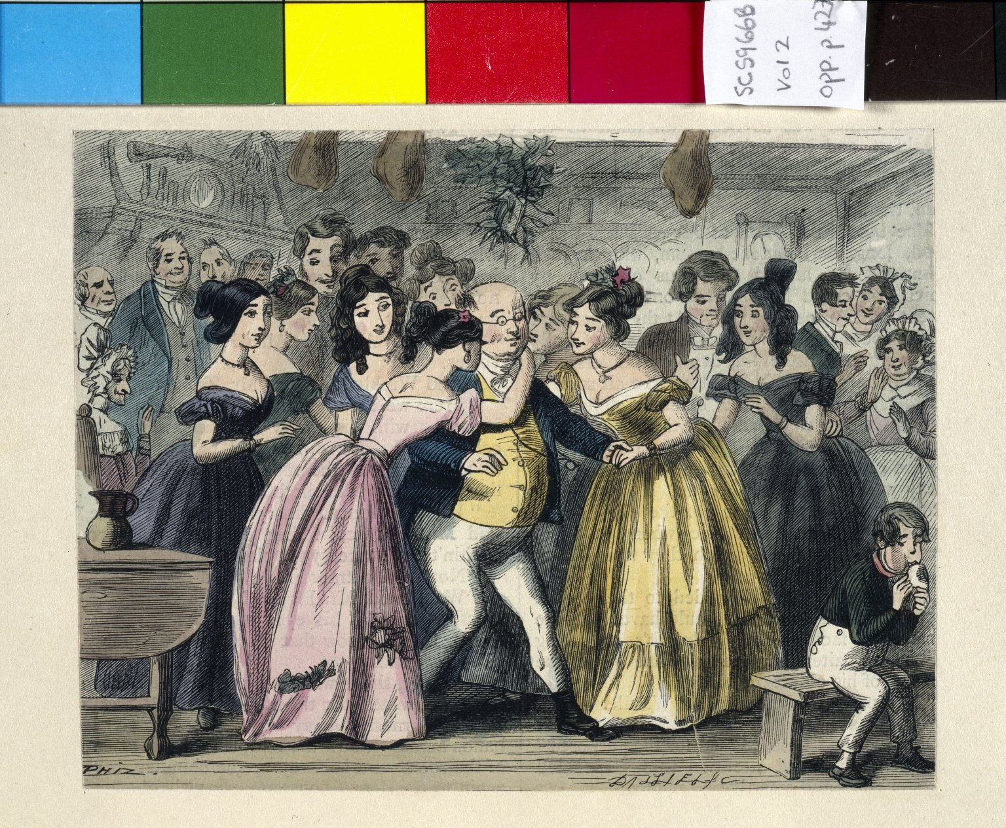
-------------
Image1
-------------
Field Data
Image Number JRL022554tr
Reference Number SC5966B
Link to Catalogue <A href=http://man-fe.hosted.exlibrisgroup.com/MU_VU1:BLENDED:44MAN_ALMA_DS21172150250001631>UoM online catalogue.</a>
Image Title Mr Wardle's Christmas Party
Parent Work Title Posthumous papers of the Pickwick Club
Alternative Parent Work Title Pickwick Papers
Creator Leech, John
Creator Role Illustrator
Creator Dickens, Charles, 1812-1870
Creator Role Author
Creator Seymour, Robert, 1798-1836
Creator Role Illustrator
Creator Buss, R. W.
Creator Role Illustrator
Creator Browne, Hablôt K. ( Phiz")
Creator Role Illustrator
Date Created 1887
Publication Details London: Chapman and Hall
Volume 2
Page/Sheet Opposite page 427
Image Sequence Number 2-427
Description Water-colour of Mr Wardle's Christmas Party.
Language Code eng-GB
Subject English literature
Category of Material Printed
Sub-Category Illustrated works
Technique Used Painting (image-making)
Medium Watercolour (paint)
Support Paper
Time Period Covered 19th Century CE
Places Covered England
Current Repository The University of Manchester Library, U.K.
Rights Holder - Image The University of Manchester Library
Rights holder - Work The University of Manchester Library
Bibliographic Citation Dickens, Charles, 'The posthumous papers of the Pickwick Club' (London: Chapman and Hall, 1887)
Image Creation Technique Scanned from colour transparency by Gten, July 2004
Metadata Language eng-GB

Slide 2
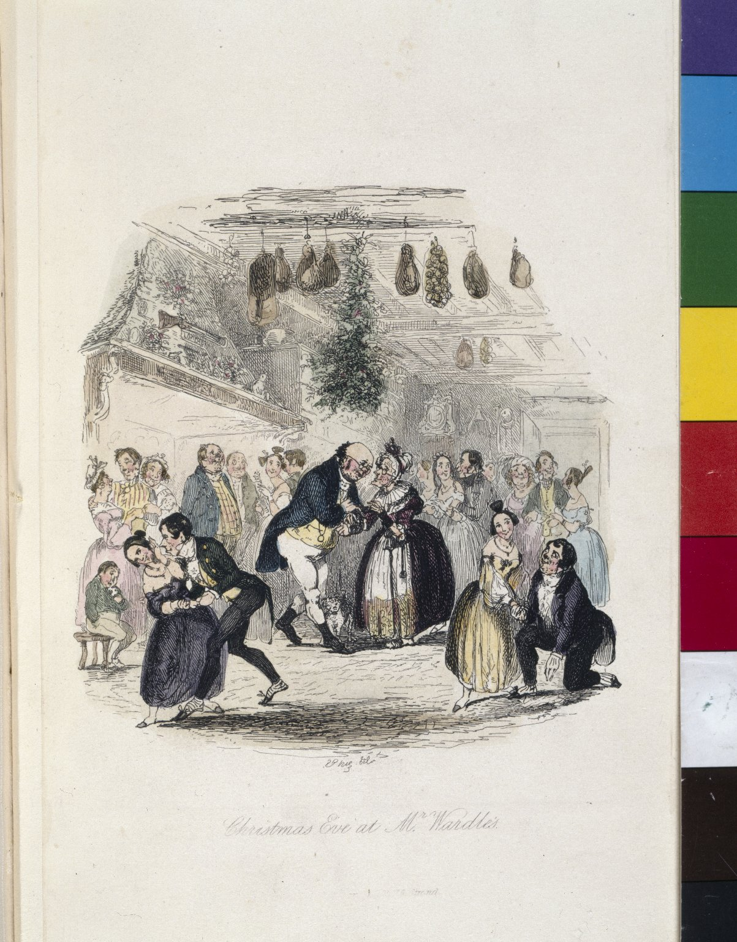
-------------
Image1
-------------
Field Data
Image Number JRL022555tr
Reference Number SC5966B
Link to Catalogue <A href=http://man-fe.hosted.exlibrisgroup.com/MU_VU1:BLENDED:44MAN_ALMA_DS21172150250001631>UoM online catalogue.</a>
Image Title Christmas Eve at Mr Wardle's
Parent Work Title Posthumous papers of the Pickwick Club
Alternative Parent Work Title Pickwick Papers
Creator Leech, John
Creator Role Illustrator
Creator Dickens, Charles, 1812-1870
Creator Role Author
Creator Seymour, Robert, 1798-1836
Creator Role Illustrator
Creator Buss, R. W.
Creator Role Illustrator
Creator Browne, Hablôt K. ( Phiz")
Creator Role Illustrator
Date Created 1887
Publication Details London: Chapman and Hall
Volume 2
Page/Sheet Frontispiece
Image Sequence Number 2-000
Description Water-colour of Christmas Eve at Mr Wardle's house
Language Code eng-GB
Subject English literature
Category of Material Printed
Sub-Category Illustrated works
Technique Used Painting (image-making)
Medium Watercolour (paint)
Support Paper
Time Period Covered 19th Century CE
Places Covered England
Current Repository The University of Manchester Library, U.K.
Rights Holder - Image The University of Manchester Library
Rights holder - Work The University of Manchester Library
Bibliographic Citation Dickens, Charles, 'The posthumous papers of the Pickwick Club' (London: Chapman and Hall, 1887)
Image Creation Technique Scanned from colour transparency by Gten, September 2004
Metadata Language eng-GB

Slide 3
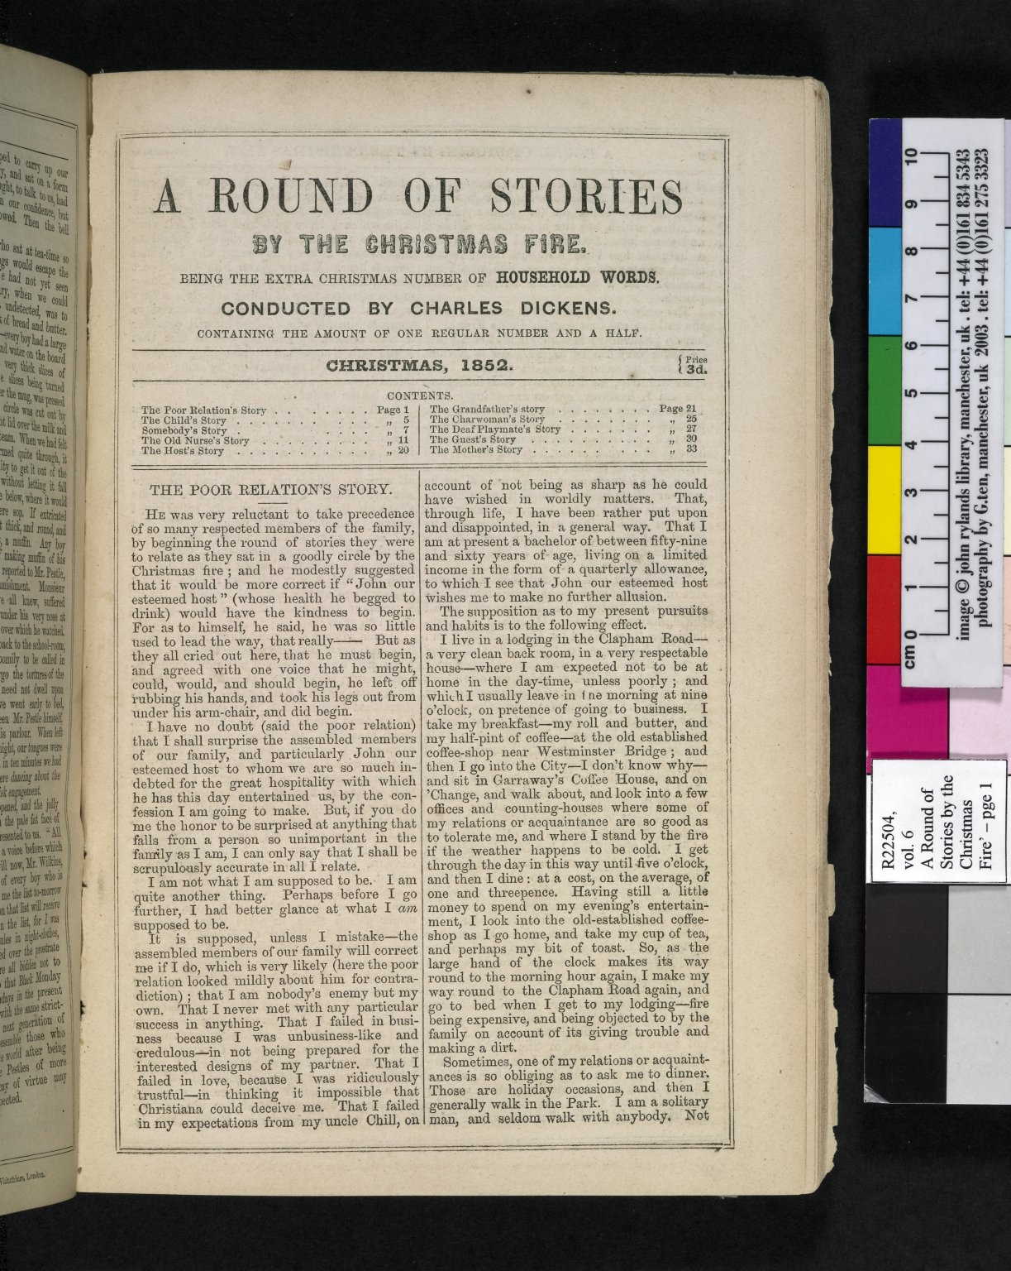
-------------
Image1
-------------
Field Data
Image Number JRL050360dc
Reference Number R22504
Link to Catalogue <A href=http://man-fe.hosted.exlibrisgroup.com/MU_VU1:BLENDED:44MAN_ALMA_DS21188917700001631>UoM online catalogue.</a>
Image Title A round of stories by the Christmas fire
Parent Work Title Household Words
Creator Dickens, Charles, 1812-1870
Creator Role Author
Date Created 1852
Publication Details London: Bradbury and Evans
Volume 6
Page/Sheet 1
Image Sequence Number 001
Description First page of 'A round of stories by the Christmas fire'.
Language Code eng-GB
Subject English literature
Category of Material Printed
Sub-Category Periodicals
Support Paper
Time Period Covered 19th Century CE
Current Repository The University of Manchester Library, U.K.
Rights Holder - Image The University of Manchester Library
Rights holder - Work The University of Manchester Library
Date Captured (yyyy-mm-dd) 2005-02-10
Image Creation Technique Digital capture by Gten
Metadata Language eng-GB

Slide 4
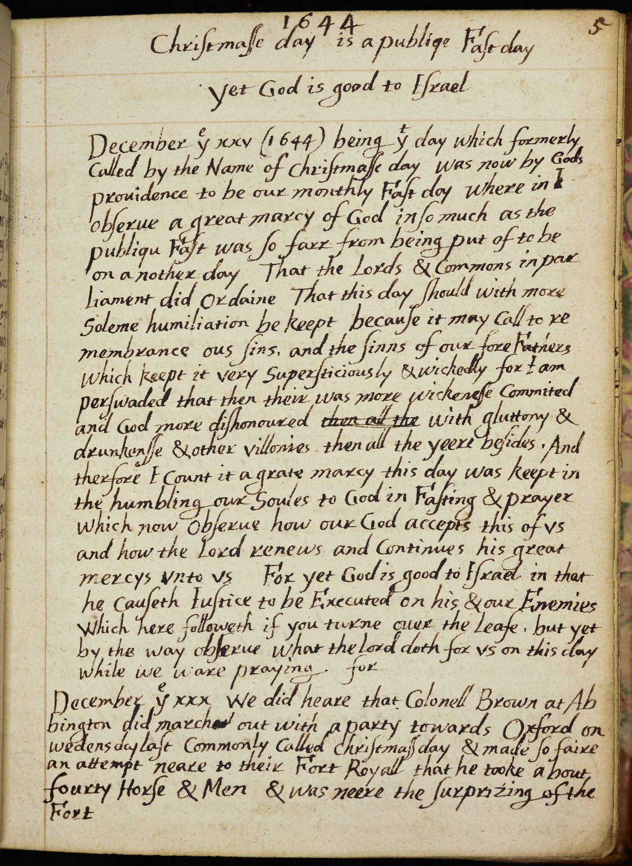
-------------
Image1
-------------
Field Data
Image Number Tatton_Wallington_023
Reference Number Tatton Park MS 68.20
Link to Catalogue <A href="http://copac.ac.uk/crn/65108619/html">COPAC online catalogue</a>
Image Title Christmas Day 1644
Parent Work Title Great marcys continued, or yet God is good to Israel
Creator Wallington, Nehemiah
Creator Role Author
Date Created 1644-1658
Page/Sheet 5
Image Sequence Number 005
Description 25 December 1644: (formerly known as Christmas Day), Colonel Brown leads a party of forty men and horses towards Oxford.
Language Code eng-GB
Subject Great Britain--History--Civil war, 1642-1649
Subject Diaries--Authorship--History--17th century
Subject Christianity
Category of Material Manuscripts
Sub-Category Diaries
Technique Used Handwriting
Medium Ink
Support Paper
Time Period Covered 17th Century CE
Places Covered England: Oxfordshire: Oxford
Item Height 211 mm
Item Width 168 mm
Item Depth 52 mm
Current Repository National Trust, Tatton Park, Cheshire
Rights Holder - Image National Trust
Rights holder - Work National Trust
References Booy, David., 'The Notebooks of Nehemiah Wallington, 1618-1654: a selection' (Aldershot, 2007), 215-234.
Notes From 1642, by order of Parliament, the last Wednesday of each month was to be a day of fasting and humiliation.
Date Captured (yyyy-mm-dd) 2010-10-18
Multi Page Number 115
Image Creation Technique Digital capture by Heritage Imaging, The University of Manchester Library
Date Image Added (yyyy-mm) 2011-02
Metadata Language eng-GB

Slide 5
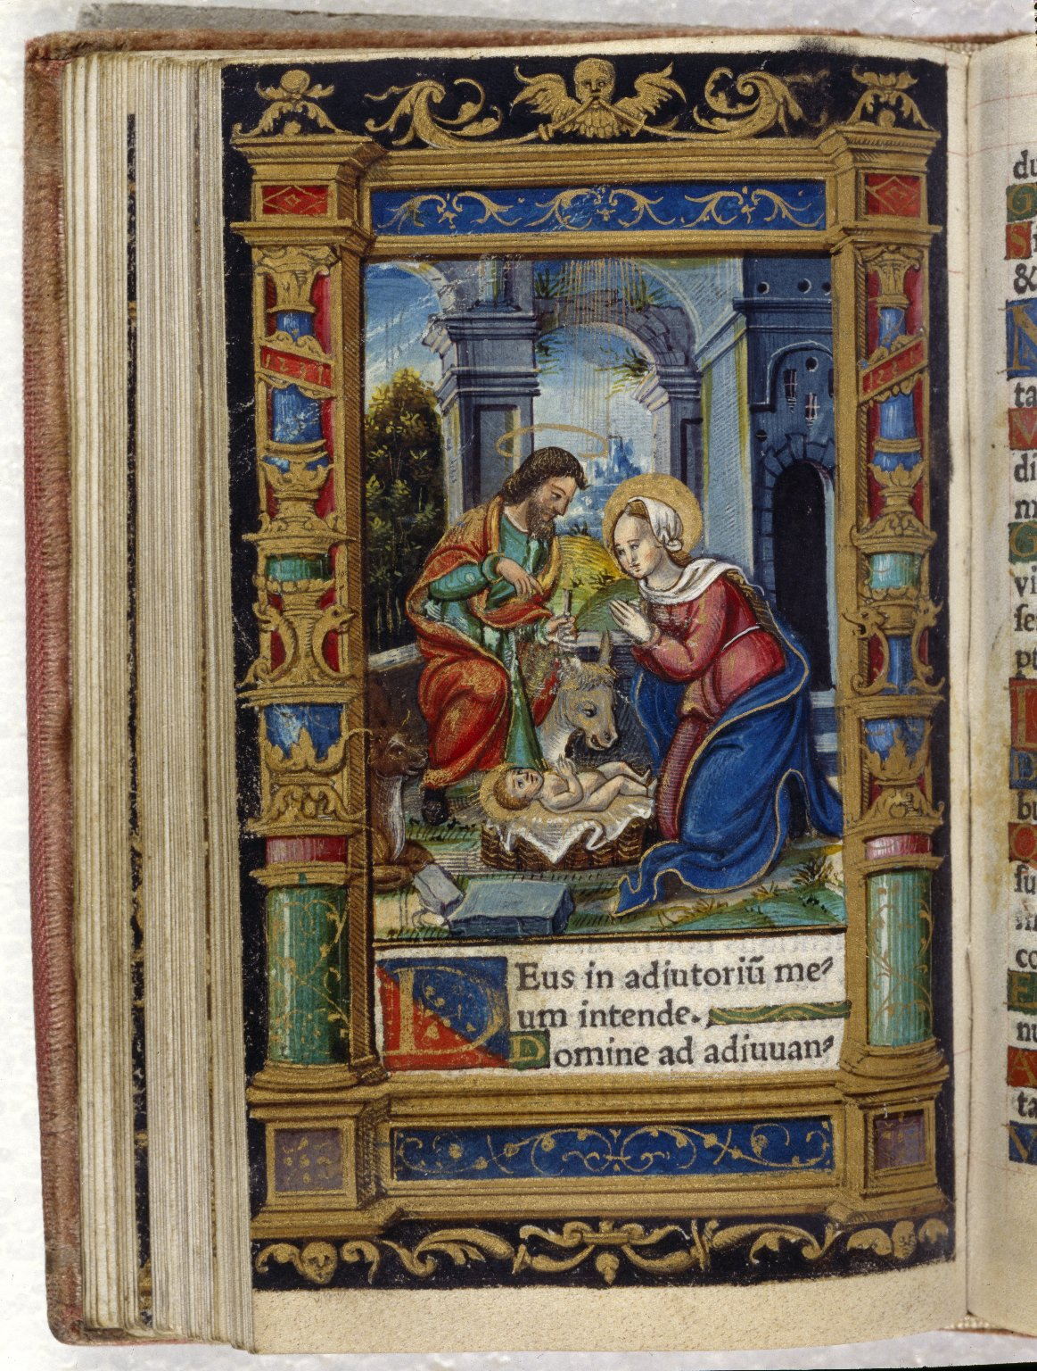
-------------
Image1
-------------
Field Data
Image Number JRL020381tr
Reference Number Aldine R14744
Link to Catalogue <A href=https://man-fe.hosted.exlibrisgroup.com/primo-explore/fulldisplay?docid=44MAN_ALMA_DS21136963760001631&context=L&vid=MU_VU1&search_scope=BLENDED&tab=local&lang=en_US>UoM online catalogue</a>
Image Title Nativity
Parent Work Title Horae in lavdem beatissimae virginis Mariae ad vsum Romanum
Translated Parent Work Title Book of Hours
Creator Catholic Church
Creator Role Author
Date Created 1529
Publication Details Venice: Aldus Manutius
Page/Sheet Opposite page 55
Image Sequence Number 055
Description Illustrated: Nativity. Full-page illustration, coloured by hand.
Language Code lat
Language Latin
Subject Catholic Church
Subject Religion
Subject Christianity
Subject Books of hours
Category of Material Printed
Support Vellum
Current Repository The University of Manchester Library, U.K.
Rights Holder - Image The University of Manchester Library
Rights holder - Work The University of Manchester Library
Image Creation Technique Scanned from colour transparency by Gten, July 2004
Metadata Language eng-GB

Slide 7
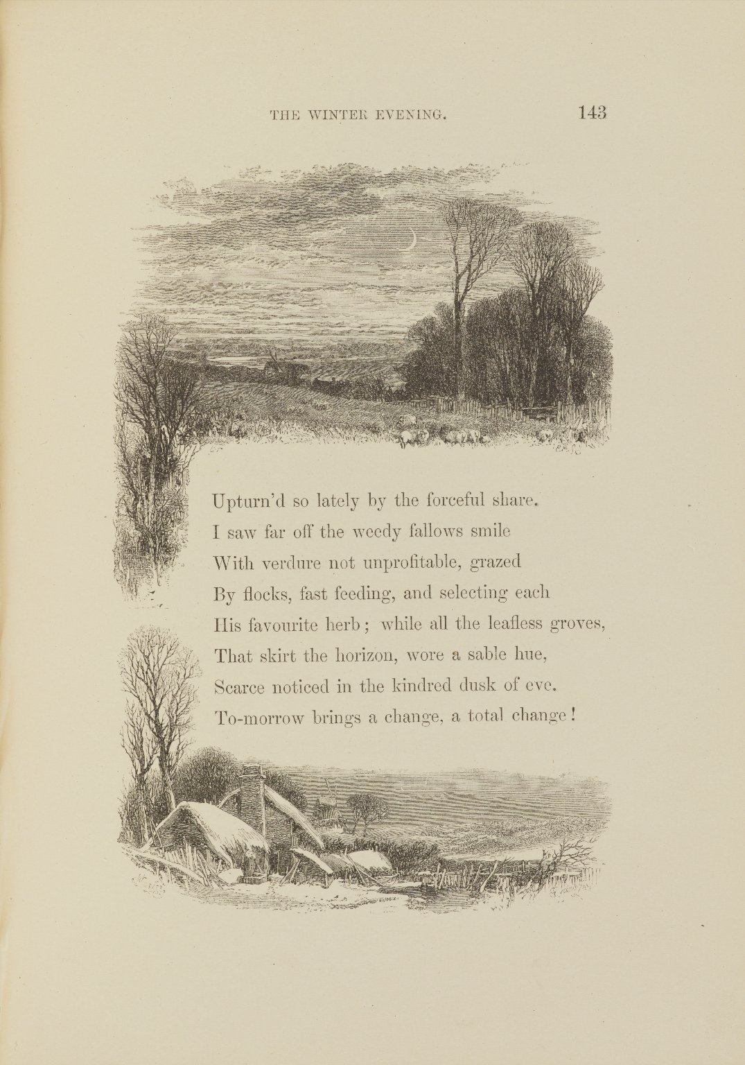
-------------
Image1
-------------
Field Data
Image Number JRL1301585
Reference Number Johnson R201763
Image Title Winter Evening
Parent Work Title The task: a poem
Creator Cowper, William, 1731-1800
Creator Role Author
Date Created 1855
Publication Details London: J. Nisbet and Co
Page/Sheet 143
Image Sequence Number 143
Description The task: a poem, engraved page from The Winter Evening.
Language Code eng-GB
Subject Poetry
Category of Material Printed
Sub-Category Illustrated works
Technique Used Engraving (printing process)
Medium Ink
Support Paper
Item Height 203 mm
Item Width 142 mm
Current Repository The University of Manchester Library, U.K.
Rights Holder - Image The University of Manchester Library
Rights holder - Work The University of Manchester Library
Date Captured (yyyy-mm-dd) 2012-10-10
Image Creation Technique Digital capture by Heritage Imaging, The University of Manchester Library
Metadata Language eng-GB

