Slide 1
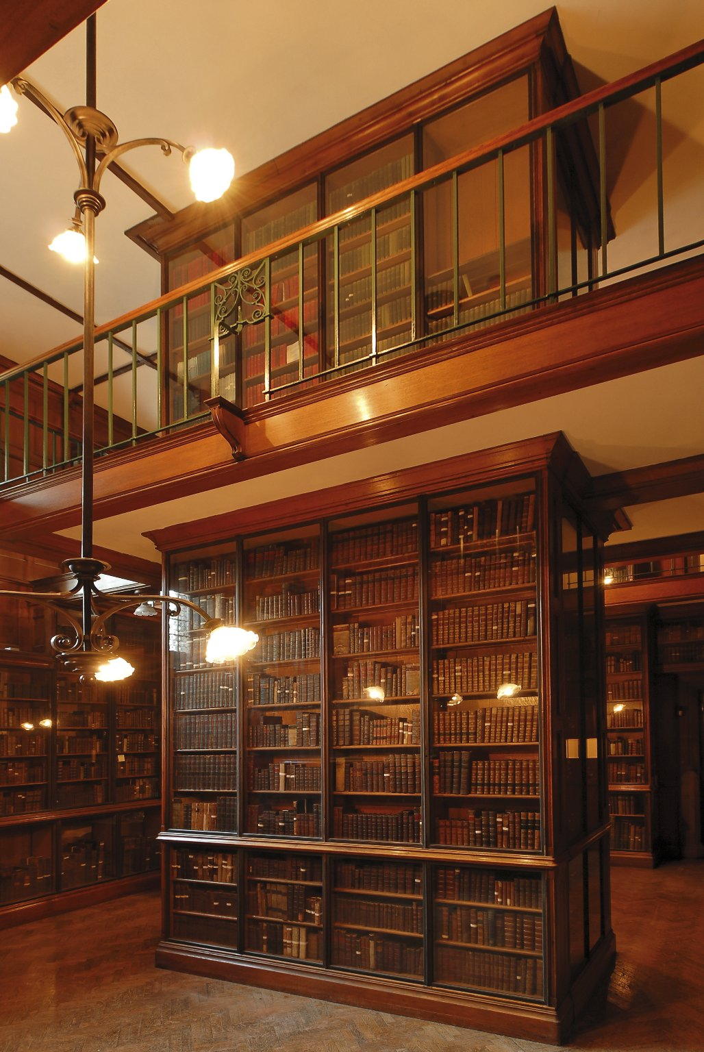
-------------
Image1
-------------
Field Data
Image Number JRL0710116dc
Image Title Spencer Room
Date Created 2007
Description Spencer Room in the John Rylands Library, Deansgate, Manchester. The woodwork is Polish oak. The Library was built by Enriqueta Augustina Rylands in memory of her husband John, a Manchester cotton millionaire. It opened to the public on 1st January 1900. The room is named after the second Earl of Spencer. The Spencer collection of printed books was one of the finest collections in private ownership. It was purchased by Mrs Rylands from the fifth Earl in 1892 and formed the core of her Library. Basil Champneys 1842-1935, architect.
Subject Architecture
Subject John Rylands Library
Subject Library buildings
Category of Material Photography
Sub-Category Digital photography
Time Period Covered 21st Century CE
Places Covered England: Greater Manchester: Manchester
Current Site The John Rylands Library, Deansgate, Manchester, U.K.
Rights Holder - Image University of Manchester Library
Rights holder - Work The University of Manchester Library
References The John Rylands Library: A Souvenir Guide (Fetherstonhaugh, 2007)
Date Captured (yyyy-mm-dd) 2007
Image Creation Technique Digital capture by Fetherstonhaugh
Date Image Added (yyyy-mm) 2007-06
Metadata Language eng-GB

Slide 2
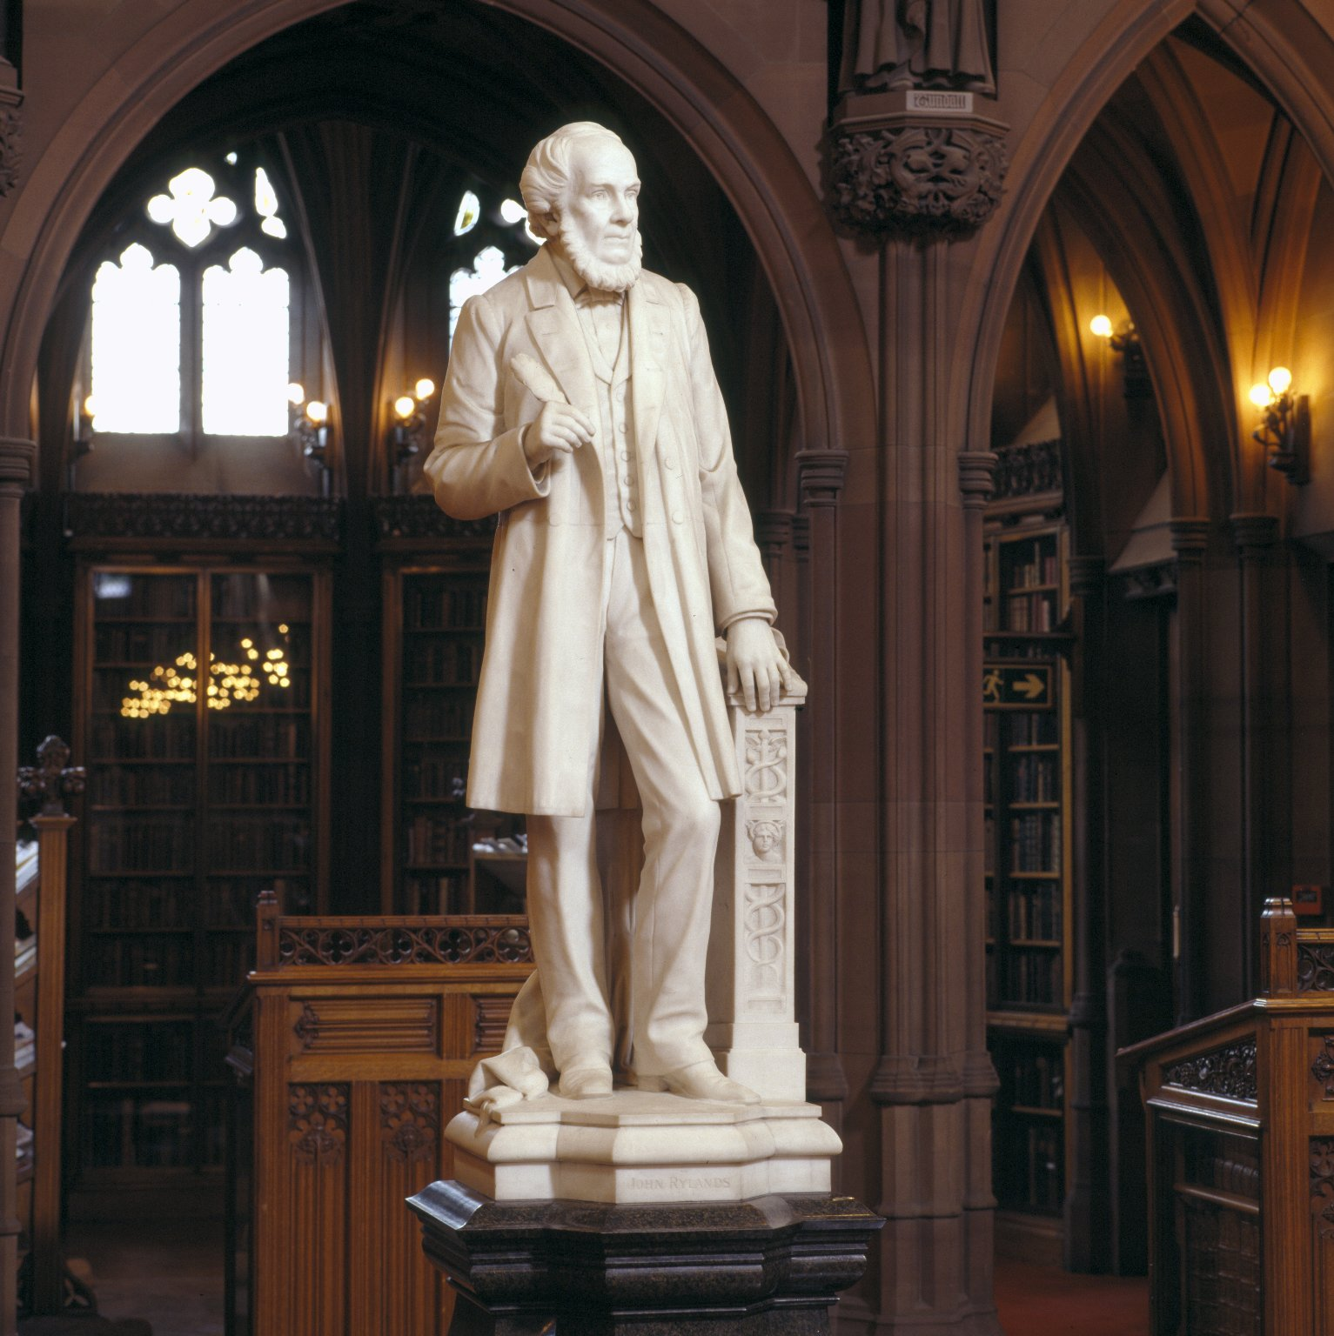
-------------
Image1
-------------
Field Data
Image Number JRL030026tr
Image Title John Rylands
Creator Cassidy, John, 1860-1939
Creator Role Sculptor
Date Created 1899
Description Statue of John Rylands in the Historic Reading Room of the John Rylands Library, Deansgate. John Rylands was a wealthy cotton magnate in Manchester. The Library was built in his memory by his wife, Enriqueta Augustina Rylands.
Subject John Rylands Library
Subject Library buildings
Subject Architecture
Sub-Category Sculpture
Technique Used Sculpting
Support Saravezza marble
Support Granite
Time Period Covered 19th Century CE
Places Covered England: Greater Manchester: Manchester
Current Site The John Rylands Library, Deansgate, Manchester, U.K.
Rights Holder - Image The University of Manchester Library
Rights holder - Work The University of Manchester Library
Access Rights <a rel="license" href="http://creativecommons.org/licenses/by-nc-sa/4.0/"><img alt="Creative Commons License" style="border-width:0" src="https://i.creativecommons.org/l/by-nc-sa/4.0/88x31.png"></a>
Image Creation Technique Scanned from colour transparency by Gten, June 2003
Metadata Language eng-GB

Slide 3
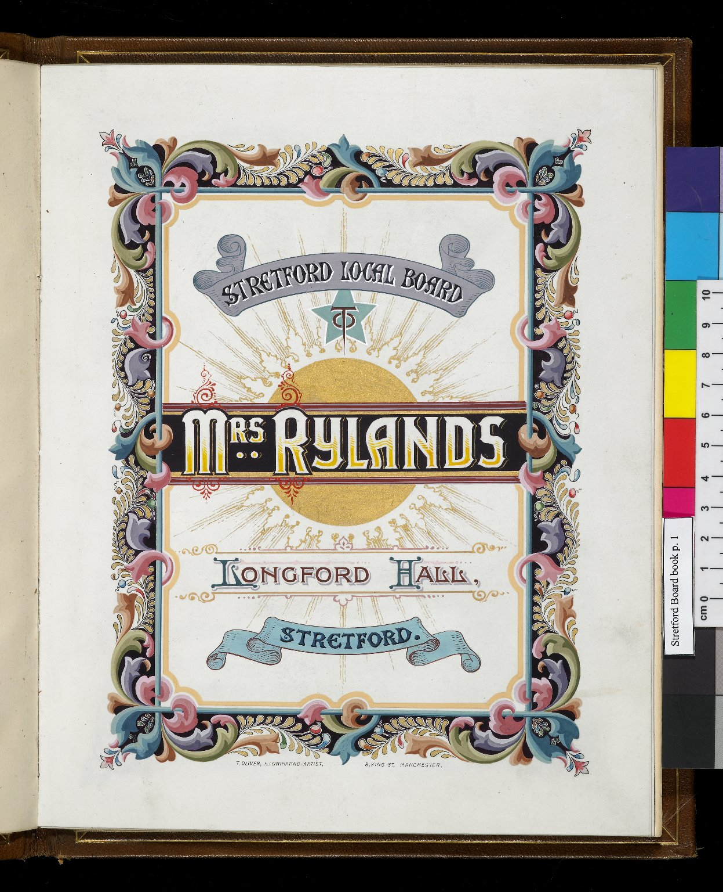
-------------
Image1
-------------
Field Data
Image Number JRL0803325dc
Reference Number RYL/2/4
Image Title Stretford Local Board Acknowledgement of Mrs Rylands
Series Title Family records ([1877]-1955)
Parent Work Title Stretford Local Board Acknowledgement of Mrs Rylands
Creator Oliver, T.
Creator Role Artist
Page/Sheet 1
Image Sequence Number 001
Description Illuminated: Stretford Local Board Acknowledgement of Mrs Rylands.
Language Code eng-GB
Category of Material Archives
Technique Used Illumination
Technique Used Handwriting
Support Paper
Creation Site England: Manchester
Places Covered England: Greater Manchester: Trafford: Stretford
Item Height 252 mm
Item Width 200 mm
Current Repository The University of Manchester Library, U.K.
Provenance Private papers
Rights Holder - Image University of Manchester Library
Rights holder - Work The University of Manchester Library
Access Rights <a rel="license" href="http://creativecommons.org/licenses/by-nc-sa/4.0/"><img alt="Creative Commons License" style="border-width:0" src="https://i.creativecommons.org/l/by-nc-sa/4.0/88x31.png"></a>
Notes T.Oliver, Illuminating artist, 8 King Street, Manchester.
Date Captured (yyyy-mm-dd) 2007-12-14
Image Creation Technique Digital capture by Gten
Date Image Added (yyyy-mm) 2008-04
Metadata Language eng-GB

Slide 4
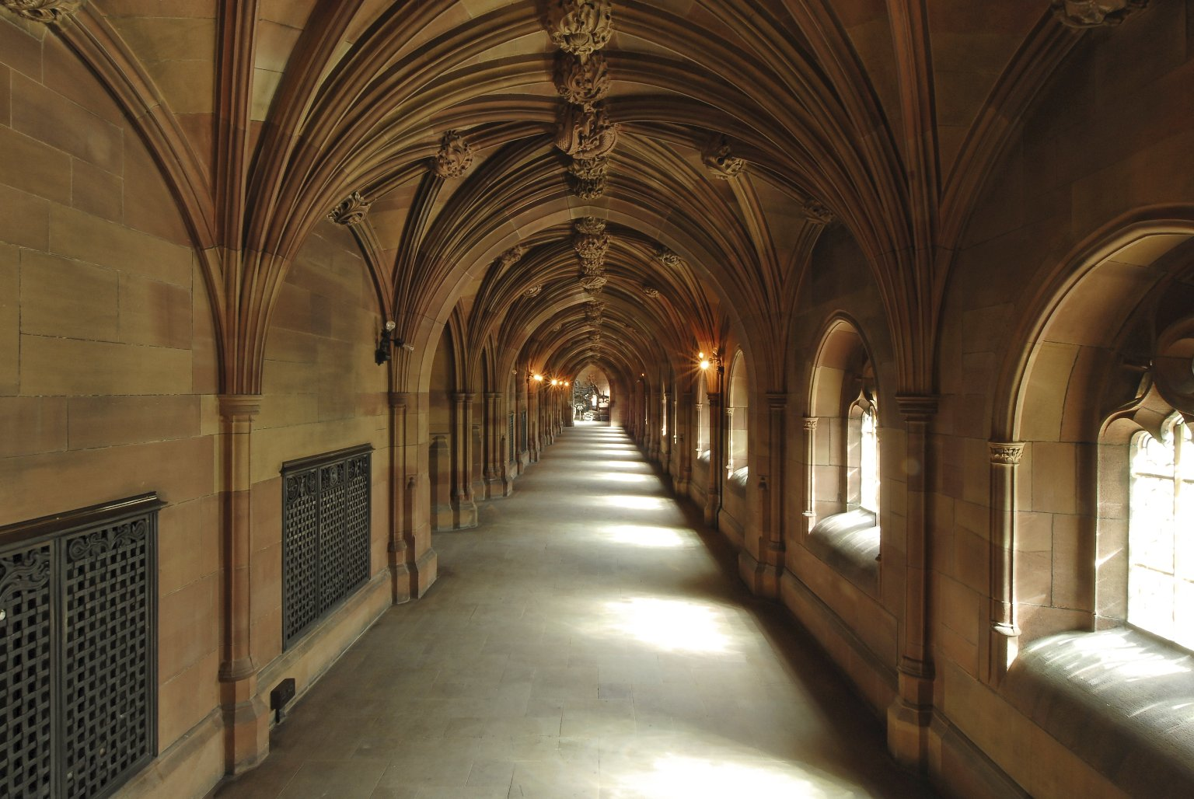
-------------
Image1
-------------
Field Data
Image Number JRL0710118dc
Image Title Cloisters
Date Created 2007
Description Cloisters of the John Rylands Library, Deansgate, Manchester. The Library was built by Enriqueta Augustina Rylands in memory of her husband John, a Manchester cotton millionaire. It opened to the public on 1st January 1900. The shawk (sandstone) was cleaned as part of a major refurbishment to the original building during 2004-2006. A glass bridge connects the cloisters to the new extension, opened in 2007. Architects: Basil Champneys (1842-1935); Austin-Smith: Lord.
Subject John Rylands Library
Subject Architecture
Subject Library buildings
Category of Material Photography
Sub-Category Digital photography
Time Period Covered 21st Century CE
Places Covered England: Greater Manchester: Manchester
Current Site The John Rylands Library, Deansgate, Manchester, U.K.
Rights Holder - Image University of Manchester Library
Rights holder - Work The University of Manchester Library
Access Rights <a rel="license" href="http://creativecommons.org/licenses/by-nc-sa/4.0/"><img alt="Creative Commons License" style="border-width:0" src="https://i.creativecommons.org/l/by-nc-sa/4.0/88x31.png"></a>
References The John Rylands Library: A Souvenir Guide (Fetherstonhaugh, 2007)
Date Captured (yyyy-mm-dd) 2007
Image Creation Technique Digital capture by Fetherstonhaugh
Date Image Added (yyyy-mm) 2007-06
Metadata Language eng-GB

Slide 5
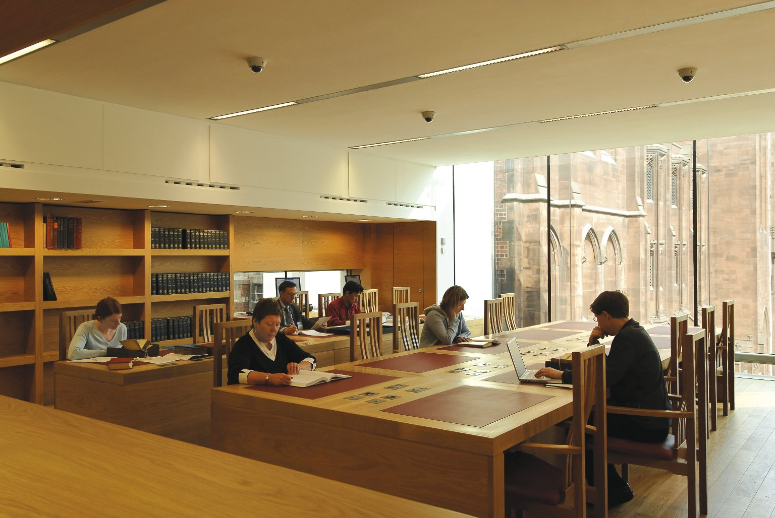
-------------
Image1
-------------
Field Data
Image Number JRL0710119dc
Image Title Elsevier Reading Room
Date Created 2007
Description Elsevier Reading Room of the John Rylands Library, Deansgate, Manchester, with a glimpse of the Spinningfield elevation of the original building through the glass panelled wall. The Library was built by Enriqueta Augustina Rylands in memory of her husband John, a Manchester cotton millionaire. It opened to the public on 1st January 1900. A major refurbishment to the original building took place during 2004-2006 and a new extension housing the Elsevier Reading Room opened in 2007. Architect: Austin-Smith: Lord.
Subject John Rylands Library
Subject Architecture
Subject Library buildings
Category of Material Photography
Sub-Category Digital photography
Time Period Covered 21st Century CE
Places Covered England: Greater Manchester: Manchester
Current Site The John Rylands Library, Deansgate, Manchester, U.K.
Rights Holder - Image University of Manchester Library
Rights holder - Work The University of Manchester Library
Access Rights <a rel="license" href="http://creativecommons.org/licenses/by-nc-sa/4.0/"><img alt="Creative Commons License" style="border-width:0" src="https://i.creativecommons.org/l/by-nc-sa/4.0/88x31.png"></a>
References The John Rylands Library: A Souvenir Guide (Fetherstonhaugh, 2007)
Date Captured (yyyy-mm-dd) 2007
Image Creation Technique Digital capture by Fetherstonhaugh
Date Image Added (yyyy-mm) 2007-06
Metadata Language eng-GB

Slide 6
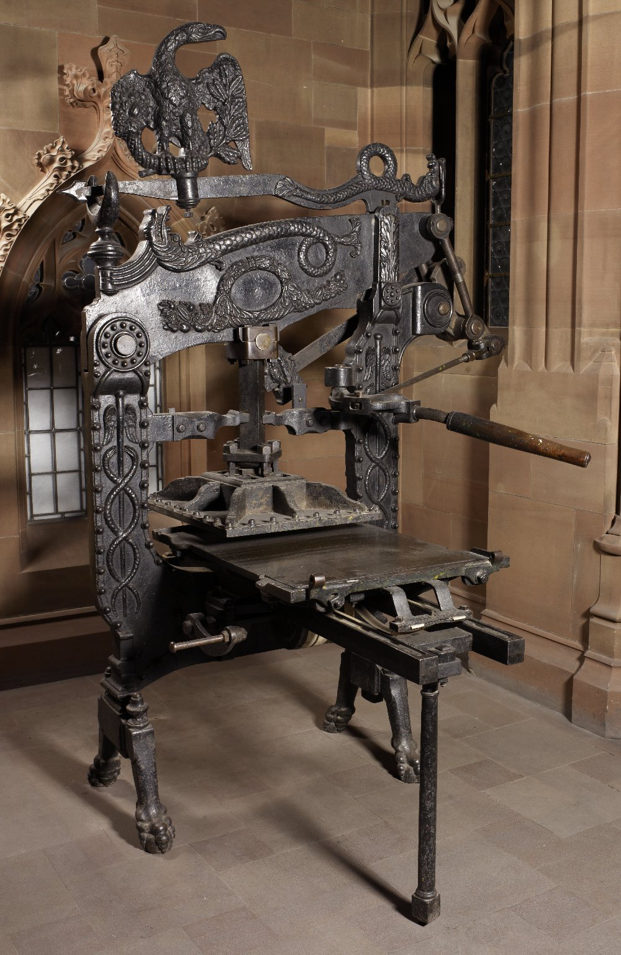
-------------
Image1
-------------
Field Data
Image Number JRL0902260dc
Image Title Columbian printing press
Date Created 2008
Description Columbian printing press, on display at the historic John Rylands Library, Deansgate.
Subject Library buildings
Subject Printing--History
Subject John Rylands Library
Time Period Covered 21st Century CE
Places Covered England: Greater Manchester: Manchester
Current Site The John Rylands Library, Deansgate, Manchester, U.K.
Rights Holder - Image University of Manchester Library
Rights holder - Work The University of Manchester Library
Access Rights <a rel="license" href="http://creativecommons.org/licenses/by-nc-sa/4.0/"><img alt="Creative Commons License" style="border-width:0" src="https://i.creativecommons.org/l/by-nc-sa/4.0/88x31.png"></a>
Date Captured (yyyy-mm-dd) 2008
Image Creation Technique Digital capture by Heritage Imaging, The University of Manchester Library
Date Image Added (yyyy-mm) 2011-05
Metadata Language eng-GB

Slide 7
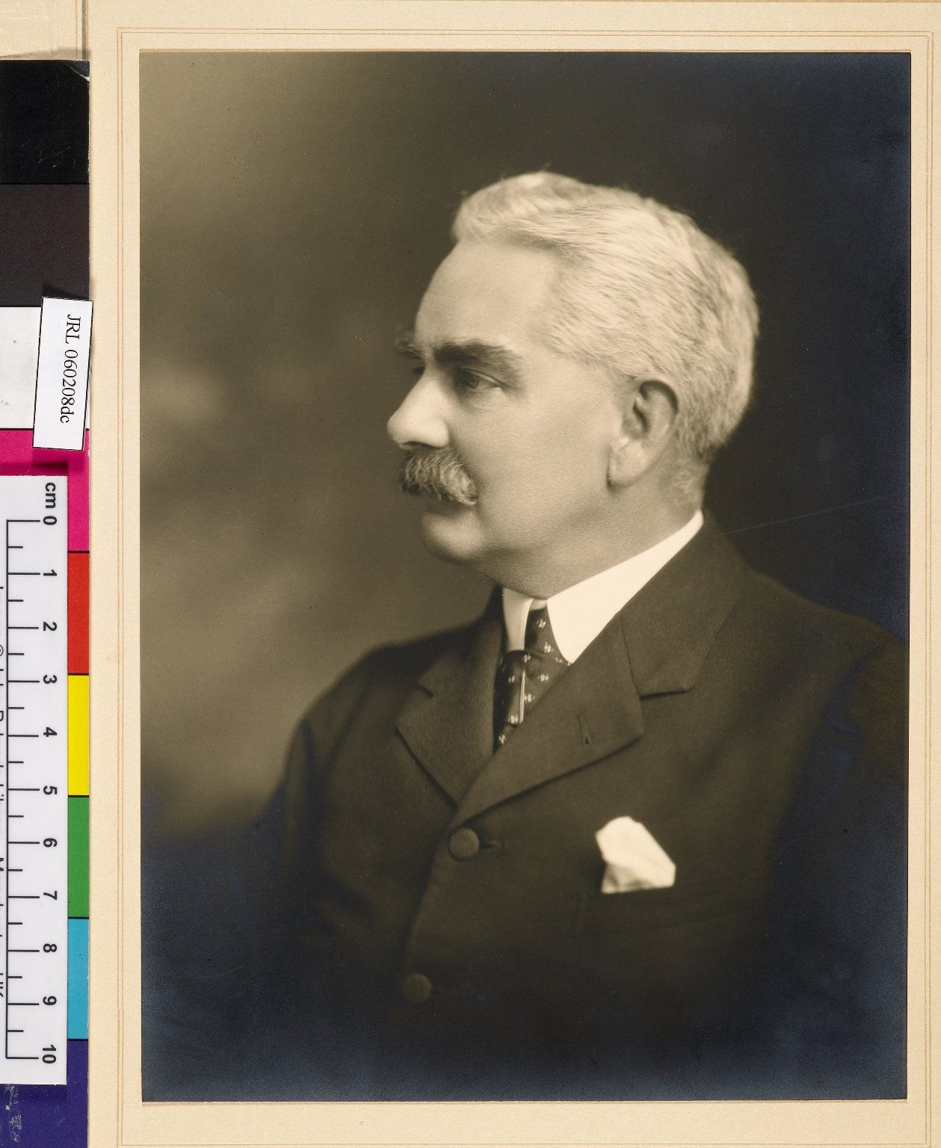
-------------
Image1
-------------
Field Data
Image Number JRL060208dc
Reference Number JRL/4/1/4/16
Image Title Henry Guppy
Creator Lafayette Ltd.
Creator Role Photographer
Description Portrait photograph of Henry Guppy, Librarian of the John Rylands Library from its opening until his death in 1948.
Subject John Rylands Library
Category of Material Archives
Category of Material Photography
Sub-Category Analogue photography
Support Paper
People Covered Guppy, Henry, 1861-1948
Item Height 195 mm
Item Width 143 mm
Current Repository The University of Manchester Library, U.K.
Rights Holder - Image The University of Manchester Library
Rights holder - Work The University of Manchester Library
Access Rights <a rel="license" href="http://creativecommons.org/licenses/by-nc-sa/4.0/"><img alt="Creative Commons License" style="border-width:0" src="https://i.creativecommons.org/l/by-nc-sa/4.0/88x31.png"></a>
Date Captured (yyyy-mm-dd) 2005-12-08
Image Creation Technique Digital capture by Gten
Date Image Added (yyyy-mm) 2006-02
Metadata Language eng-GB

Slide 8
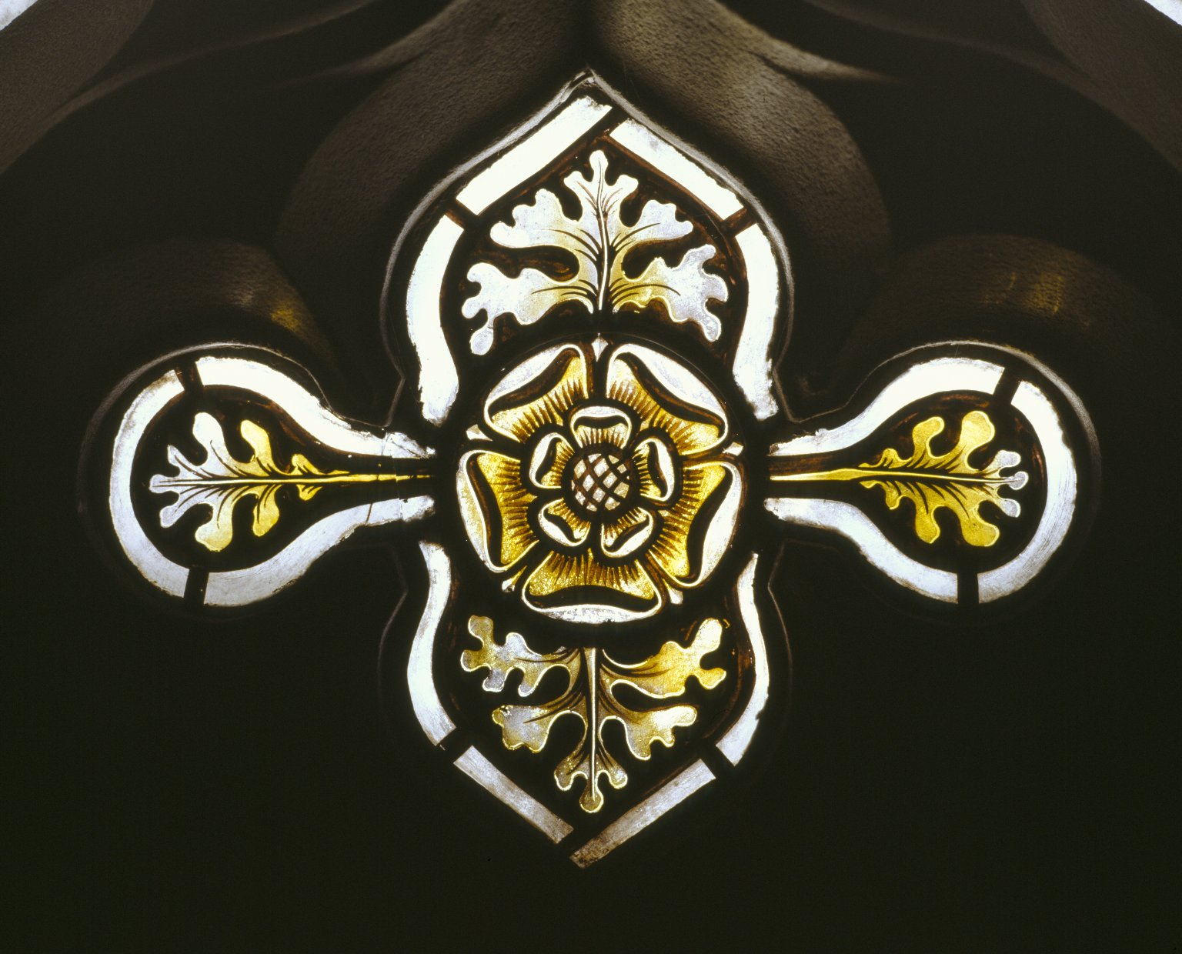
-------------
Image1
-------------
Field Data
Image Number JRL022153tr
Image Title Stained glass rose
Creator Kempe, Charles Eamer, 1837-1907
Description Detail of pale yellow, stained glass rose; corridor left of exhibition room in the John Rylands Library, Deansgate.
Subject Architecture
Subject Library buildings
Subject Glass painting and staining
Subject John Rylands Library
Support Glass
Places Covered England: Greater Manchester: Manchester
Current Site The John Rylands Library, Deansgate, Manchester, U.K.
Rights Holder - Image The University of Manchester Library
Rights holder - Work The University of Manchester Library
Access Rights <a rel="license" href="http://creativecommons.org/licenses/by-nc-sa/4.0/"><img alt="Creative Commons License" style="border-width:0" src="https://i.creativecommons.org/l/by-nc-sa/4.0/88x31.png"></a>
Image Creation Technique Scanned from colour transparency by Gten, July 2004
Metadata Language eng-GB

Slide 9
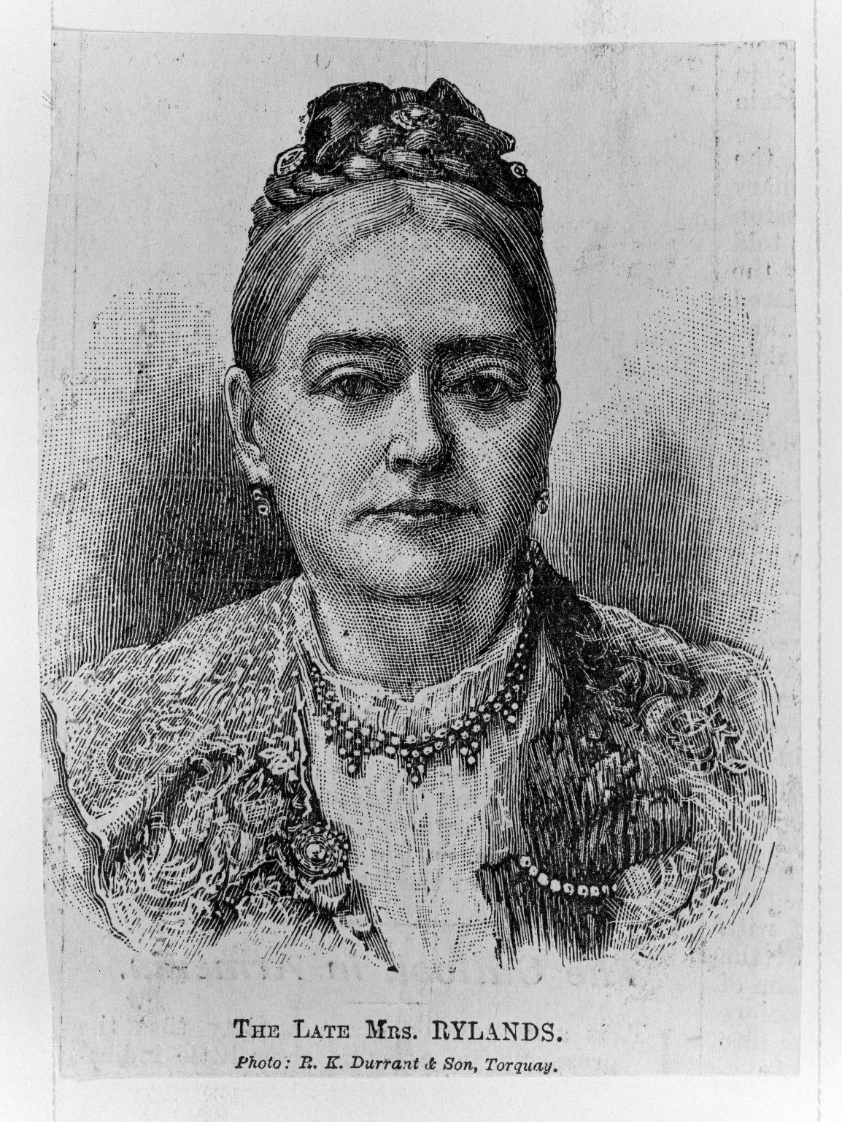
-------------
Image1
-------------
Field Data
Image Number JRL021682bw
Image Title The Late Mrs Rylands
Description Portrait engraving of Enriqueta Rylands from a photograph by R.K. Durrant and Son of Torquay.
Category of Material Archives
Sub-Category Portraits
Technique Used Engraving
Current Repository The University of Manchester Library, U.K.
Rights Holder - Image The University of Manchester Library
Rights holder - Work The University of Manchester Library
Access Rights <a rel="license" href="http://creativecommons.org/licenses/by-nc-sa/4.0/"><img alt="Creative Commons License" style="border-width:0" src="https://i.creativecommons.org/l/by-nc-sa/4.0/88x31.png"></a>
Image Creation Technique Scanned from black/white negative by Gten, May 2005
Metadata Language eng-GB

