Slide 2
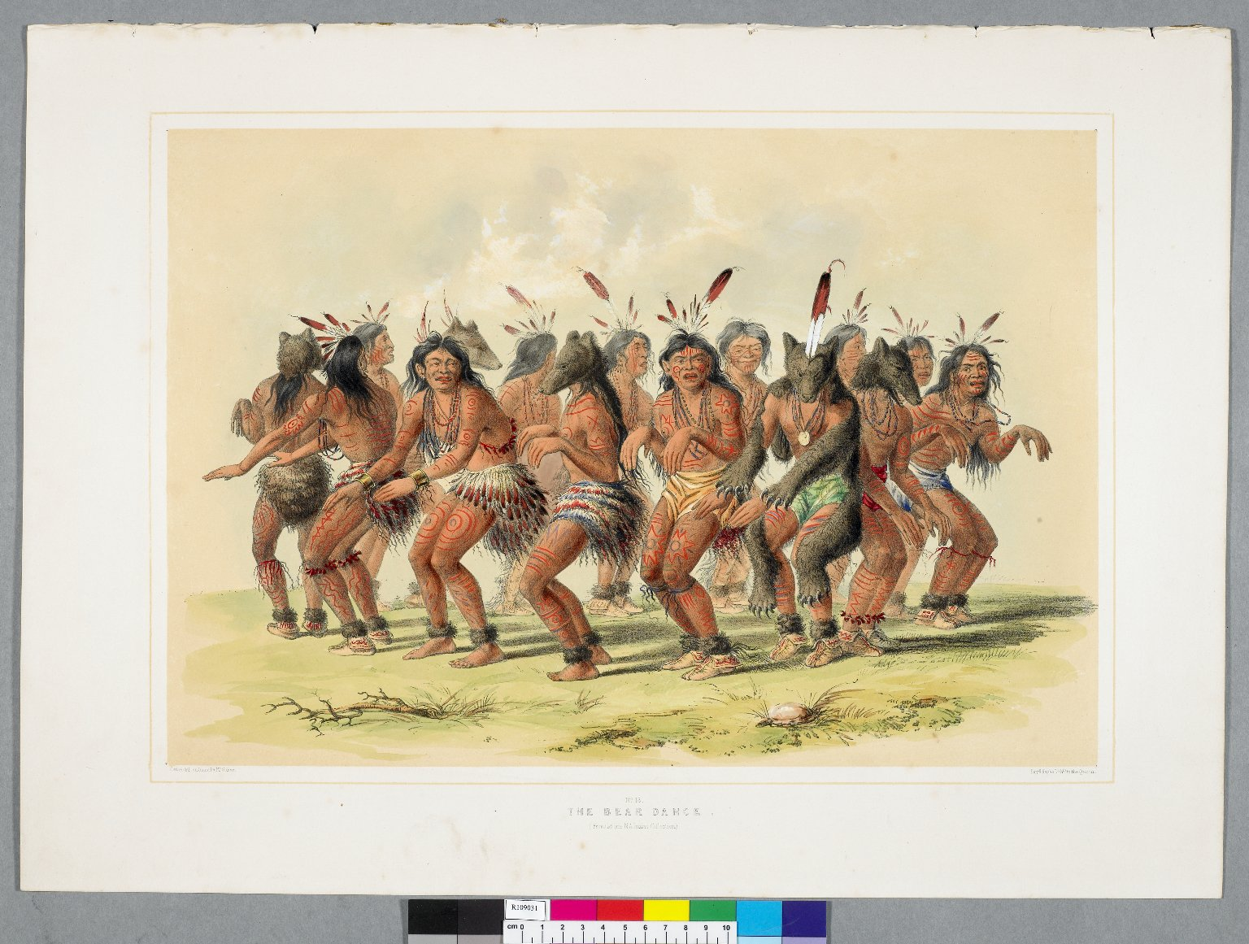
-------------
Image1
-------------
Field Data
Image Number JRL0710145dc
Reference Number R109031
Link to Catalogue <A href=http://man-fe.hosted.exlibrisgroup.com/MU_VU1:BLENDED:44MAN_ALMA_DS21144771900001631>UoM online catalogue.</a>
Image Title The bear dance
Parent Work Title Catlin's North American Indian portfolio: Hunting scenes and amusements of the Rocky Mountains and prairies of America / From drawings and notes of the author, made during eight years' travel amongst forty-eight of the wildest and most remote tribes of savages in North America.
Creator Catlin, George, 1796-1872
Creator Role Author
Date Created 1844
Publication Details London: Geo. Catlin, C. and J. Adlard
Page/Sheet Plate 18
Description Illustration: American Indians performing a bear dance.
Language Code eng-GB
Subject Indians of North America
Category of Material Printed
Technique Used Drawing (image-making)
Support Paper
Time Period Covered 19th Century CE
Item Height 695 mm
Item Width 430 mm
Current Repository The University of Manchester Library, U.K.
Rights Holder - Image The University of Manchester Library
Rights holder - Work The University of Manchester Library
Date Captured (yyyy-mm-dd) 2007-07-19
Image Creation Technique Digital capture by Gten
Date Image Added (yyyy-mm) 2007-09
Metadata Language eng-GB

Slide 3
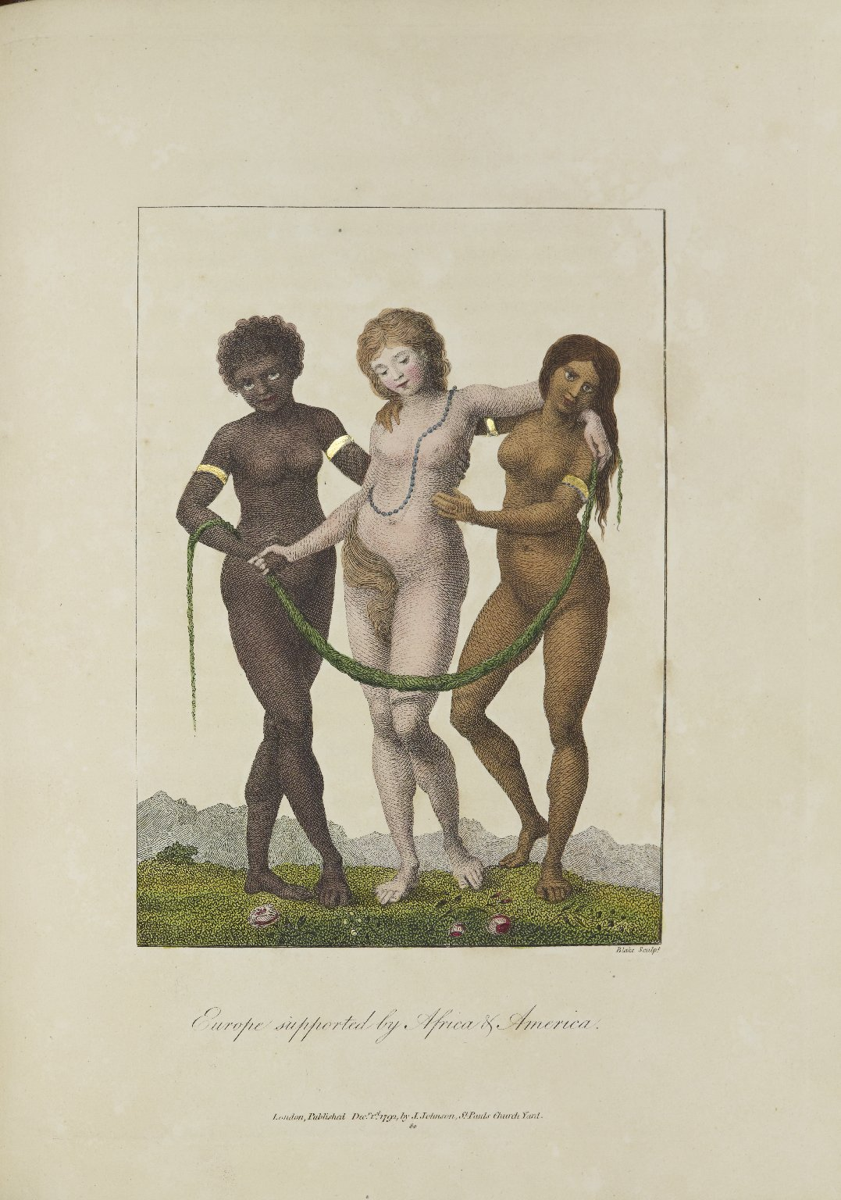
-------------
Image1
-------------
Field Data
Image Number JRL1304324
Reference Number Spencer 9331
Link to Catalogue <A href=http://man-fe.hosted.exlibrisgroup.com/MU_VU1:BLENDED:44MAN_ALMA_DS21141881760001631>UoM online catalogue.</a>
Image Title Europe supported by Africa and America
Parent Work Title Narrative, of a five years' expedition, against the revolted negroes of Surinam in Guiana,: on the wild coast of South America; from the year 1772, to 1777: elucidating the history of that country, and the description of its productions, viz. quadrupedes, birds, fishes, reptiles, trees, shrubs, fruits, & roots; with an account of the Indians of Guiana, & negroes of Guinea; J.G. Stedman; Illustrated with 80 elegant engravings, designed by the author
Creator Stedman, John Gabriel
Creator Role Author
Creator Role Engraver
Date Created 1796
Publication Details London : printed for J. Johnson, & J. Edwards
Page/Sheet 394
Image Sequence Number 394
Description Engraving of three women, captioned 'Europe supported by Africa & America'. Plate is hand-coloured.
Language Code eng-GB
Language English
Subject Slavery
Category of Material Printed
Sub-Category Illustrated works
Technique Used Engraving (printing process)
Support Paper
Time Period Covered 18th Century CE
Places Covered South America
Current Repository The University of Manchester Library, U.K.
Provenance Spencer, George John Spencer, Earl, 1758-1834, former owner
Rights Holder - Image The University of Manchester Library
Rights holder - Work The University of Manchester Library
Date Captured (yyyy-mm-dd) 2012-12-12
Image Creation Technique Digital capture by Heritage Imaging, The University of Manchester Library
Date Image Added (yyyy-mm) 2013-01
Metadata Language eng-GB

Slide 4
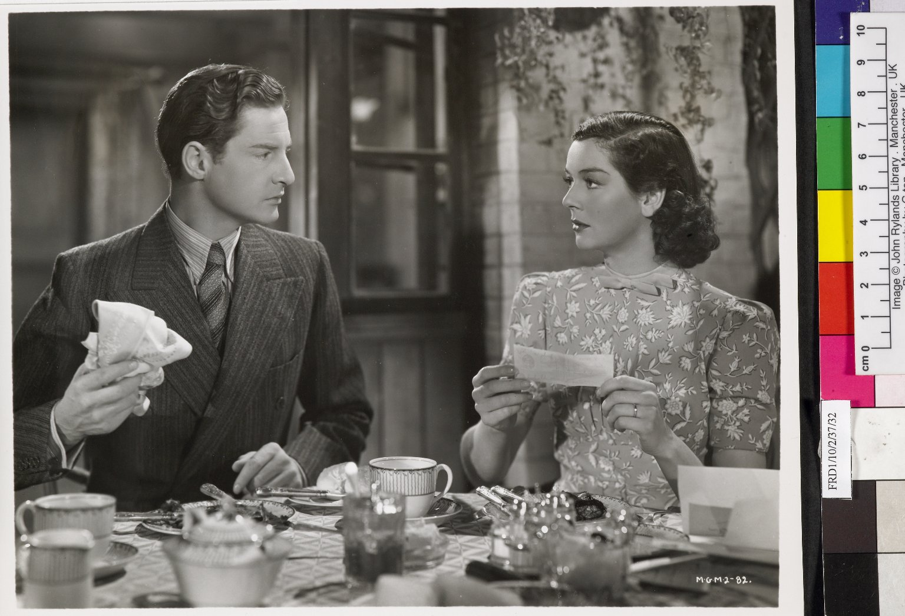
-------------
Image1
-------------
Field Data
Image Number JRL0700937dc
Reference Number FRD/1/10/2/37/32
Image Title Film set of "The Citadel"
Parent Work Title Bundle of photographs
Date Created c1938
Description Film still from "The Citadel", starring Robert Donat and Rosalind Russell. The still is part of a bundle of photographs from the film.
Subject Motion pictures
Category of Material Archives
Sub-Category Analogue photography
Support Paper
Time Period Covered 20th Century CE
People Covered Donat, Robert, 1905-1958
People Covered Russell, Rosalind, 1907-1976
Item Height 245 mm
Item Width 200 mm
Current Repository The University of Manchester Library, U.K.
Provenance Private papers
Rights Holder - Image The University of Manchester Library
Rights holder - Work MGM
Notes Bundle of photographs ( n.d. [1938])
Date Captured (yyyy-mm-dd) 2006-09-14
Image Creation Technique Digital capture by Gten
Date Image Added (yyyy-mm) 2007-01
Metadata Language eng-GB

Slide 5
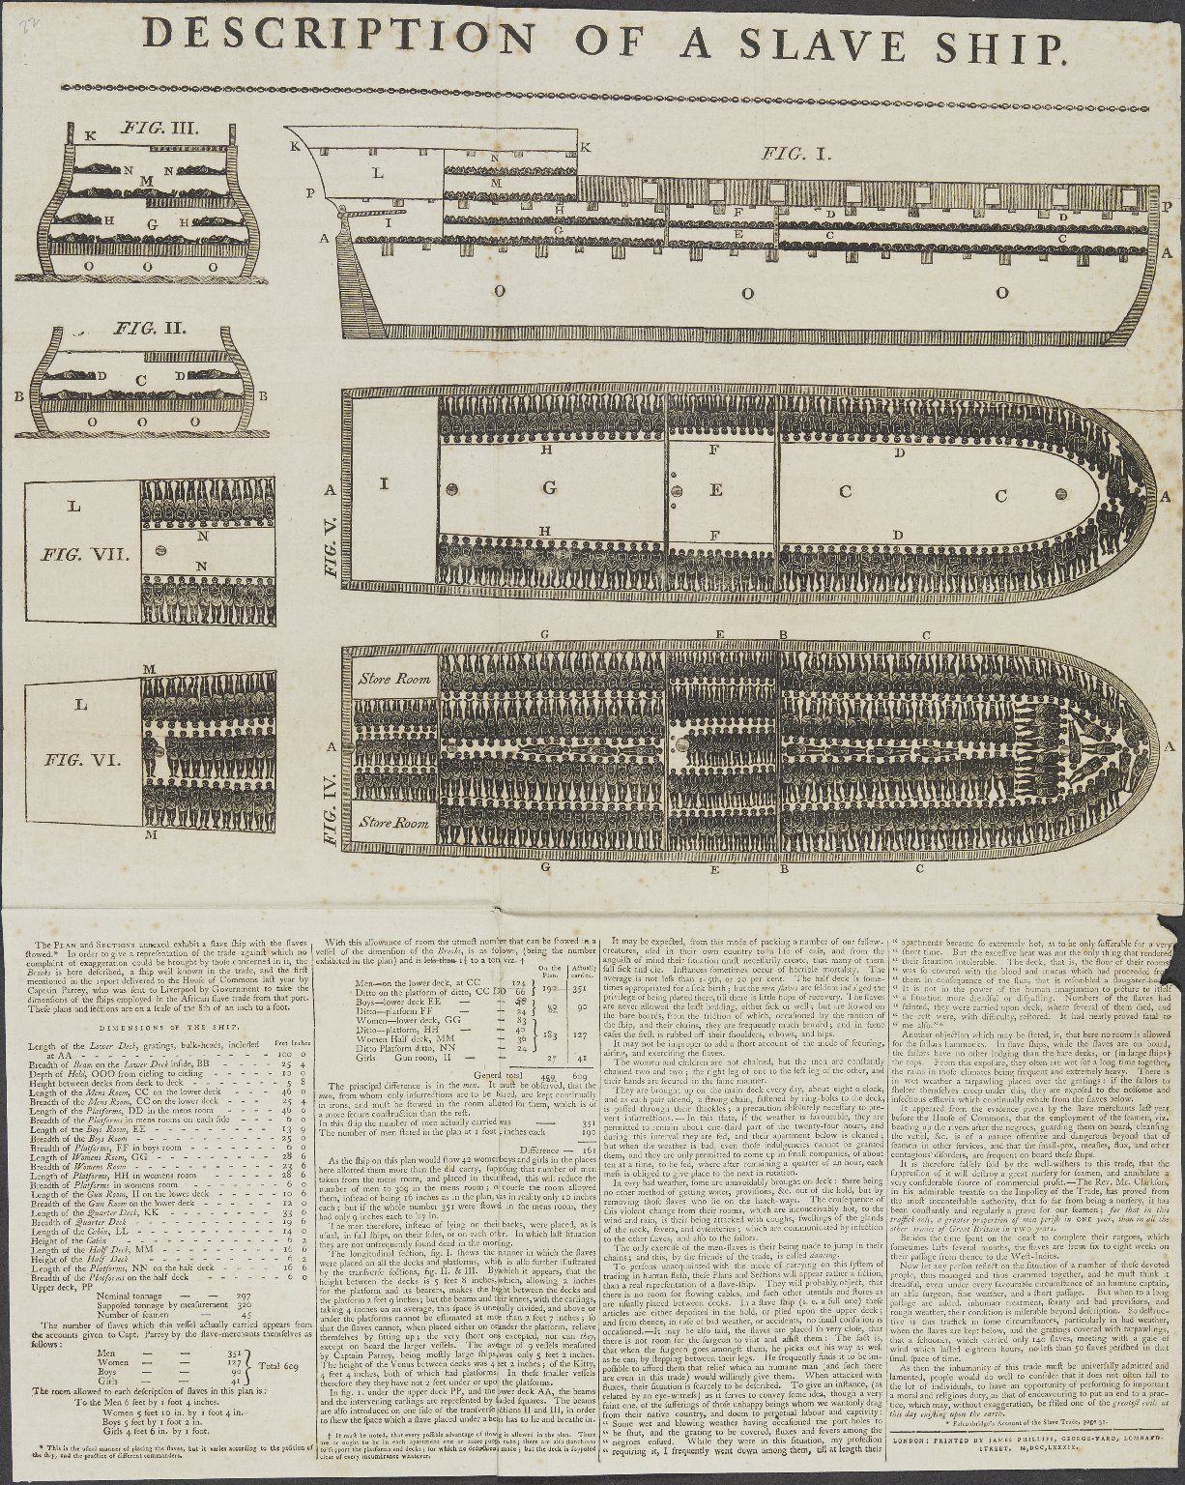
-------------
Image1
-------------
Field Data
Image Number JRL1301003
Reference Number English MS 343/22
Image Title Description of a slave ship
Parent Work Title Miscellaneous Autograph Collection
Creator Phillips, James
Creator Role Printer
Date Created 1789
Publication Details London: Printed by James Phillips, George-Yard, Lombard Street
Description Illustrated: plan and sections of the Brooks slave ship, depicting the ship at full capacity. The text describes the conditions aboard the ship. This image was widely used by abolitionist campaigners.
Language Code eng-GB
Language English
Subject Ships
Subject Slavery
Category of Material Manuscripts
Sub-Category Broadsides
Technique Used Printing (process)
Support Paper
Time Period Covered 18th Century CE
Current Repository The University of Manchester Library, U.K.
Rights Holder - Image The University of Manchester Library
Rights holder - Work The University of Manchester Library
Access Rights <a rel="license" href="http://creativecommons.org/licenses/by-nc-sa/4.0/"><img alt="Creative Commons License" style="border-width:0" src="https://i.creativecommons.org/l/by-nc-sa/4.0/88x31.png" /></a>
Date Captured (yyyy-mm-dd) 2012-11-28
Image Creation Technique Digital capture by Heritage Imaging, The University of Manchester Library
Date Image Added (yyyy-mm) 2013-01
Metadata Language eng-GB

