Slide 1
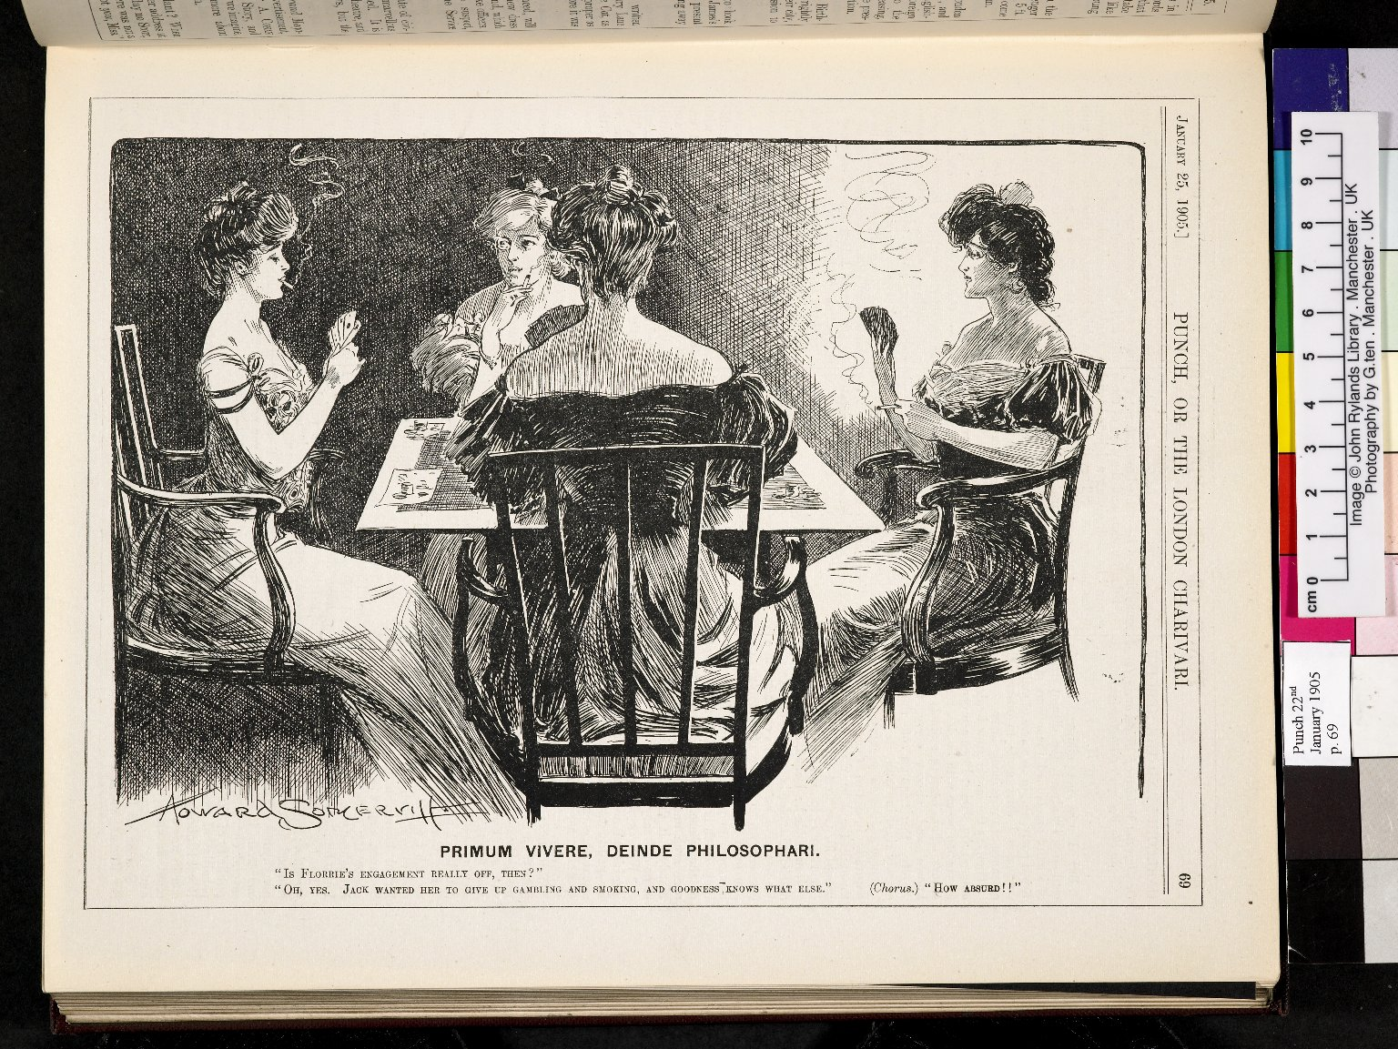
-------------
Image1
-------------
Field Data
Image Number JRL060076dc
Reference Number R17772
Link to Catalogue <A href=http://man-fe.hosted.exlibrisgroup.com/MU_VU1:BLENDED:44MAN_ALMA_DS21136997950001631>UoM online catalogue</a>
Image Title Primum vivere, diende philosophari
Parent Work Title Punch Magazine
Alternative Parent Work Title London charivari
Creator Someritt, Howard
Creator Role Artist
Date Created 1905-01-25
Publication Details London: Punch Publications
Page/Sheet 69
Image Sequence Number 069
Description Cartoon depicting women sat around a card table, playing cards and smoking. It reads: "Is Florrie's engagement really off, then?" "Oh, yes. Jack wanted her to give up gambling and smoking, and goodness knows what else." (Chorus.) "How absurd!!".
Language Code eng-GB
Subject Cartoons
Subject Women--Suffrage
Category of Material Printed
Support Paper
Creation Site England: London
Time Period Covered 20th Century CE
Places Covered England: Greater London: London
Item Height 272 mm
Item Width 210 mm
Current Repository The University of Manchester Library, U.K.
Rights Holder - Image The University of Manchester Library
Rights holder - Work The University of Manchester Library
Access Rights <a rel="license" href="http://creativecommons.org/licenses/by-nc-sa/4.0/"><img alt="Creative Commons License" style="border-width:0" src="https://i.creativecommons.org/l/by-nc-sa/4.0/88x31.png" /></a><br />This work is licensed under a <a rel="license" href="http://creativecommons.org/licenses/by-nc-sa/4.0/">Creative Commons Attribution-NonCommercial-ShareAlike 4.0 International License.</a> Copyright of The University of Manchester
Notes Publication suspended, April 1992-September 1996
Date Captured (yyyy-mm-dd) 2005-09-29
Image Creation Technique Digital capture by Gten
Metadata Language eng-GB

Slide 3
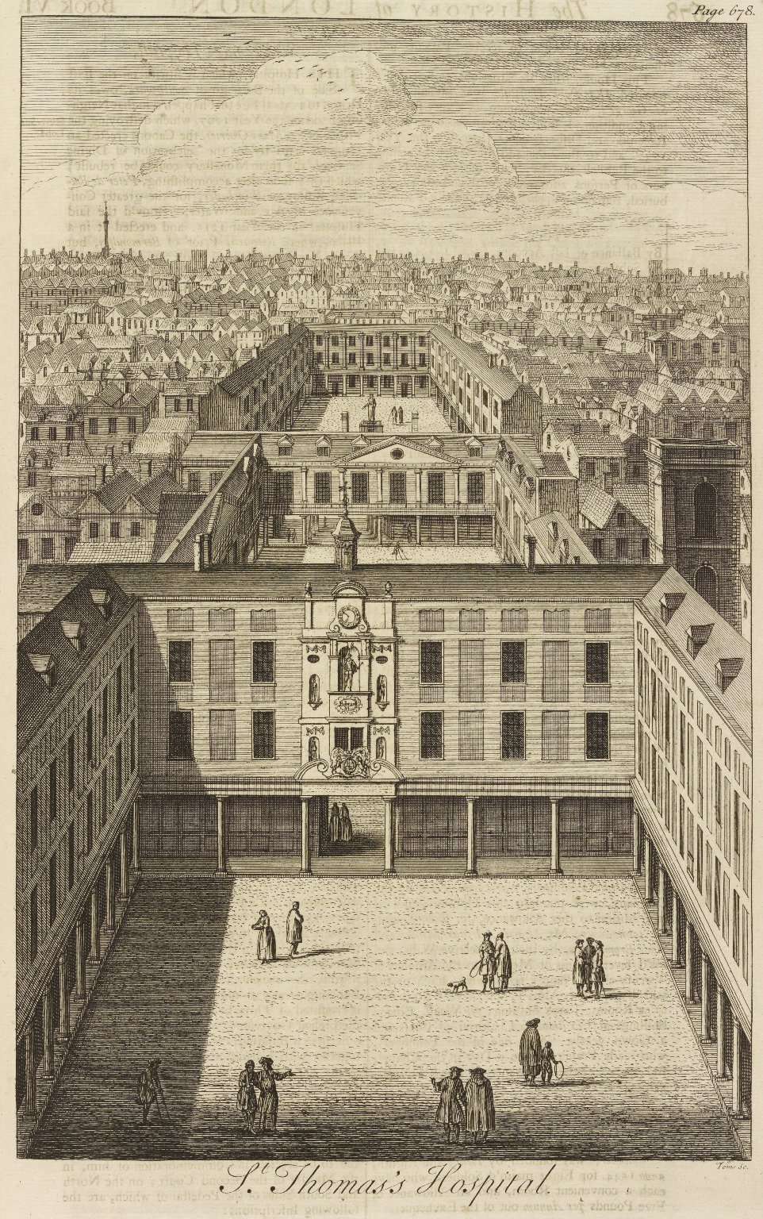
-------------
Image1
-------------
Field Data
Image Number JRL0900001dc
Reference Number Spencer 5284
Link to Catalogue <A href=http://man-fe.hosted.exlibrisgroup.com/MU_VU1:BLENDED:44MAN_ALMA_DS21150422400001631>UoM online catalogue</a>
Image Title St Thomas's Hospital
Parent Work Title The history of London: from its foundation by the Romans, to the present time. ... In nine books
Creator Richardson, Samuel, 1689-1761
Creator Role Printer
Creator Maitland, William, 1693?-1757
Creator Role Author
Date Created 1739
Publication Details London : printed by Samuel Richardson
Page/Sheet Opposite page 678
Image Sequence Number 678
Description Illustration of St Thomas's Hospital, London.
Language Code eng-GB
Language English
Subject Medicine--History
Subject Hospitals
Subject Architecture
Category of Material Printed
Sub-Category Illustrated works
Technique Used Drawing (image-making)
Support Paper
Time Period Covered 18th Century CE
Places Covered England: Greater London: London
Current Repository The University of Manchester Library, U.K.
Provenance Spencer, George John Spencer, Earl, 1758-1834, former owner
Rights Holder - Image The University of Manchester Library
Rights holder - Work The University of Manchester Library
Access Rights <a rel="license" href="http://creativecommons.org/licenses/by-nc-sa/4.0/"><img alt="Creative Commons License" style="border-width:0" src="https://i.creativecommons.org/l/by-nc-sa/4.0/88x31.png" /></a>
Date Captured (yyyy-mm-dd) 2008-07-31
Image Creation Technique Digital capture by Heritage Imaging, The University of Manchester Library
Date Image Added (yyyy-mm) 2008-10
Metadata Language eng-GB

Slide 4
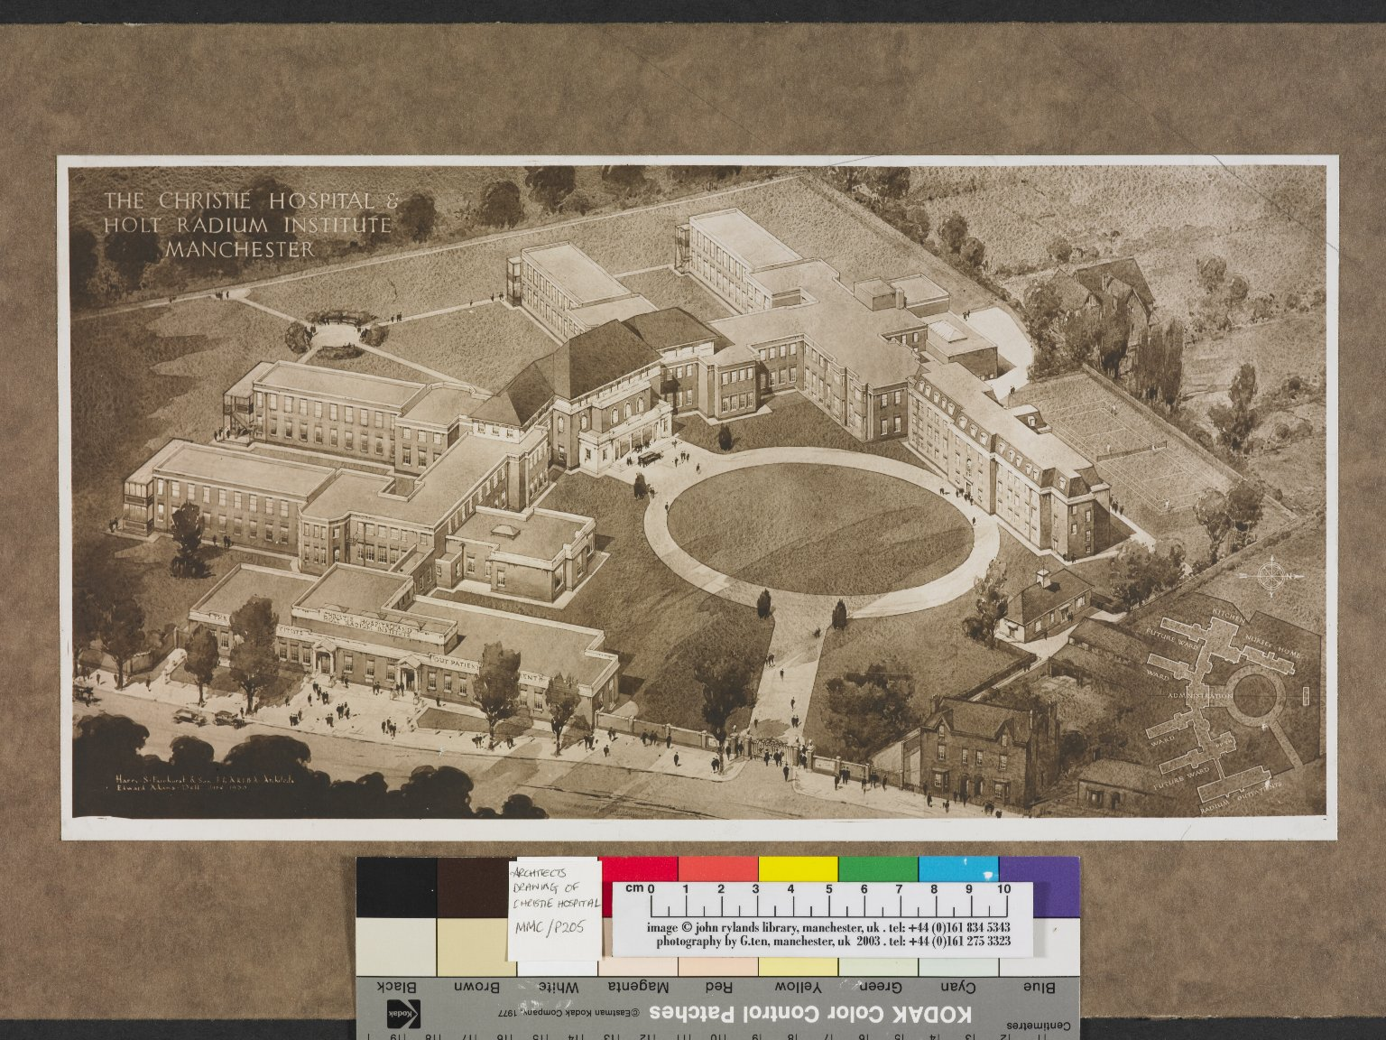
-------------
Image1
-------------
Field Data
Image Number JRL040063dc
Reference Number MMC P205
Image Title Christie Hospital
Parent Work Title Christie Hospital & Holt Radium Institute Manchester
Creator Adams, Edward
Creator Role Architect
Date Created 1930-06
Description Sepia coloured architect's drawing of Christie Hospital and Holt Radium Institute buildings and grounds in Manchester. The drawing includes additional proposed building plans in the bottom right corner. The architectural company: Harry S. Fairhurst & Son.
Subject Architecture
Subject Medicine
Subject Hospitals
Category of Material Archives
Sub-Category Plans (drawings)
Technique Used Drawing (image-making)
Places Covered England: Greater Manchester: Manchester
Current Repository The University of Manchester Library, U.K.
Rights Holder - Image The University of Manchester Library
Rights holder - Work The University of Manchester Library
Date Captured (yyyy-mm-dd) 2004-09-09
Image Creation Technique Digital capture by Gten
Metadata Language eng-GB

Slide 5
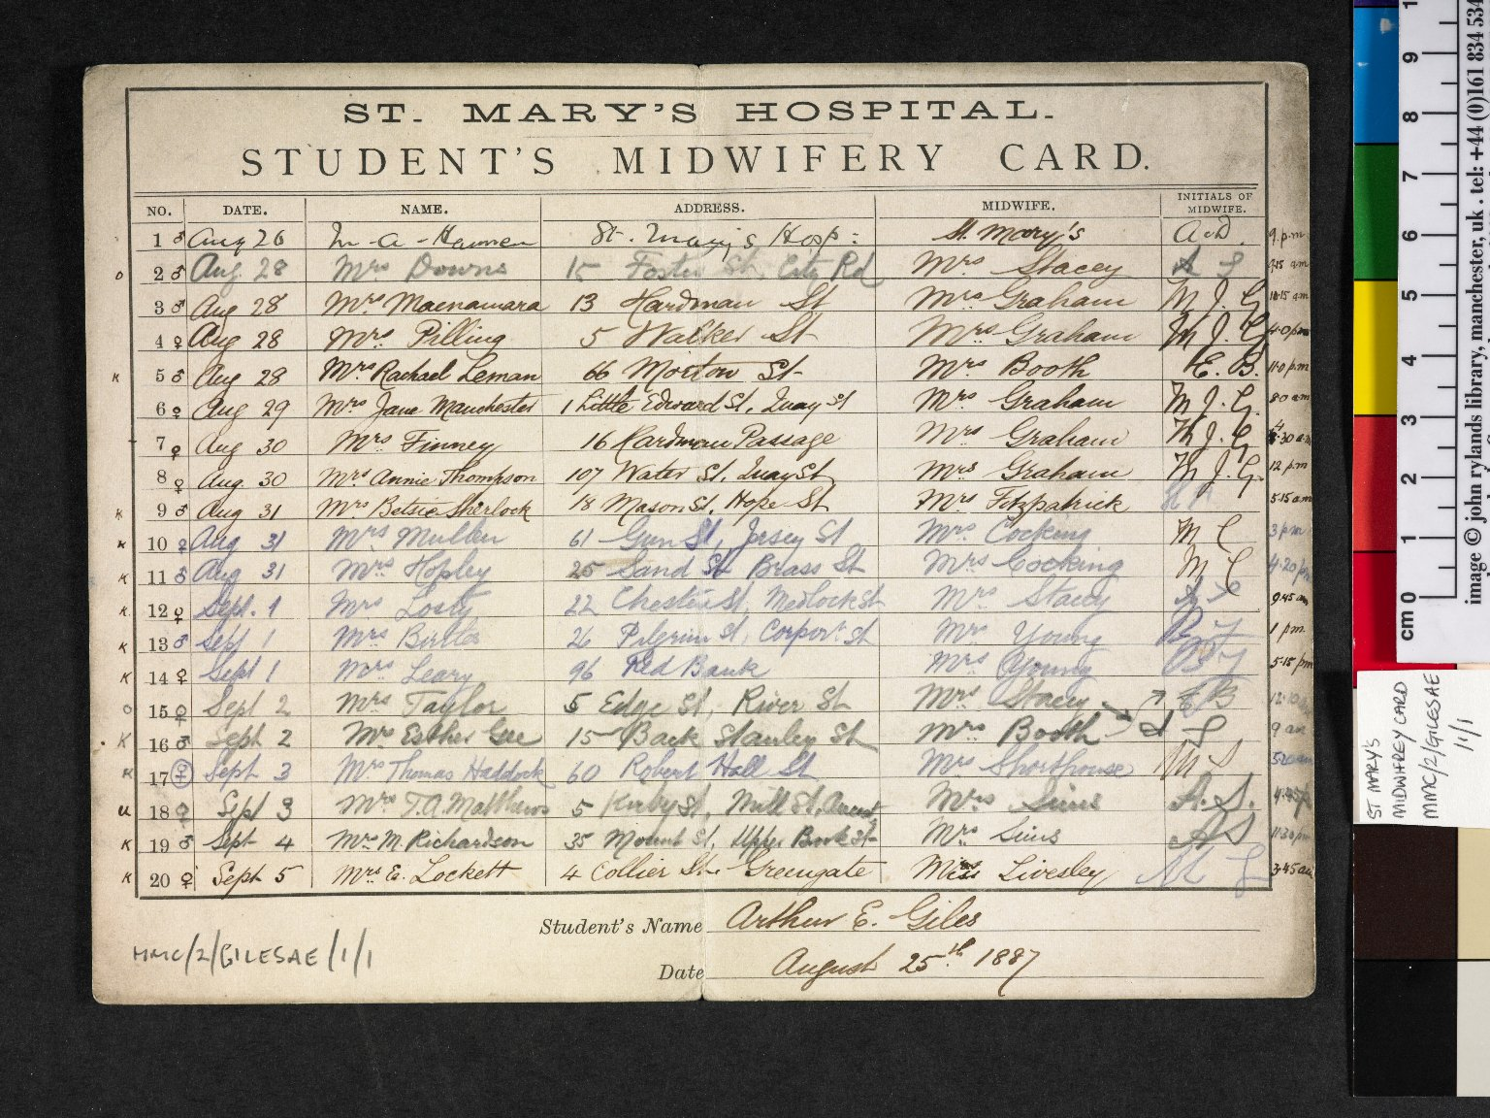
-------------
Image1
-------------
Field Data
Image Number JRL040071dc
Reference Number MMC/2/GilesAEJ/1/ 1
Link to Catalogue <a href="http://www.librarysearch.manchester.ac.uk/MU_VU1:BLENDED:44MAN_ELGAR_DSgb133mmc2a">Manchester Medical Collection: Biographical Files A-G</a>
Image Title St Mary's Hospital Student's Midwifery Card
Parent Work Title St Mary's Hospital Student's Midwifery Card
Date Created 1887-08-25
Description Carte de visite photographs of Bardsley by C.A. Duval and Co. , n.d. One signed by Bardsley. Slight differences in pose.
Language Code eng-GB
Subject Midwifery
Subject Medicine--History
Category of Material Archives
Technique Used Handwriting
Support Card
Time Period Covered 19th Century CE
Places Covered England: Greater Manchester: Manchester
Current Repository The University of Manchester Library, U.K.
Rights Holder - Image The University of Manchester Library
Rights holder - Work The University of Manchester Library
Date Captured (yyyy-mm-dd) 2004-09-09
Image Creation Technique Digital capture by Gten
Metadata Language eng-GB

Slide 7
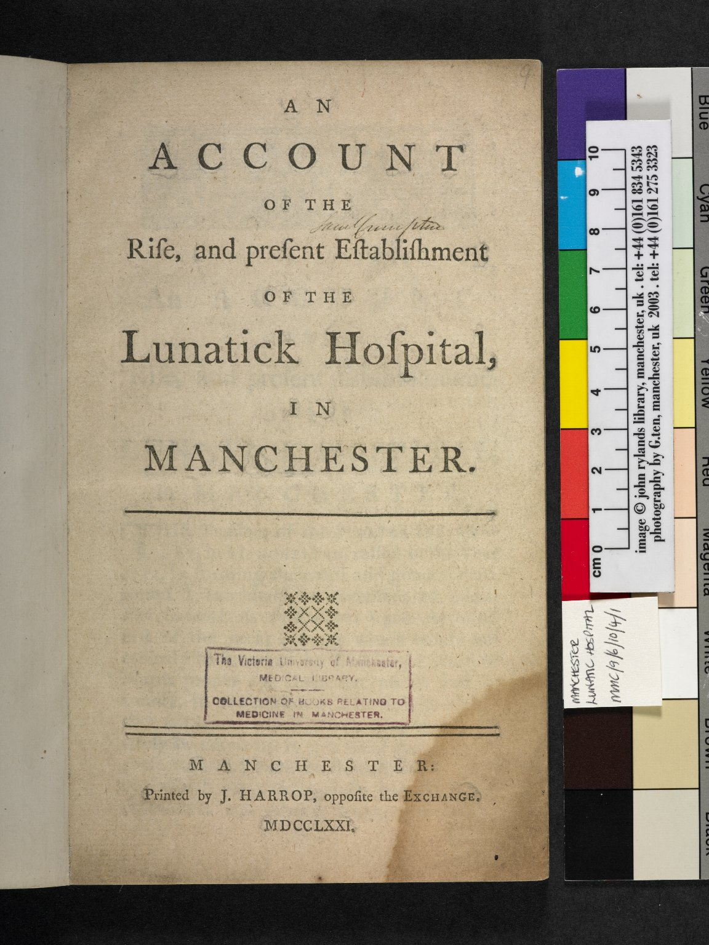
-------------
Image1
-------------
Field Data
Image Number JRL040081dc
Reference Number MMC/9/6/10/4/1
Link to Catalogue <a href="https://www.librarysearch.manchester.ac.uk/primo-explore/fulldisplay?docid=44MAN_ELGAR_DSead-gb133-mmc3-16#0000000&context=L&vid=MU_NUI&search_scope=BLENDED&tab=local&lang=en_US">The Manchester Medical Collection: Sections 3-16</a>
Image Title Lunatick Hospital
Parent Work Title Account Of The Rise, and present Establishment Of The Lunatick Hospital in Manchester
Date Created 1771
Publication Details Manchester : J. Harrop
Description Manchester Medical Collection. Title page of a pamphlet on the Manchester Lunatic Hospital. The page bears a signature next the title and is stamped near the bottom with 'The Victoria University of Manchester Medical Library'.
Language Code eng-GB
Subject Medicine
Subject Hospitals
Category of Material Archives
Sub-Category Pamphlets
Technique Used Printing (process)
Support Paper
Current Repository The University of Manchester Library, U.K.
Rights Holder - Image The University of Manchester Library
Rights holder - Work The University of Manchester Library
Image Creation Technique Digital capture by Gten, October 2004
Metadata Language eng-GB

Slide 8
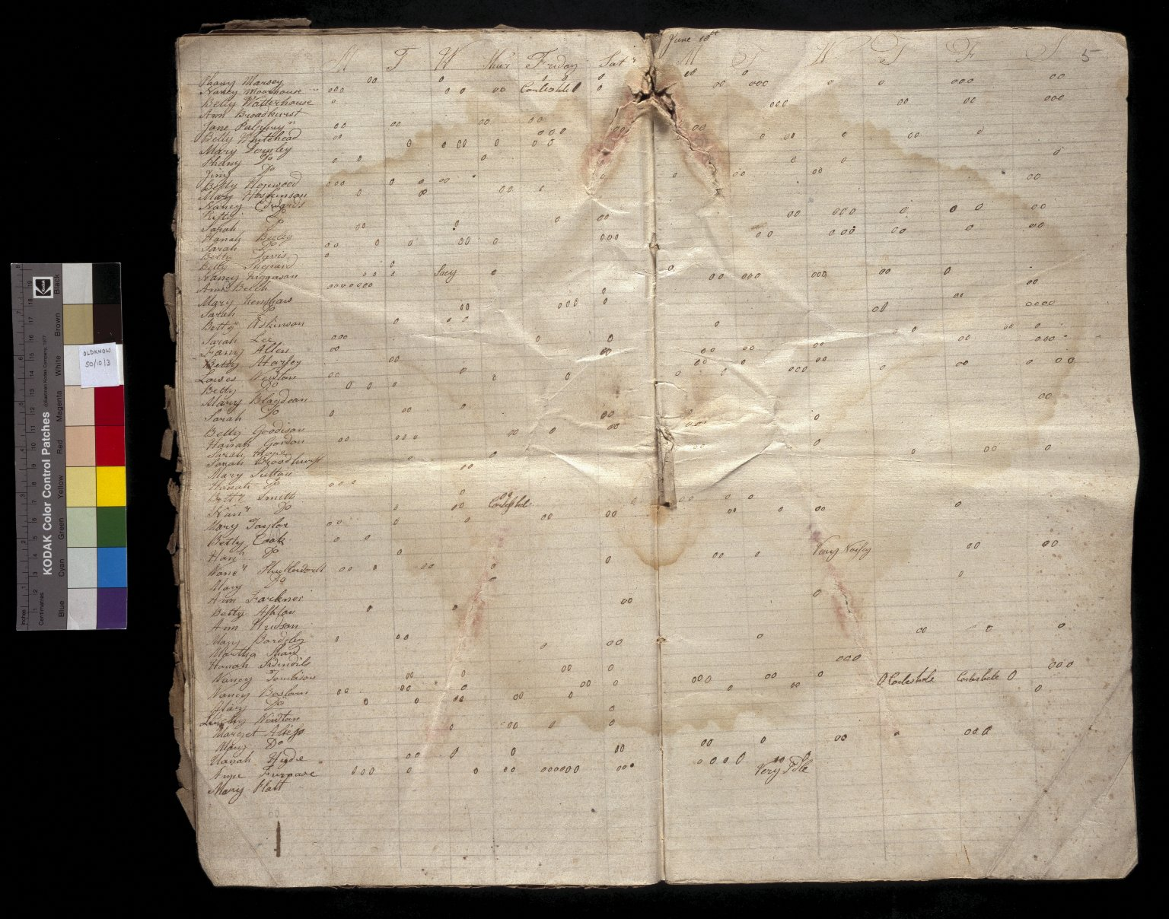
-------------
Image1
-------------
Field Data
Image Number JRL022660tr
Reference Number SO/10/3
Link to Catalogue <A href=https://www.librarysearch.manchester.ac.uk/primo-explore/fulldisplay?docid=44MAN_ELGAR_DS&context=L&vid=MU_NUI&search_scope=BLENDED&tab=local&lang=en_US>The Oldknow Papers</a>
Image Title Conduct of women workers in the textile industry
Series Title Records relating to Bleaching, Cutting and Finishing
Parent Work Title Report book
Date Created 1787
Page/Sheet 5
Description Double page opening Record of textile mill workers' conduct; includes remarks such as 'very idle' & 'careless holes'. 1787, May - August.
Language Code eng-GB
Language English
Subject Textile industry
Subject Industries
Category of Material Archives
Sub-Category Codex
Technique Used Handwriting
Medium Ink
Time Period Covered 18th Century CE
Places Covered England
Item Height Opening: 483 mm
Item Width Opening: 533 mm
Current Repository The University of Manchester Library, U.K.
Rights Holder - Image The University of Manchester Library
Rights holder - Work The University of Manchester Library
Image Creation Technique Scanned from colour transparency by Gten, October 2003
Metadata Language eng-GB

