Slide 7
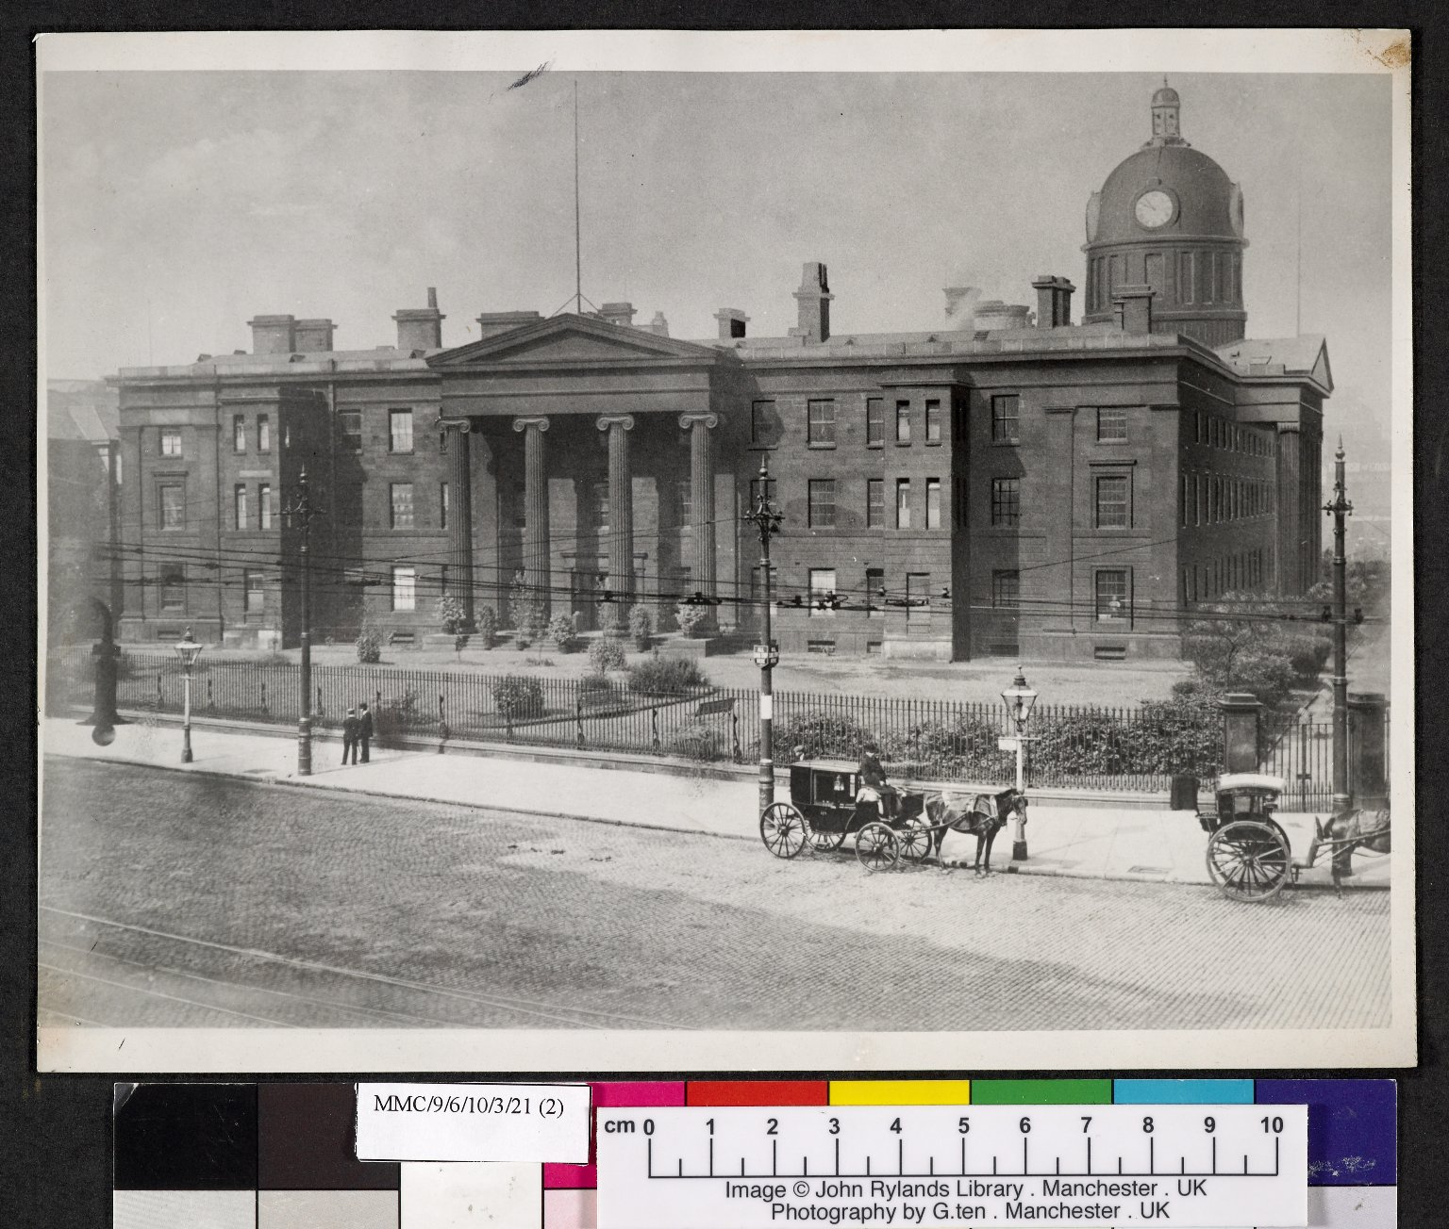
-------------
Image1
-------------
Field Data
Image Number JRL060083dc
Reference Number MMC/9/6/10/3/21/(2)
Link to Catalogue <a href="https://www.librarysearch.manchester.ac.uk/primo-explore/fulldisplay?docid=44MAN_ELGAR_DSead-gb133-mmc3-16#0000000&context=L&vid=MU_NUI&search_scope=BLENDED&tab=local&lang=en_US">The Manchester Medical Collection: Sections 3-16</a>
Image Title Old Manchester Royal Infirmary at Piccadilly
Series Title Hospitals and related institutions in the Manchester area
Date Created 1909
Description Photograph of the former Royal Infirmary situated at Piccadilly, Manchester.
Subject Architecture
Subject Hospitals
Subject Medicine--History
Category of Material Archives
Sub-Category Analogue photography
Support Paper
Creation Site England: Greater Manchester: Manchester
Places Covered England: Greater Manchester: Manchester
Item Height 252 mm
Item Width 200 mm
Current Repository The University of Manchester Library, U.K.
Rights Holder - Image The University of Manchester Library
Rights holder - Work The University of Manchester Library
Access Rights <a rel="license" href="http://creativecommons.org/licenses/by-nc-sa/4.0/"><img alt="Creative Commons License" style="border-width:0" src="https://i.creativecommons.org/l/by-nc-sa/4.0/88x31.png" /></a><br />This work is licensed under a <a rel="license" href="http://creativecommons.org/licenses/by-nc-sa/4.0/">Creative Commons Attribution-NonCommercial-ShareAlike 4.0 International License.</a> Copyright of The University of Manchester
Date Captured (yyyy-mm-dd) 2005-09-29
Image Creation Technique Digital capture by Gten
Metadata Language eng-GB

Slide 8
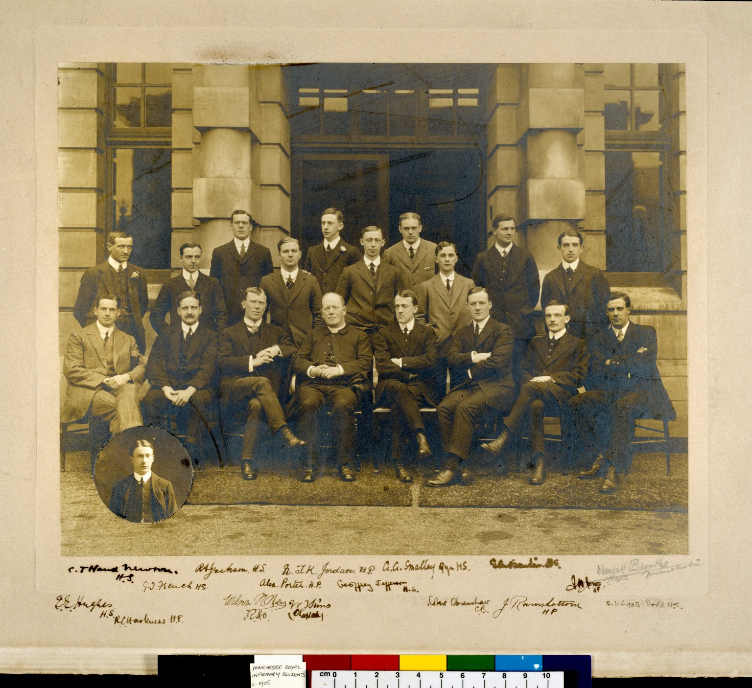
-------------
Image1
-------------
Field Data
Image Number JRL040085tr
Reference Number MMCP/97
Image Title Manchester Royal Infirmary Residents
Date Created 1910
Description Group portrait of Manchester Royal Infirmary residents c.1910 with small inset portrait in the bottom left corner. The mounted frame has a number of signatures.
Subject Medicine--History
Subject Hospitals
Category of Material Archives
Sub-Category Analogue photography
Support Mounted on card
Time Period Covered 20th Century CE
Places Covered England: Greater Manchester: Manchester
Current Repository The University of Manchester Library, U.K.
Rights Holder - Image The University of Manchester Library
Rights holder - Work The University of Manchester Library
Image Creation Technique Digital capture by Heritage Imaging, The University of Manchester Library
Metadata Language eng-GB

Slide 9
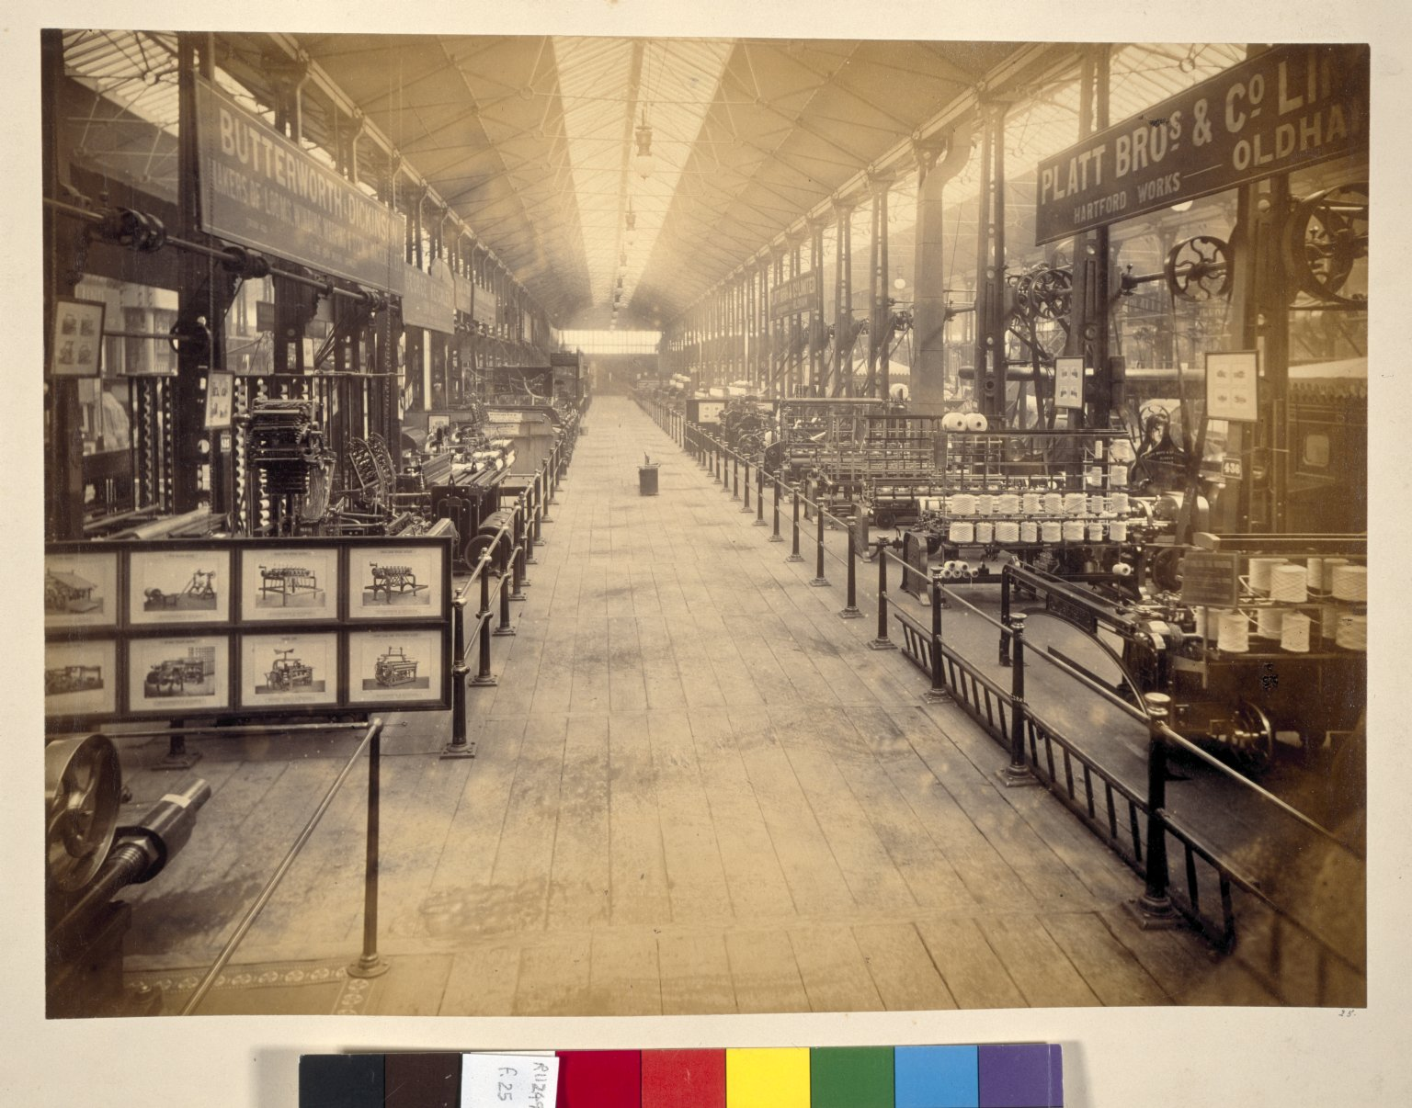
-------------
Image1
-------------
Field Data
Image Number JRL022986tr
Reference Number R112495
Image Title Spinning & textile machinery
Parent Work Title Royal Jubilee Exhibition, Manchester, 1887
Date Created 1887
Page/Sheet 25
Image Sequence Number 025
Description Photograph showing a range of spinning and textile manufacturing machinery at the Jubilee Exhibition.
Subject Industries
Subject Textile industry
Category of Material Printed
Sub-Category Analogue photography
Support Paper
Time Period Covered 19th Century CE
Places Covered England: Greater Manchester: Manchester
Current Repository The University of Manchester Library, U.K.
Rights Holder - Image The University of Manchester Library
Rights holder - Work The University of Manchester Library
Image Creation Technique Scanned from colour transparency by Gten, June 2005
Metadata Language eng-GB

