Slide 12
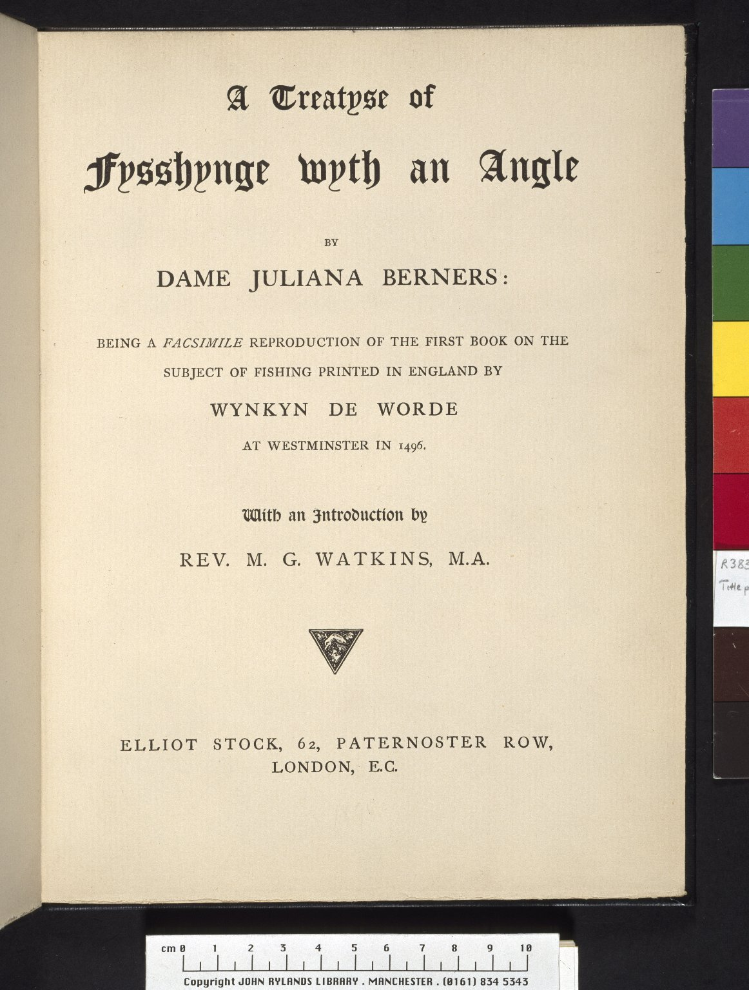
-------------
Image1
-------------
Field Data
Image Number JRl023225tr
Reference Number R38396
Link to Catalogue <A href=http://man-fe.hosted.exlibrisgroup.com/MU_VU1:BLENDED:44MAN_ALMA_DS21157546150001631>UoM online catalogue.</a>
Image Title Treatise of fishing
Parent Work Title A treatyse of fysshynge wyth an angle / by Dame Juliana Berners / being a facsimile reproduction of the first book on the subject of fishing printed in England by Wynkyn de Worde, at Westminster in 1496
Alternative Parent Work Title Treatise of fishing
Creator Berners, Juliana, 1388?-
Creator Role Author
Date Created 1880
Publication Details London: Elliot Stock
Page/Sheet Title page
Image Sequence Number 000
Description Title page of a facsimile reproduction of the first book on the subject of fishing to be printed in England. It was printed by Wynkyn de Worde on Caxton's press at Westminster in 1496.
Language Code eng-GB
Subject Printing--History
Subject Fishing
Category of Material Printed
Time Period Covered 1200 - 1500 CE
Places Covered England
Current Repository The University of Manchester Library, U.K.
Rights Holder - Image The University of Manchester Library
Rights holder - Work The University of Manchester Library
Image Creation Technique Scanned from colour transparency by Gten, June 2007
Date Image Added (yyyy-mm) 2007-06
Metadata Language eng-GB

Slide 13
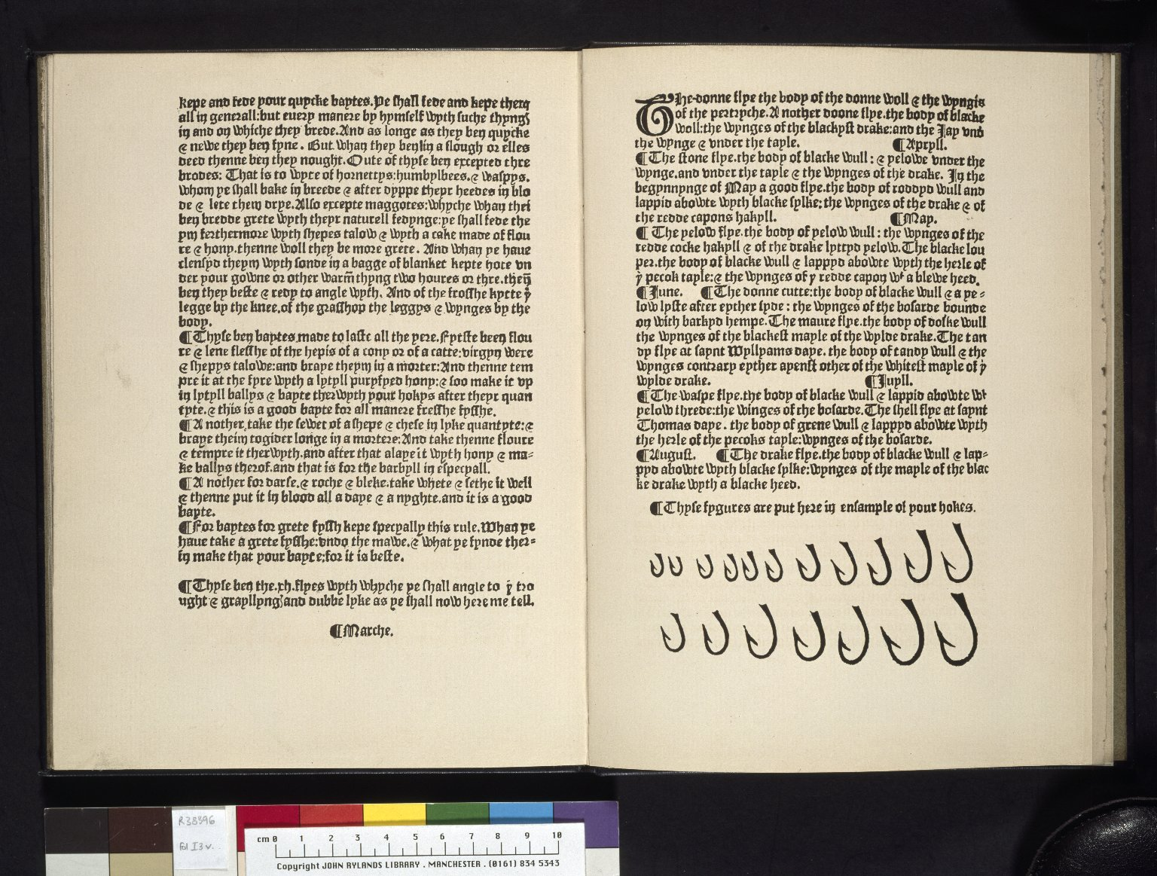
-------------
Image1
-------------
Field Data
Image Number JRl023226tr
Reference Number R38396
Link to Catalogue <A href=http://man-fe.hosted.exlibrisgroup.com/MU_VU1:BLENDED:44MAN_ALMA_DS21157546150001631>UoM online catalogue.</a>
Image Title Fish hooks
Parent Work Title A treatyse of fysshynge wyth an angle / by Dame Juliana Berners / being a facsimile reproduction of the first book on the subject of fishing printed in England by Wynkyn de Worde, at Westminster in 1496
Alternative Parent Work Title Treatise of fishing
Creator Berners, Juliana, 1388?-
Creator Role Author
Date Created 1880
Publication Details London: Elliot Stock
Page/Sheet 13v-14r
Image Sequence Number 013v
Description Examples of fish hooks. The text describes various types of fly and bait. Facsimile reproduction of the first book on the subject of fishing to be printed in England. It was printed by Wynkyn de Worde on Caxton's press at Westminster in 1496.
Language Code eng-GB
Subject Fishing
Category of Material Printed
Sub-Category Illustrated works
Time Period Covered 1200 - 1500 CE
Places Covered England
Current Repository The University of Manchester Library, U.K.
Rights Holder - Image The University of Manchester Library
Rights holder - Work The University of Manchester Library
Image Creation Technique Scanned from colour transparency by Gten, June 2007
Date Image Added (yyyy-mm) 2007-06
Metadata Language eng-GB

