Slide 1
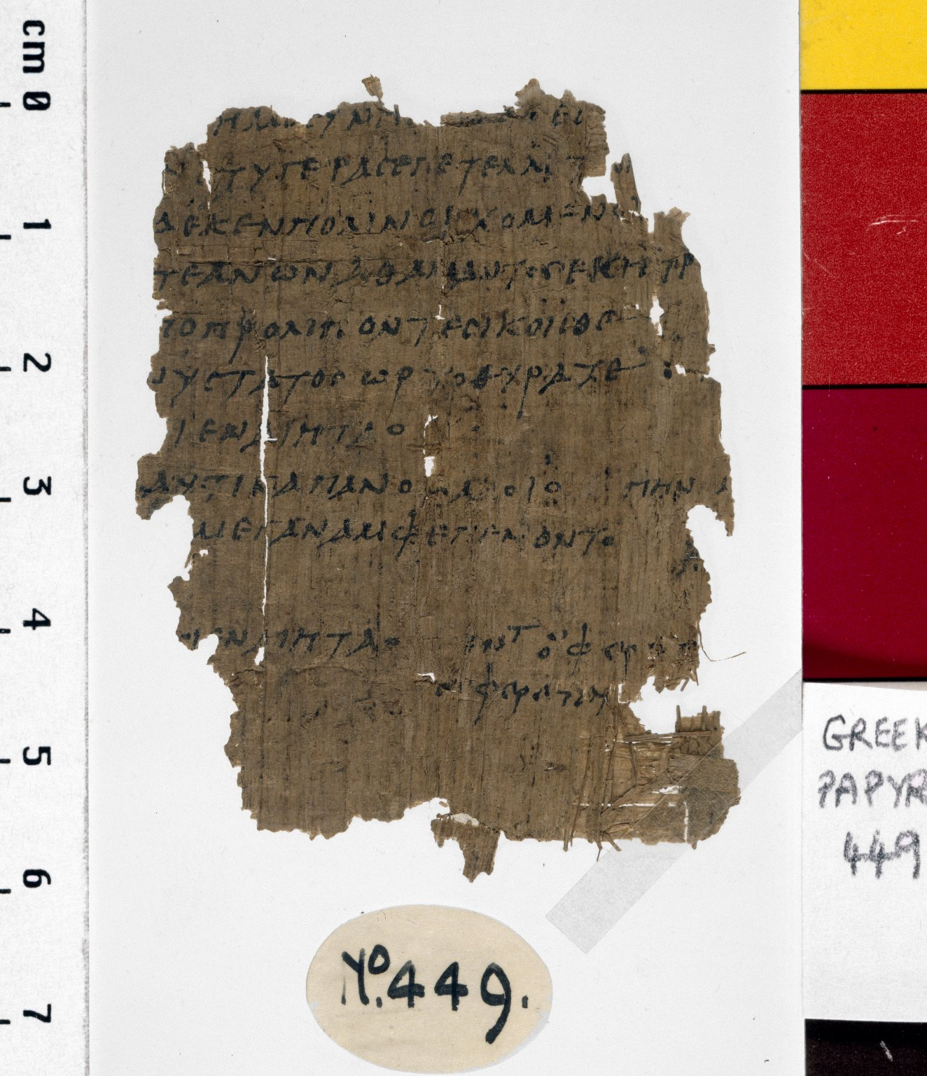
-------------
Image1
-------------
Field Data
Reference number Greek P 449
Side recto
Image Number JRL030005tr
Image Title Argonautica fragment
Trismegistos Number <A href="http://www.trismegistos.org/text/59171"> 59171</a>
Subject Classical literature
Subject Mythology, Greek
Creator Role Author
Creator Apollonius Rhodius
Source Title Argonautica
Section Book III
Citation reference P. Ryl. 2 449, P. Oxy. 6 874
Time period covered 750 - 1 BCE
Place covered Greece
Language Greek
Language code grc
Item height 62 mm
Item width 46 mm
Technique used Handwriting
Support material Papyrus
Discovery site Egypt: Oxyrhynchus (mod. Bahnasa)
Bibliography Hunt, Arthur S., et al. Catalogue of the Greek and Latin Papyri in the John Rylands Library, Manchester, University Press, 1911-1952
Current repository The University of Manchester Library, U.K.
Category Manuscripts
Sub-Category Fragments
Image rights The University of Manchester Library
Work rights The University of Manchester Library
Image sequence number grc0449r
Image technique Scanned from colour transparency by Gten, July 2004
Metadata language eng-GB

Slide 2
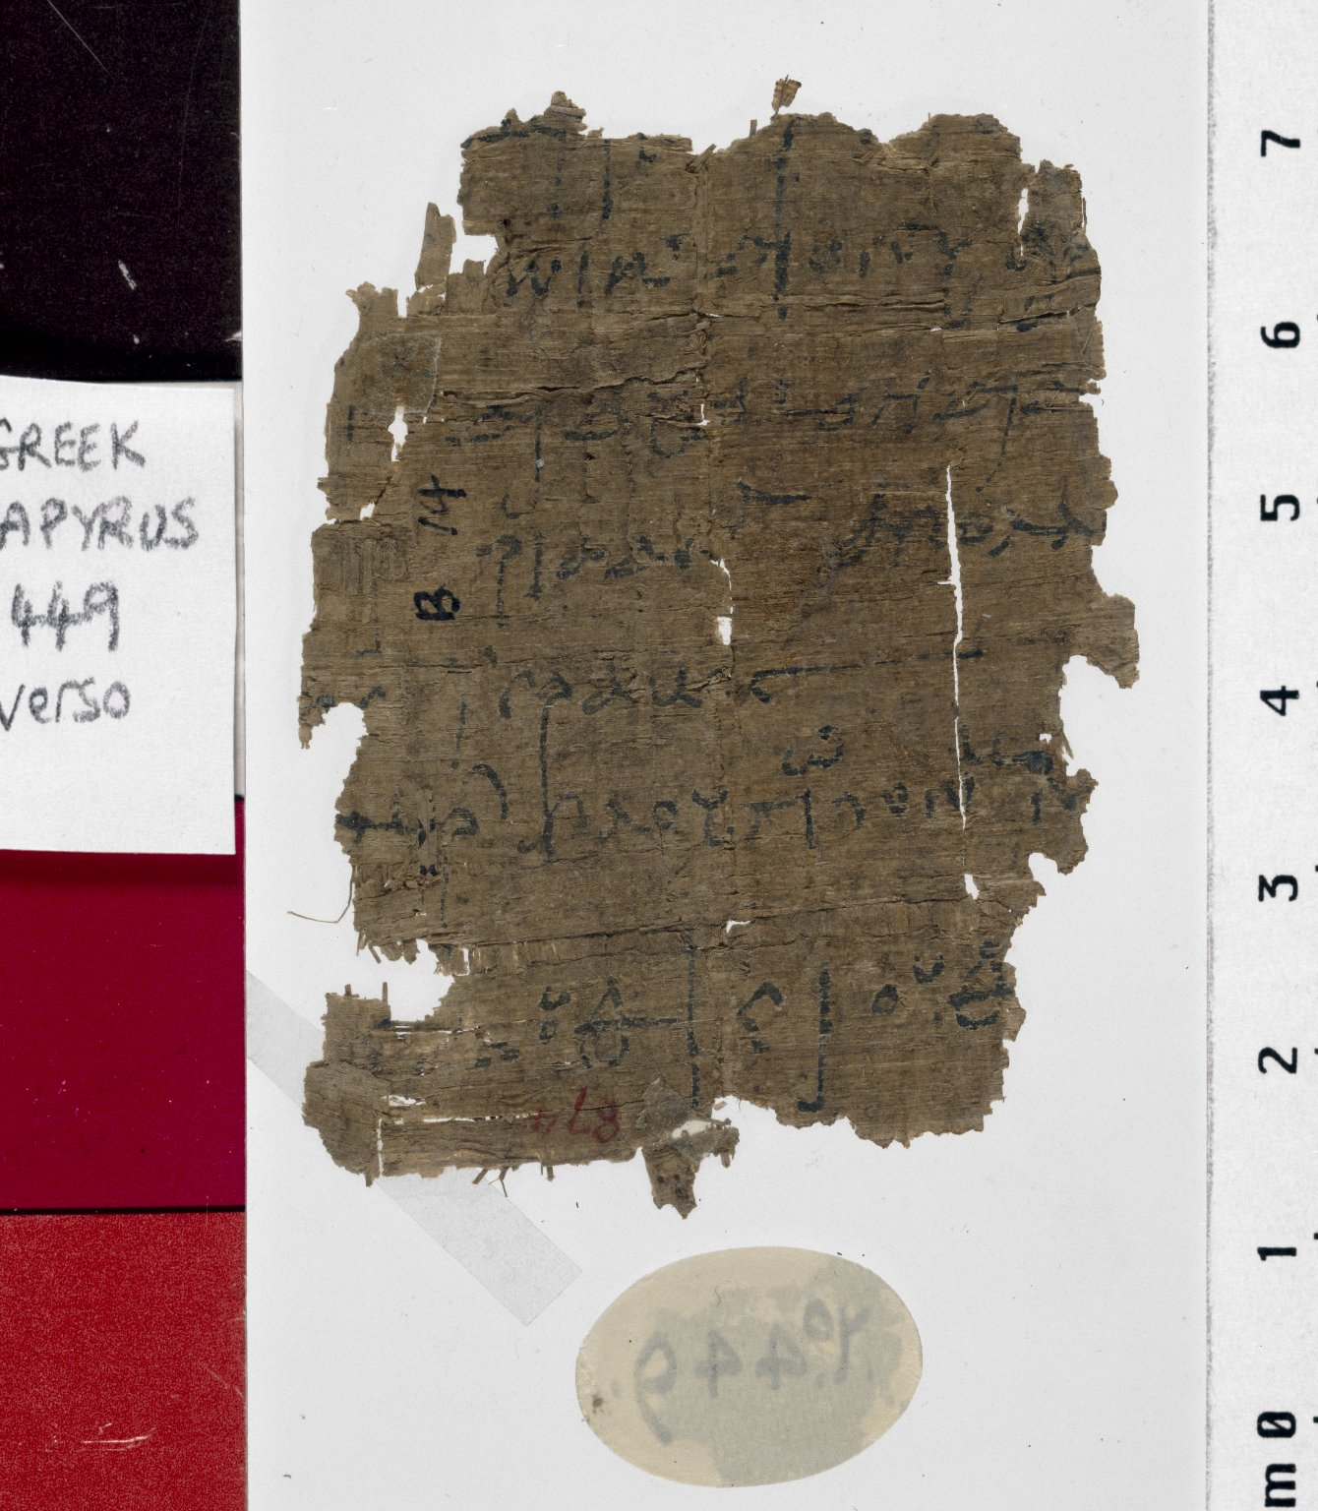
-------------
Image1
-------------
Field Data
Reference number Greek P 449
Side verso
Image Number JRL030006tr
Image Title Argonautica fragment
Trismegistos Number <A href="http://www.trismegistos.org/text/59171"> 59171</a>
Subject Classical literature
Subject Mythology, Greek
Creator Role Author
Creator Apollonius Rhodius
Source Title Argonautica
Section Book III
Citation reference P. Ryl. 2 449, P. Oxy. 6 874
Time period covered 750 - 1 BCE
Place covered Greece
Language Greek
Language code grc
Item height 62 mm
Item width 46 mm
Technique used Handwriting
Support material Papyrus
Discovery site Egypt: Oxyrhynchus (mod. Bahnasa)
Bibliography Hunt, Arthur S., et al. Catalogue of the Greek and Latin Papyri in the John Rylands Library, Manchester, University Press, 1911-1952
Current repository The University of Manchester Library, U.K.
Category Manuscripts
Sub-Category Fragments
Image rights The University of Manchester Library
Work rights The University of Manchester Library
Image sequence number grc0449v
Image technique Scanned from colour transparency by Gten, July 2004
Metadata language eng-GB

